Slide 1



Effective Techniques for Message Reduction and Load Balancing in Distributed Graph Computation
Da Yan (CUHK), James Cheng (CUHK), Yi Lu (CUHK), Wilfred Ng (HKUST)

Slide 2
Outline
Motivation
Vertex Mirroring
Request-Response Paradigm
Conclusion

Slide 3
Large-Scale Graph Analytics
Online social networks
Facebook, Twitter
Web graphs
The Semantic Web
Freebase
Spatial networks
Road network, terrain mesh

Slide 4
Distributed Graph Processing Systems
Think like a vertex / vertex-centric programming
Synchronous
Pregel, Giraph, GPS, …
Asynchronous
GraphLab (PowerGraph), …
We focus on the BSP model of Pregel

Slide 5
Pregel Review
Graph Partitioning
Distribute vertices along with their adjacency lists to machines
1
2
4
5
6
0
3
7
8
0
1 | 3
1
0 | 2 | 3
2
1 | 3 | 4 | 7
3
0 | 1 | 2 | 7
4
2 | 5 | 7
5
4 | 6
6
5 | 8
7
2 | 3 | 4 | 8
8
6 | 7
M₀
M₁
M₂

Slide 6
Pregel Review
Iterative computing
Superstep, barrier
Message passing
Programming interfaces
u.compute(msgs)
u.send_msg(v)
get_superstep_number()
u.vote_to_halt()
Called inside u.compute(msgs)

Slide 7
Pregel Review
Vertex state
Active / inactive
Reactivated by messages
Stop condition
All vertices are halted, and
No pending messages for the next superstep

Slide 8
Weakness of Pregel
Bottleneck vertices
Some vertices send / receive many many messages
Causes
High-degree vertices
Delegates in pointer jumping algorithms
Effects
Imbalanced workload
High communication workload

Slide 9
Outline
Motivation
Vertex Mirroring
Request-Response Paradigm
Conclusion

Slide 10
Algorithm for Connected Components
Hash-Min
Each vertex v broadcasts the smallest vertex (ID) it sees so far, denoted by min(v)
Initialize min(v) as the smallest vertex among 1- ego network
In a superstep, v obtains the smallest vertex from the incoming messages, denoted by u
If u < min(v), v sets min(v) = u and sends min(v) it to all its neighbors
Finally, v votes to halt

Slide 11
Algorithm for Connected Components
Hash-Min
3
1
1
0
7
5
0
6
8
5
0
0
0
6
2
0
4
2
Superstep 1

Slide 12
Algorithm for Connected Components
Hash-Min
3
0
1
There are still pending messages
0
7
5
0
6
8
0
0
0
0
0
2
0
4
0
Superstep 2

Slide 13
Algorithm for Connected Components
Hash-Min
3
0
1
0
7
5
0
6
8
0
0
0
0
0
2
0
No pending message, terminate
4
0
Superstep 3

Slide 14
Algorithm for PageRank
Each vertex v sums incoming messages as PageRank(v), and broadcasts PageRank(v) / out-degree(v) to out-neighbors
Initially, PageRank(v) = 1

Slide 15
Idea of Mirroring
Skewed vertex degree distribution
Small-world phenomenon, power-law graphs
MAX-degree ≫ AVG-degree
Data | Type | |V| | |E| | AVG Deg | Max Deg
WebUK | directed | 133,633,040 | 5,507,679,822 | 41.21 | 22,429
LiveJournal | directed | 10,690,276 | 224,614,770 | 21.01 | 1,053,676
Twitter | directed | 52,579,682 | 1,963,263,821 | 37.34 | 779,958
BTC | undirected | 164,732,473 | 772,822,094 | 4.69 | 1,637,619

Slide 16
Idea of Mirroring
Skewed vertex degree distribution
Small-world phenomenon, power-law graphs
MAX-degree ≫ AVG-degree
Homogeneous messages
Hash-Min: min(v)
PageRank: PageRank(v) / out-degree(v)

Slide 17
Idea of Mirroring
v₁
u₁
w₁
v₂
u₂
w₂
…
…
…
…
…
v_{j}
u_{i}
w_{k}
…
…
…
M₂
M₁
M₃

Slide 18
Idea of Mirroring
v₁
u₁
w₁
v₂
u₂
w₂
u_{i}
u_{i}
…
…
…
…
…
v_{j}
u_{i}
w_{k}
…
…
…
M₂
M₁
M₃

Slide 19
Idea of Mirroring
Let degree(v) = 1M, # of machines = 100
Option 1: v sends 1M messages to its neighbors
Option 2
Create a mirror of v on each machine (that contains v’s neighbors)
Each mirror contains an adjacency list of local neighbors
v sends at most 100 messages to its mirrors, which then forwards them to local neighbors

Slide 20
Tradeoff: Mirroring v.s. Message Combining
Create mirror for u₄?
Consider messages to v₂
u₁
v₁
v₂
v₁
u₂
v₁
v₂
v₂
u₃
v₁
v₂
v₃
u₄
v₁
v₂
v₃
v₄
v₄
…
…
M₁
M₂

Slide 21
Tradeoff: Mirroring v.s. Message Combining
Create mirror for u₄?
Message combining without mirroring u₄
u₁
v₁
v₂
u₁
v₁
u₂
v₁
v₂
u₂
v₂
a(u₁) + a(u₂)
+ a(u₃) + a(u₄)
u₃
v₁
v₂
u₃
v₃
u₄
v₁
v₂
v₃
v₄
u₄
v₄
…
…
…
M₁
M₁
M₂

Slide 22
Tradeoff: Mirroring v.s. Message Combining
Create mirror for u₄?
Message combining with u₄ mirrored
u₁
v₁
v₂
u₁
v₁
a(u₁) + a(u₂) + a(u₃)
u₂
v₁
v₂
u₂
v₂
u₃
v₁
v₂
u₃
v₃
a(u₄)
u₄
v₁
v₂
v₃
v₄
u₄
u₄
v₄
…
…
…
M₁
M₁
M₂

Slide 23
Tradeoff: Mirroring v.s. Message Combining
Conclusion: only mirror high-degree vertices
Degree threshold τ
Choice of τ
M machines, n vertices, m edges

Slide 24
Tradeoff: Mirroring v.s. Message Combining
Conclusion: only mirror high-degree vertices
Degree threshold τ
Choice of τ
M machines, n vertices, m edges
Average degree: deg_{avg} = m / n

Slide 25
Tradeoff: Mirroring v.s. Message Combining
Conclusion: only mirror high-degree vertices
Degree threshold τ
Choice of τ
M machines, n vertices, m edges
Average degree: deg_{avg} = m / n
Optimal τ is M · exp{deg_{avg} / M}
See our paper for the proof

Slide 26
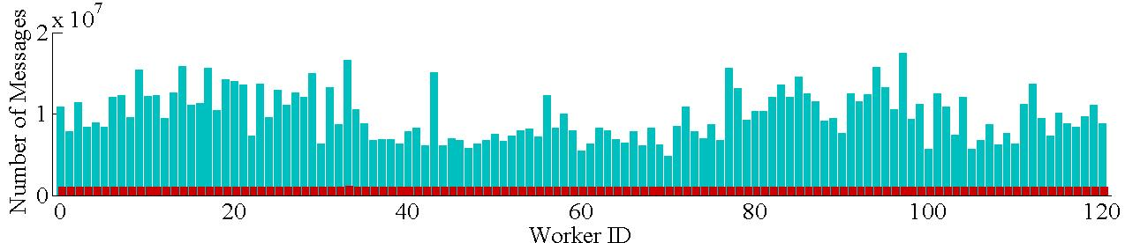
Effectiveness
Effectiveness
Hash-Min on the BTC dataset
27 seconds without mirroring
10 seconds with mirroring
Number of messages sent by each worker in Pregel+
(blue bars — w/o mirroring, red bars — mirroring)

Slide 27
Outline
Motivation
Vertex Mirroring
Request-Response Paradigm
Conclusion

Slide 28
Algorithm Applicability
Pointer Jumping
Popular technique in PRAM
To achieve O(log|V|) time complexity / supersteps
As algorithm goes on, there are fewer and fewer delegates communicating with more and more vertices

Slide 29
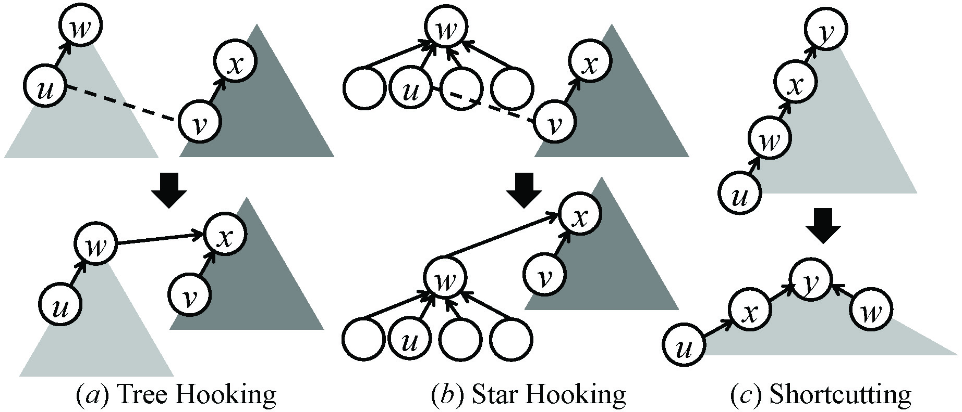
S- V Algorithm
Compute connected components in O(log|V|) supersteps
Merge small trees into large trees
Roots are delegates
See our paper for details

Slide 30
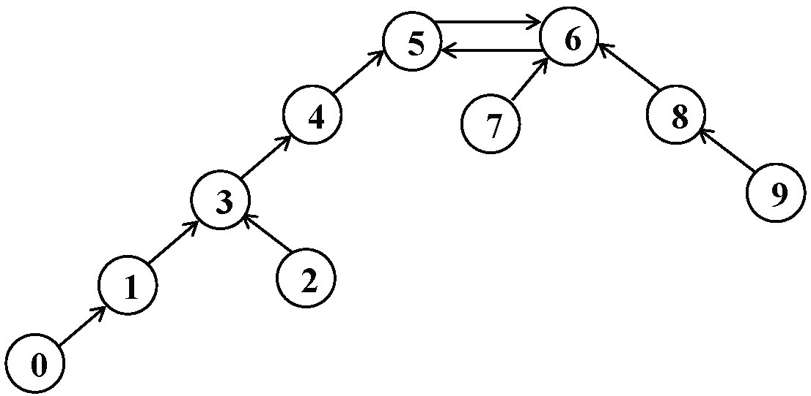
Finding Minimum Spanning Forest (MSF)
Merge vertices into conjoined trees each with a supervertex
Each vertex picks an edge with the minimum weight

Slide 31
Finding Minimum Spanning Forest (MSF)
Merge vertices into conjoined trees each with a supervertex
Each vertex picks an edge with the minimum weight
Collapse each conjoined tree into a vertex and repeat
Supervertices are delegates
See our paper for details

Slide 32
Request-Respond API
Retains all basic Pregel operations
A vertex v can request attribute a(u) in superstep i, and a(u) will be available in superstep (i + 1)
Here, u can be a delegate, and a(u) may be requested by many vertices v

Slide 33
Idea of Request-Respond
Assume 1M vertices v request a(u) from u
Without request-respond
v sends message <v> to u (1M messages in total)
v₁
<v₁>
v₂
<v₂>
u
<v₃>
v₃
<v₄>
a(u)
v₄
M₁
M₂

Slide 34
Idea of Request-Respond
Assume 1M vertices v request a(u) from u
Without request-respond
v sends message <v> to u (1M messages in total)
For each messags <v>, u sends a(u) to v (1M messages in total)
v₁
a(u)
v₂
a(u)
u
a(u)
v₃
a(u)
v₄
a(u)
M₁
M₂

Slide 35
Idea of Request-Respond
Assume 1M vertices v request a(u) from u
With request-respond
Let # of machines = 100
v requests a(u), but only one request is sent from each machine to the machine of u (at most 100 requests)
a(u) is sent to every machine that requests a(u) (at most 100 responses)
In superstep (i + 1), when v accesses a(u), it obtains the response received by local machine

Slide 36
Idea of Request-Respond
Assume 1M vertices v request a(u) from u
With request-respond
v₁
v₂
request u
u | D[u]
u
v₃
v₄
D[u]
M₁
M₂

Slide 37
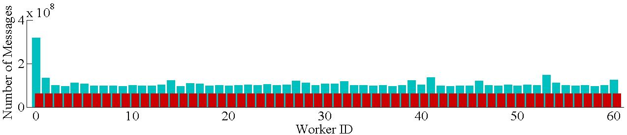
Effectiveness
S-V on the USA road network
262 seconds without request-respond
138 seconds with request-respond
Number of messages sent by each worker using Pregel+
(blue bars — w/o req-resp, red bars — with req-resp)

Slide 38
Effectiveness
S-V on the USA road network
262 seconds without request-respond
138 seconds with request-respond
MSF on the BTC dataset
83 seconds without request-respond
37 seconds with request-respond

Slide 39
Outline
Motivation
Vertex Mirroring
Request-Response Paradigm
Conclusion

Slide 40
Conclusion
Pregel+: our open-source implementation of Pregel
http://bit.do/pregel
Two message reduction techniques
Mirroring
Theoretical analysis of its tradeoff with message combining
Request-Respond Paradigm
Designed for algorithms using pointer-jumping, or for relatively dense graphs

Slide 41
More on Pregel+
Cost Model & Algorithm Design
Pregel Algorithms for Graph Connectivity Problems with Performance Guarantees [PVLDB'14]
Novel Computing Model (Block-Centric)
A Block-Centric Framework for Distributed Computation on Real-World Graphs [PVLDB'14]
System Performance Comparison
Large-Scale Distributed Graph Computing Systems: An Experimental Evaluation [PVLDB'15]

Slide 42

http://bit.do/pregel

