Slide 1
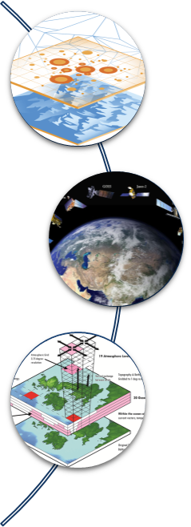
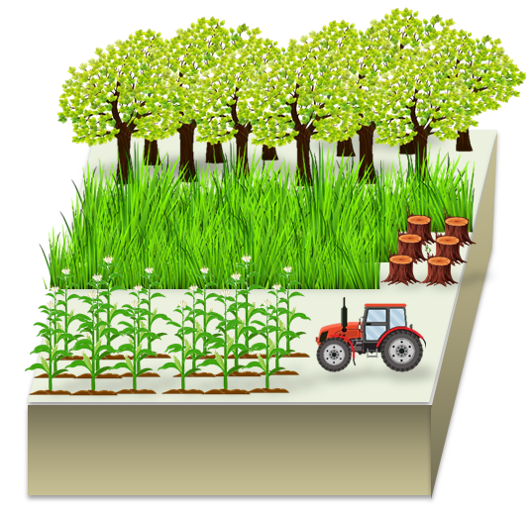
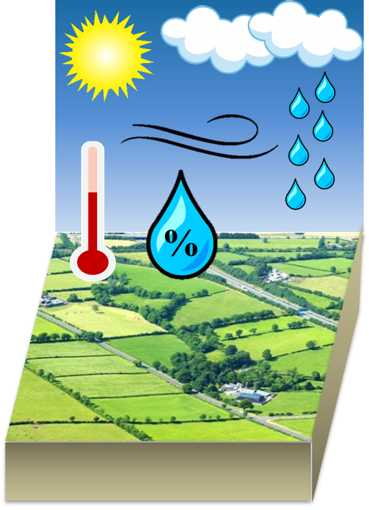
Methodology
Research
1. Feedback of vegetation to climate
Ground observation
Biophysics
Remote sensing
Extreme climate
Model simulation
Vegetation Change
Climate change
2. Impact of climate on vegetation dynamics

