Slide 1
Database Lab Project
SSP4 Group 2
Wu Sibing, Dou Maokang, Hu Wenqi, Liu Yanli, Xiao Yang

Slide 2
Mindmap
Create
Create table according to the schema
Add primary key, foreign key declarations (constraints)
Insert
Create and insert data to the table
Formulate
Formulate SQL queries for sample questions
Try out
Try out the queries

Slide 3
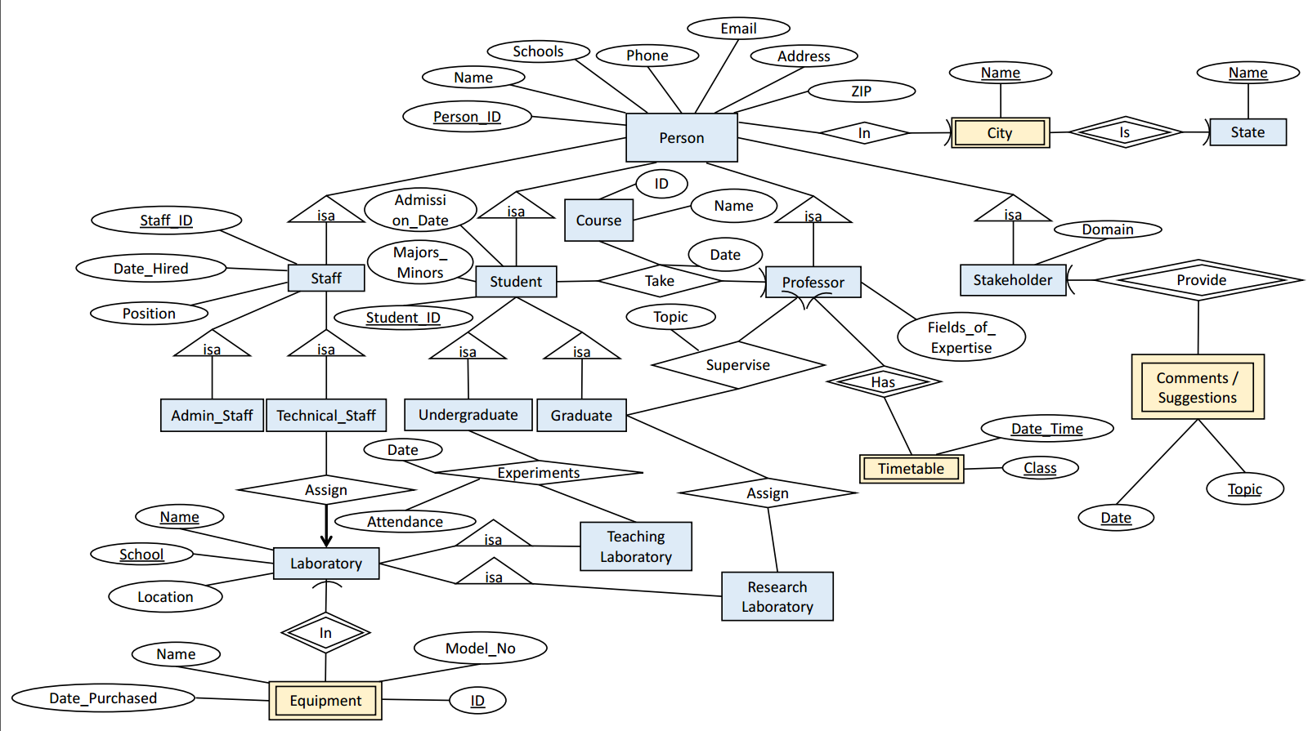
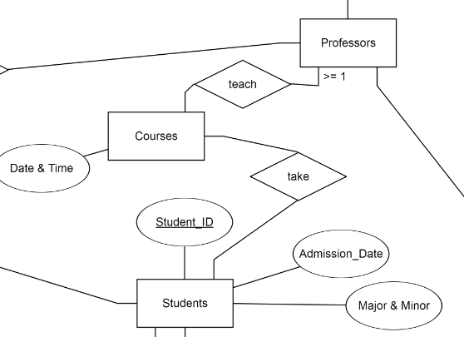

Slide 4
Schema
State(Name)
City(City_Name, State_Name)
Person(Person_ID, Name, Schools, Phone, Email, Address, ZIP, City_Name, State_Name)
Staff(Person_ID, Staff_ID, Date_Hired, Position)
Admin_Staff(Person_ID, Admin_Staff_ID)
Technical_Staff(Person_ID, Technical_Staff_ID, Lab_Name, Lab_School)
Laboratory(Lab_Name, Lab_School, Location)

Slide 5
Schema(cont.)
Equipment(Lab_Name, Lab_School, Equipment_ID, Model_No, Name, Date_Purchased)
Teaching Laboratory(Lab_Name, Lab_School)
Experiments(Teaching_Lab_Name, Teaching_Lab_School, Undergraduate_Person_ID, Undergraduate_Student_ID, Date, Attendance)
Research Laboratory(Lab_Name, Lab_School)
Assign(Graduate_Person_ID, Graduate_Student_ID, Lab_Name, Lab_School)
Professor(Person_ID, Fields_of_Expertise)
Timetable(Prof_ Person_ID, Date_Time, Class)

Slide 6
Schema(cont.)
Course(ID, Name, Date, Prof_Person_ID)
Take(Person_ID, Student_ID, Course_ID, Take_Date)
Stakeholder(Person_ID, Domain)
Comments/Suggestions(Stakeholder_Person_ID, Date, Topic)
Student(Person_ID, Student_ID, Majors_Minors, Admission_Date, takecourse_Prof_Person_ID)
Undergraduate(Person_ID, Undergraduate_Student_ID)
Graduate(Student_Person_ID, Graduate_Student_ID, Prof_ Person_ID, Supervise_Topic)

Slide 7
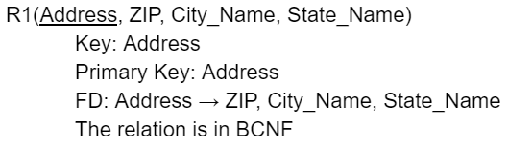
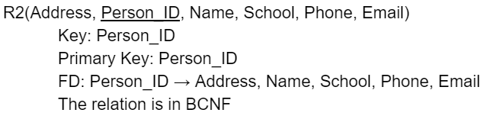
Create table
Person(Person_ID, Name, Schools, Phone, Email, Address, ZIP, City_Name, State_Name)

Slide 8
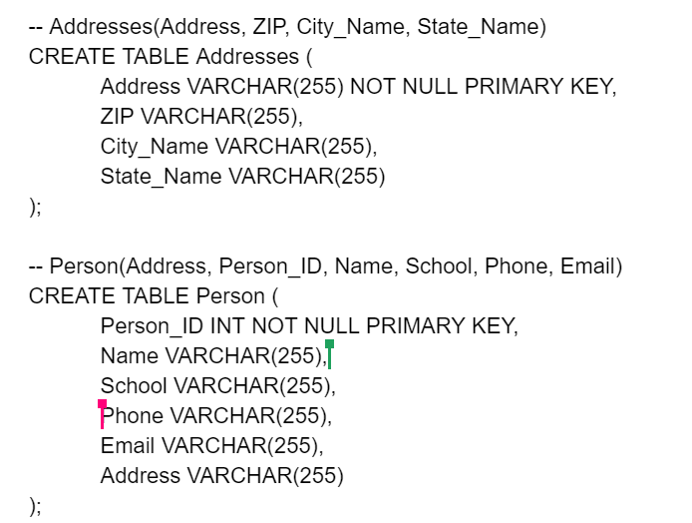
Create table

Slide 9
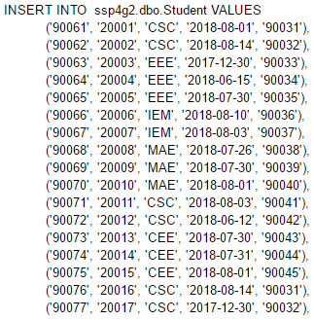
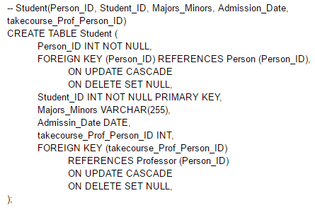
Insert Table
Primary Key: Student_ID
…....

Slide 10
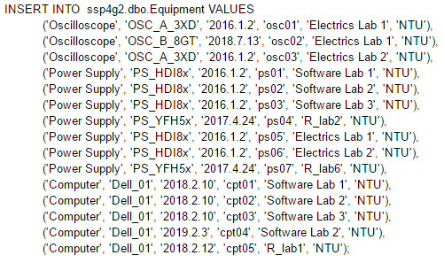
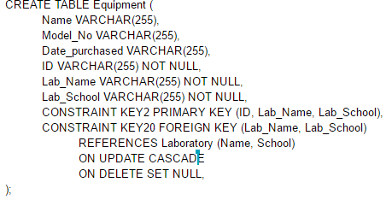
Equipment(Lab_Name, Lab_School, Equipment_ID, Model_No, Name, Date_Purchased)
Primary Keys: {Lab_Name, Lab_School, Equipment_ID}

Slide 11
Query
Q1. Find all Stakeholders who belong to the “public” domain.
Person
Stakeholder
Person_ID | Name | School | Phone | Email | Address
… | … | … | … | … | …
Person_ID | Domain
... | …
Person.Person_ID = Stakeholder.Person_ID
AND Stakeholder.Domain = 'public';
Person_ID | Name | School | Phone | Email | Address | Domain
someone |  |  |  |  |  | public

Slide 12
Query
Q1. Find all Stakeholders who belong to the “public” domain.
SELECT Person.Person_ID, Name
FROM Person, Stakeholder
WHERE Person.Person_ID = Stakeholder.Person_ID AND
Stakeholder.Domain = 'public';

Slide 13
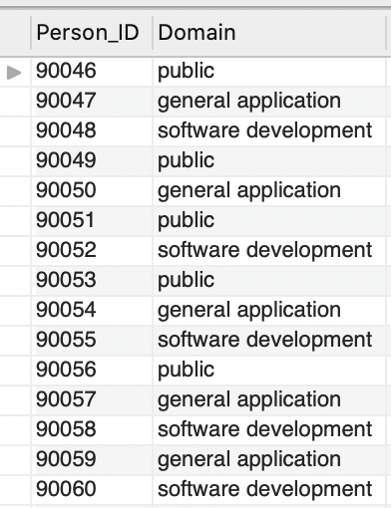
Q1: Find all Stakeholders who belong to the “public” domain.
Expected Results:
90046 → Ryan
90049 → Nathan
90051 → Isaiah
90053 → Josiah
90056 → Hunter

Slide 14
Q2. Find all Stakeholders who have provided at least five comments or suggestions.
Person
Comments_n_Suggestions
Person_ID | Name | School | Phone | Email | Address
… | … | … | … | … | …
Stakeholder_ Person_ID | Date | Topic
… | … | …
Person_ID = Stakeholder_Person_ID
Person_ID | Name | School | Phone | Email | Address | Stakeholder_Person_ID | Date | Topic
someone A |  |  |  |  |  |  | … | …
someone A |  |  |  |  |  |  | … | …
GROUP BY Person_ID
HAVING COUNT(Topic) >= 5

Slide 15
Q2. Find all Stakeholders who have provided at least five comments or suggestions.
SELECT Person_ID
FROM Person, Comments_n_Suggestions
WHERE Person_ID = Stakeholder_Person_ID
GROUP BY Person_ID
HAVING COUNT(Topic) >= 5;

Slide 16
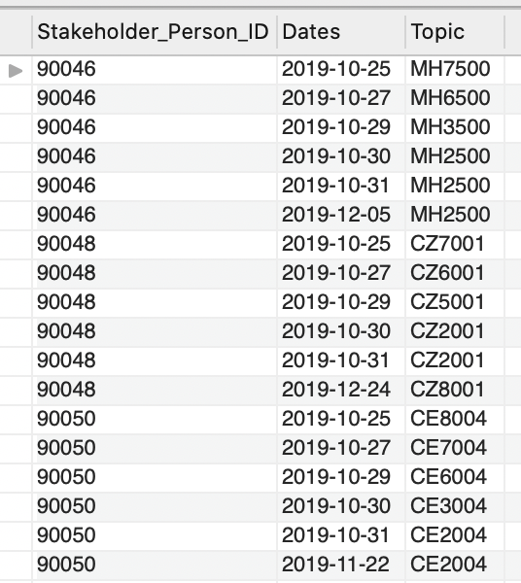
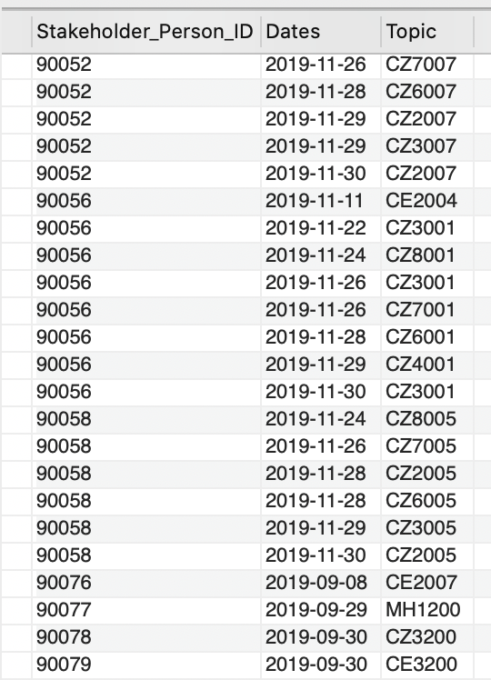
Q2. Find all Stakeholders who have provided at least five comments or suggestions.
Expected Results:
90046 →
90048 →
90050 →
90052 →
90056 →
90068 →

Slide 17
Q3. Find Graduates who are supervised by more than one professor and assigned to more than one research laboratory.
Using Sub-Query
Assign
Graduate_Person_ID | Graduate_Student_ID | Lab_Name | Lab_School
… | … | … | …
GROUP BY Graduate_Person_ID
HAVING COUNT(Lab_Name) > 1
Graduate_Person_ID
Graduate
Person_ID | Graduate_Student_ID | Prof_Person_ID | Supervise_Topic
… | … | … | …
Person_ID IN
Graduate_Person_ID
GROUP BY G1.Person_ID
HAVING COUNT(G1.Prof_Person_ID) > 1

Slide 18
Q3. Find Graduates who are supervised by more than one professor and assigned to more than one research laboratory.
SELECT G.Person_ID
FROM Graduate AS G
WHERE G.Person_ID IN (
SELECT A.Graduate_Person_ID
FROM Assign AS A
GROUP BY A.Graduate_Person_ID
HAVING COUNT(Lab_Name) > 1
)
GROUP BY G.Person_ID
HAVING COUNT(*) > 1;

Slide 19
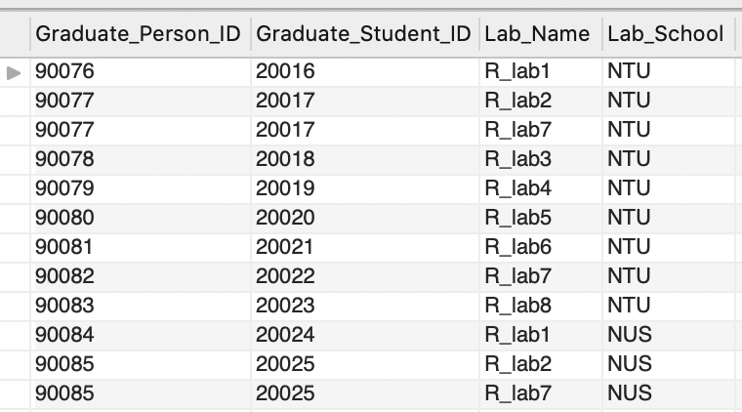
Q3. Find Graduates who are supervised by more than one professor and assigned to more than one research laboratory.
Graduates assigned to more than 1 research lab:
90077
90085

Slide 20
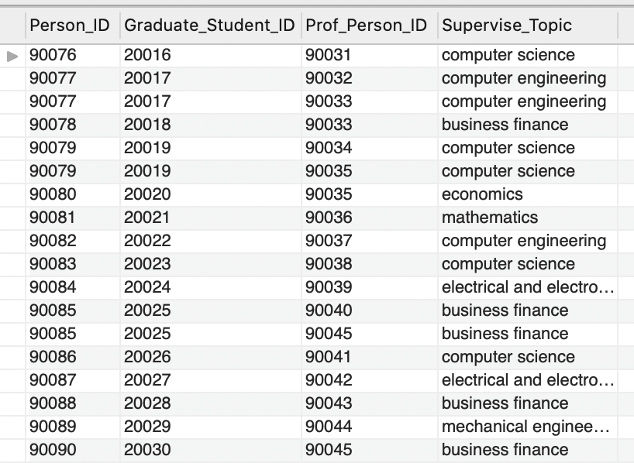
Q3. Find Graduates who are supervised by more than one professor and assigned to more than one research laboratory.
Graduates assigned to more than 1 research lab:
90077
90085
Expected Results:
90077 →
90085 →

Slide 21
Q4. Find all Professors who teach more than one courses in the semester.
SELECT Person_ID, Name
FROM Person
WHERE Person_ID IN (
SELECT T.Prof_Person_ID
FROM Timetable AS T
GROUP BY T.Prof_Person_ID
HAVING COUNT(*) > 1
)

Slide 22
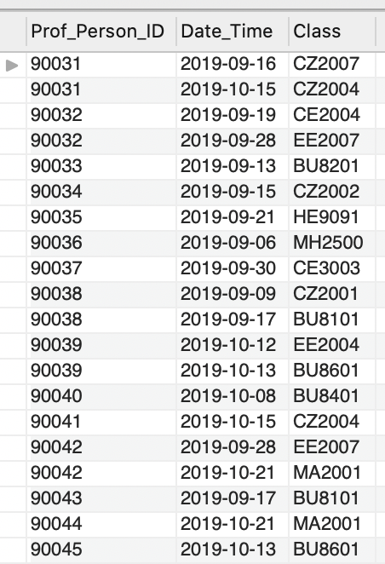
Q4. Find all Professors who teach more than one courses in the semester.
Expected Results:
90077 →
90085 →
Expected Results:
90031 →
90032 →
90038 →
90039 →
90042 →

Slide 23
Q5. List all the Equipment belonging to a particular Laboratory.
-- Assume Lab Name = "Software Lab 2"
SELECT DISTINCT Name
FROM Equipment AS E
WHERE E.Lab_Name = 'Software Lab 2';

Slide 24
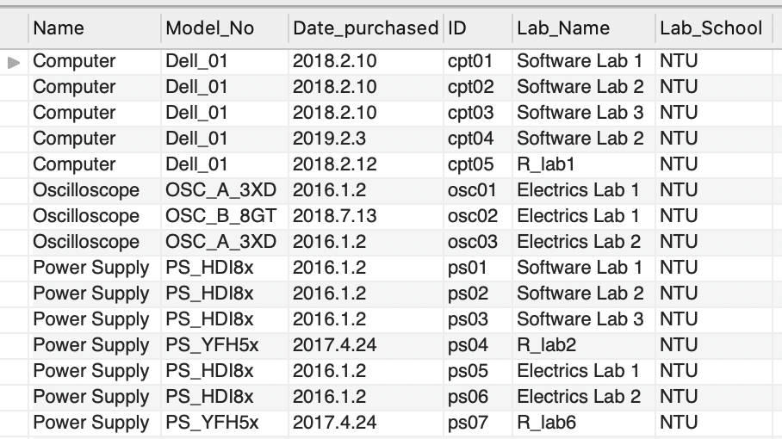
Q5. List all the Equipment belonging to a particular Laboratory.
Expected Results:
Computer
Power Supply

Slide 25
Q6. Find all Undergraduates who have not attended at least one laboratory experiments.
SELECT Name
FROM Person AS P, Experiments AS E
WHERE P.Person_ID = E.Undergraduate_Person_ID
AND E.Attendance = 0;

Slide 26
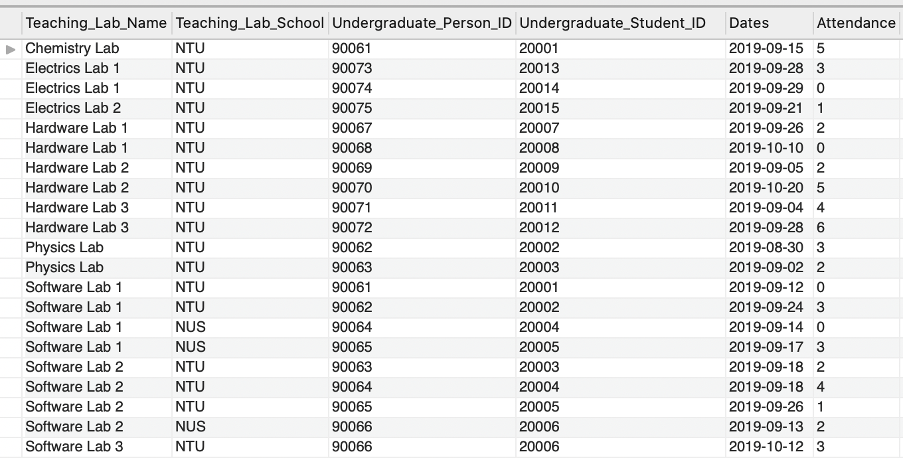
Q6. Find all Undergraduates who have not attended at least one laboratory experiments.
SELECT P.Person_ID, P.Name
FROM Person AS P, Experiments AS E
WHERE P.Person_ID = E.Undergraduate_Person_ID AND E.Attendance = 0;
Expected Results:
90061 →
90064 →
90068 →
90074 →

Slide 27
Q7. List all Graduates who are doing research and taking courses in the semester.
SELECT DISTINCT P.Person_ID, Name
FROM Person AS P, Assign as A, Takes as T
WHERE P.Person_ID = A.Graduate_Person_ID
AND P.Person_ID = T.Person_ID;

Slide 28
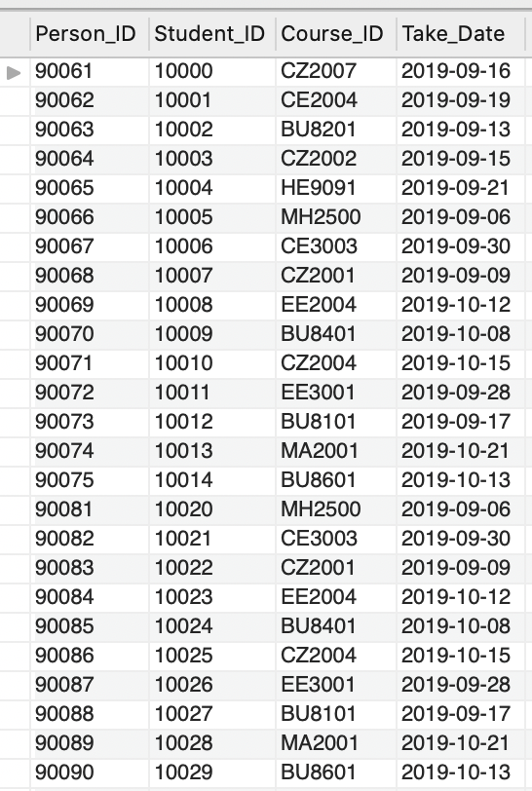
Q7. List all Graduates who are doing research and taking courses in the semester.
SELECT DISTINCT P.Person_ID, Name
FROM Person AS P, Assign as A, Takes as T
WHERE P.Person_ID = A.Graduate_Person_ID AND P.Person_ID = T.Person_ID;
Assign
Take
Expected Results:
90081 →
90082 →
90083 →
90084 →
90085 →

Slide 29
Q & A

