Slide 1


Certified Robustness of Graph Classification against Topology Attack with Randomized Smoothing
Zhidong Gao, Rui Hu, Yanmin Gong
Department of Electrical and Computer Engineering
University of Texas at San Antonio
11.07.2020

Slide 2
Certified Robustness of Graph Classification against Topology Attack with Randomized Smoothing
Zhidong Gao, Rui Hu, Yanmin Gong
Department of Electrical and Computer Engineering
University of Texas at San Antonio
11.07.2020

Slide 3
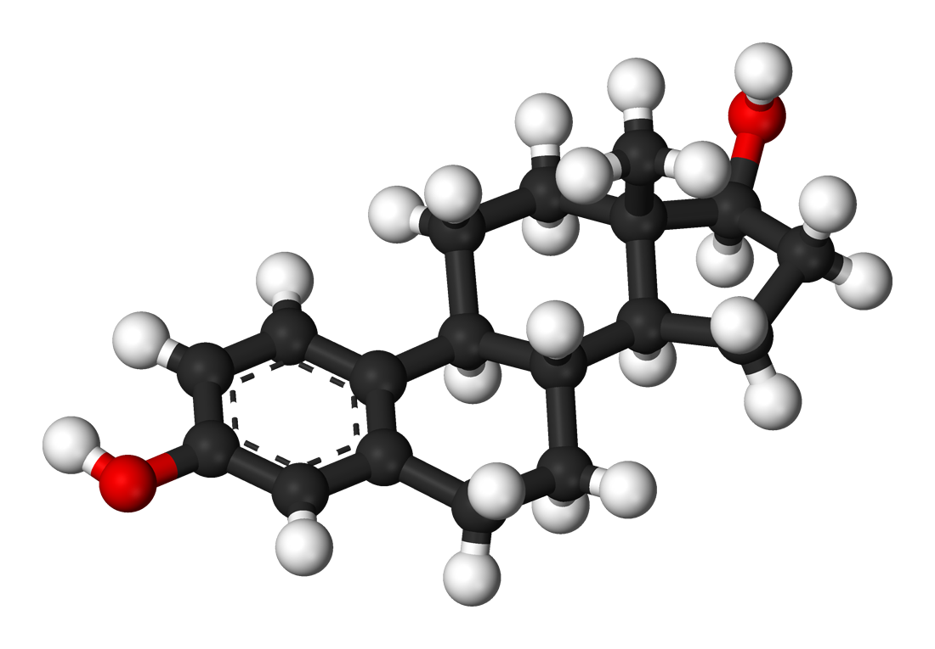
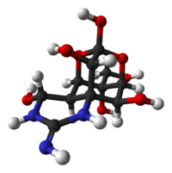
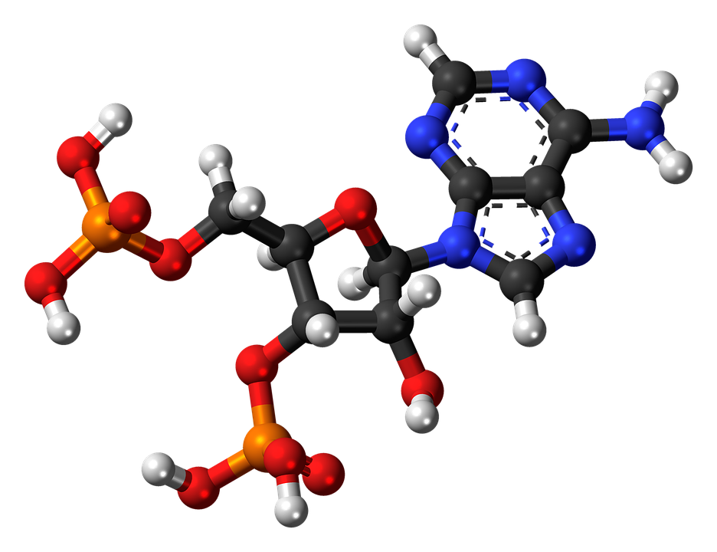
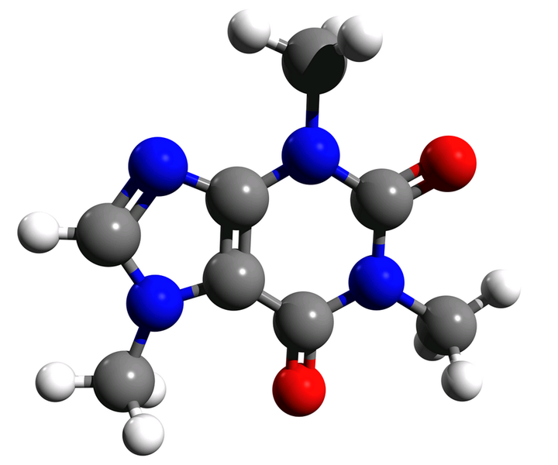
Graph Classification
Toxic
Non-toxic
Toxic?
Non-toxic?
This Photo by Unknown Author is licensed under CC BY-SA
Notes:
Graph classification, or the problem of assigning labels to a graph in a dataset, has found practical applications in diverse fields, including malware detection learning molecular fingerprints and anticancer hyper food prediction.

Slide 4
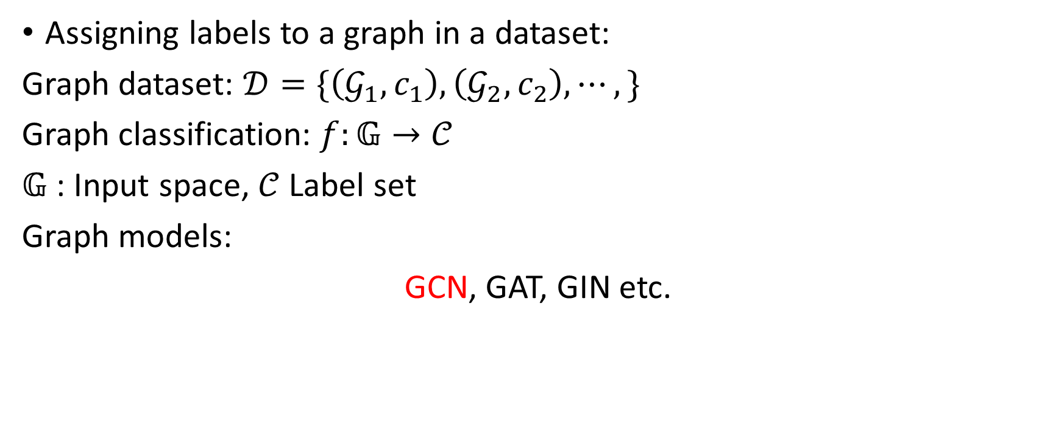
Graph Classification
Assigning labels to a graph in a dataset:
Graph dataset: $𝒟=\{\left(𝒢_{1},c_{1}\right),\left(𝒢_{2},c_{2}\right),⋯,\}$
Graph classification: $f:𝔾→𝒞$
$𝔾$ : Input space, $𝒞$ Label set
Graph models:
GCN, GAT, GIN etc.
Notes:
Given a set of graphs D, graph classification aims assigning labels for each graph.

Slide 5
GNN is Sensitive
Zügner, D., Akbarnejad, A., & Günnemann, S. (2018, July). Adversarial attacks on neural networks for graph data.
Dai, H., Li, H., Tian, T., Huang, X., Wang, L., Zhu, J., & Song, L. (2018). Adversarial attack on graph structured data.
Xu, K., Chen, H., Liu, S., Chen, P. Y., Weng, T. W., Hong, M., & Lin, X. (2019). Topology attack and defense for graph neural networks: An optimization perspective.

Slide 6
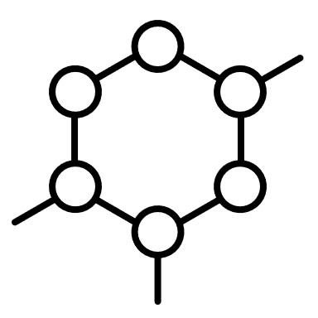
GNN is Sensitive
$$f$$
$$f$$
Toxic
Non-toxic
Small change of graph leads different prediction of GNN model

Slide 7
Randomized smoothing
Notes:
Randomized smoothing is a technique for certifying adversarial robustness whereby each prediction is accompanied by a radius in which the classifier’s prediction is guaranteed to remain constant.

Slide 8
Randomized smoothing in GCN

Slide 9
Toxic
Non-toxic
$$f$$
$$f$$
Small change of graph leads different prediction of GNN model
Toxic
Non-toxic
Toxic?
Non-toxic?

Slide 10
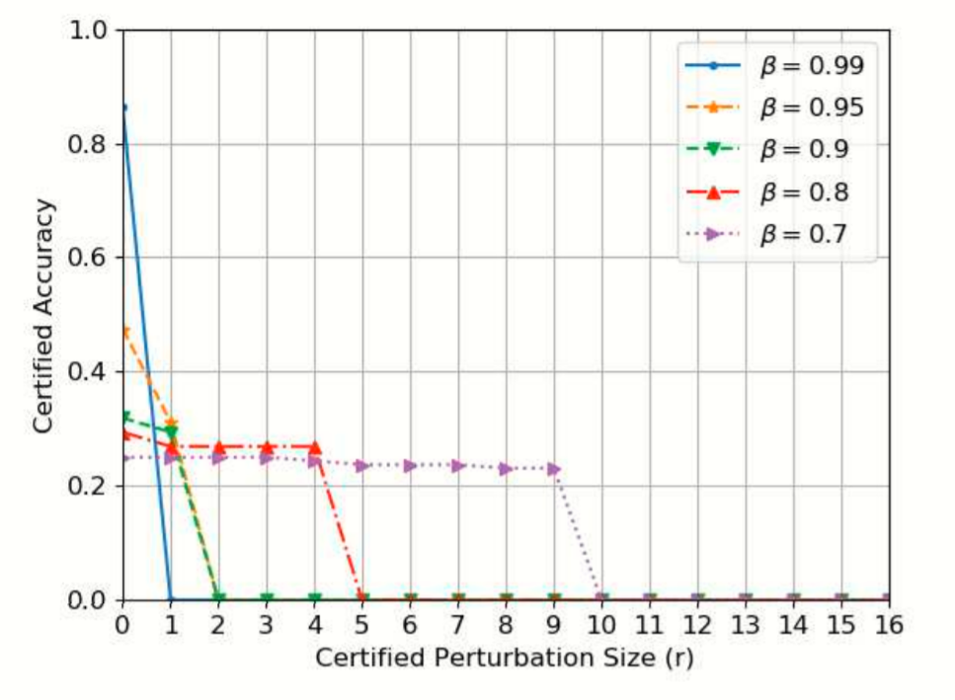
Experiment

