Slide 1

XplainAct: Visualization for Personalized Intervention Insights
Yanming Zhang , Krishnakumar Hegde, Klaus Mueller
Visual Analytics and Imaging Lab
Computer Science Department
Stony Brook University

Slide 2

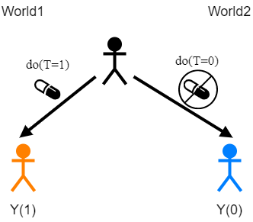


Causality is everywhere
World 1
Bob
World 2
Medicine Smoking causes lung cancer
Economics Raising interest rates reduces inflation
Environment Deforestation leads to soil erosion
Normal BP
Hypertension
Y_{i}(1)
Y_{i}(0)
Causal/treatment effect: Y_{i}(1)-Y_{i}(0)
An example of treatment effect

Slide 3



Conditional Average Treatment Effect
Average Treatment effect (ATE): E[Y(1)]-E[Y(0)]
Not Necessarily!
Beneficial for all?
Population
Conditional Average Treatment effect (CATE): E[Y(1)|X]-E[Y(0)|X]
Strata
Focus on each subgroup

Slide 4
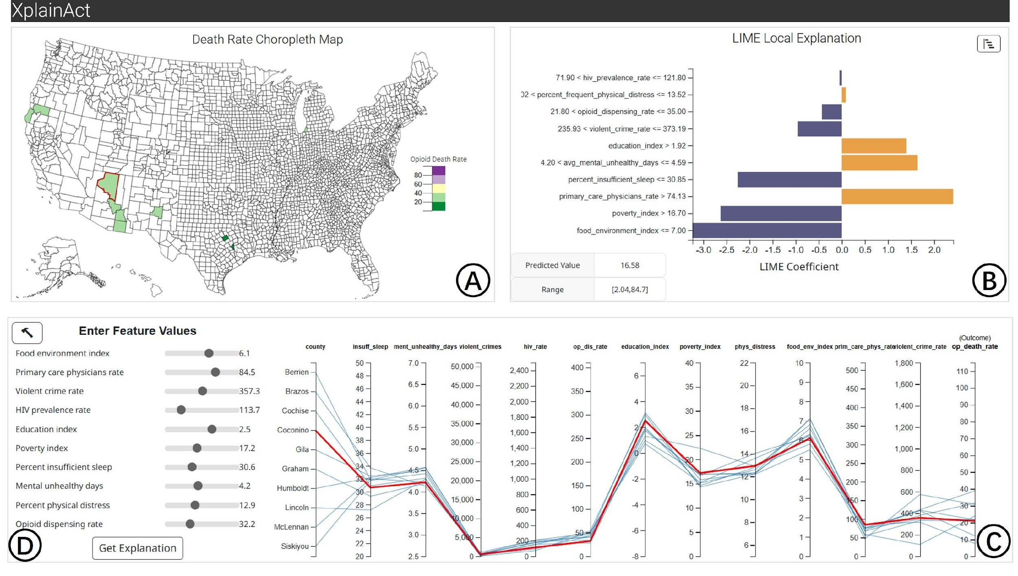
Challenges
Feasibility in applying interventions
Ethical concerns
Time cost
Money cost
Explainability in intervention analysis
How the AI/ML system came up with the result
XplainAct for interventional effect analysis

Slide 5

Deign Goals
DG1: Specify intervention and estimate outcomes
DG2: Identify subgroups
DG3: Explain intervention results
DG4: Show feature-to-space relations.

Slide 6
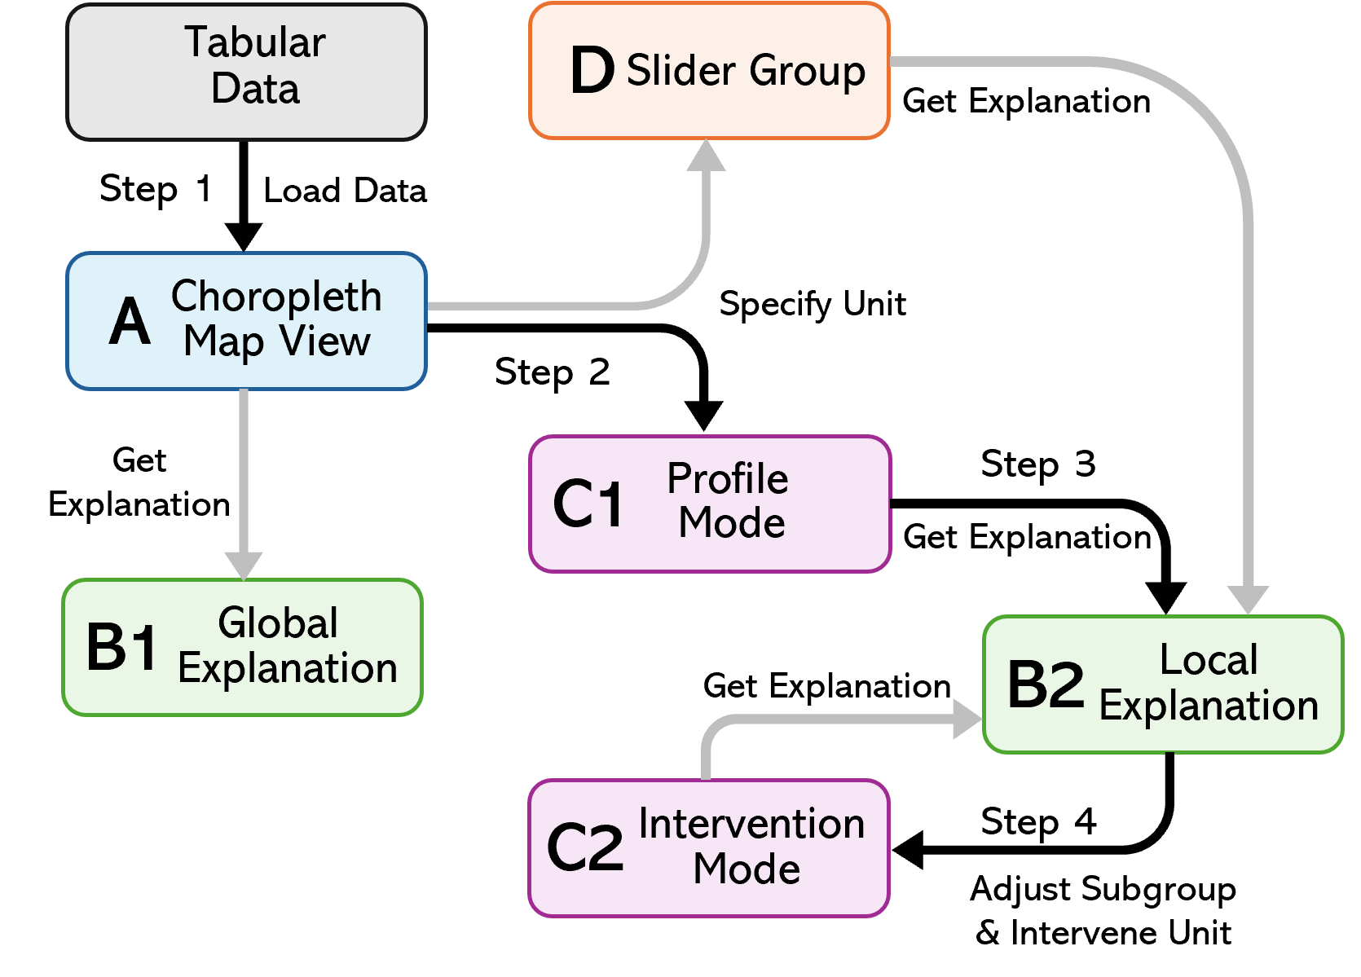
XplainAct Interface
Workflow of XplainAct
Overview of XplainAct Interface

Slide 7
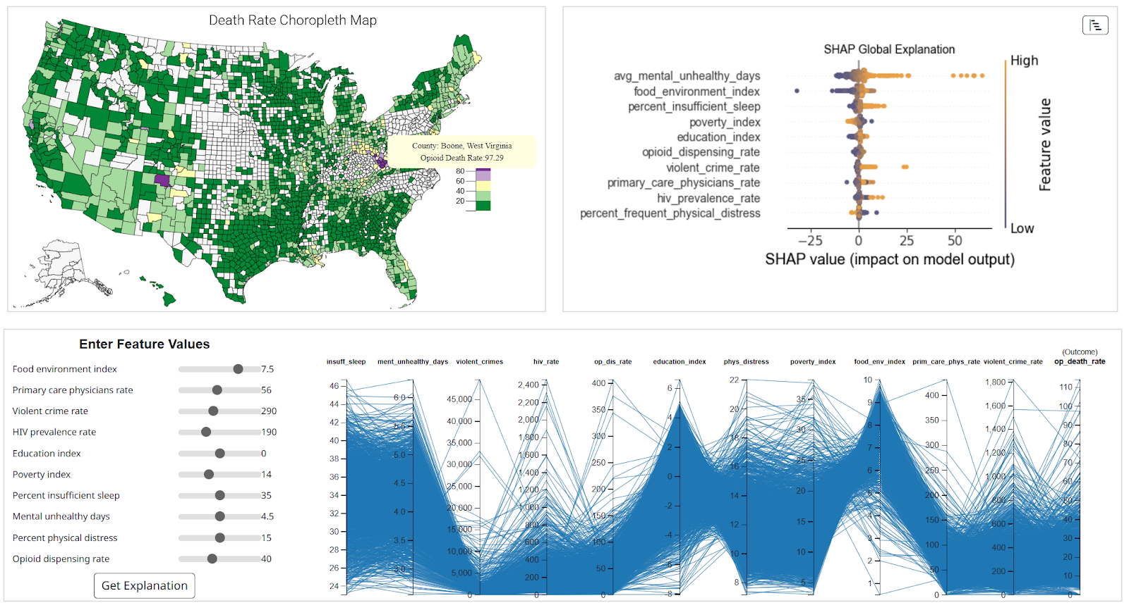

Case Study
Taylor (a health-conscious citizen)

Slide 8
Case Study
Workflow of XplainAct

Slide 9
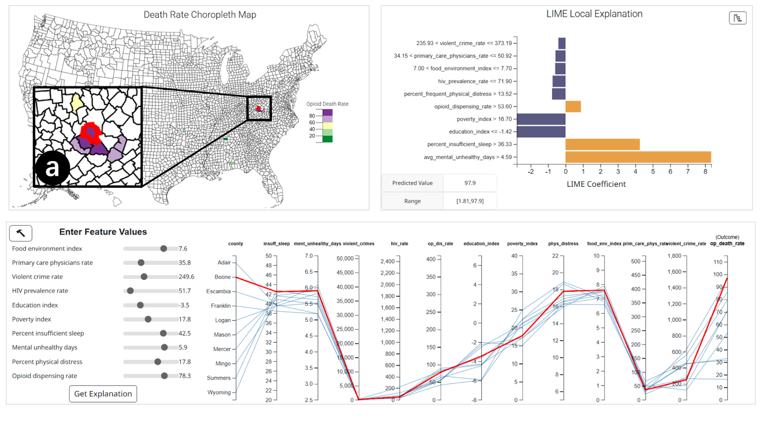
Case Study
Workflow of XplainAct

Slide 10
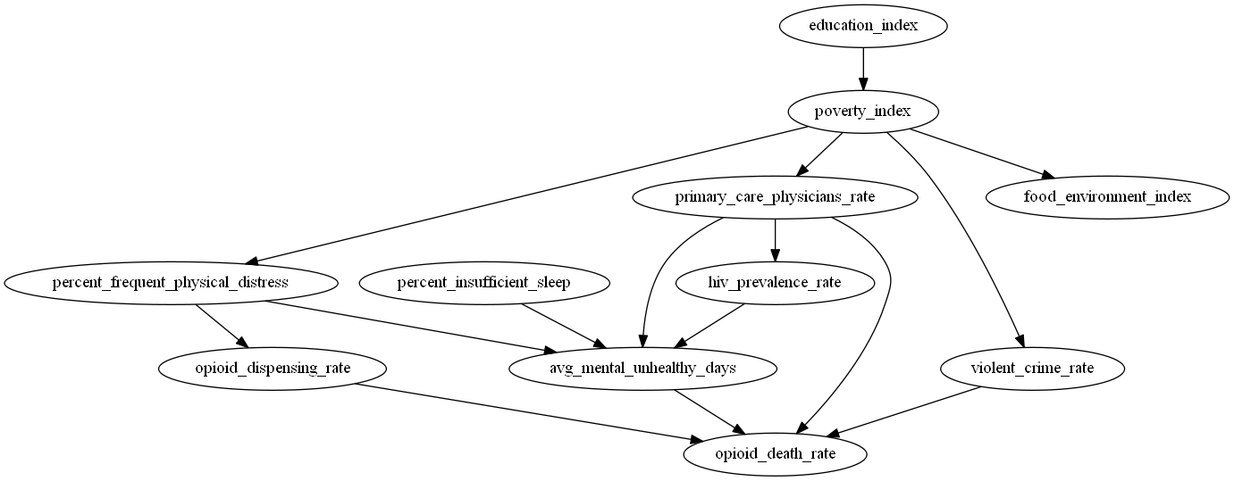
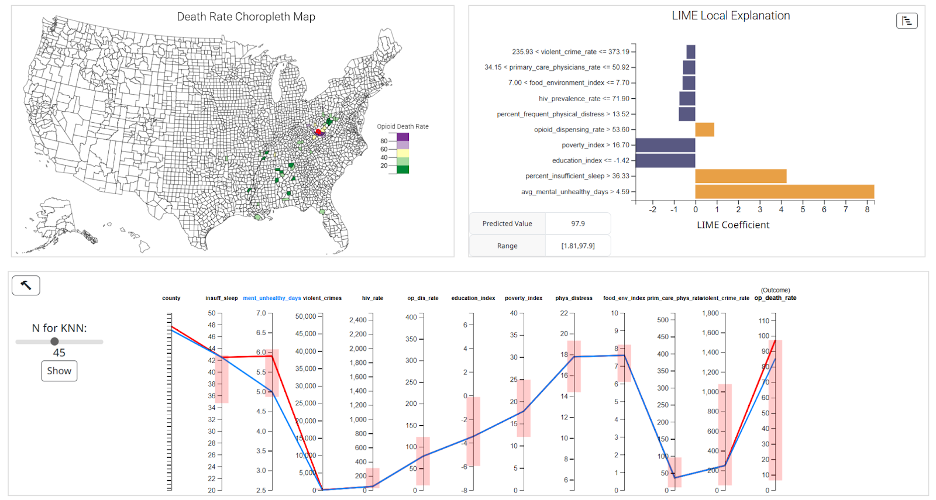
Case Study
Causal Graph under the Hood
Workflow of XplainAct

Slide 11
Limitations and Future Work
Scalability: Dimensionality Reduction
Subgroup finding and definition: Flexible subgroup identification; local causal model
User Studies: effectiveness in enhancing explainability comparing to other tools

