Slide 1




GPOP PROJECT: Simulating an evolving population
ZHONG Yann M2 BIM-INFO
GPOP: Population Genetics

Slide 2
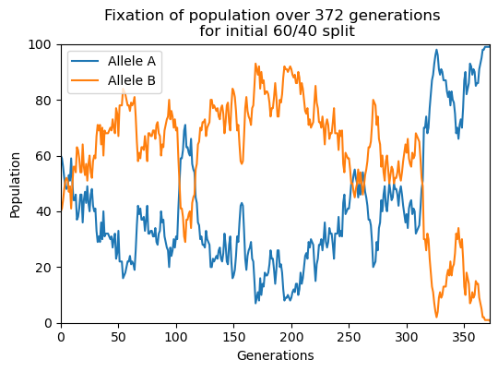
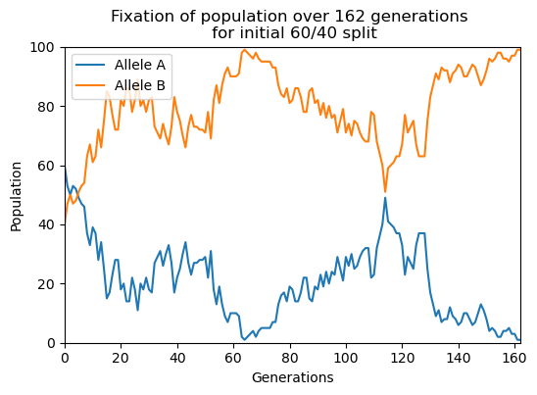
QUESTION 1:
Genetic drift
60/40 split can have either allele dominate over the other, though naturally one is more likely than the other

Slide 3
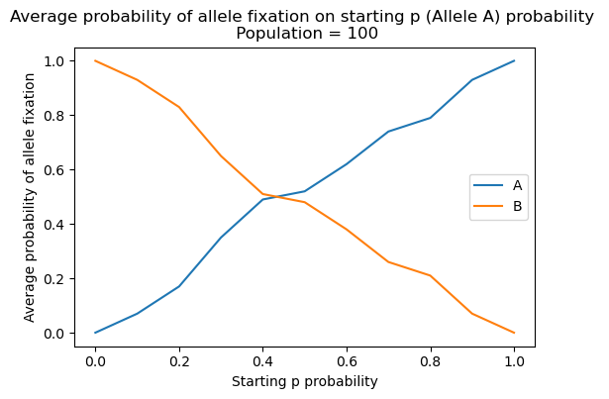
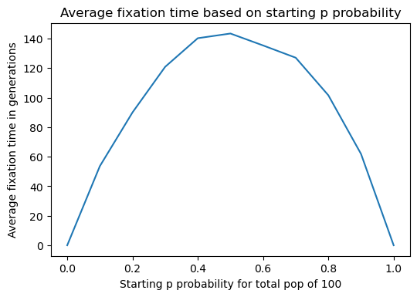
QUESTION 1:
Genetic drift
Expected as according to intuition, notably the first plot

Slide 4
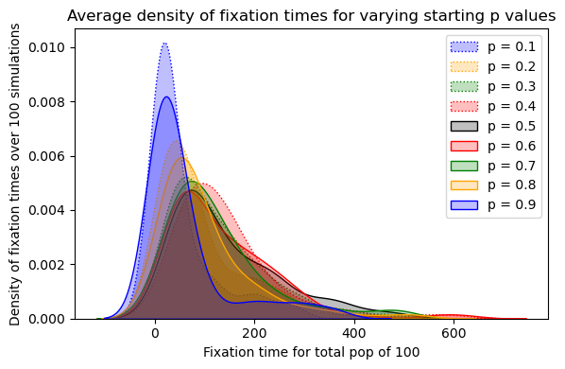
QUESTION 1:
Genetic drift
“Symmetrical” fixation times will always have similar peak densities

Slide 5
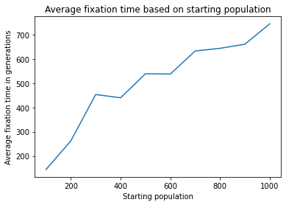
QUESTION 1:
Genetic drift
Simulation of 100, 200, 300… 1000 population size
Note: p = 0.6 for all these simulations

Slide 6
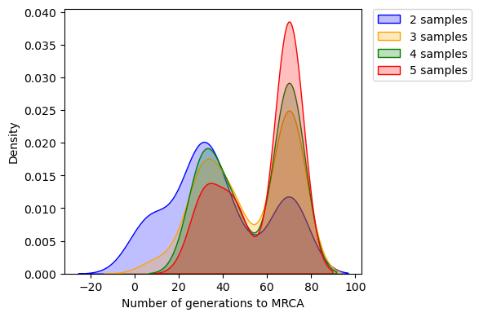
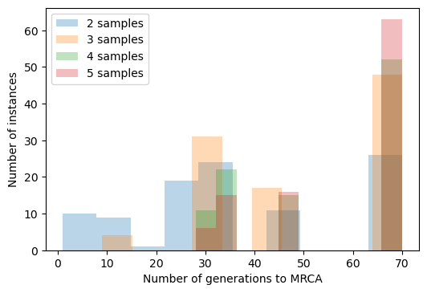
QUESTION 2:
Coalescent model
Note: population = 100
Each member of initial population was a different allele

Slide 7
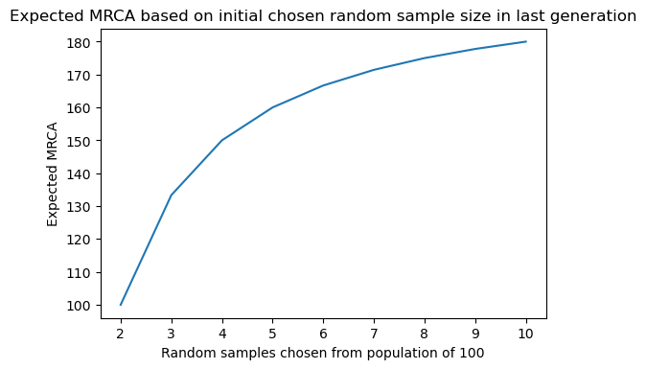
QUESTION 2:
Coalescent model
Expected vs simulated: expected seems to take longer to find MRCA, as according to formula seen in class

Slide 8
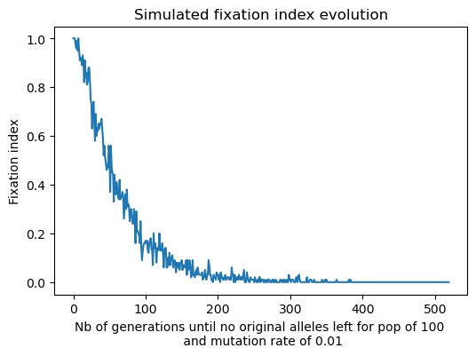
QUESTION 3:
Mutations in the infinite allele model
Erroneous plot: misunderstood mutation rate
(Kept it as illustrative example)

Slide 9
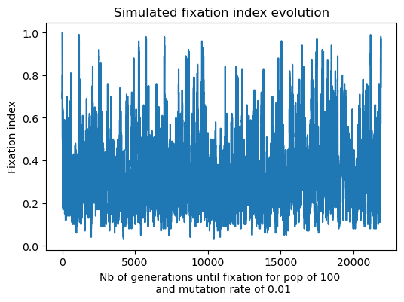
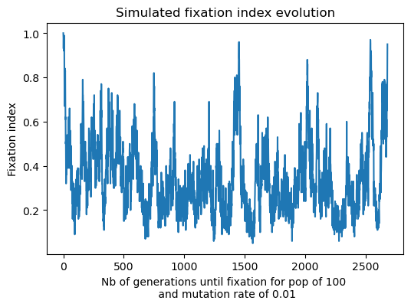
QUESTION 3:
Mutations in the infinite allele model
Considerably longer time to fixation
(Still possibly flawed but intuitively makes more sense)
Expected to drop overall

Slide 10
QUESTION 3:
Mutations in the infinite allele model
Population never converges for higher values of mutation rate, also possibly due to erroneous code.

Slide 11
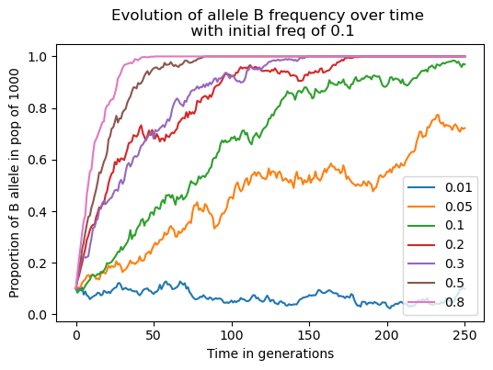
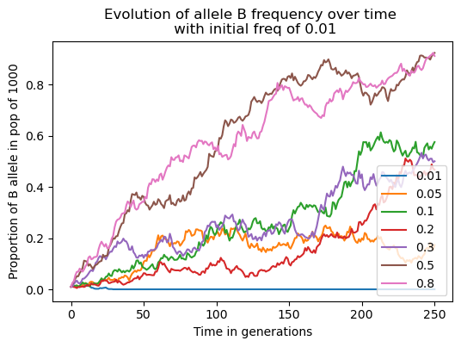
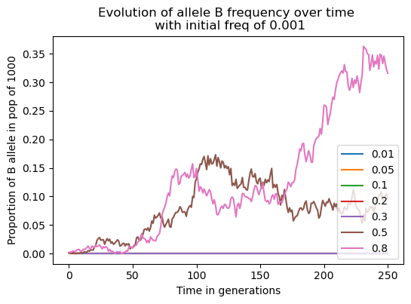
QUESTION 4:
Selection
With lower initial frequency of allele B, only higher fitness parameters s allow for the allele to survive.
Additionally, 250 generations is not enough for fixation.

Slide 12
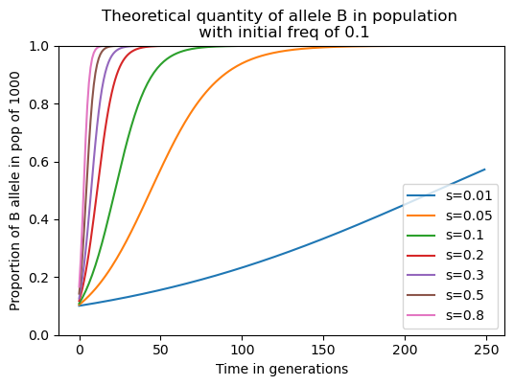
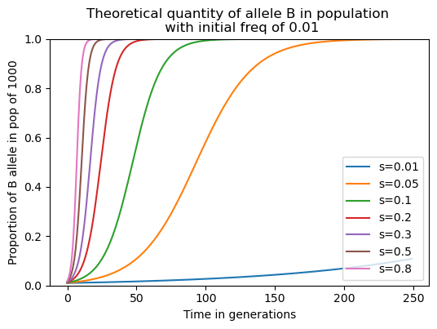
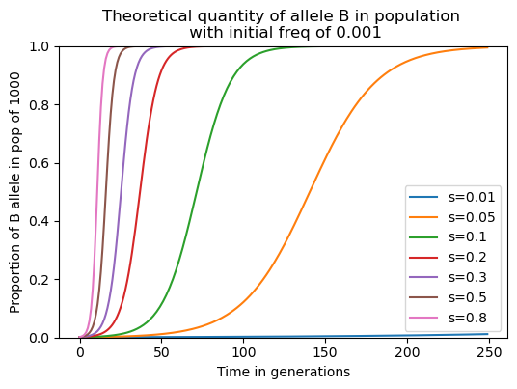
QUESTION 4:
Selection
Expected, according to formulas seen in class: does not correspond to simulations: fixation is still achieved rapidly, even for low values of s

Slide 13
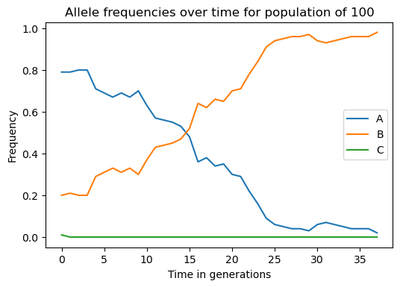
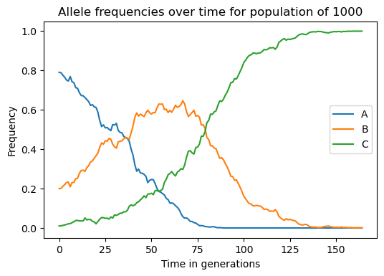
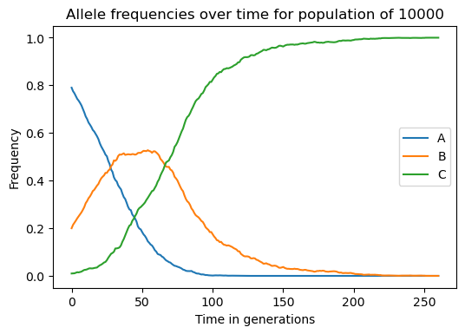
QUESTION 5:
Clonal interference
Allele C manages to fixate for a large enough population, but fails to do for smaller ones.

Slide 14
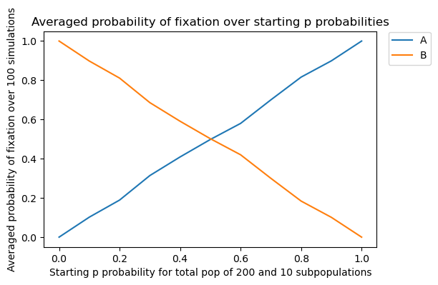
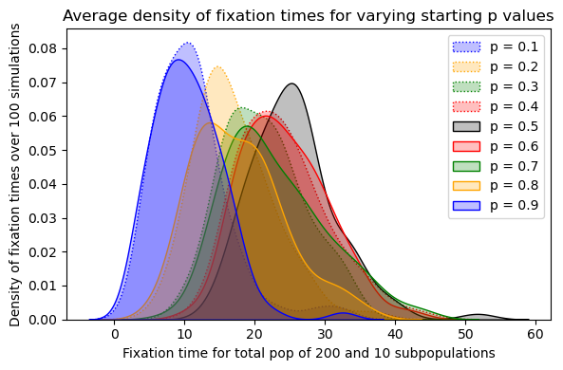
QUESTION 6:
Population structure
Much lower overall time for fixation (intuitive), since every subpopulation will converge much faster to fixation

Slide 15
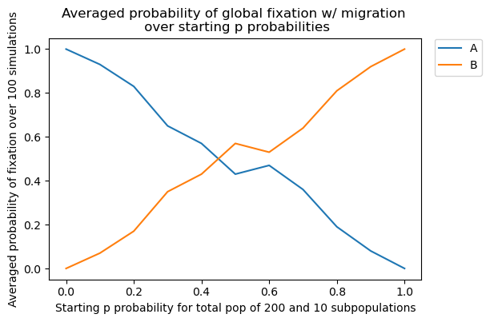
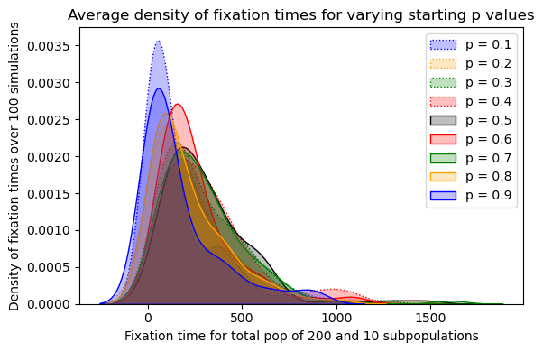
QUESTION 7:
Migration
Much higher overall time for fixation (intuitive), since we are looking for global fixation of the population

Slide 16
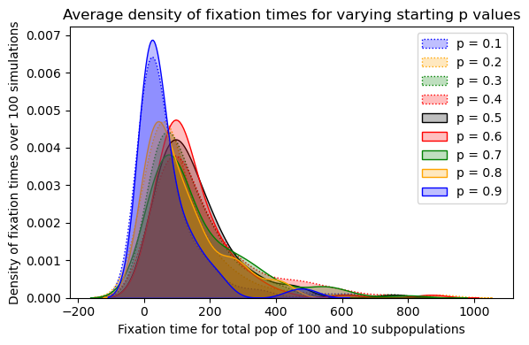
QUESTION 7:
Migration
Compared to task 1: higher overall fixation time.
As expected extremes (0.1 and 0.9) always have lower fixation times

