Slide 1
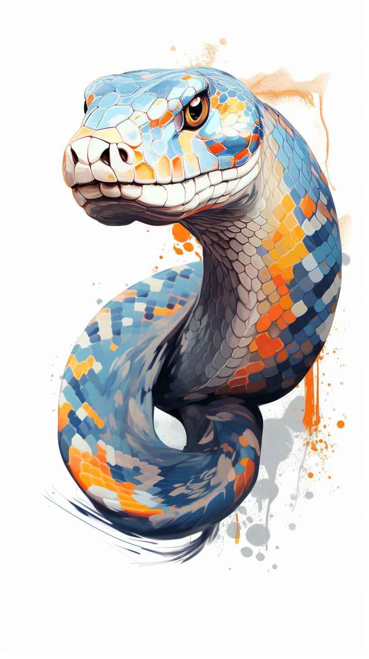
MATLAB with Python
Yann Debray

