Slide 1
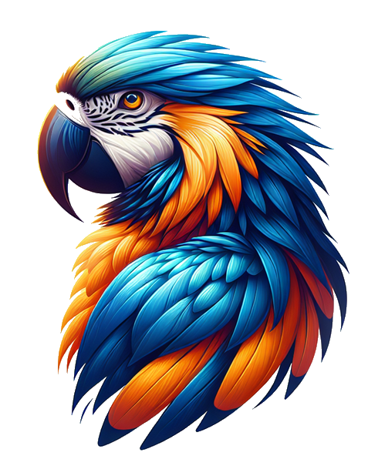
Programming GPTs
A practical guide to building intelligent applications with OpenAI
Yann Debray

