Slide 1


NFTiX
Yann Gabbud

Slide 2
Contents
Goals
System overview
Ticket resale V2
Ticket resale V1
Conclusion
Use case: ticket resale
Challenges

Slide 3
Goals
Initial goal
Build a secure decentralized marketplace for the ticketing industry
-> Exchange
Updated goal
Build a decentralized ticket engine powering a ticket distribution system and a regulated marketplace
-> User management, access control, ticket and event management, regulated exchange

Slide 4
Challenges
Challenges
Hard to implement on-chain regulation because of:
1. Contract immutability
2. Maximum gas limit
3. Data privacy and GDPR law
Solution
Oracles execute transaction regulation logic and generate transaction approval message
Smart contracts verify transaction approval message and execute transaction
Benefits
1. Simpler smart contracts
2. Cheaper transactions
3. Support any regulation rule
4. Easily scalable logic
5. GDPR compliant

Slide 5
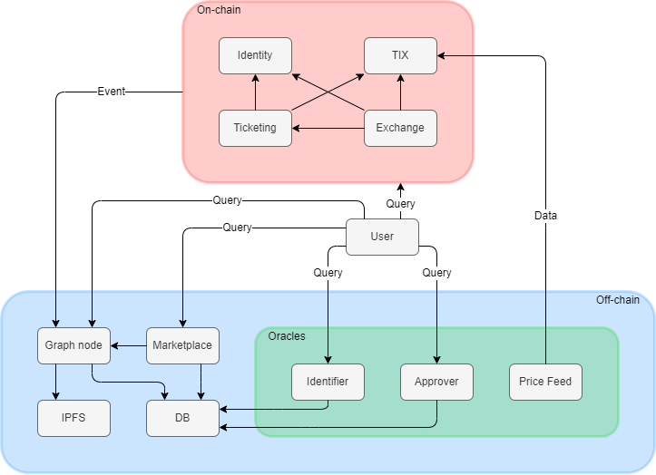
System overview

Slide 6




Use case: ticket resale
Resale agreement
Seller
Buyer
How to remove trust?
How to enforce regulation?

Slide 7

Ticket resale V1: Resale offer approval
Seller
Buyer
Identity
Ticketing
TIX
Approver
Exchange
Get approval
Verification and proof generation
Resale approval proof

Slide 8
Ticket resale V1: Ticket management approval
Seller
Buyer
Identity
Ticketing
TIX
Approver
Exchange
Approve exchange to manage ticket
Grant approval
Confirmation

Slide 9
Ticket resale V1: Resale offer registration
Seller
Buyer
Identity
Ticketing
TIX
Approver
Exchange
Register resale offer
Perform checks (valid proof, ticket not already on resale, etc…)
Optional buyer is a spectator?
Yes
Confirmation
Register offer

Slide 10
Ticket resale V1: TIX management approval
Seller
Buyer
Identity
Ticketing
TIX
Approver
Exchange
Approve exchange to manage TIX
Grant approval
Confirmation

Slide 11
Ticket resale V1: Resale accept
Seller
Buyer
Identity
Ticketing
TIX
Approver
Exchange
Accept resale
Perform checks (Buyer == optional buyer, ticket is on resale, etc…)
Compute seller, NFTiX and organizer shares
Transfer ticket
Transfer shares
Confirmation
Remove ticket from resale

Slide 12
Externally approved transfer
Limitation
Too many transaction required to perform complex tasks
Objective
Atomically execute tasks containing several subtasks
Mechanism
Externally approved transfer: The standard ERC20 and ERC721 accept approval based on proof

Slide 13
Ticket resale V2: Resale offer approval
Seller
Buyer
Identity
Ticketing
TIX
Approver
Exchange
Get approval
Verification and proof generation
Resale approval proof
No change

Slide 14


Ticket resale V2: Resale offer registration
Seller
Buyer
Identity
Ticketing
TIX
Approver
Exchange
Marketplace
Create resale offer proof and ticket transfer approval proof
Register resale offer

Slide 15

Ticket resale V2: Buyer preparation
Seller
Buyer
Identity
Ticketing
TIX
Approver
Exchange
Marketplace
Confirmation
Create seller, NFTiX and organizer TIX transfer approval proofs

Slide 16
Ticket resale V2: Resale execution
Seller
Buyer
Identity
Ticketing
TIX
Approver
Exchange
Marketplace
Resell
Check resale approval proof and resale offer proof
Transfer ticket
Check ticket transfer approval proof and transfer ticket
Check TIX transfer approval proofs and transfer TIXs
Transfer shares
Confirmation

Slide 17
Conclusion
Benefits
1. Decentralized
2. Non-custodial
3. Regulated
Contribution
New approval mechanism for the standard ERC20 and ERC721
Production
Performant and cheap
-> Deployable in production

Slide 18
Question ?
Goals
System overview
Ticket resale V2
Ticket resale V1
Conclusion
Use case: ticket resale

Slide 20
Missing related works: Off-chain processing
Bitcontracts: Supporting Smart Contracts in Legacy Blockchains
https://eprint.iacr.org/2019/857.pdf
SlimChain: Scaling Blockchain Transactions through Off-Chain Storage and Parallel Processing
http://vldb.org/pvldb/vol14/p2314-xu.pdf
Off-chaining Models and Approaches to Off-chain Computations
https://www.ise.tu-berlin.de/fileadmin/fg308/publications/2018/Off-chaining_Models_and_Approaches_to_Off-chain_Computations.pdf

