Slide 1


NFTiX
Yann Gabbud

Slide 2
Contents
Goals
System overview
Ticket resale V2
Ticket resale V1
Conclusion
Use case: ticket resale
Challenges

Slide 3
Goals
Initial goal
Build a secure marketplace for the ticketing industry that fights fraud and black market
-> Exchange
Updated goal
Build a non-custodial decentralized ticket engine powering a ticket distribution system and a regulated marketplace
-> User management system
-> Ticket management system
-> Regulated exchange

Slide 4
Challenges
Challenges
Hard to implement on-chain regulation because of:
1. Maximum gas limit
2. Contract immutability
3. Data privacy and GDPR law
Solution
Oracles execute transaction regulation logic and generate transaction approval message = sig(hash(tx args))
Smart contracts verify transaction approval message and execute transaction
Benefits
1. Simpler smart contracts
2. Cheaper transactions
3. Support any regulation rule
4. Easily scalable logic
5. GDPR compliant
6. Traceability
7. Accountability

Slide 5
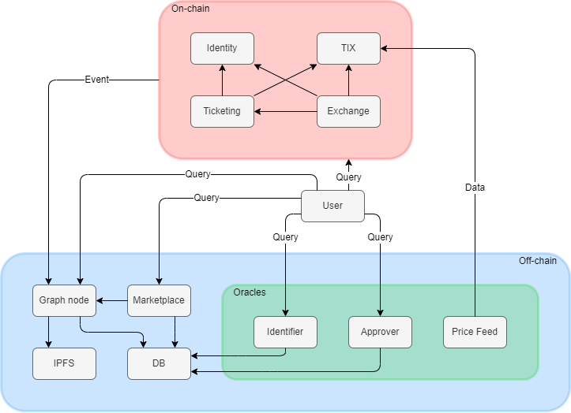
System overview

Slide 6




Use case: ticket resale
Resale agreement
Seller
Buyer
How to remove trust?
How to enforce regulation?

Slide 7

Ticket resale V1: Transaction and ticket approval
Seller
Buyer
Identity
Ticketing
TIX
Approver
Exchange
Get approval
Transaction verification and transaction approval message
generation
Resale approval proof
Approve Exchange contract to transfer his ticket

Slide 8
Ticket resale V1: Offer registration and TIX approval
Seller
Buyer
Identity
Ticketing
TIX
Approver
Exchange
Register resale offer
Perform checks (transaction approval message is valid, ticket not already on resale, etc…)
Register offer
Approve Exchange contract to transfer his TIXs

Slide 9
Ticket resale V1: Resale offer settlement
Seller
Buyer
Identity
Ticketing
TIX
Approver
Exchange
Accept resale
Perform checks (Buyer == optional buyer, ticket is on resale, etc…)
Compute seller, NFTiX and organizer shares
Transfer ticket
Transfer shares
Remove ticket from resale

Slide 10
Ticket resale V1: Numbers
(Measurements made on 21.02.2022)
Operation | Time on Ethereum | Time on Polygon | Cost on Ethereum | Cost on Polygon
Request transaction approval | 0.5 (s) | 0.5 (s) | Free | Free
Approve Exchange to transfer ticket | 15 (s) | 2 (s) | 8.10 (CHF) | < 0.01 (CHF)
Register resale offer | 15 (s) | 2 (s) | 13.90 (CHF) | < 0.01 (CHF)
Approve Exchange to transfer TIX | 15 (s) | 2 (s) | 7.72 (CHF) | < 0.01 (CHF)
Accept offer | 15 (s) | 2 (s) | 26.18 (CHF) | 0.01 (CHF)
Total | 30 - 60 (s) | 4 - 8 (s) | 55.90 (CHF) | < 0.04 (CHF)

Slide 11
Improvements
Limitations
1. Too many transactions needed to perform complex tasks -> high fees and complexity
2. Need to revert to previous state in case of resale cancellation by the buyer
Objective
Atomically execute tasks containing several subtasks
Mechanisms
1. Off-chain offer registration
2. Externally approved transfer: Modified version of ERC20 and ERC721 that accepts transfer based on approval message

Slide 12
Ticket resale V2: Transaction approval
Seller
Buyer
Identity
Ticketing
TIX
Approver
Exchange
Marketplace
Get approval
Transaction verification and transaction approval message
generation
Resale approval proof
No change

Slide 13


Ticket resale V2: Resale offer registration
Seller
Buyer
Identity
Ticketing
TIX
Approver
Exchange
Marketplace
Create resale offer approval message and ticket transfer approval message
Register resale offer

Slide 14

Ticket resale V2: Buyer preparation
Seller
Buyer
Identity
Ticketing
TIX
Approver
Exchange
Marketplace
Get resale offer
Create seller, NFTiX and organizer TIX transfer approval messages

Slide 15
Ticket resale V2: Resale execution
Seller
Buyer
Identity
Ticketing
TIX
Approver
Exchange
Marketplace
Resell
Check transaction approval message and resale offer approval message
Transfer ticket
Check ticket transfer approval message and transfer ticket
Check TIX transfer approval messages and transfer TIXs
Transfer shares

Slide 16
Ticket resale V2: Numbers
(Measurements made on 21.02.2022)
Operation | Time on Ethereum | Time on Polygon | Cost on Ethereum | Cost on Polygon
Request transaction approval | 0.5 (s) | 0.5 (s) | Free | Free
Register resale offer | 0.5 (s) | 0.5 (s) | Free | Free
Get resale offer | 0.5 (s) | 0.5 (s) | Free | Free
Execute resale transaction | 15 (s) | 2 (s) | 30.97 (CHF) | 0.01 (CHF)
Total | 16.5 (s) | 3.5 (s) | 30.97 (CHF) | 0.01 (CHF)

Slide 17
Ticket resale V1 vs V2
(Measurements made on 21.02.2022)
Version | Time on Ethereum | Time on Polygon | Cost on Ethereum | Cost on Polygon | Number of transactions
V1 | ~ 45 (s) | ~ 6 (s) | ~ 56 (CHF) | ~ 0.05 (CHF) | 4
V2 | ~ 17 (s) | ~ 4 (s) | ~ 31 (CHF) | ~ 0.01 (CHF) | 1
Version | On-chain storage | On-chain computation | Advantages
V1 | Yes | Less | A single approval message to verify
V2 | No | More | No need to write data

Slide 18
Conclusion
Main benefits
1. Decentralized
2. Non-custodial
3. Regulated
4. Fraud resistant
5. Black market resistant
Contribution
1. Blockchain based ticket engine
2. Useful approval mechanism for the ERC20 and ERC721 standard
Production
Performant and cheap
-> Deployable in production?

Slide 19
Questions ?
Goals
System overview
Ticket resale V2
Ticket resale V1
Conclusion
Use case: ticket resale
Challenges

Slide 25
Missing related works: Off-chain processing
Bitcontracts: Supporting Smart Contracts in Legacy Blockchains
https://eprint.iacr.org/2019/857.pdf
SlimChain: Scaling Blockchain Transactions through Off-Chain Storage and Parallel Processing
http://vldb.org/pvldb/vol14/p2314-xu.pdf
Off-chaining Models and Approaches to Off-chain Computations
https://www.ise.tu-berlin.de/fileadmin/fg308/publications/2018/Off-chaining_Models_and_Approaches_to_Off-chain_Computations.pdf

