Slide 1
Final Presentation for Berry Street
Han Sun, Shirui Cheng, Haobo Wang
Yanni Zhang, Qiyi Zhang

Slide 2
Introduction to our team
Boxjelly
Han Sun: Product Owner
Qiyi Zhang: Scrum Master
Shirui Cheng: Development & Deployment Environment Lead
Yanni Zhang: Quality Assurance Lead
Haobo Wang: Architecture Lead

Slide 3
Project Background Overview
This project is part of the Berry Street Y-Change plan.
The goal of the plan is to advocate institutional and social changes, so that young people with life experience have more opportunities for decision-making and are no longer regarded as limited in ability.

Slide 4
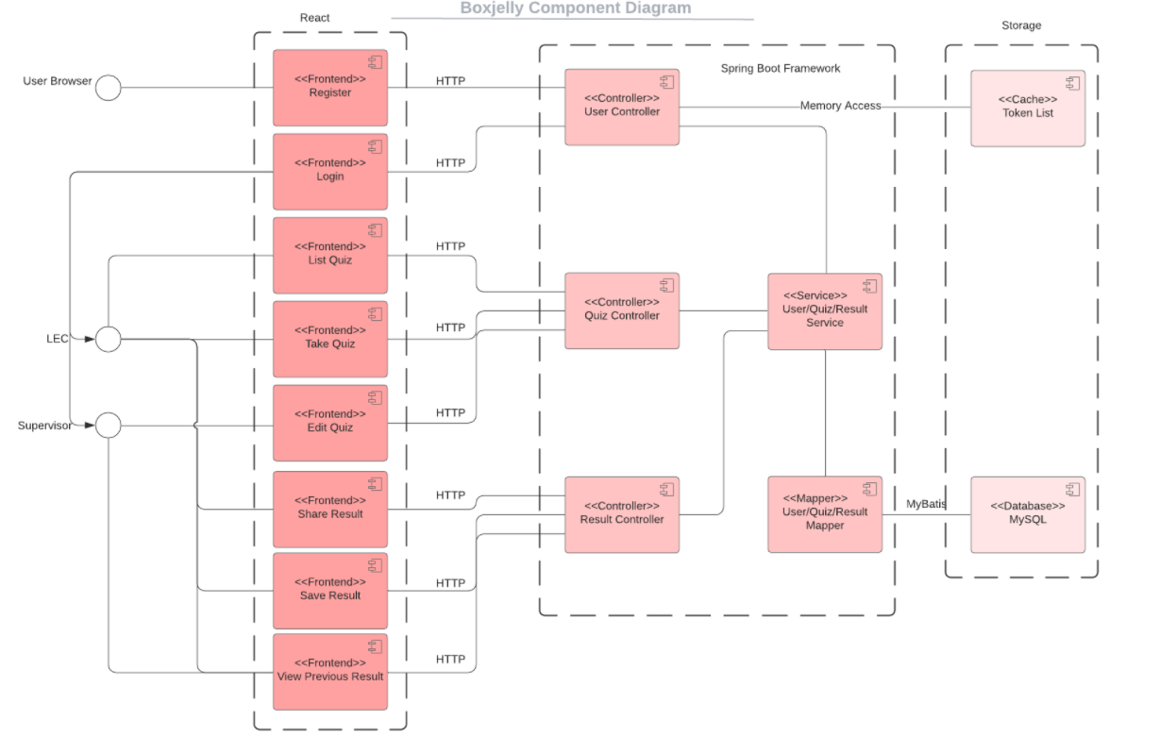

Frontend
Backend
Database

Slide 5
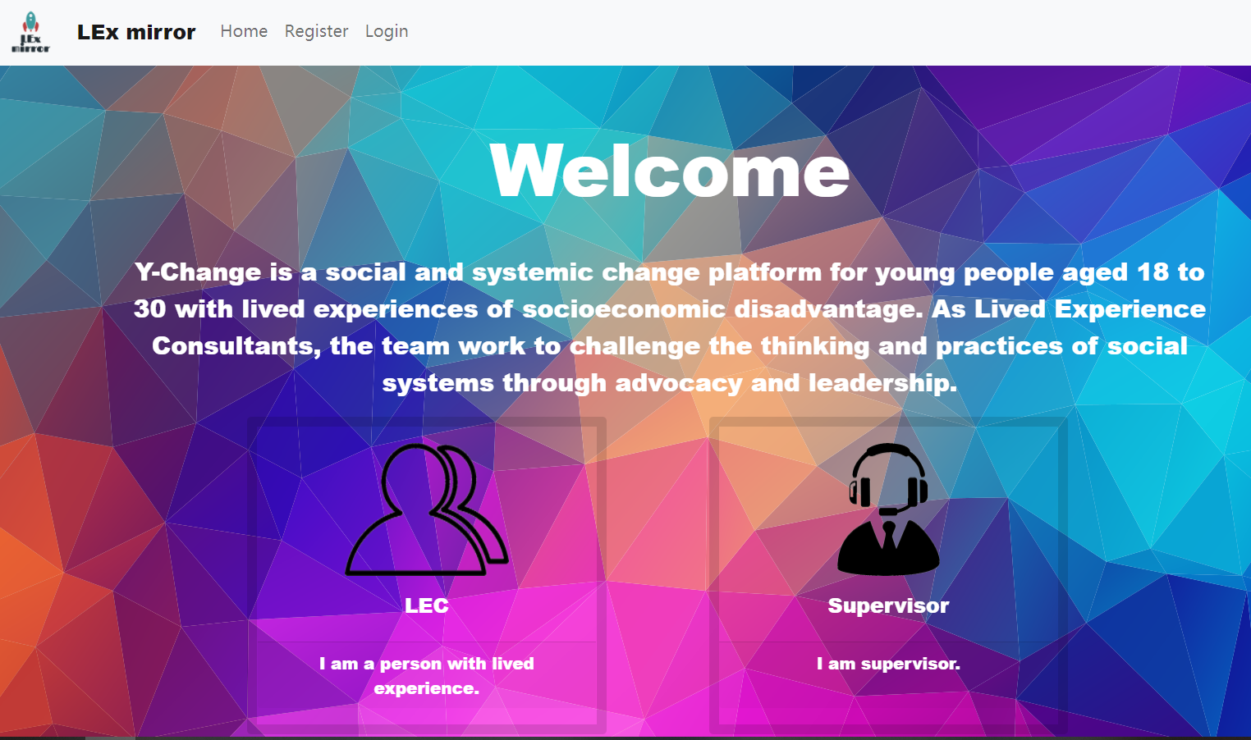
Berry Street
Lived Experience Consultants

Slide 6
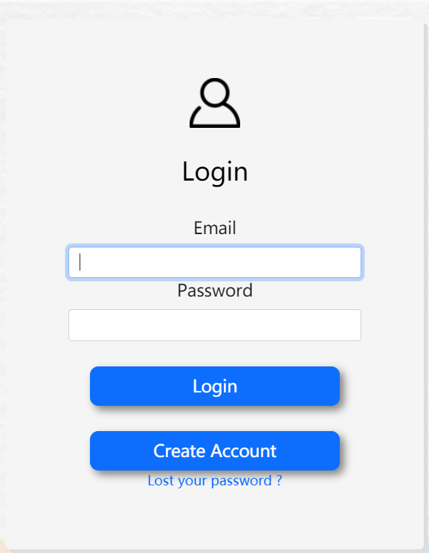
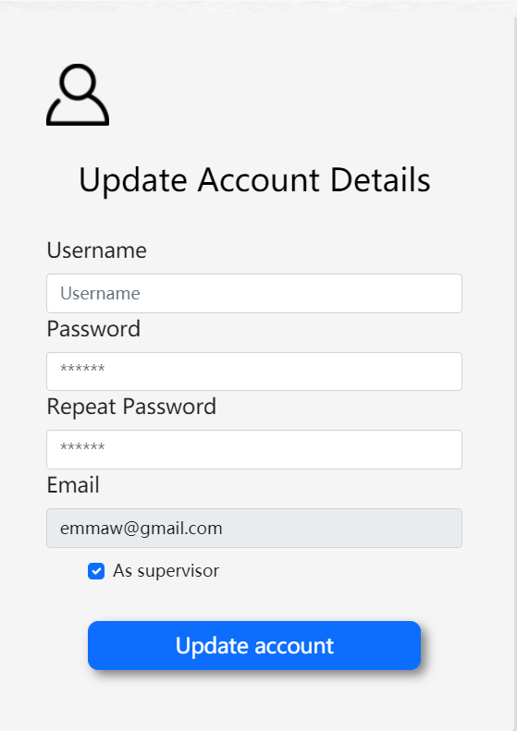
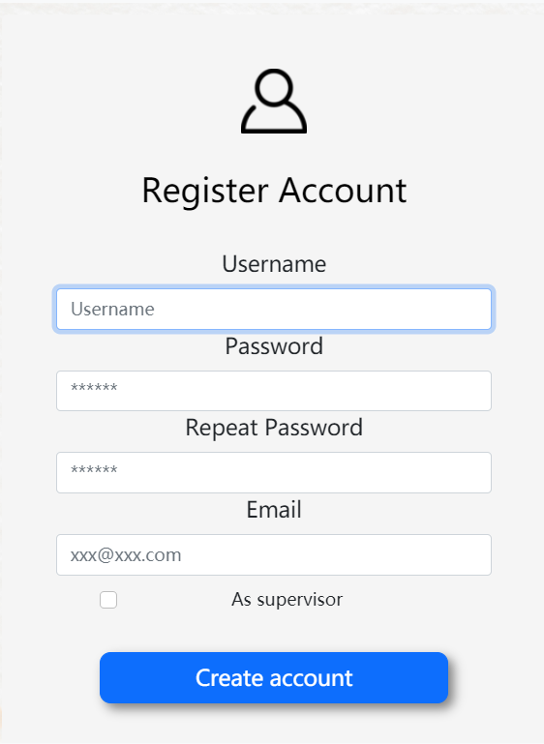
Website detail
Basic Functions
Register
Login
Update account detail

Slide 7
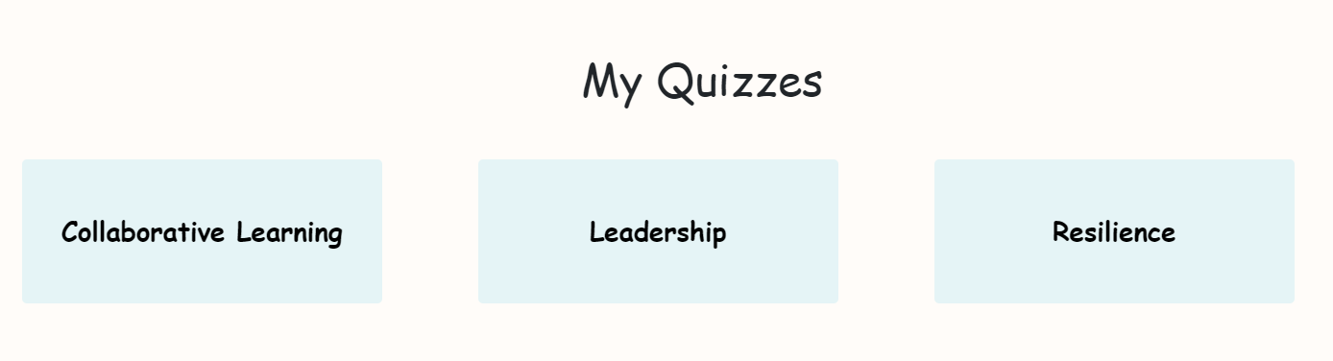
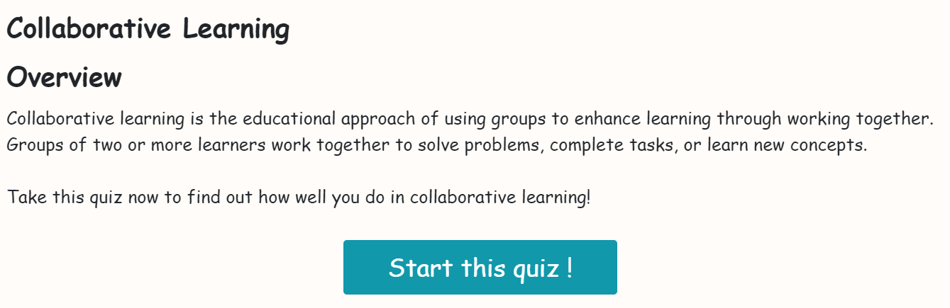
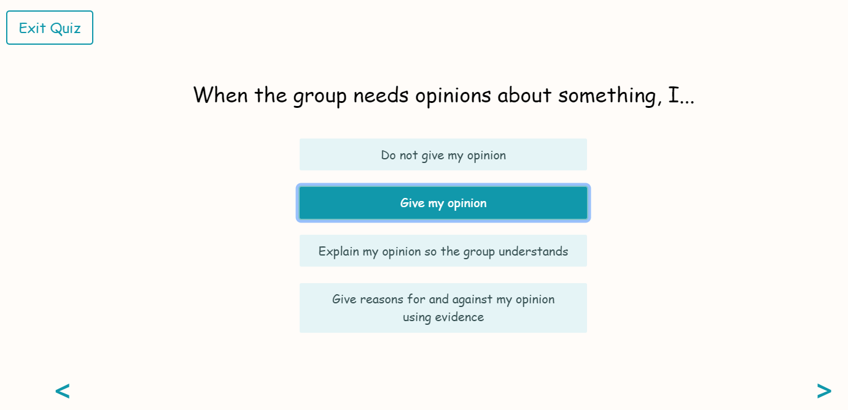
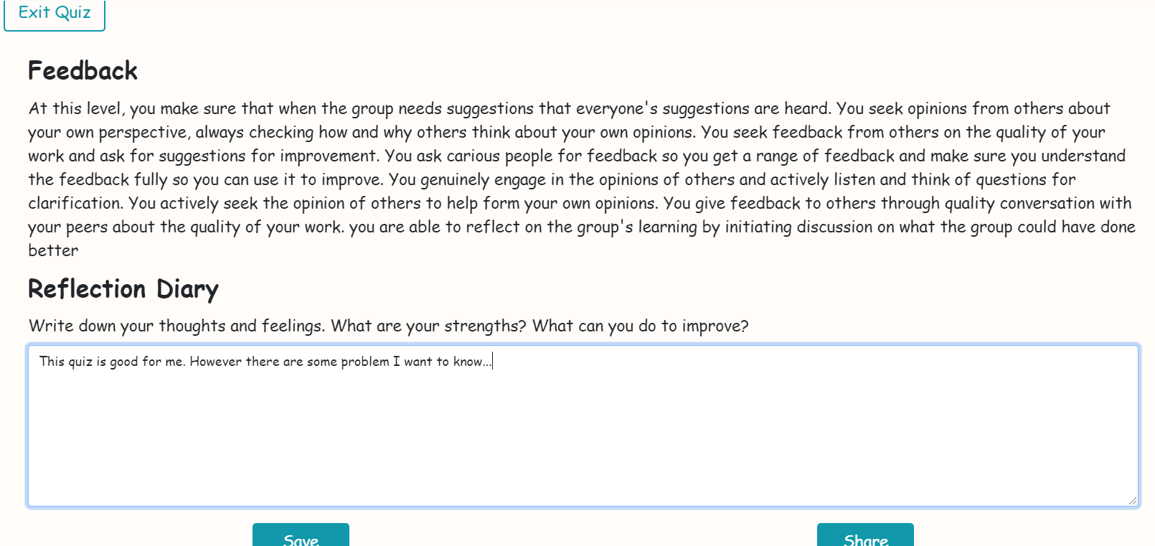
Website detail
LECs
Take Quiz
See the feedback and give reflection

Slide 8
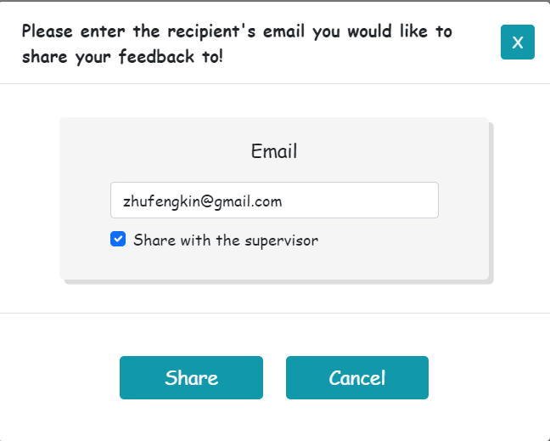
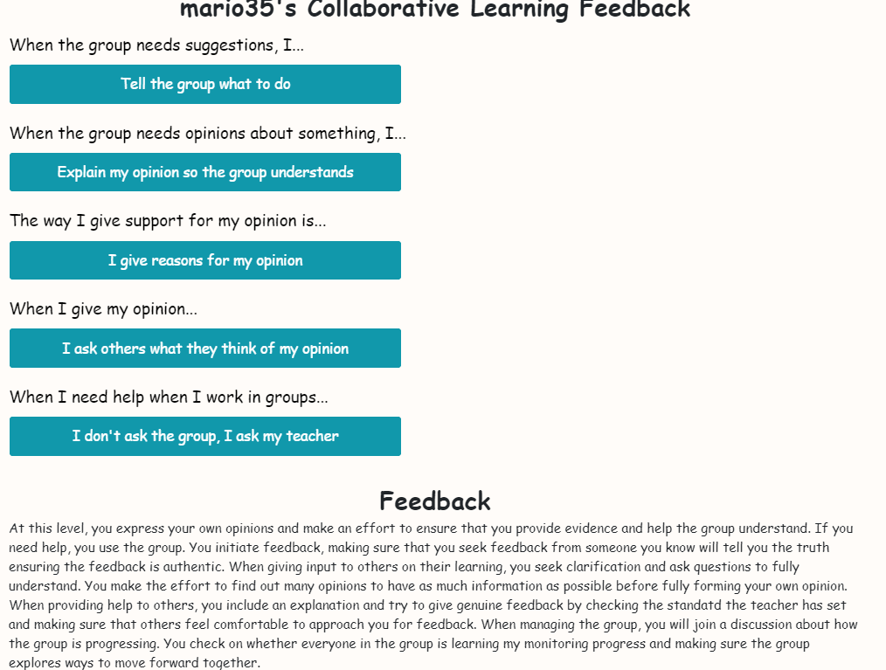
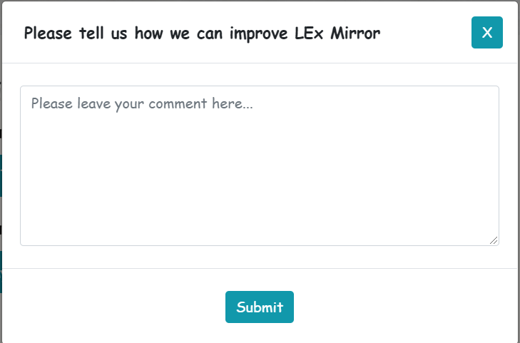
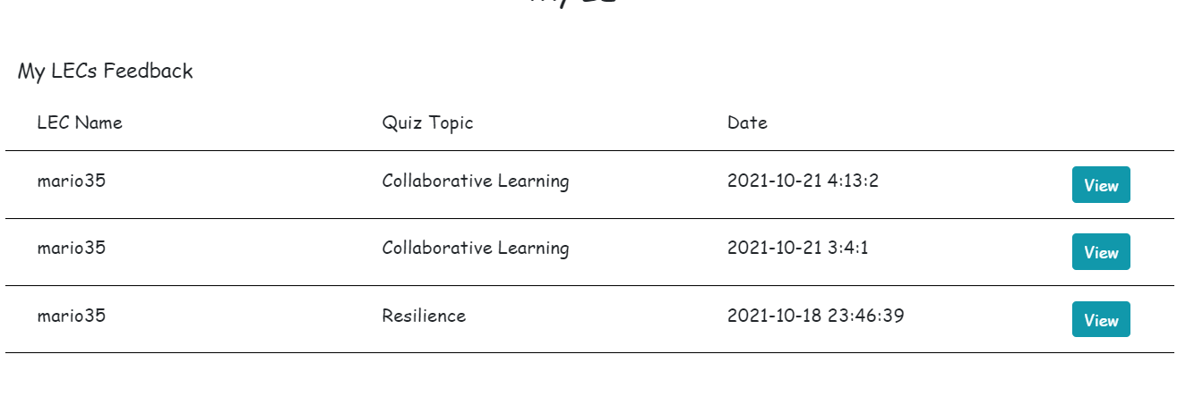
Website detail
LECs
Save and share the result.
View saved result and feedback

Slide 9
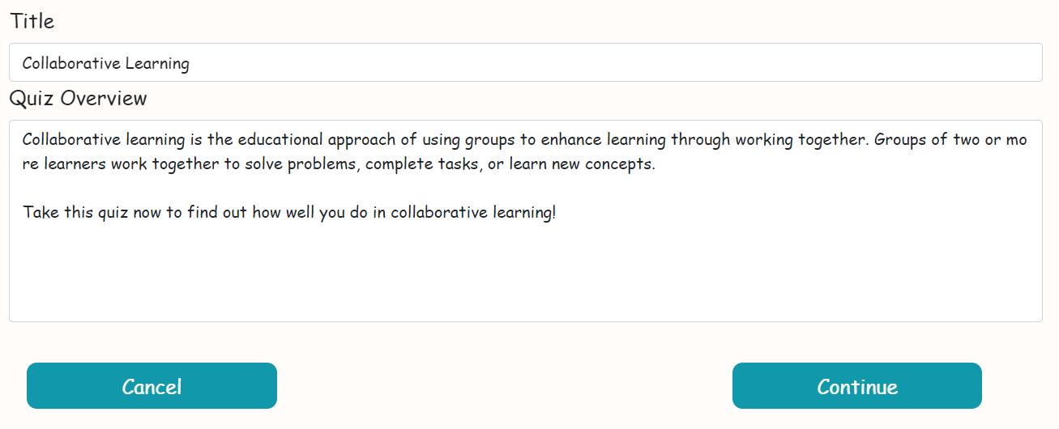
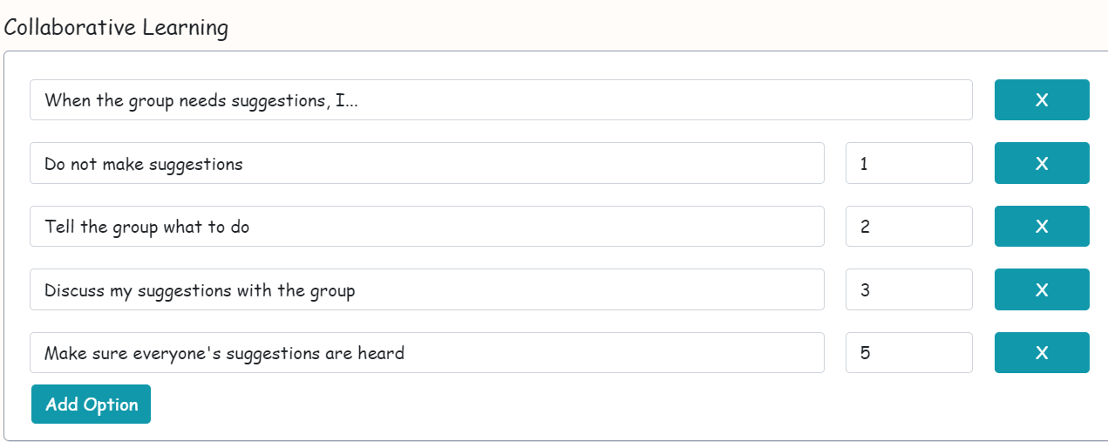
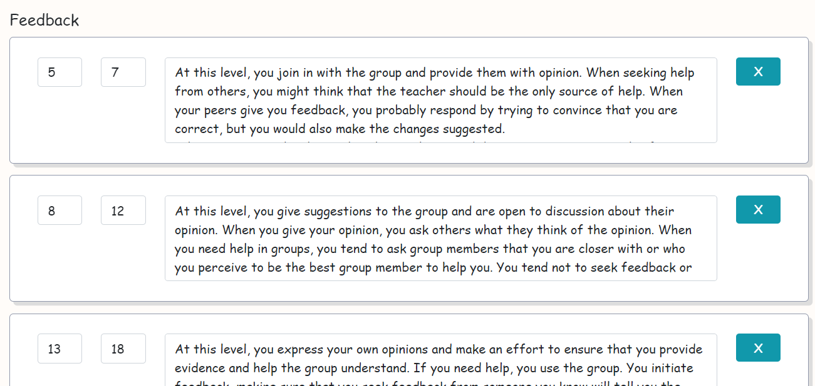
Website detail
Supervisors
Create/Edit/Delete Quiz

Slide 10
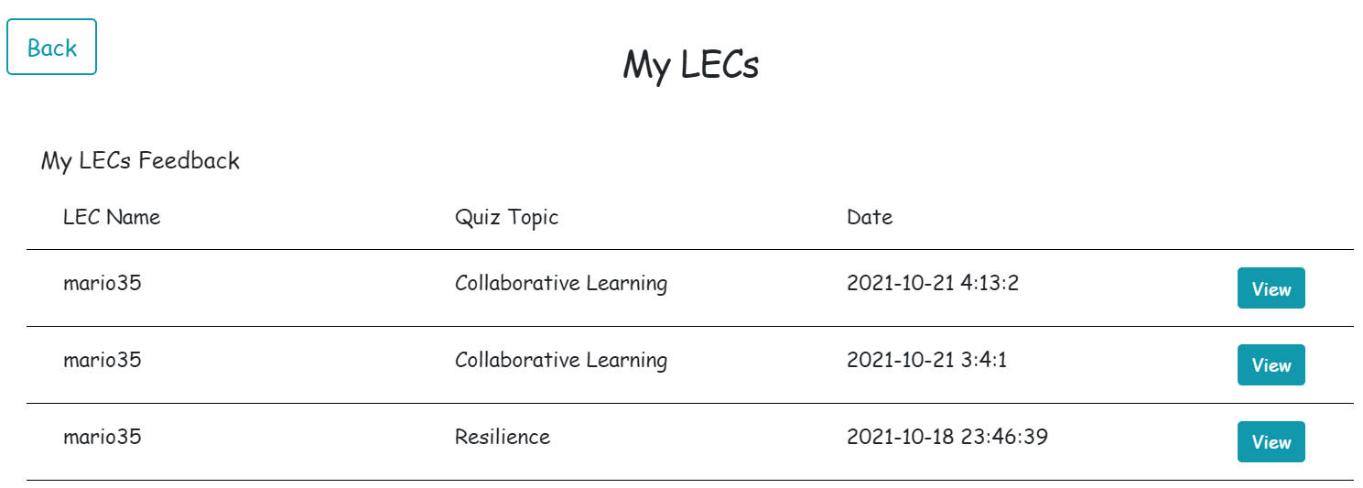
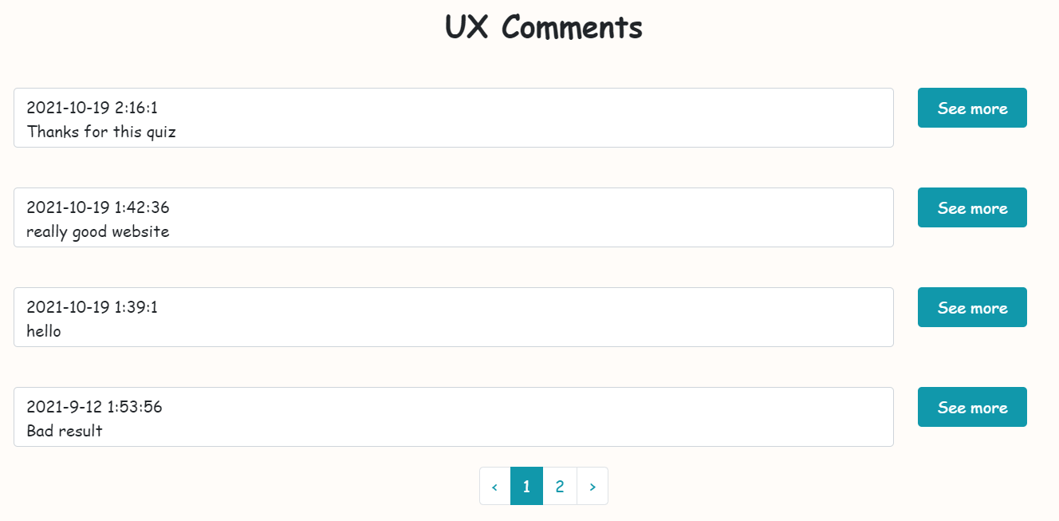
Website detail
Supervisors
View the feedback shared by LECs
View the comment given by users

Slide 11
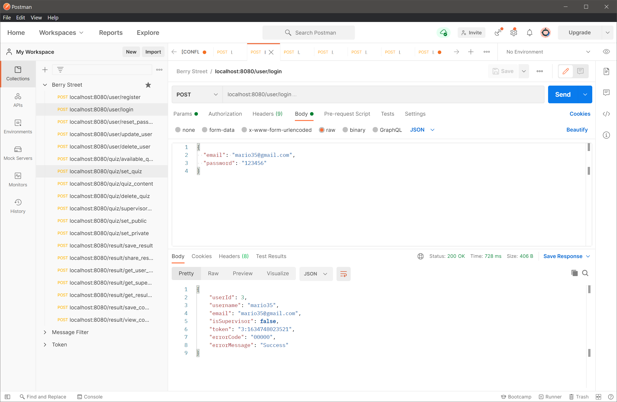
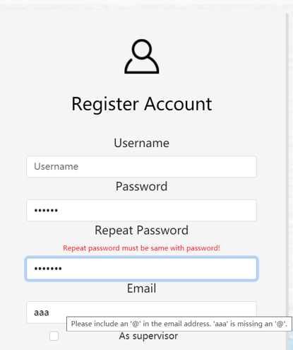
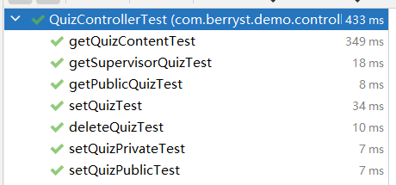
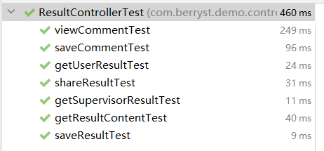
Quality Assurance
Unit Testing with Spring boot’s framework
Manual Test with
Integration Testing through edge cases
Used Real Data

Slide 12
Live Demostration

Slide 13
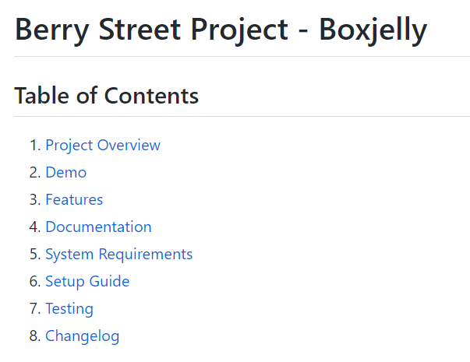
Handover

Slide 14
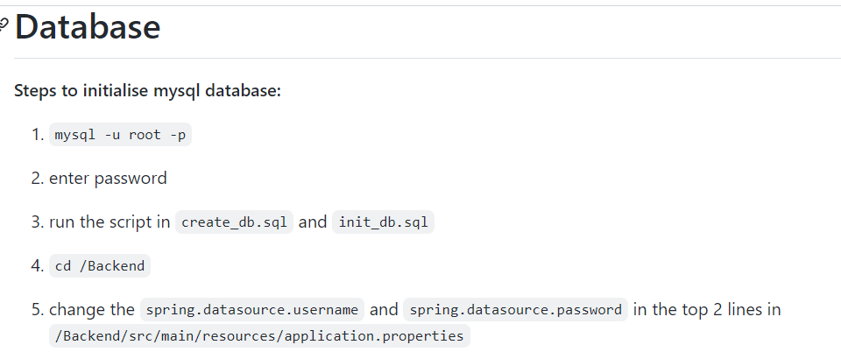
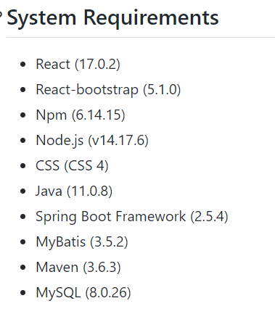
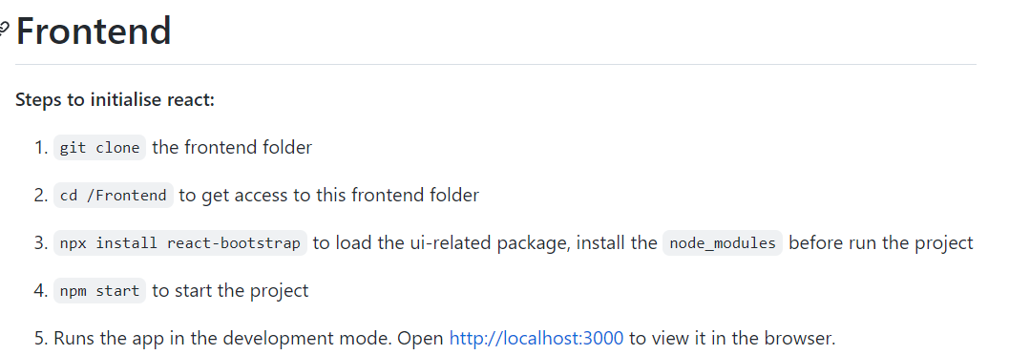

Slide 15
Thanks for your listening

