Slide 1

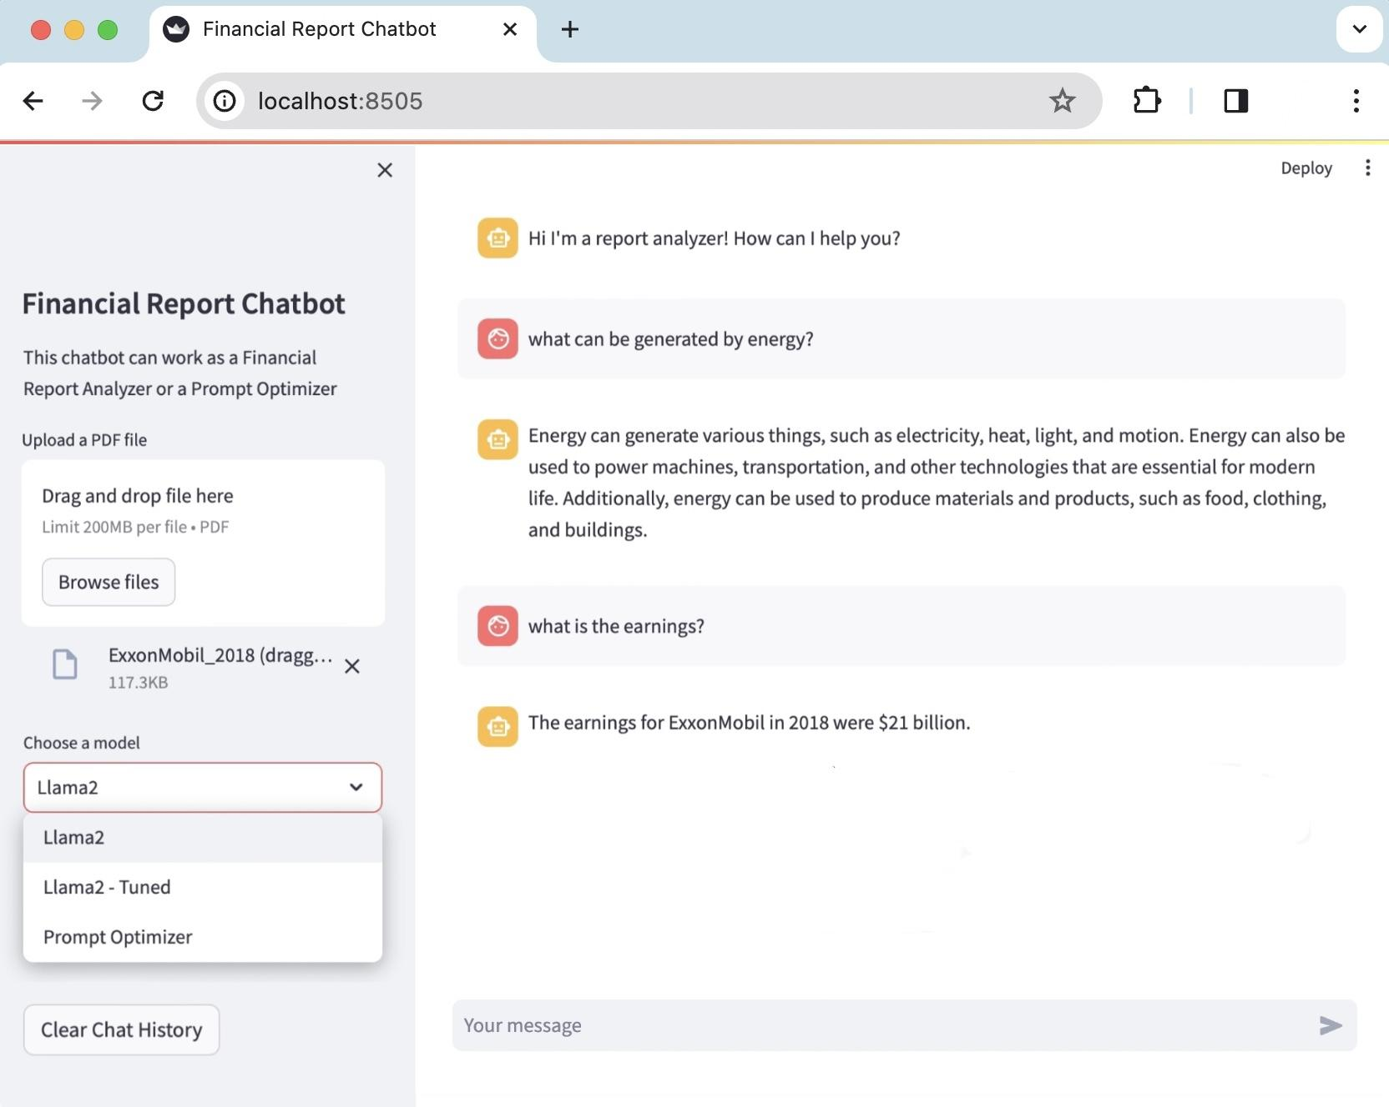
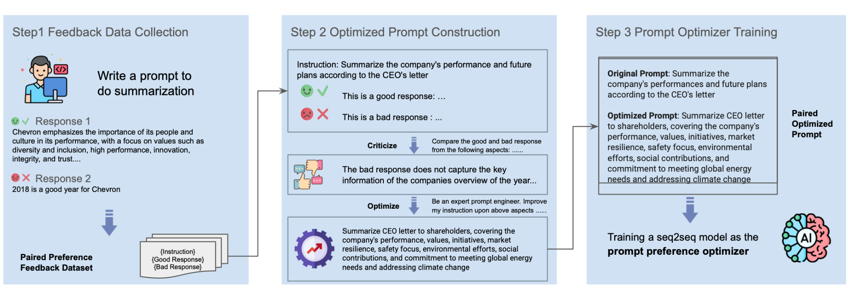
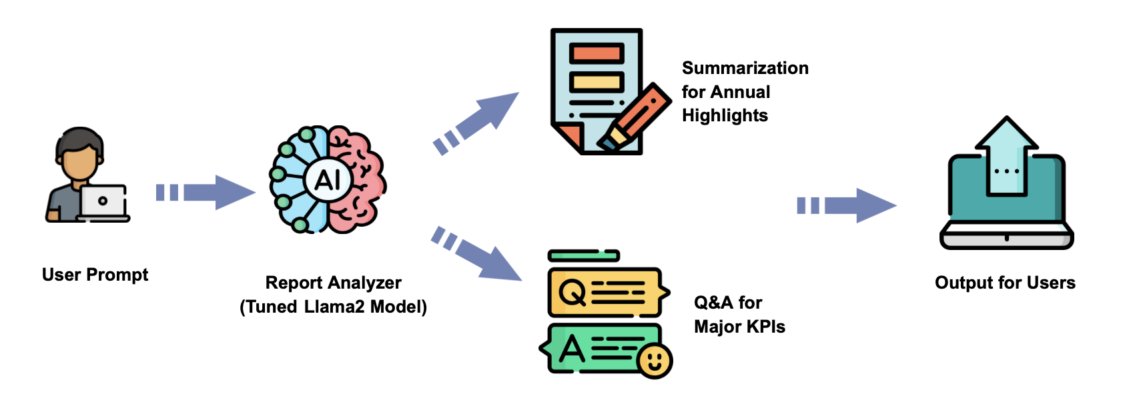
Reinforcement Learning for Generative AI Large Language Models
Yanni Chen, Junyuan Huang, Yi Lu, Xiaolin Sima, Michelle Sun
Satish Banka, Subha Seshagiri
Data Science Capstone Project
with Accenture
Introduction
We want to unlock significant insights into the Oil and Gas Industry through the use of generative AI. Company documentations such as annual reports and sustainability reports can range from 50 to 500 pages, and often contain large amount of numeric and textual information. With the help of Large Language Models (LLMs), the process of understanding how the company performs can be really efficient.
Streamlit Web App
As a final deliverable, we deploy our Prompt Optimizer and Report Analyzer into a web app through Streamlit. On the left-hand side bar, users are able to drop their files and specify which model they would like to use. On the right-hand side, users can enter their message and start a conversation with the chatbot.
Prompt Optimizer (Black-Box Prompt Optimization)
The BPO algorithm operates by enabling the model to optimize the prompt itself by learning what is a good prompt that can produce ideal result. In our approach, we utilized our dataset to fine-tune the THUDM/BPO model, which is based on Llama2. A comparison of outputs pre and post fine-tuning revealed a consistent improvement, as evidenced by higher average Rouge and Bleu scores in the generated results.
Figure 1. Alignment Stage of Black-Box Prompt Optimization
Figure 3. Financial Report Chatbot Web App interface through Streamlit
Report Analyzer (Q&A and Summarization)
Our aim is to comprehensively analyze a targeted company's report, focusing on two key aspects: summarizing annual highlights and extracting major KPIs. To accomplish this, we fine-tuned the Llama2 model using a custom dataset that includes informative summarizations and accurate KPI extractions. Specifically, the model adeptly identifies the CEO report—a key source of annual highlights—and produces concise and insightful summarizations. In terms of Q&A, the Rouge score increased by 20% after fine-tuning and initial reinforcement learning design.
Achievement & Recommendation
Our report analyzer system, comprising a prompt optimizer and a report analyzer, serves as a compelling proof of concept for the effective application of large language models in the consulting industry, particularly within the field of report analysis. For the next step, utilizing a larger dataset for fine-tuning the model and designing a more comprehensive rewarding system for reinforcement learning during the training process can be considered.
Acknowledgments
We would like to acknowledge our industry mentors Satish Bank and Subha Seshagiri, and our course instructors Vivian Zhang and Ju-Chin Chao, who contributed to and ensured the progress of this project.
References
Cheng, Jiale, et al. Black-Box Prompt Optimization: Aligning Large Language Models without Model Training. arXiv:2311.04155, arXiv, 7 Nov. 2023. arXiv.org, http://arxiv.org/abs/2311.04155.
Nantasenamat, Chanin. “How to Build a Llama 2 Chatbot.” Streamlit, 31 Aug. 2023, blog.streamlit.io/how-to-build-a-llama-2-chatbot.
Figure 2. Report Analyzer Workflow

Slide 2

Poster with Horizontal Layout: Title of Poster in Calibri, Bold, 60-80 Points
Names of Authors in Calibri, 44 Points, Bold
Industry Mentors (if applicable) in 40 points bold
Faculty Mentors in 40 points bold
Data Science Capstone Project
with [sponsor company]
or [faculty name, affilation]
Heading (Calibri: 44 Points, Bold)
The first section of the poster should define the topic and show its importance. A good test is whether the poster can orient the audience to these two aspects in 20 seconds. Shown in Figure 1 are two possible layouts for a poster. This section was set in Calibri, boldface, 36 points.
Heading (Calibri: 44 Points, Bold)
One section of a poster should present the results. Often the results can be depicted with graphs, such as for an experiment, or with drawings such as with a design.
Shown in Figure 3 are two more possible layouts for a poster. This section was set in Calibri, boldface, 36 points. Note that the amount of type in the sections affects the choice, size, and boldfacing of the typeface. No matter the type that you select for the sections, you should still use a bold sans serif for the headings.
Phrase Headline That Is Set in Initial Capital Letters
For posters that present one main result, a good design is to cast the title as a sentence that states the result
i
i
Phrase Headline That Is Set in Initial Capital Letters
For posters that present one main result, a good design is to cast the title as a sentence that states the result
i
Figure 1. Two possible layouts for poster (caption: 32 points, bold).
Heading (Calibri: 44 Points, Bold)
The second section of the poster might serve a number of purposes: background information, methods, or system design. An important point with posters is to rely on visuals rather than longs blocks of text to communicate. Figure 2 shows two more possible layouts for posters. This section was set in Calibri, boldface, 36 points.
Figure 3. Two more possible layouts for poster (caption: 32 points, bold).
Heading (Calibri 44 Points)
The final section of the poster generally provides conclusions and recommendations. This section was set in Calibri, boldface, 36 points. As with the first section, this section is read by most passers-by.
Phrase Headline That Is Set in Initial Capital Letters
For posters that present one main result, a good design is to cast the title as a sentence that states the result
Acknowledgments (Calibri, 36 points, bold)
In this template, acknowledgments are set in Calibri, 32 points. Try to keep the acknowledgments to one or two lines.
References (Calibri, 36 points, bold)
First reference in Calibri, 32 points, with reverse indent: alphabetical or numerical order.
Second reference in Calibri, 32 points, with reverse indent: alphabetical or numerical order.
Figure 2. Two other possible layouts for poster (caption: 32 points, bold).

