Slide 1


YANNICK HUCHARD
Enterprise
Morphogenesis
Enterprise Architecture as the morphogenetic system of the enterprise: how strategy becomes a target form, and how that form is generated, scaled, and kept viable under continuous change.
Yannick Huchard · White paper briefing · August 2026
Notes:
White paper: cover, Abstract, 5.1. One slide, one thesis. The numbered slides that follow match the numbered chapters.

Slide 2
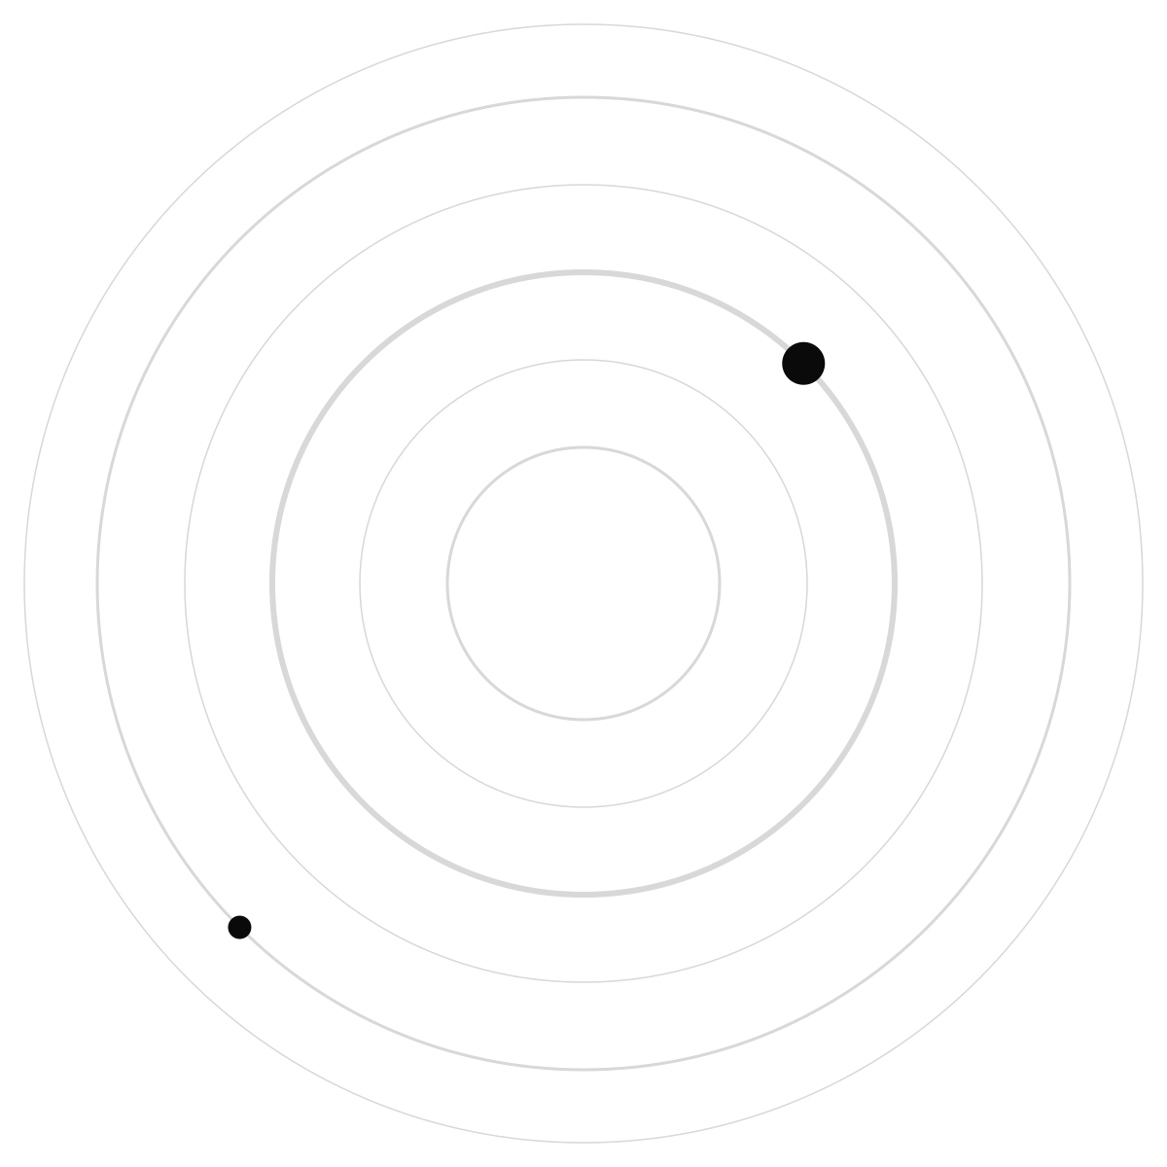
AGENDA
The paper's arc, in the order it is written
1
1 The bind
Ch. 1. The object moved. Description-and-review did not.
2
2-4 Metaphor to regulation
Blueprint fails. Biology names mechanisms. Cybernetics makes them a control loop.
3
5-7 A theory of form
Target form, graph, growth, navigator, and what EA must actually deliver.
4
8-10 Why now, and proof
AI relocates architecture. The programmable enterprise. A worked example.
5
11-14 Practice, then doubt
Operating model. Research propositions. Limits. Conclusion.
YANNICK HUCHARD
Notes:
White paper: Contents. This deck is a high-level map of the manuscript, not a substitute. Each later slide is one chapter.

Slide 3

CHAPTER 1
The enterprise will not sit still. EA still describes it as if it would.
EA exists because local design creates enterprise-wide externalities. That need intensified. It did not stay the same kind of problem.
Cloud, SaaS, regulation, geopolitics, and now generative AI move the object while the method still assumes a describable, reviewable target. When feasible change volume rises, every centrally reviewed decision joins a queue. Latency, not intent, starts to govern.
1.2
the object being architected keeps moving
1.6
intent-to-execution latency becomes the bottleneck
1.7
the identity crisis of the architect is a consequence, not the cause
YANNICK HUCHARD
Notes:
White paper: Chapter 1, especially 1.2, 1.5, 1.6, 1.7. Unique claim: the framework-practice gap is predictable once the object is non-stationary.

Slide 4

CHAPTER 2
We inherited a building. We are architecting a living system.
BLUEPRINT
MORPHOGENESIS
An external designer, a complete object, then occupancy
Target state as a drawing, then a programme to reach it
Description of anatomy mistaken for generation of anatomy
Form generated while the enterprise keeps operating
Mechanisms: position, signals, rules, memory, repair
Almost every piece has precedent; the loop is what is new
YANNICK HUCHARD
Notes:
White paper: Chapter 2, especially 2.1-2.3. Unique claim: this is an extension of EA, not a replacement of TOGAF or Zachman.

Slide 5
CHAPTER 3
Borrow mechanisms. Do not copy cells.
1
2
3
Position
Rules and memory
Repair
Identity depends on where a component belongs. Without positional information, local excellence still fragments the whole.
Local rules generate global structure. The system must remember what it is, or regeneration recreates the wrong form.
Homeostasis and regeneration are maintenance as active regulation, not a project that ends when the drawing is met.
YANNICK HUCHARD
Notes:
White paper: Chapter 3. Unique claim: 3.7 already bounds the analogy. Do not oversell Levin or Waddington. Functional categories only.

Slide 6
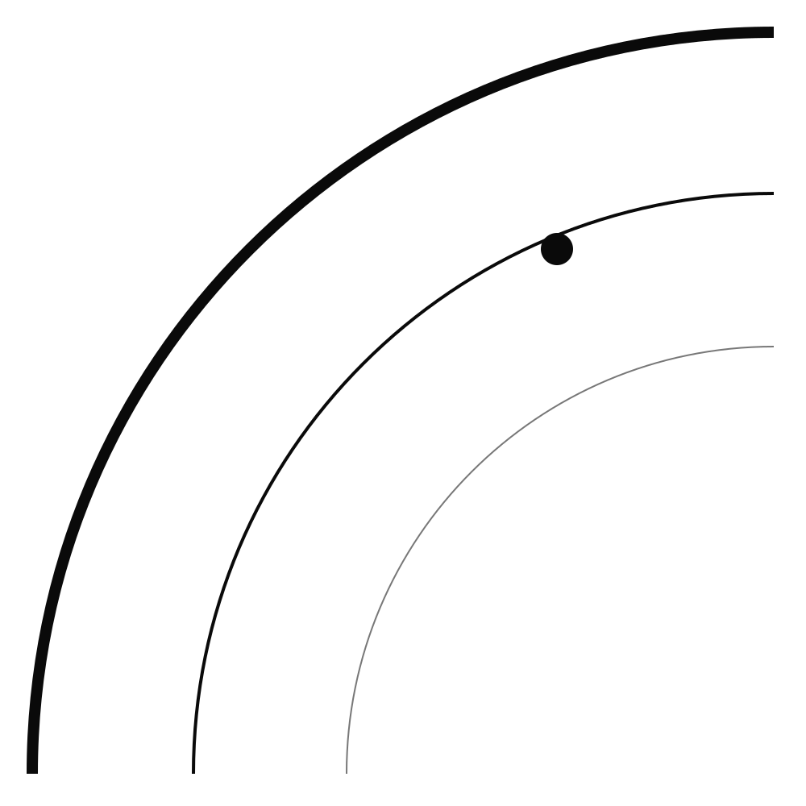
CHAPTER 4
EA is a regulator. A regulator needs a live model and a closed loop.
1
2
3
4
Sense
Interpret
Decide
Adopt
Detect endogenous and exogenous change against the current form.
An adequate model of the enterprise. Stale repositories cannot regulate.
Intervene only where the viable region is threatened or options are being burned.
Propagate, then measure whether the enterprise actually moved. Latency of this loop is a first-class metric.
YANNICK HUCHARD
Notes:
White paper: Chapter 4, Ashby and Conant-Ashby. Unique claim: architecture latency (sense, interpret, decide, propagate, adopt) is how you evaluate the EA function itself.

Slide 7
CHAPTER 5
Strategy becomes a target form. The target is a region, not a point.
Enterprise Morphogenesis is the set of mechanisms that translate strategic intent into a form, develop toward it, and keep it viable. Become, remain dominant, or stay put: all are target form. Architecture makes the choice structural.
The Enterprise Graph is the substrate. Capabilities are projections. Invariants define identity. Developmental rules generate conforming members. Sensing, homeostasis, integrity, and legibility keep the form inhabitable.
A_t
viable region, not one future-state file
Graph
anatomy; maps are stakeholder projections
d_t
deviation, with causes and correction paths
YANNICK HUCHARD
Notes:
White paper: Chapter 5, especially 5.1-5.6, 5.11-5.12. Unique claim: remaining in position is still a designed form. Designer is not retired; the design object moves up to form and mechanisms.

Slide 8
CHAPTER 6
Growth is allometric. The architect is still a designer, and now a navigator.
IF WE ONLY ADD
IF FORM IS TO HOLD
Multiply the current enterprise as if size were capacity
Designer of parts, or cartographer and gatekeeper
Architecture spoken only to architects
Different components scale by different laws. Reuse is a scaling mechanism
Designer of form and mechanisms; navigator of destination, constraints, route
The same truth at board, engineer, and agent resolution
YANNICK HUCHARD
Notes:
White paper: Chapter 6. Unique claim: 6.2 adds navigator; it does not delete designer. Communication is part of the control mechanism (6.3).

Slide 9
CHAPTER 7
If the theory is right, these are the deliverables.
1
2
3
Outcomes
Mechanisms
Representations
Coherence, alignment, adaptability, resilience, scalable growth. Not a thicker repository.
Target form, invariants, developmental rules, graph, fitness, sensing, path, executable constraints, people, provenance.
Diagrams, maps, boards, and standards are instruments. They are not the product.
YANNICK HUCHARD
Notes:
White paper: Chapter 7. Unique claim: a hierarchy of outcomes, mechanisms, representations. Table 1 maps old artifacts onto morphogenetic functions.

Slide 10
CHAPTER 8
AI did not retire architecture. It retired review-as-the-control-path.
Faster making raises the feasible volume of change. Without corresponding architectural mechanisms, speed accelerates fragmentation. Agents are a new population of semi-autonomous actors that application inventories were not designed for.
Architecture must be available inside generate-test-refine: constraints during change. Context becomes infrastructure. Autonomy is earned with observability, reversibility, and shrinking authority as impact grows.
Inside
architecture as API and agent tool, not a 120-page standard
Context
positional identity for every agent, scoped, not a dumped repository
Earned
wide autonomy for reversible work; contraction for irreversible work
YANNICK HUCHARD
Notes:
White paper: Chapter 8. Unique claim: this is why the argument is urgent in 2026, not why the theory exists. The theory is morphogenesis. AI is the accelerator.

Slide 11
CHAPTER 9
Judgment condenses into substrate. That is the programmable enterprise.
1
2
3
4
Frontier
Dyad
Automatic
Express
Novelty and exceptions. The architect acts first. Rulings are recorded.
Human-led human-agent design. Provenance of what was accepted or overridden.
Recurring rulings encoded. Scale is the share of work that no longer needs a reviewer.
Domain factories turn condensed intent into conforming systems, with a human half still required.
YANNICK HUCHARD
Notes:
White paper: Chapter 9. Unique claim: programmable does not mean people become instructions. Condensation without sunset ossifies.

Slide 12
CHAPTER 10
A regulated insurer under AI-driven growth. Then the claimed scope is stress-tested.
Group capabilities that must scale (identity, claims, model governance) versus variation that must stay local (tax, language, distribution). The target form is not one system for everything. It is where commonality creates scale and where difference is intentional.
The paper then asks whether the same mechanisms hold beyond digital services: pit-to-port mining, telecommunications form retirement. Physical assets stay first-class in the graph.
Common
group capabilities that should scale across markets
Local
intentional variation, isolated on purpose
10.1
mining and telco as scope tests, not decorations
YANNICK HUCHARD
Notes:
White paper: Chapter 10 and 10.1. Unique claim: generalization is argued, not assumed. M&A as graph reconciliation is named and deferred.

Slide 13
CHAPTER 11
Distributed architecture, still one loop. Start small and complete.
1
2
3
Operating model
Practices remain
Bootstrap
Group EA owns form, invariants, graph, fitness. Domains translate. Platforms encode. Boards handle fewer routine decisions.
Solution architecture, references, platforms, portfolio, M&A: each stops producing descriptions and starts producing conditions. Design stays. The object moves up.
One domain, a graph slice, 2-3 executable invariants, one sensor, provenance. A loop is real only when consumed. Six unpaired gauge dials. No maturity ladder.
YANNICK HUCHARD
Notes:
White paper: Chapter 11, especially 11.3-11.4 and Table 4. Unique claim: adopting morphogenetic EA is itself a morphogenesis. Local mandate is enough.

Slide 14
CHAPTER 12
10
P3
executable constraints should beat manual review under high change volume
Fail
incoherent intent, no authority, stale model, incentives to diverge
Falsifiable propositions, not a proof. The paper ends as a research programme: target-form clarity, projection coherence, encoded rules, sensing, attractors, allometry, physical completeness, expression machinery.
YANNICK HUCHARD
Notes:
White paper: Chapter 12, Table 5. Unique claim: architecture without authority is a named failure case.

Slide 15
CHAPTER 13
The analogy is a tool. It is not a shield.
1
2
3
Not a prescription
Normative form
Integrity is not neutrality
A morphogen gradient does not tell you how to set incentives. Enterprise evidence has to do that.
Someone decides what fitness means. Do not hide that in an optimizer. Attractors can be abused if every state is called viable.
Provenance can be gamed. Capture can include the architecture function. Challenge, not records for their own sake.
YANNICK HUCHARD
Notes:
White paper: Chapter 13. Unique claim: Levin is represented carefully. The theory is to be revised if the comparative predictions fail.

Slide 16
“
The architect remains responsible for design, but the most valuable design object is increasingly the system of conditions within which distributed design occurs.
Section 14 · designer kept, object moved
YANNICK HUCHARD
Notes:
White paper: Section 14. Pair with the Executive Summary line on mechanisms.

Slide 17


YANNICK HUCHARD
Become, remain,
and rearchitect
yannickhuchard.com · White paper v1.0 · Chapters 1-14
Notes:
White paper: 14 callout. The manuscript, not this deck, is the argument.

