Slide 1


YANNICK HUCHARD
Enterprise
Morphogenesis
How we keep being the enterprise we mean to be, while work, customers, and AI keep changing.
Yannick Huchard · A conversation with everyone · August 2026
Notes:
White paper: cover. Morphogenesis means how a living thing gets its shape and keeps it. Say that once, not on the cover.

Slide 2
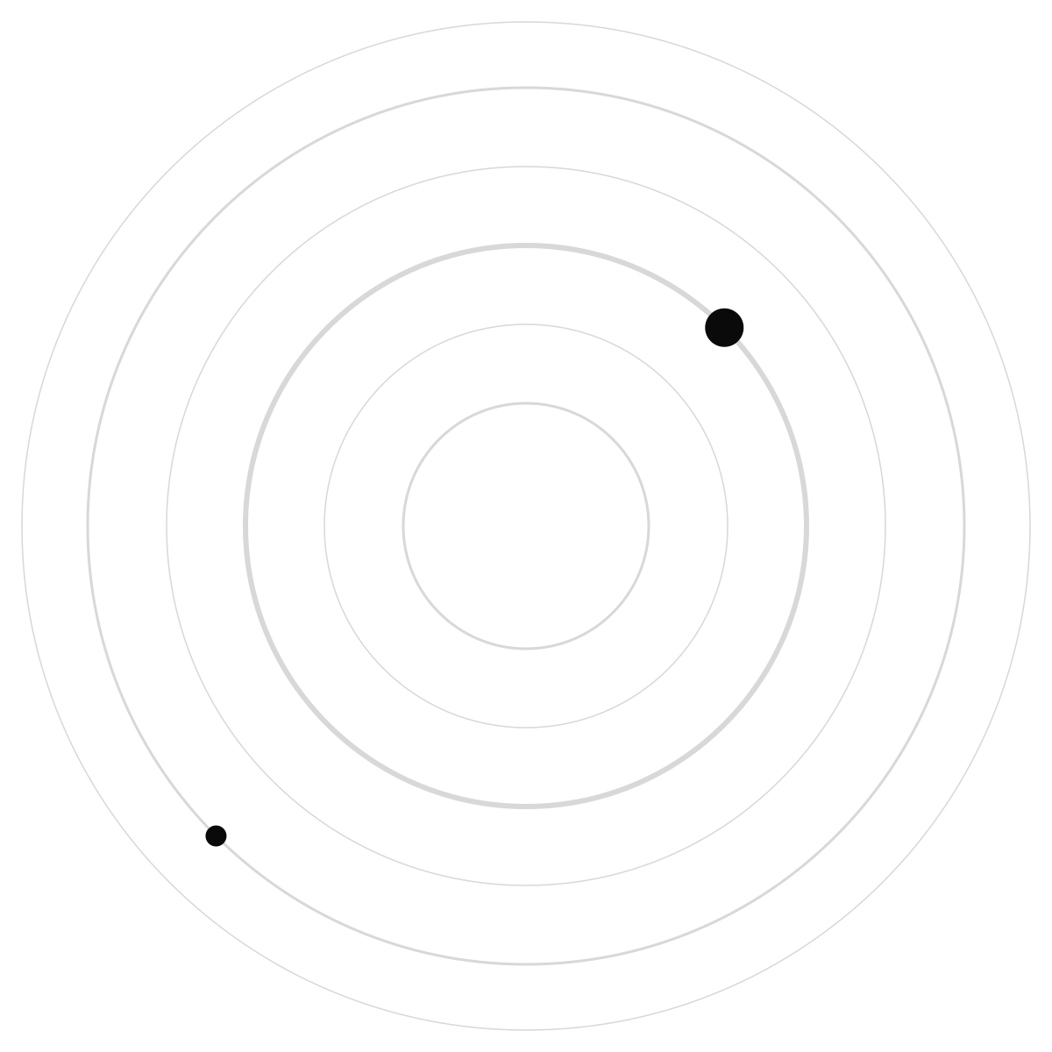
AGENDA
The same paper, in the order it was written
1
1 Why we are stuck
The company keeps moving. Our pictures of it do not.
2
2-4 A better picture of the problem
Not a building. A living system with a control loop.
3
5-7 The shape we mean to be
Strategy is a shape. There is one map. There are deliverables that are not documents.
4
8-10 Why this is urgent, with an example
AI speeds making. Guardrails have to live in the work. An insurer, then other industries.
5
11-14 How we work, and what we do not claim
Start with one team. Measure honestly. Know the limits.
YANNICK HUCHARD
Notes:
White paper: Contents, translated. One slide per chapter follows, in paper order.

Slide 3

CHAPTER 1
We keep working while the company changes. Our drawings assume it paused.
Local shortcuts are rational. Stacked together they become slower customers, duplicated tools, and surprises in risk. Someone else always pays.
AI did not create that. It made the gap expensive: teams can change faster than the shared picture of the company can keep up.
Moving
strategy, rules, technology, and the company itself, at once
Waiting
review queues start to run the estate
Role
if the method is unclear, the job looks unclear
YANNICK HUCHARD
Notes:
White paper: Chapter 1. Translate non-stationary as: it keeps moving while we are using it.

Slide 4

CHAPTER 2
A building waits. An enterprise does not.
THE OLD PICTURE
THE LIVING PICTURE
Finish the drawing, then occupy it
One future picture, then a programme
More diagrams as the way to stay in control
We sell and ship while we change
Mechanisms that keep a shape, not a master drawing
Same profession, different job: design the conditions of design
YANNICK HUCHARD
Notes:
White paper: Chapter 2.

Slide 5
CHAPTER 3
What we actually borrow from living systems
1
2
3
Where you sit
Local rules
Repair
Who you are at work depends on where you belong in the whole, not only on your team name.
A few shared rules, repeated, produce a global shape. That is how organisms develop without a pixel drawing.
Keeping the shape is active work: notice drift, fix it, remember what we are.
YANNICK HUCHARD
Notes:
White paper: Chapter 3. Say once: this is analogy, not biology class.

Slide 6
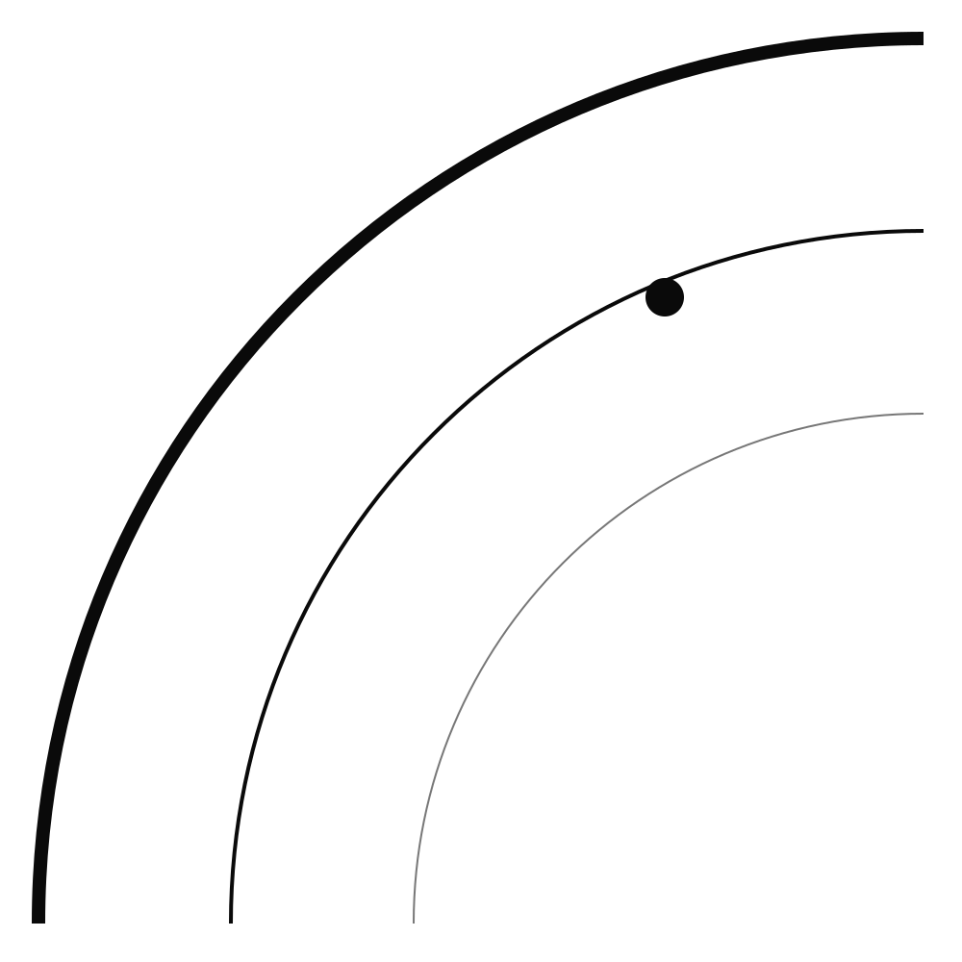
CHAPTER 4
Architecture is how we steer, not how we decorate.
1
2
3
4
See
Understand
Choose
Check
Notice change in the work, the market, the rules.
A picture of the company that is actually used, not a folder nobody opens.
Intervene when the shape we mean is at risk.
Did the company actually move? Waiting is part of the score.
YANNICK HUCHARD
Notes:
White paper: Chapter 4.

Slide 7
CHAPTER 5
Strategy is a shape. Even 'stay as we are' is a shape.
If we mean to remain trusted, dominant, or safe, that is a form. If nobody makes it usable, we drift and call it delivery.
One living map of products, teams, systems, and obligations. Capability posters are views of that map, not a second company.
Region
many acceptable ways to be the intended company
Map
one substrate, many views
Readable
if people cannot navigate it, it cannot steer them
YANNICK HUCHARD
Notes:
White paper: Chapter 5. Morphogenesis, said once: how a living thing gets its shape and keeps it.

Slide 8
CHAPTER 6
Getting bigger is not copying yourself.
ADD MORE OF THE SAME
GROW WITHOUT LOSING THE SHAPE
More people, more apps, more controls, same structure
Architects as map-makers or stop-signs
The truth lives in a pack only architects can read
Share what should be common so complexity does not explode
Architects still design, and they help us not get lost
Board, engineer, and AI agent see the same truth at their scale
YANNICK HUCHARD
Notes:
White paper: Chapter 6.

Slide 9
CHAPTER 7
What you should be able to get from architecture
1
2
3
A usable destination
Running conditions
Not the binder
The shape strategy requires, including remain, with room to move.
A few rules and a map that work in the tools, plus a way to object.
Slides and reviews are tools. They are not the result.
YANNICK HUCHARD
Notes:
White paper: Chapter 7.

Slide 10
CHAPTER 8
Faster making needs better guardrails, not more reviewers.
If AI helps you produce change in a day, waiting six weeks for a routine yes is not safety. It is a queue. High-stakes decisions still need a human.
The guardrails have to live where the work happens: in the tools, with a clear place on the map, and permission that shrinks as the blast radius grows.
You
still decide in your domain, with a clearer where
Rules
the few that must hold, at the moment of work
Stop
irreversible or dangerous acts stay human
YANNICK HUCHARD
Notes:
White paper: Chapter 8.

Slide 11
CHAPTER 9
What we learn the hard way should not have to be re-learned by hand.
1
2
3
4
New
Together
Then automatic
Factories
Someone meets the exception first. That is still a person.
Person plus AI as a pair, with a record of who decided.
If the same case returns, the rule should run.
Each domain rehearses that migration. Experts remain the human half.
YANNICK HUCHARD
Notes:
White paper: Chapter 9. Programmable does not mean people become scripts.

Slide 12
CHAPTER 10
An insurer that must grow with AI, without becoming one blob or a thousand islands.
Some things should be the same everywhere: who the customer is, how a claim is orchestrated, how a model is governed. Some things must stay local: tax, language, distribution.
The same idea is tested on a mine and a telecoms network. Buildings, machines, and networks count. They are not 'IT later.'
Same
the capabilities that should travel
Different
variation we keep on purpose
Physical
if it can fail in the real world, it is on the map
YANNICK HUCHARD
Notes:
White paper: Chapter 10.

Slide 13
CHAPTER 11
We do not start by converting the company.
1
2
3
Who does what
Your existing crafts stay
Monday
A small centre holds the shape and the map. Teams design inside it. Platforms make the rules real.
Solution design, platforms, portfolio work: still there. They produce conditions, not packs.
One willing team, one real job, two or three rules that run, one signal, a written exception path. If nobody uses it, we do not scale the story.
YANNICK HUCHARD
Notes:
White paper: Chapter 11. No maturity ladder.

Slide 14
CHAPTER 12
10
Honest
it also lists how this fails: no mandate, a map nobody uses
Next
the long argument lives in the white paper, not on this slide
The paper does not ask you to believe it. It lists tests: does a live map catch drift sooner? Do running rules beat a queue? Does a region of acceptable forms beat one frozen picture?
YANNICK HUCHARD
Notes:
White paper: Chapter 12.

Slide 15
CHAPTER 13
What this is not
1
2
3
Not nature's orders
Not automatic virtue
Not a paper trail as proof
Biology does not tell us how to run a company. It names a kind of problem.
Someone still chooses the intended shape. That is a leadership act.
Records can hide capture. You still need the right to disagree.
YANNICK HUCHARD
Notes:
White paper: Chapter 13.

Slide 16
“
We do not merely architect the enterprise. We architect the mechanisms through which the enterprise continuously becomes, remains and rearchitects itself.
Chapter 14 · 'remains' is the word to keep
YANNICK HUCHARD
Notes:
White paper: Chapter 14. Remaining trusted or dominant is a chosen form.

Slide 17


YANNICK HUCHARD
Stay the enterprise
we mean to be
yannickhuchard.com · White paper v1.0 · Ch. 1-14
Notes:
White paper: 14. Three acts: use the map, contest a bad rule, be the human half if you are the expert.

