Slide 1
Computer Systems
Lecturer: Szabolcs Mikulas
E-mail: szabolcs@dcs.bbk.ac.uk
URL: http://www.dcs.bbk.ac.uk/~szabolcs/compsys.html
Textbook:
W. Stallings, Operating Systems: Internals and Design Principles, 9th ed., Prentice Hall, 2018
Recommended reading:
W. Stallings, Computer Organization and Architecture 10th ed., Prentice Hall, 2016
A.S. Tanenbaum, Modern Operating Systems, 2nd or 3rd ed. Prentice Hall, 2001 or 2008

Slide 2

Chapter 1
Computer System Overview
Operating Systems:
Internals and Design Principles, 6/E
William Stallings
With additional inputs from Computer Organization and Architecture, Parts 1 and 2
Patricia Roy
Manatee Community College, Venice, FL
©2008, Prentice Hall

Slide 3
Computer Structure - Top Level
Peripherals
Computer
Central
Processing
Unit
Main
Memory
Computer
Systems
Interconnection
Input
Output
Communication
lines

Slide 4
The Central Processing Unit - CPU
CPU
Computer
Arithmetic
and
Logic Unit
I/O
Registers
System
Bus
CPU
Internal CPU
Interconnection
Memory
Control
Unit

Slide 5
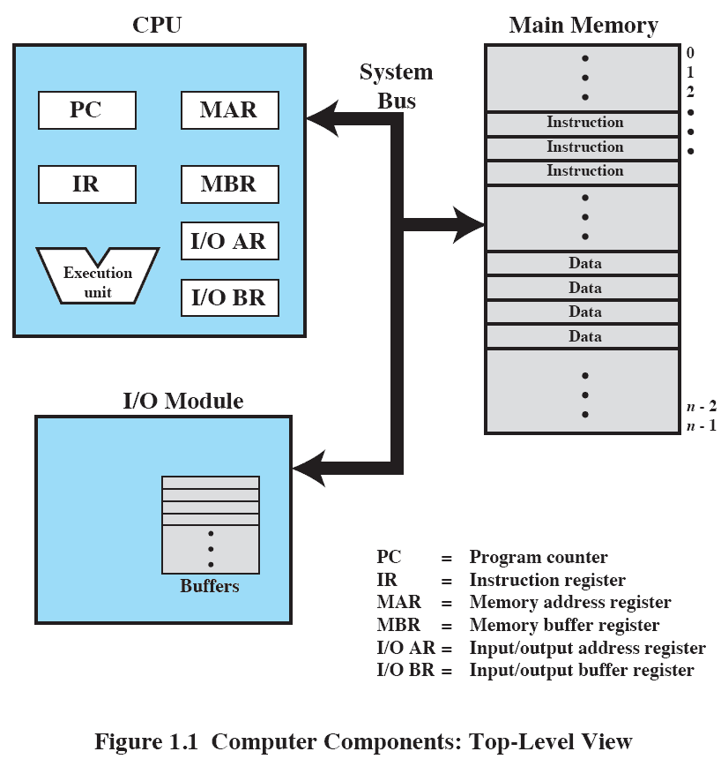
Computer Components - Registers

Slide 6
Control and Status Registers
Used by processor to control the operation of the processor
Used by privileged OS routines to control the execution of programs
Program counter (PC): Contains the address of the next instruction to be fetched
Instruction register (IR): Contains the instruction most recently fetched
Program status word (PSW): Contains status information

Slide 7
User-Visible Registers
May be referenced by machine language, available to all programs – application programs and system programs
Data
Address
  Index: Adding an index to a base value to get the effective address
  Segment pointer: When memory is divided into segments, memory is referenced by a segment and an offset inside the segment
  Stack pointer: Points to top of stack

Slide 8
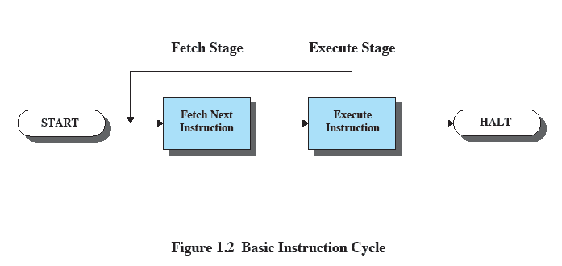
Basic Instruction Cycle

Slide 9
Fetch Cycle
Program Counter (PC) holds address of next instruction to be fetched
Processor fetches instruction from memory location pointed to by PC
Increment PC
  Unless told otherwise
Instruction loaded into Instruction Register (IR)
Processor interprets instruction and performs required actions

Slide 10
Execute Cycle
Data transfer
  Between CPU and main memory
  Between CPU and I/O module
Data processing
  Some arithmetic or logical operation on data
Control
  Alteration of sequence of operations, e.g. jump
Combinations of the above

Slide 11
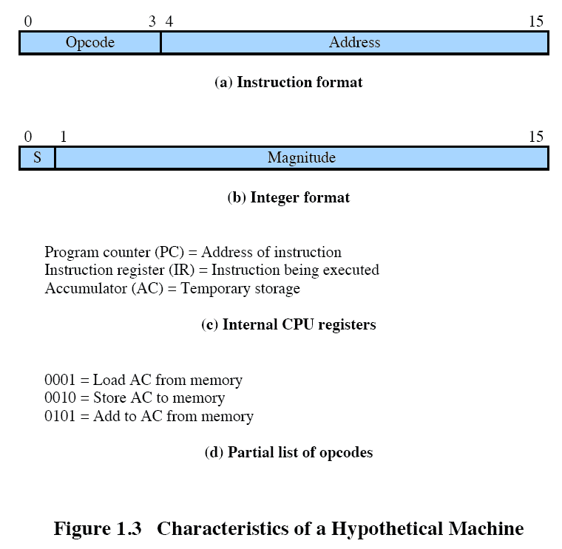
Characteristics of a Hypothetical Machine

Slide 12
Simple Computation
Using some implicit addressing (e.g. AC) and hexadecimal notation
How to add the contents (3 and 2) of two memory locations (940 and 941) and store the result at a memory location (941)
1. load data from 940 (into AC):
1940, i.e., LOAD 940 // 3 -> AC
2. perform addition using 941 (and AC):
5941, i.e., ADD 941 // 2+3 -> AC
3. store result at 941 (from AC):
2941, i.e., STORE 941 // 5 -> 941

Slide 13
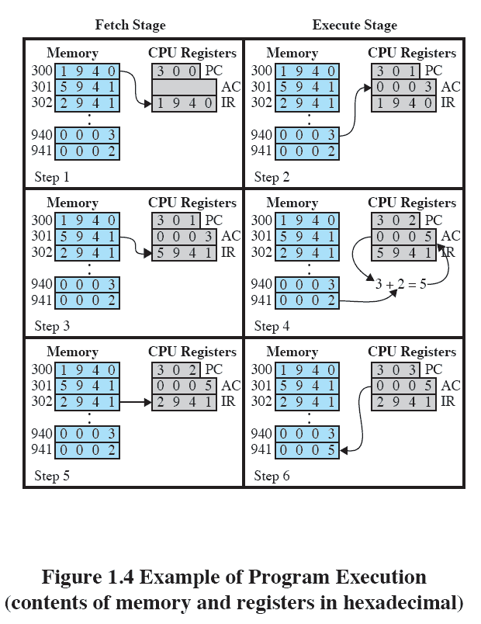
Example of Program Execution

Slide 14
CPU Speed
Speed of CPU clocked is measured in frequency: 1 Hz (hertz) – 1 cycle per second
1 GHz = 10^3 MHz = 10^6 KHz = 10^9 Hz (instead of 10^3 one can use 2^10=1024)
Length of a cycle measured in seconds
1 second = 10^3 milliseconds = 10^6 microseconds = 10^9 nanoseconds
Performing one operation may take longer than one clock cycle!!! – Accessing memory is slower that pure arithmetic operation (using the registers)

Slide 15
Interrupts
Interrupts the normal sequencing of the processor – suspends current activity and runs special code
Program generated: result of an instruction, e.g. division by 0, overflow, illegal machine instruction
Hardware generated: timer, I/O (when finished or error), other errors (e.g. parity check)

Slide 16
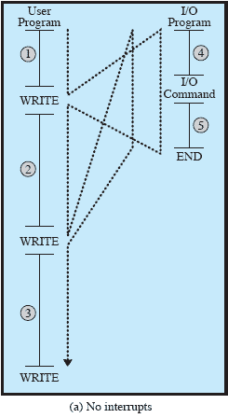
Program Flow of Control

Slide 17
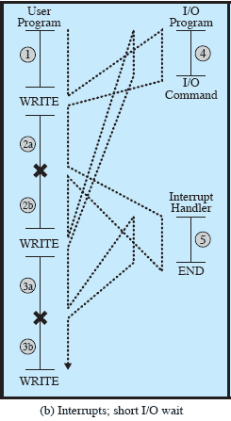
Program Flow of Control

Slide 18
Interrupt Stage
Processor checks for interrupts
If interrupt occurred
  Suspend execution of program
  Execute interrupt-handler routine
  Afterwards control may be returned to suspended program

Slide 19
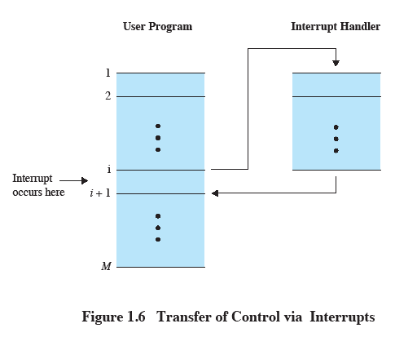
Transfer of Control via Interrupts

Slide 20
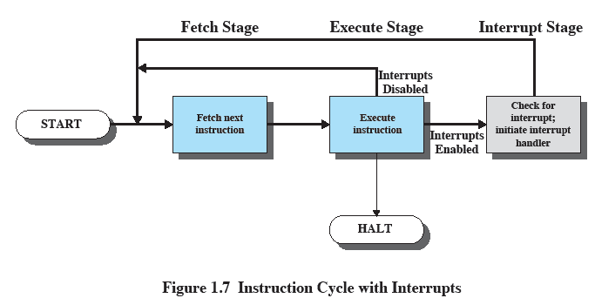
Instruction Cycle with Interrupts

Slide 21
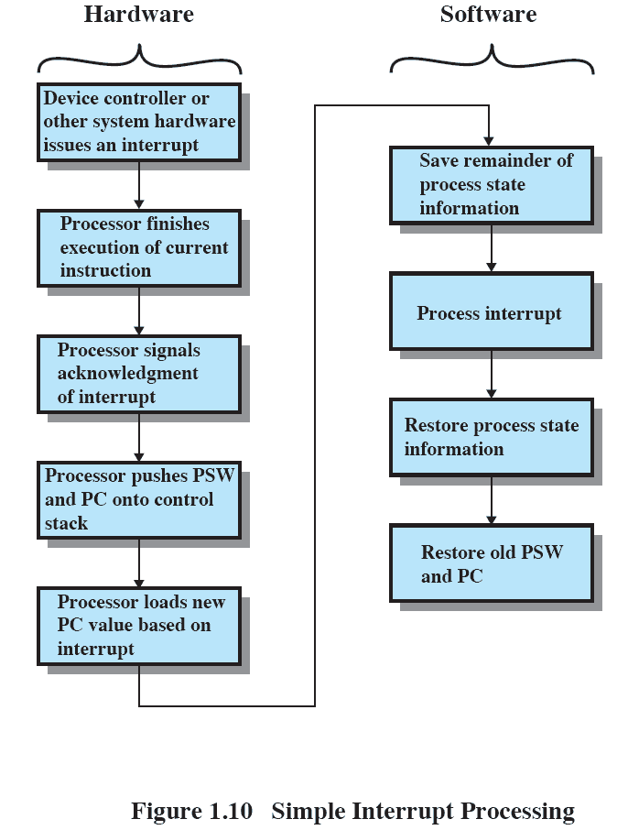
Simple Interrupt Processing

Slide 22
Multiple Interrupts
1 Disable interrupts
  Processor will ignore further interrupts whilst processing one interrupt
  Interrupts remain pending and are checked after first interrupt has been processed
  Interrupts handled in sequence as they occur
2 Define priorities
  Low priority interrupts can be interrupted by higher priority interrupts
  When higher priority interrupt has been processed, processor returns to previous interrupt

Slide 23
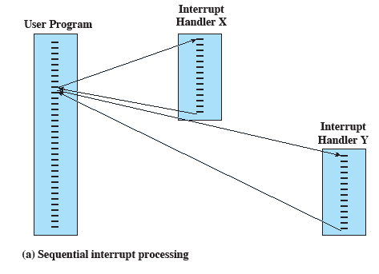
Sequential Interrupt Processing

Slide 24
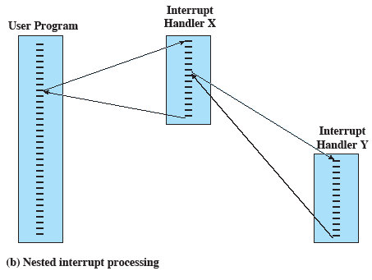
Nested Interrupt Processing

Slide 25

Time Sequence of Multiple Interrupts

Slide 26
Connecting
All the units must be connected
Different type of connection for different type of unit
  Memory
  Input/Output
  CPU

Slide 27

Computer Modules

Slide 28
Memory Connection
Receives and sends data
Receives addresses (of locations)
Receives control signals
  Read
  Write
  Timing

Slide 29
Input/Output Connection(1)
Similar to memory from computer’s viewpoint
Output
  Receive data from computer
  Send data to peripheral
Input
  Receive data from peripheral
  Send data to computer

Slide 30
Input/Output Connection(2)
Receive control signals from computer
Send control signals to peripherals
  e.g. spin disk
Receive addresses from computer
  e.g. port number to identify peripheral
Send interrupt signals (control)

Slide 31
CPU Connection
Reads instruction and data
Writes out data (after processing)
Sends control signals to other units
Receives (& acts on) interrupts

Slide 32
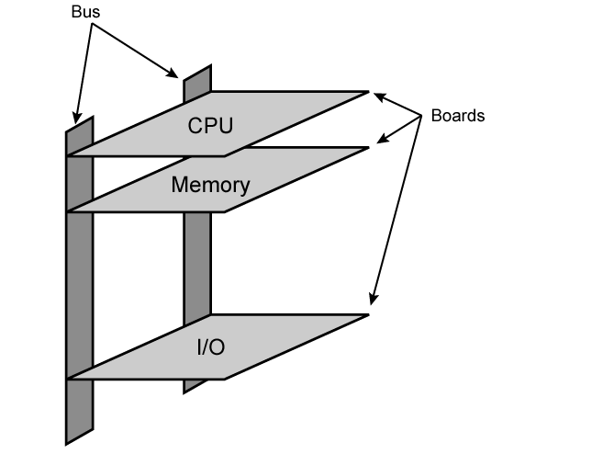
Physical Realization of Bus Architecture

Slide 33

Bus Interconnection Scheme

Slide 34
Data Bus
Carries data
  Remember that there is no difference between “data” and “instruction” at this level
Width (number of lines) is a key determinant of performance, since this determines how many bits can be transferred in one go (cycle)
  32 to hundreds of bits

Slide 35
Address bus
Identify the source or destination of data
e.g. CPU needs to read an instruction (data) from a given location in memory
Bus width determines maximum memory capacity of system
  e.g. 8080 has 16 bit address bus giving 64K address space

Slide 36
Control Bus
Memory or I/O read/write signals
Interrupt request/acknowledgment
Clock signals
Bus request/grant signals

Slide 37

Traditional (ISA) (with cache)

Slide 38
Memory Hierarchy
Faster access time, greater cost per bit
Greater capacity, smaller cost per bit
Greater capacity, slower access speed

Slide 39
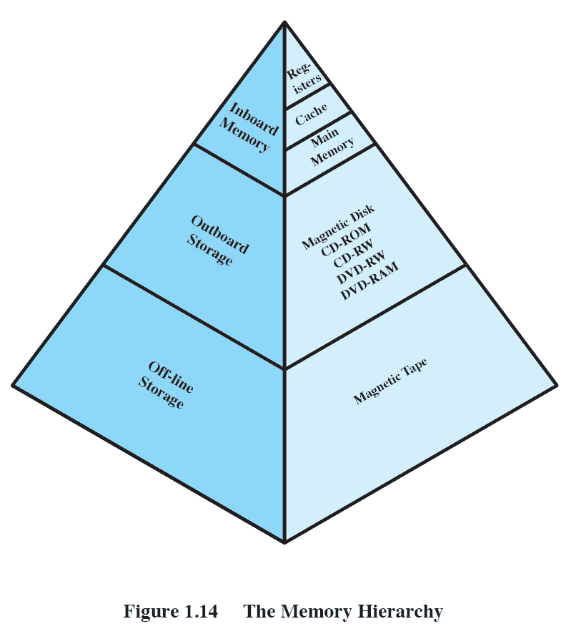
The Memory Hierarchy

Slide 40
Going Down the Hierarchy
Decreasing cost per bit
Increasing capacity
Increasing access time
Decreasing frequency of access to the memory by the processor (optimally - requires good design)

Slide 41
Main Memory
Contains data (including instructions) in binary format: sequences of bits
1B=1 byte=8 bits=8b
Word – a sequence of bytes, length is system specific (1, 2, 4, 8, etc. bytes)
Block – a sequence of words, typically in the magnitude of several kilobytes (KB)
An address - a location in memory. It specifies (the beginning of) a word or block - depending on the size of data transfer

Slide 42
Performance Balance
Processor speed increased
Memory capacity increased
Memory speed lags behind processor speed

Slide 43
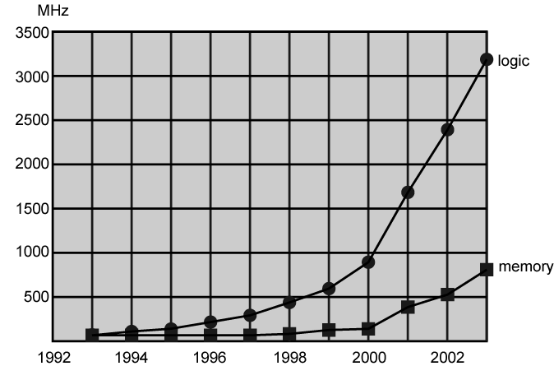
Logic and Memory Performance Gap

Slide 44
Cache Memory
Processor speed faster than memory access speed
Main memory becomes a bottleneck
Exploit the principle of locality of reference: During the course of the execution of a program, memory references tend to cluster -spatial locality (sequential access), and the same data maybe needed again – temporal locality (iteration loop).
Introduction of small, fast memory - cache

Slide 45
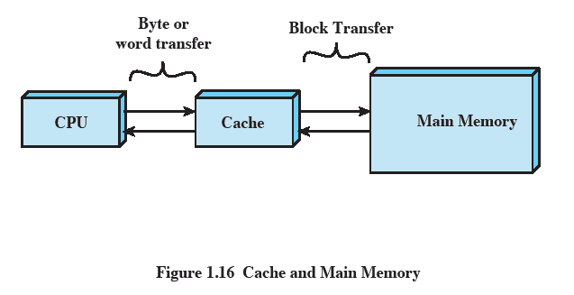
Cache and Main Memory

Slide 46
Cache Principles
Contains copy of a portion of main memory
Processor first checks cache
If not found, block of memory read into cache
Because of locality of reference, likely future memory references are in that block
Modern systems have several caches (instruction, data) on different levels (L1 on chip, L2, etc.)

Slide 47
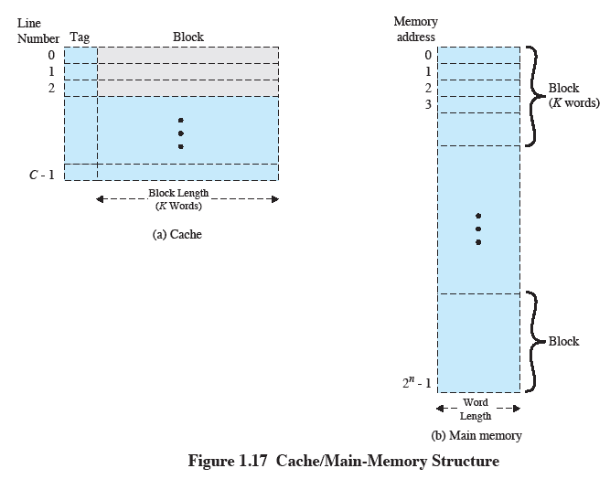
Cache/Main-Memory Structure

Slide 48
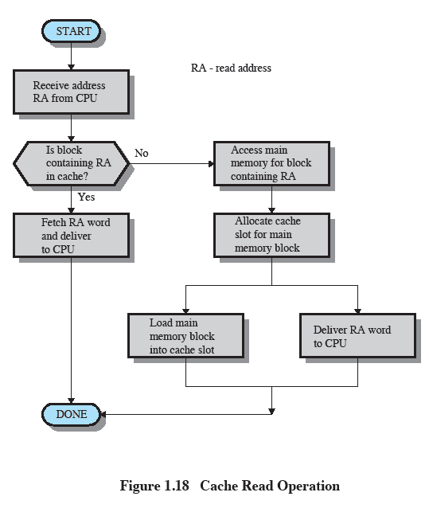
Cache Read Operation

Slide 49
Size
Cache size
  Small caches have significant impact on performance
Block size
  The unit of data exchanged between cache and main memory
  Larger block size results in more hits until probability of using newly fetched data becomes less than the probability of reusing data that have to be moved out of cache

Slide 50
(Re)placement
Mapping function
  Determines which cache location the block will occupy
Replacement algorithm
  Chooses which block to replace
  Least-recently-used (LRU) algorithm

Slide 51
Write policy
Dictates when the memory write operation takes place
  Write through: occurs every time the block is updated
  Write back: occurs when the block is replaced
    Minimize write operations
    Leave main memory in an obsolete state

Slide 52
Dynamic RAM
Bits stored as charge in capacitors
Charges leak
Need refreshing even when powered
Simpler construction
Smaller per bit
Less expensive
Need refresh circuits
Slower
Main memory
Essentially analogue
  Level of charge determines value

Slide 53
Static RAM
Bits stored as on/off switches
No charges to leak
No refreshing needed when powered
More complex construction
Larger per bit
More expensive
Does not need refresh circuits
Faster
Cache
Digital
  Uses flip-flops

Slide 54
I/O Devices
Programs with intensive I/O demands
Large data throughput demands
Processors can handle this, but memory is limited and slow
Problem moving data
Solutions:
  Caching
  Buffering
  Higher-speed interconnection buses
  More elaborate bus structures
  Multiple-processor configurations

Slide 55
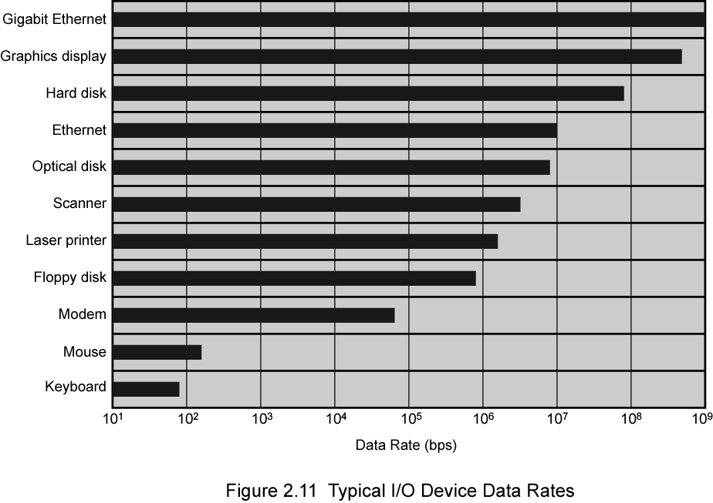
Typical I/O Device Data Rates

Slide 56
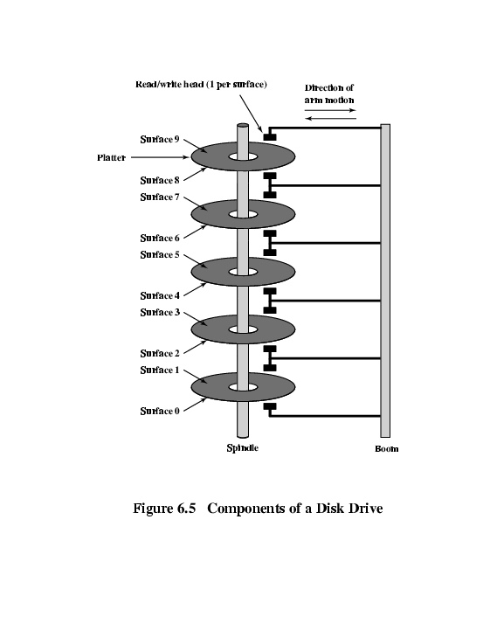
Hard disk

Slide 57
Speed
Seek time
  Moving head above the correct track
(Rotational) latency
  Waiting for the correct sector to rotate under head
Access time = Seek + Latency
Transfer rate

Slide 58
Input/Output Problems
Wide variety of peripherals
  Delivering different amounts of data
  At different speeds
  In different formats
All slower than CPU and RAM
Need I/O modules

Slide 59
I/O Steps
CPU checks I/O module device status
I/O module returns status
If ready, CPU requests data transfer
I/O module gets data from device
I/O module transfers data to CPU
Variations for output, DMA, etc.

Slide 60
I/O Mapping
Memory mapped I/O
  Devices and memory share an address space
  I/O looks just like memory read/write
  No special commands for I/O
    Large selection of memory access commands available
Isolated I/O
  Separate address spaces
  Need I/O or memory select lines
  Special commands for I/O
    Limited set

Slide 61
Input Output Techniques
Programmed
Interrupt driven
Direct Memory Access (DMA)

Slide 62
Programmed I/O (1)
CPU has direct control over I/O
  Sensing status
  Read/write commands
  Transferring data
CPU waits for I/O module to complete operation
Wastes CPU time

Slide 63
Programmed I/O (2)
CPU requests I/O operation
I/O module performs operation
I/O module sets status bits
CPU checks status bits periodically
I/O module does not inform CPU directly
I/O module does not interrupt CPU
CPU may wait or come back later

Slide 64
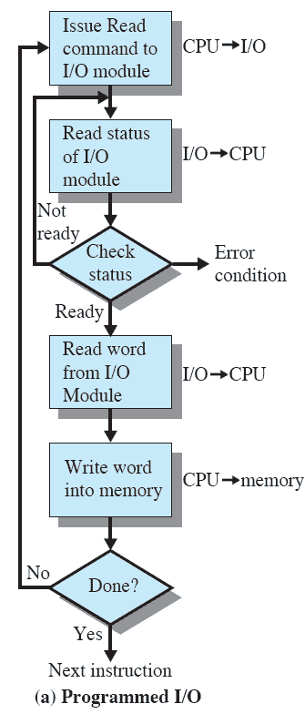
Programmed I/O (3)
I/O module performs the action
Sets the appropriate bits in the I/O status register
CPU checks status bits periodically
No interrupts occur
Processor checks status until operation is complete

Slide 65
Interrupt Driven I/O
Overcomes CPU waiting
No repeated CPU checking of device
I/O module interrupts when ready

Slide 66
Interrupt Driven I/O (2)
CPU issues read command
I/O module gets data from peripheral while CPU does other work
I/O module interrupts CPU
CPU requests data
I/O module transfers data

Slide 67
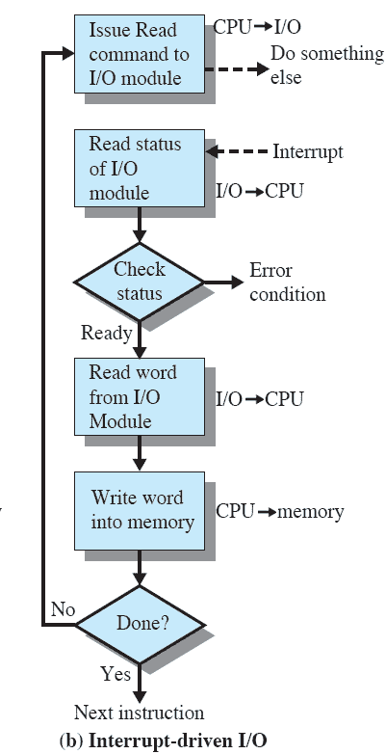
Interrupt-Driven I/O (3)
Processor is interrupted when I/O module ready to exchange data
Processor saves context of program executing and begins executing interrupt-handler

Slide 68
Simple Interrupt Processing

Slide 69
Direct Memory Access
Interrupt driven and programmed I/O require active CPU intervention
  Transfer rate is limited
  CPU is tied up
DMA, an additional module (hardware) on bus
DMA controller takes over from CPU for I/O

Slide 70
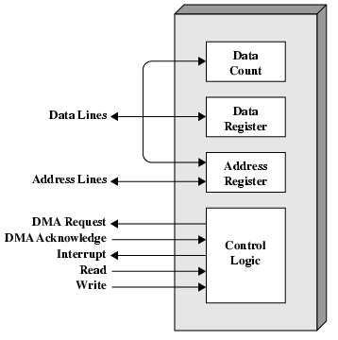
Typical DMA Module Diagram

Slide 71
DMA Operation
CPU tells DMA controller:-
  Read/Write
  Device address
  Starting address of memory block for data
  Amount of data to be transferred
CPU carries on with other work
DMA controller deals with transfer
DMA controller sends interrupt when finished

Slide 72
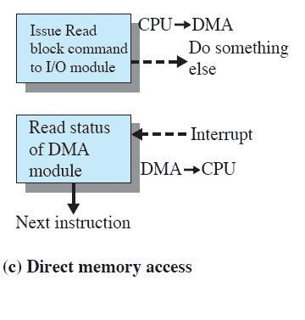
Direct Memory Access
Transfers a block of data directly to or from memory
An interrupt is sent when the transfer is complete
More efficient

Slide 73
DMA Transfer - Cycle Stealing
DMA controller takes over bus for a cycle
Transfer of one word of data
Not an interrupt
  CPU does not switch context
CPU suspended just before it accesses bus
  i.e. before an operand or data fetch or a data write
Slows down CPU but not as much as CPU doing transfer

Slide 74
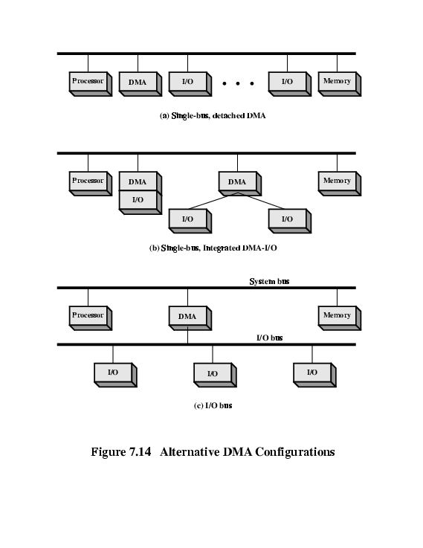
DMA Configurations (1)
Single Bus, Detached DMA controller
Each transfer uses bus twice
  I/O to DMA then DMA to memory
CPU is suspended twice

Slide 75
DMA Configurations (2)
Single Bus, Integrated DMA controller
Controller may support >1 device
Each transfer uses bus once
  DMA to memory
CPU is suspended once

Slide 76
Improvements in Chip Organization and Architecture
Increase hardware speed of processor
  Fundamentally due to shrinking logic gate size
    More gates, packed more tightly, increasing clock rate
    Propagation time for signals reduced
Increase size and speed of caches
  Dedicating part of processor chip
    Cache access times drop significantly
Change processor organization and architecture
  Increase effective speed of execution
  Parallelism

Slide 77
Problems with Clock Speed and Logic Density
Power
  Power density increases with density of logic and clock speed
  Dissipating heat
RC delay
  Speed at which electrons flow limited by resistance and capacitance of metal wires connecting them
  Delay increases as RC product increases
  Wire interconnects thinner, increasing resistance
  Wires closer together, increasing capacitance
Memory latency
  Memory speeds lag processor speeds
Solution: More emphasis on organizational and architectural approaches

Slide 78
Increased Cache Capacity
Typically two or three levels of cache between processor and main memory
Chip density increased
  More cache memory on chip - faster cache access
Original Pentium chip devoted about 10% of chip area to cache, while Pentium 4 devotes about 50%

Slide 79
More Complex Execution Logic
Enable parallel processing of instructions
Pipeline works like an assembly line
  Processing different stages of the instruction cycle of different instructions at same time along pipeline (e.g. while executing an arithmetic instruction fetch the next instruction)
Superscalar allows multiple pipelines within single processor
  Several functional units for the pipeline stages (loaders, decoders, execution units, etc.)
  Instructions that do not depend on one another can be executed in parallel

Slide 80
Multiple Cores
Multiple processors on single chip
  Large shared cache and private caches (cache coherency!)
Within a processor, increase in performance is proportional to square root of increase in complexity
If software can use multiple processors, doubling number of processors almost doubles performance (provided that code can be parallelized)
So, use two simpler processors on the chip rather than one more complex processor
Example: IBM POWER4
  Two cores based on PowerPC

Slide 81
GPU and GPGPU
Some computations are massively parallelizable, i.e., can be executed at the same time on different execution units
Typically, iteration loops without dependencies, e.g. matrix multiplication
SIMD (single instruction, multiple data), e.g. sum up the products of matrix rows and columns (e.g. MAD)
Processors with hundreds or thousands of execution units and special instructions
Originally for graphics, but processing huge data
Requires special code (CUDA) for parallel code and thread management

Slide 82
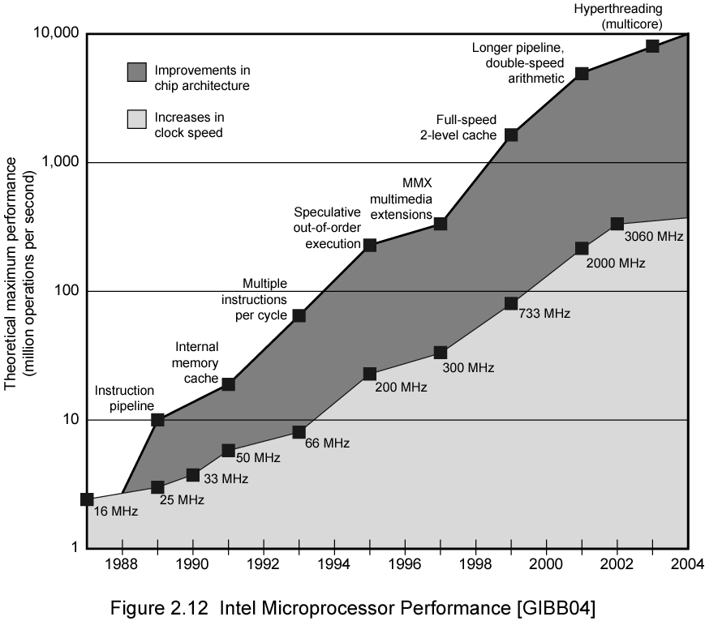
Intel Microprocessor Performance

