Slide 1
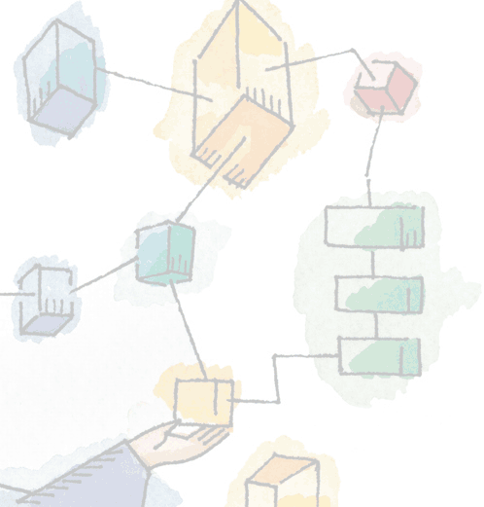
Chapter 2
Operating System Overview
Operating Systems:
Internals and Design Principles, 6/E
William Stallings
Patricia Roy
Manatee Community College, Venice, FL
©2008, Prentice Hall

Slide 2
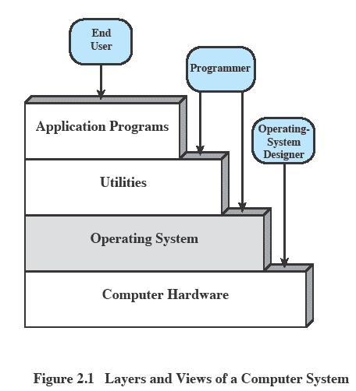
Layers and Views

Slide 3
What is an Operating System
It is an extended, or virtual, machine
  provides a simple, high-level abstraction, i.e., hides the “messy details” which must be performed
  presents user with a virtual machine, easier to use
  provides services; programs obtain these by system calls
It is a resource manager
  provides orderly and controlled allocation for programs in terms of time and space, multiplexing

Slide 4
Services Provided by the OS
Program creation
Program execution
Access to I/O devices
Controlled access to resources, e.g. files
System access
Error detection and response
Accounting

Slide 5
Operating System
Functions the same way as ordinary computer software
  It is a program that is executed, but with extra privileges
Kernel: Portion of operating system that is in main memory
  Contains most frequently used functions
  Also called the nucleus

Slide 6
Evolution of Operating Systems
Serial processing
  No operating system
  Machines run from a console with display lights (error messages), input device (punch card, tape) and printer (for output)
  Setup included loading and compiling the program, and loading and linking common functions – very time consuming (errors!)

Slide 7
Simple Batch Systems
Resident Monitor program: scheduling, privileged operations
Users submit jobs to operator
Operator batches jobs
Monitor controls sequence of events to process batch
When one job is finished, control returns to Monitor which reads next job
Monitor handles scheduling (e.g. FIFO, SJF)

Slide 8
OS Features
Memory protection
  Do not allow the memory area containing the monitor to be altered by user program
Timer
  Prevents a job from monopolizing the system (when allocated time is up, job is stopped)
Privileged instructions
  Certain machine level instructions (e.g. I/O) can only be executed by the monitor – kernel or supervisor mode vs. user mode

Slide 9
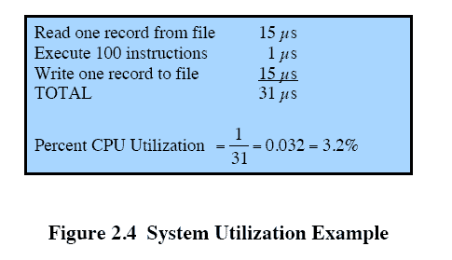
System Utilization Example

Slide 10

Uniprogramming
Processor must wait for I/O instruction to complete before preceding

Slide 11
Multiprogramming
Processor has more than one program to execute
The sequence in which the programs are executed depends on their relative priority and whether they are waiting for I/O
After an interrupt handler completes, control may not return to the program that was executing at the time of the interrupt

Slide 12
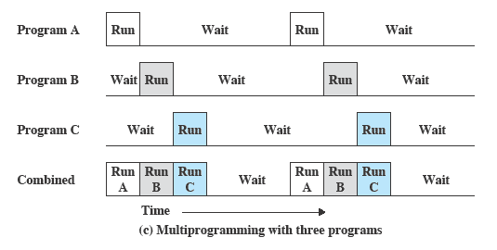
Multiprogramming

Slide 13
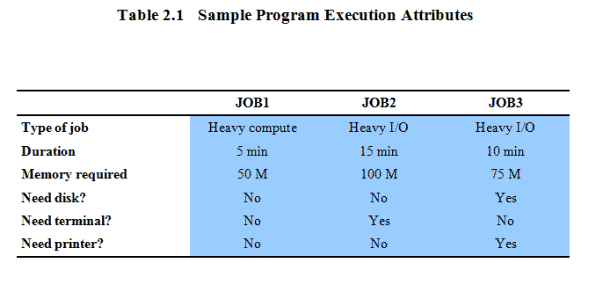
Example

Slide 14
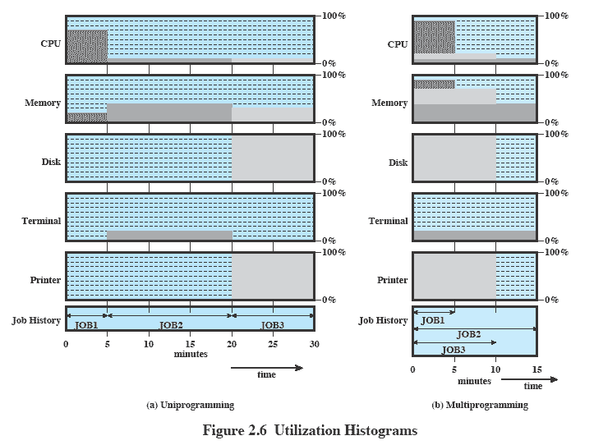

Slide 15
Time Sharing Systems
Using multiprogramming to handle multiple interactive jobs
Processor’s time is shared among multiple users
Multiple users simultaneously access the system through terminals

Slide 16
Major OS Concepts
Process
Memory management
Information protection and security
Scheduling and resource management
System structure

Slide 17
Process
A program in execution
An instance of a program running on a computer
The entity that can be assigned to and executed on a processor
A unit of activity characterized by
  A single sequential thread of execution
  A current state
  An associated set of system resources: memory image, open files, locks, etc.

Slide 18
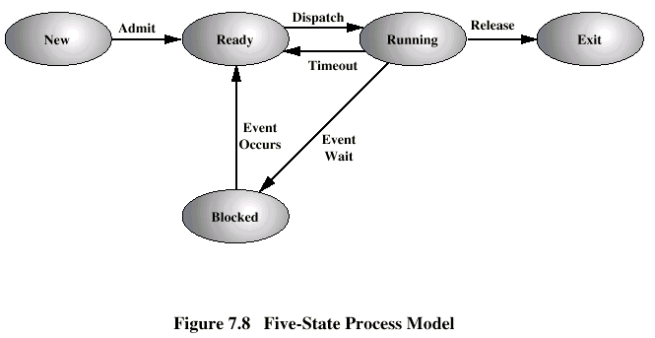
Five State Process Model

Slide 19
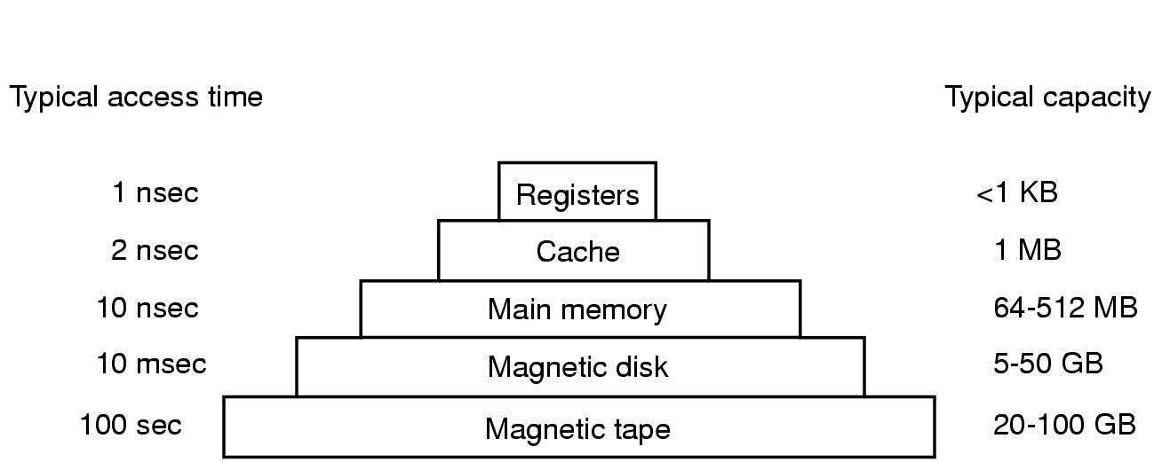
Memory
Typical memory hierarchy (numbers shown on the right are a bit out-dated)

Slide 20
Memory Management
Process isolation
Automatic allocation and management
Support of modular programming
Protection and access control
Long-term storage

Slide 21
Process – memory image
Consists of three components, segments
  An executable program – code segment
  Associated data needed by the program – data segment
  Execution context of the program
    All information the operating system needs to manage the process – process table entry (state, priority, accounting), stack (entered subprocedures, value of PC in suspended mode)

Slide 22
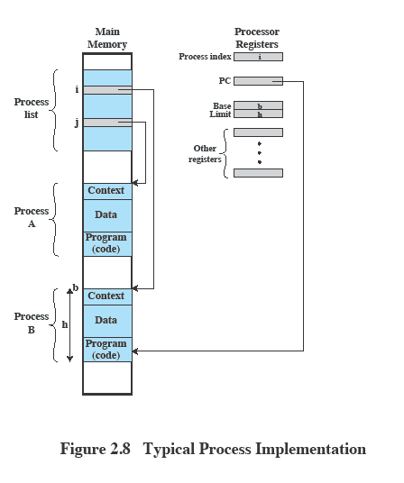

Slide 23
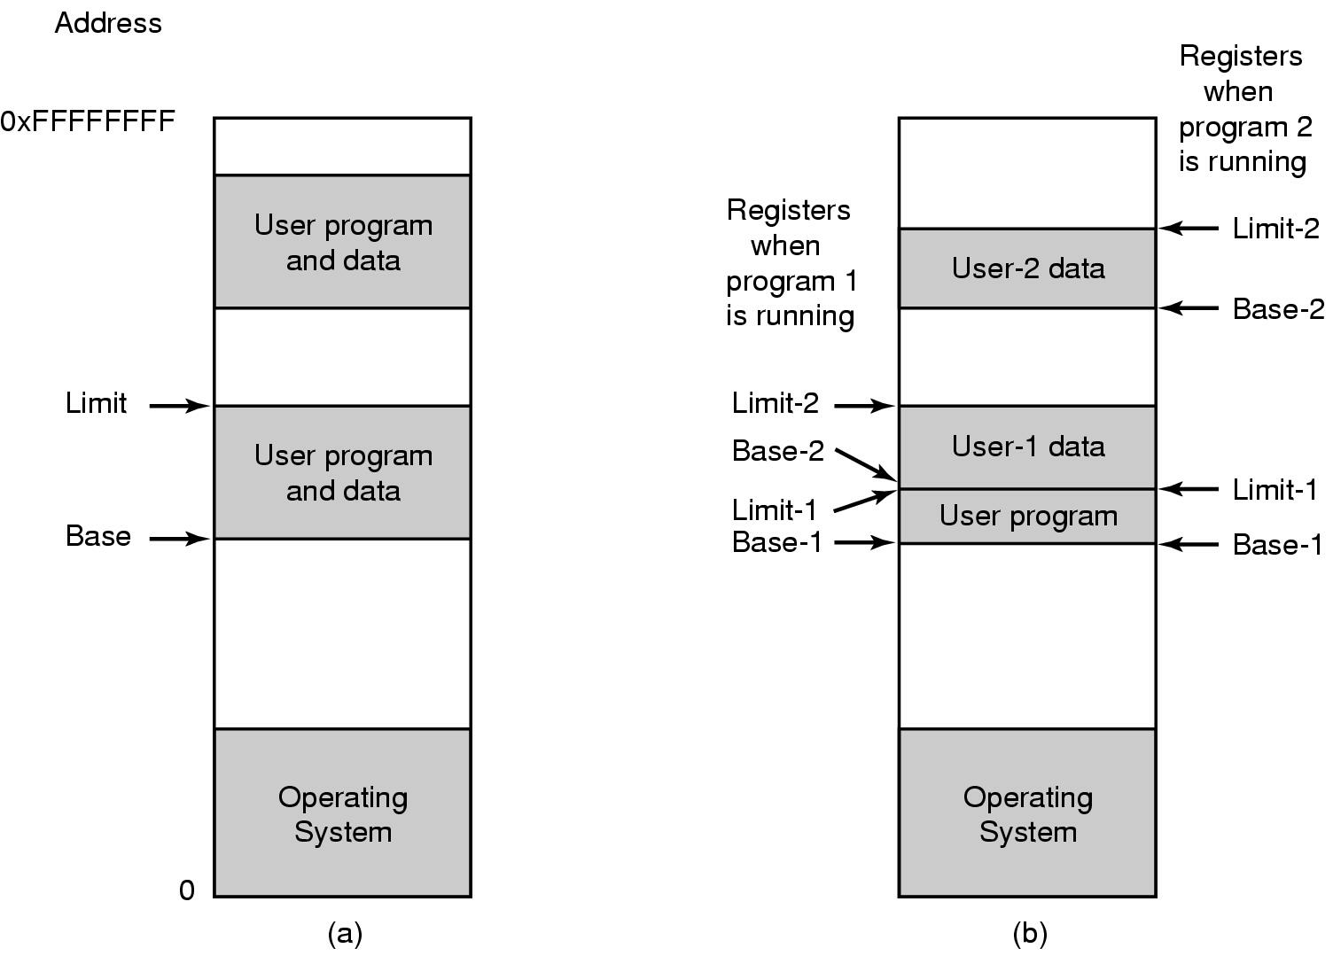
One base-limit pair and two base-limit pairs

Slide 24
Virtual Memory
Problems with large programs, growing segments, fragmentation
Addressing memory from a logical point of view
Implementation is by the system – transparent to the programmer

Slide 25
Paging
Allows process to be comprised of a number of fixed-size blocks, called pages
Virtual address is a page number and an offset within the page
Each page may be located anywhere in main memory – page frame
Real address or physical address in main memory

Slide 26
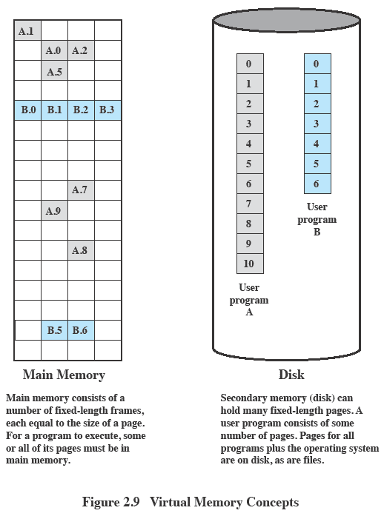
Virtual Memory

Slide 27
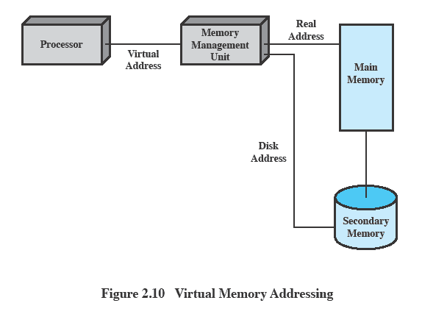
Virtual Memory Addressing

Slide 28
Information Protection and Security
Availability
  Protecting the system against interruption
Confidentiality (access control)
  Assuring that users cannot read data for which access is unauthorized
Data integrity (access control)
  Protection of data from unauthorized modification
Authenticity (login)
  Proper verification of the identity of users and the validity of messages or data

Slide 29
Scheduling and Resource Management
Fairness
  Give equal and fair access to resources
Differential responsiveness
  Discriminate among different classes of jobs
Efficiency
  Maximize throughput, minimize response or turnaround time, and accommodate as many users as possible

Slide 30
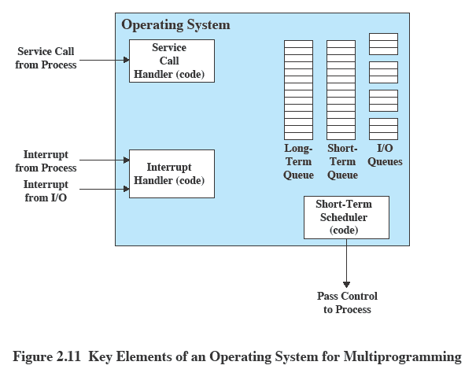

Slide 31
System Calls
Interface between OS and user programs (to perform privileged operations)
Machine dependent, but can be invoked by standard procedure libraries

Slide 32
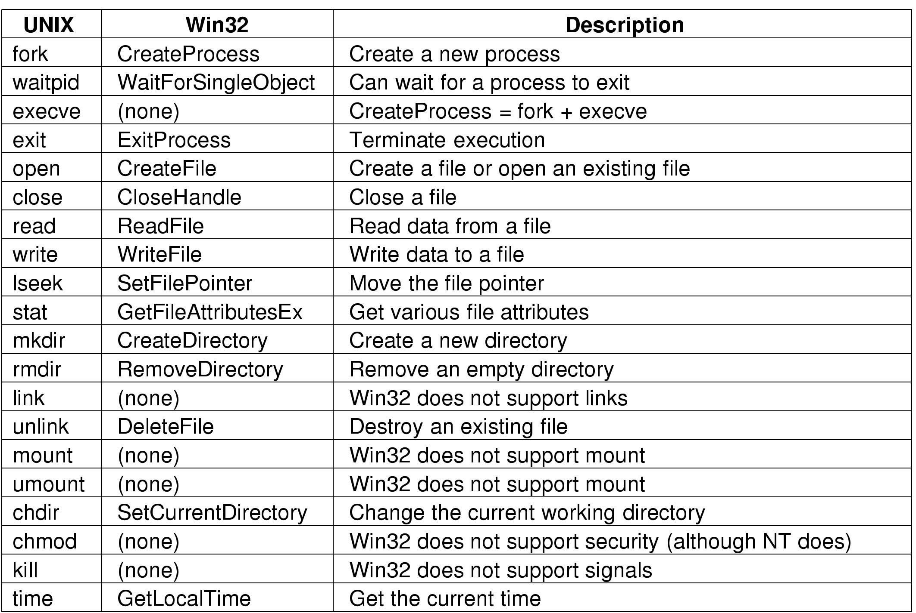

Slide 33

11 steps in making read (fd, buffer, nbytes)

Slide 34
System Structure
Hierarchical structure:
  View the system as a series of levels
  Each level performs a related subset of functions
  Each level relies on the next lower level to perform more primitive functions
Modular structure:
  Different functions carried out by different modules
  Communication between the modules

Slide 35
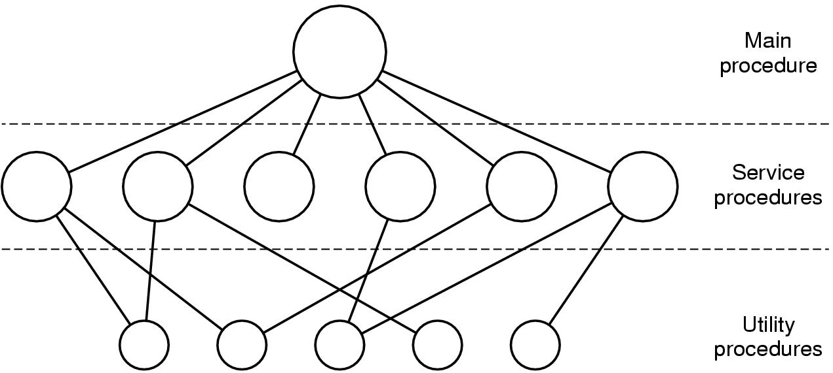
Monolithic System
Simple structuring model for a monolithic system

Slide 36
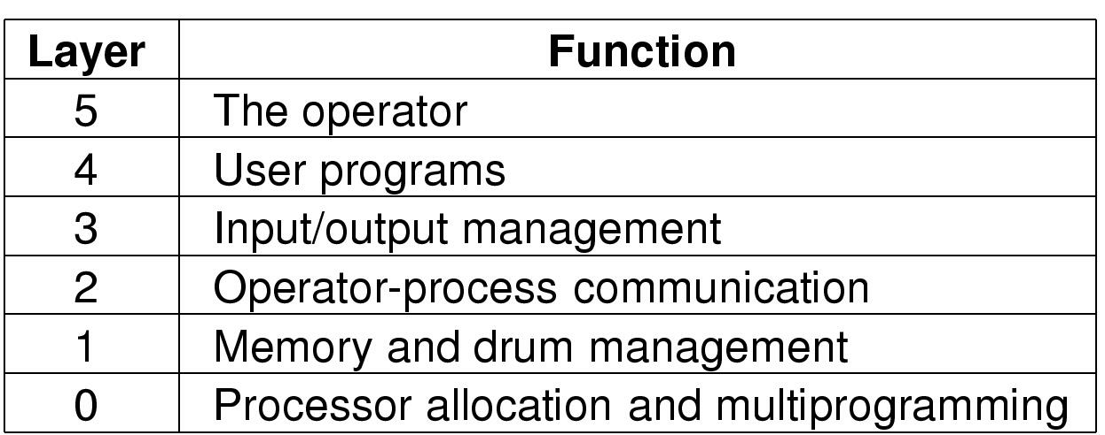
Layered System
Structure of the THE operating system
MULTICS - concentric rings

Slide 37
Machine Level
Level 1
  Objects are registers, memory cells, and logic gates; Operations are clearing a register or reading a memory location
Level 2
  Processor’s instruction set; Operations such as add, subtract, load, and store
Level 3
  Procedure or subroutine, call/return operation
Level 4
  Interrupts

Slide 38
Concepts with Multiprogramming
Level 5
  Process as a program in execution
  Suspend and resume processes
Level 6
  Secondary storage devices
  Transfer of blocks of data
Level 7
  Creates logical address space for processes
  Organizes virtual address space into blocks

Slide 39
Deal with External Objects
Level 8
  Communication of information and messages between processes (pipe)
Level 9
  Supports long-term storage of named files
Level 10
  Provides access to external devices using standardized interfaces

Slide 40
Deal with External Objects
Level 11
  Responsible for maintaining the association between the external (abstract) and internal identifiers, plus access rights
Level 12
  Provides full-featured facility for the support of processes (address space, resources, etc.)
Level 13
  Provides an interface to the OS for the user

Slide 41
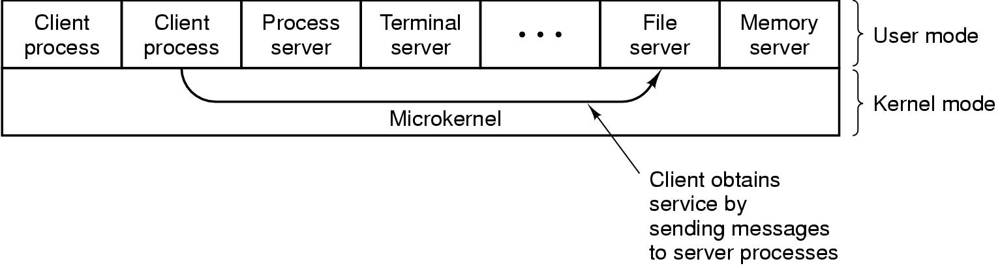
Microkernel architecture
Assigns only a few essential functions to the kernel
    Address spaces
    Interprocess communication (IPC)
    Basic scheduling
Client-server model

Slide 42
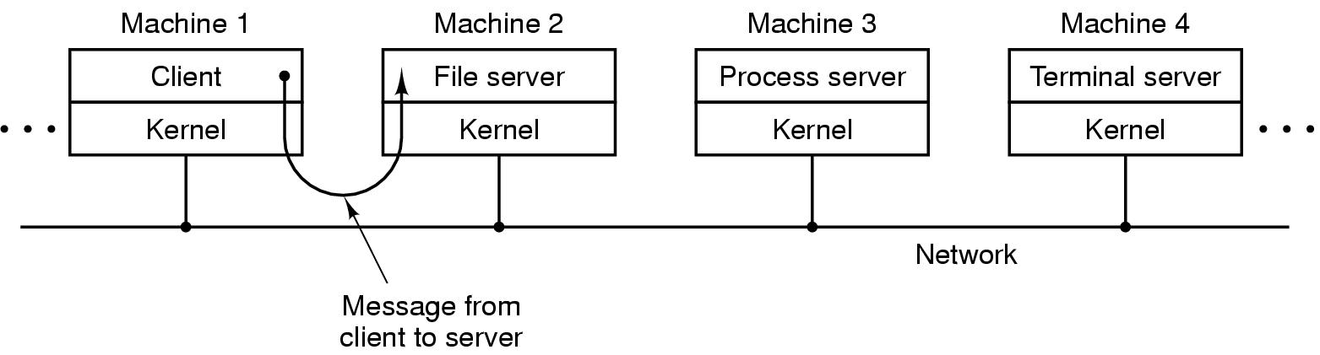
Distributed operating systems
The client-server model in a distributed system

Slide 43
Latest Achievements 1
Multithreading
  Process is divided into threads that can run concurrently
    Thread
      Dispatchable unit of work
      Executes sequentially and is interruptable
    Process is a collection of one or more threads, which share resources

Slide 44
Latest Achievements 2
Symmetric multiprocessing (SMP)
  There are multiple processors
  These processors share same main memory and I/O facilities
  All processors can perform the same functions
  Scheduling!
  Cache coherency!

Slide 45
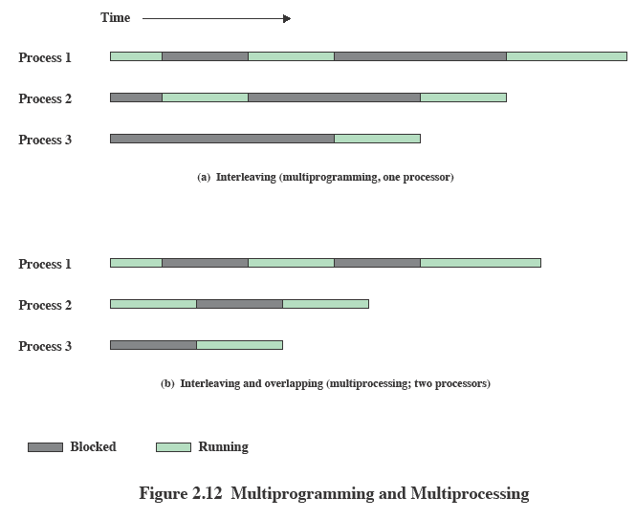

Slide 46
Windows Architecture
Modular structure for flexibility
Executes on a variety of hardware platforms
Started with microkernel … and then grew and grew

Slide 47
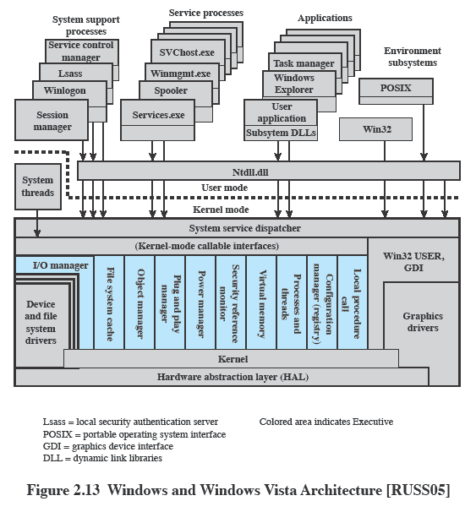

Slide 48
Client/Server Model
Simplifies the Executive
  Possible to construct a variety of application programs
Improves reliability
  Each server runs outside the kernel, protected from other servers
Provides a uniform means for applications to communicate via RPCs
Provides base for distributed computing (support for SMP)

Slide 49
Kernel-Mode Components (1)
Kernel
  Consists of the most used low level components: scheduling, process switching, interrupt handling
Hardware abstraction layer (HAL)
  Isolates the operating system from platform-specific hardware differences – portability
  DMA, bus, interrupts, timer

Slide 50
Kernel-Mode Components (2)
Device drivers
  Translate user I/O function calls into specific hardware device I/O requests
Windowing and graphics systems
  Implements the graphical user interface (GUI)

Slide 51
Windows Executive (1)
I/O manager: dispatching device drivers
Cache manager
Object manager: naming, security of objects
Plug and play manager: loading drivers
Power manager

Slide 52
Windows Executive (2)
Security reference monitor: enforces access validation
Virtual memory manager: paging, translation between virtual and physical addresses
Process/thread manager
Configuration manager: setting parameters
Local procedure call (LPC) facility: communication between processes

Slide 53
UNIX
Monolithic - hardware is surrounded by the operating system software
System V Release 4 (SVR4)
BSD (=> Mac OS)
Solaris 10

Slide 54
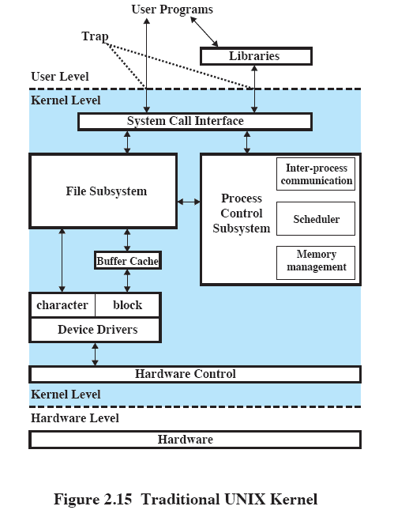

Slide 55
Linux
Modular structure
Collection of loadable modules: they implement OS functions and execute in kernel mode on behalf of current process
  Dynamic linking
  Stackable modules: hierarchy between clients and libraries

Slide 56
