Slide 1
Chapters 12, 13 and 14,
William Stallings
Computer Organization and Architecture
10th Edition
CPU: Instruction Sets and Instruction Cycles

Slide 2
What is an Instruction Set?
The complete collection of instructions that are understood by a CPU
Machine language: binary representation of operations and (addresses of) arguments
  Assembly language: mnemonic representation for humans, e.g.,
  OP A,B,C (meaning A <- OP(B,C))
Notes:
2

Slide 3
Elements of an Instruction
Operation code (opcode)
  Do this: ADD, SUB, MPY, DIV, LOAD, STOR
Source operand reference
  To this: (address of) argument of op, e.g. register, memory location
Result operand reference
  Put the result here (as above)
Next instruction reference (often implicit)
  When you have done that, do this: BR
Notes:
3

Slide 4
Instruction Types
Data transfer: registers, main memory, stack or I/O
Data processing: arithmetic, logical
Control: systems control, transfer of control
Notes:
6

Slide 5
Data Transfer
Store, load, exchange, move, clear, set, push, pop
Specifies: source and destination (memory, register, stack), amount of data
May be different instructions for different (size, location) movements, e.g.,
IBM S/390: L (32 bit word, R<-M), LH (halfword, R<-M), LR (word, R<-R), plus floating-point registers LER, LE, LDR, LD
Or one instruction and different addresses, e.g. VAX: MOV
Notes:
19

Slide 6
Arithmetic
Add, Subtract, Multiply, Divide (for signed integer, floating point and packed decimal) – may involve data movement
May include
  Absolute (|a|)
  Increment (a++)
  Decrement (a--)
  Negate (-a)
Notes:
20

Slide 7
Logical
Bitwise operations: AND, OR, NOT, XOR, TEST, CMP, SET
Shifting and rotating functions, e.g.
  logical right shift for unpacking: send 8-bit character from 16-bit word
  arithmetic right shift: division and truncation for odd numbers
  arithmetic left shift: multiplication without overflow
Notes:
21

Slide 8
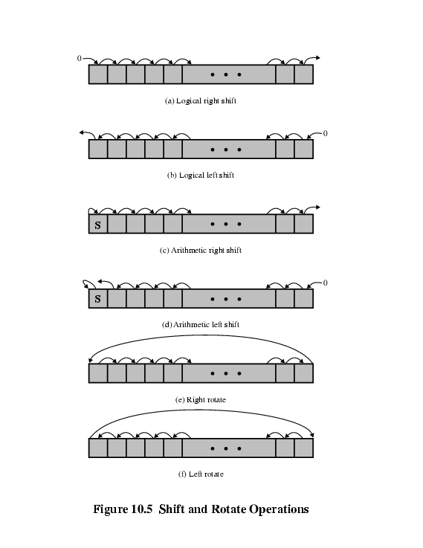

Slide 9
Systems Control
Privileged instructions: accessing control registers or process table
CPU needs to be in specific state
  Ring 0 on 80386+
  Kernel mode
For operating systems use
Notes:
24

Slide 10
Transfer of Control
Skip, e.g., increment and skip if zero:
ISZ Reg1, cf. jumping out from loop
Branch instructions: BRZ X (branch to X if result is zero), BRP X (positive), BRN X (negative), BRE X,R1,R2 (equal)
Procedure (economy and modularity): call and return
Notes:
25

Slide 11
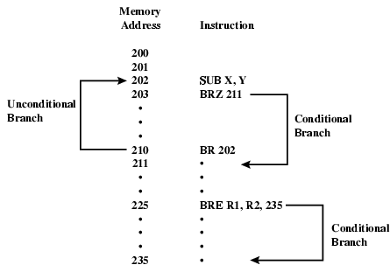
Branch Instruction

Slide 12
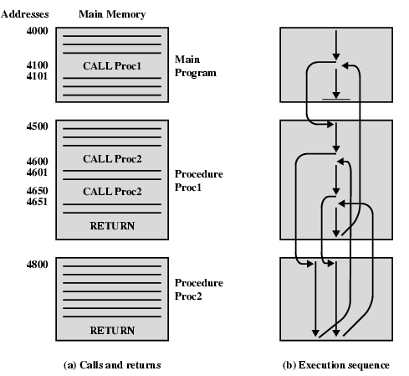
Nested Procedure Calls

Slide 13
Types of Operand
Addresses: immediate, direct, indirect, stack
Numbers: integer or fixed point (binary, twos complement), floating point (sign, significand, exponent), (packed) decimal (246 = 0000 0010 0100 0110)
Characters: ASCII (128 printable and control characters + bit for error detection)
Logical Data: bits or flags, e.g., Boolean 0 and 1
Notes:
14

Slide 14
Pentium Data Types
Addressing is by 8 bit unit
General data types: 8 bit Byte, 16 bit word, 32 bit double word, 64 bit quad word
Integer: signed binary using twos complement representation
(Un)packed decimal
Near pointer: offset in segment
Bit field
Strings
Floating point
Notes:
15

Slide 15
Instruction Formats
Layout of bits in an instruction
Includes opcode
Includes (implicit or explicit) operand(s)
Usually more than one instruction format in an instruction set – see RISC v CISC

Slide 16
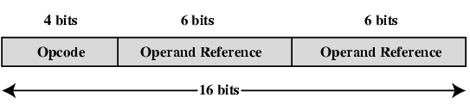
Simple Instruction Format
(using two addresses)

Slide 17
Number of Addresses
More addresses
  More complex (powerful?) instructions
  More registers - inter-register operations are quicker
  Less instructions per program
Fewer addresses
  Less complex (powerful?) instructions
  More instructions per program, e.g. data movement
  Faster fetch/execution of instructions
Example: Y=(A-B)/[(C+(D*E)]
Notes:
11

Slide 18
3 addresses
Operation Result, Operand 1, Operand 2
  Not common
  Needs very long words to hold everything
  SUB Y,A,B Y <- A-B
  MPY T,D,E T <- D*E
  ADD T,T,C T <- T+C
  DIV Y,Y,T Y <- Y/T
Notes:
7

Slide 19
2 addresses
One address doubles as operand and result
  Reduces length of instruction
  Requires some extra work: temporary storage
  MOVE Y,A Y <- A
  SUB Y,B Y <- Y-B
  MOVE T,D T <- D
  MPY T,E T <- T*E
  ADD T,C T <- T+C
  DIV Y,T Y <- Y/T
Notes:
8

Slide 20
1 address
Implicit second address, usually a register (accumulator, AC)
LOAD D AC <- D
MPY E AC <- AC*E
ADD C AC <- AC+C
STOR Y Y <- AC
LOAD A AC <- A
SUB B AC <- AC-B
DIV Y AC <- AC/Y
STOR Y Y <- AC
Notes:
9

Slide 21
Addressing Modes
Immediate
Direct
Indirect
Register
Register Indirect
Displacement (Indexed)
Stack
Notes:
2

Slide 22
Immediate Addressing
Operand is part of instruction
Operand = address field
e.g., ADD 5 or ADD #5
  Add 5 to contents of accumulator
  5 is operand
No memory reference to fetch data
Fast
Limited range
Notes:
3

Slide 23
Direct Addressing
Address field contains address of operand
Effective address (EA) = address field (A)
e.g., ADD A
  Add content of cells A from memory to AC
  Look in memory at address A for operands
Single memory reference to access data
No additional calculations needed to work out effective address
Limited address space (length of address field)
Notes:
5

Slide 24
Direct Addressing Diagram
Instruction
Opcode
Address A
Memory
Operand
Notes:
6

Slide 25
Indirect Addressing (1)
Memory cell pointed to by address field contains the address of (pointer to) the operand
EA = (A)
  Look in A, find address (A) and look there for operand
E.g. ADD (A)
  Add contents of cell pointed to by contents of A to accumulator
Multiple memory accesses to find operand
Notes:
7

Slide 26
Indirect Addressing Diagram
Instruction
Opcode
Address A
Memory
Pointer to operand
Operand
Notes:
9

Slide 27
Register Addressing (1)
Operand is held in register named in address field
EA = R
Limited number of registers
Very small address field needed
  Shorter instructions
  Faster instruction fetch
Notes:
10

Slide 28
Register Addressing Diagram
Instruction
Opcode
Register Address R
Registers
Operand
Notes:
12

Slide 29
Register Indirect Addressing
Cf. indirect addressing
EA = (R)
Operand is in memory cell pointed to by contents of register R
Large address space (2^{n})
One fewer memory access than indirect addressing
Notes:
13

Slide 30
Register Indirect Addressing Diagram
Instruction
Opcode
Register Address R
Memory
Registers
Pointer to Operand
Operand
Notes:
14

Slide 31
Displacement Addressing
EA = A + (R)
Address field hold two values
  A = base value
  R = register that holds displacement
  or vice versa
See segmentation
Notes:
15

Slide 32
Displacement Addressing Diagram
Instruction
Opcode
Register R
Address A
Memory
Registers
Displacement
+
Operand
Notes:
16

Slide 33
Versions of displacement addressing
Relative Addressing: EA = A + (PC), i.e., get operand from A cells away from current location pointed to by PC
Indexed addressing:
  Good for iteration, e.g., accessing arrays
  EA = A + R
  R++
Notes:
17

Slide 34
PowerPC Addressing Modes
Load/store architecture (see next slide):
  Displacement and indirect indexed
  EA = base + displacement/index
  with updating base by computed address
Branch address
  Absolute
  Relative (see loops): (PC) + I
  Indirect: from register
Arithmetic
  Operands in registers or part of instruction
  For floating point: register only

Slide 35
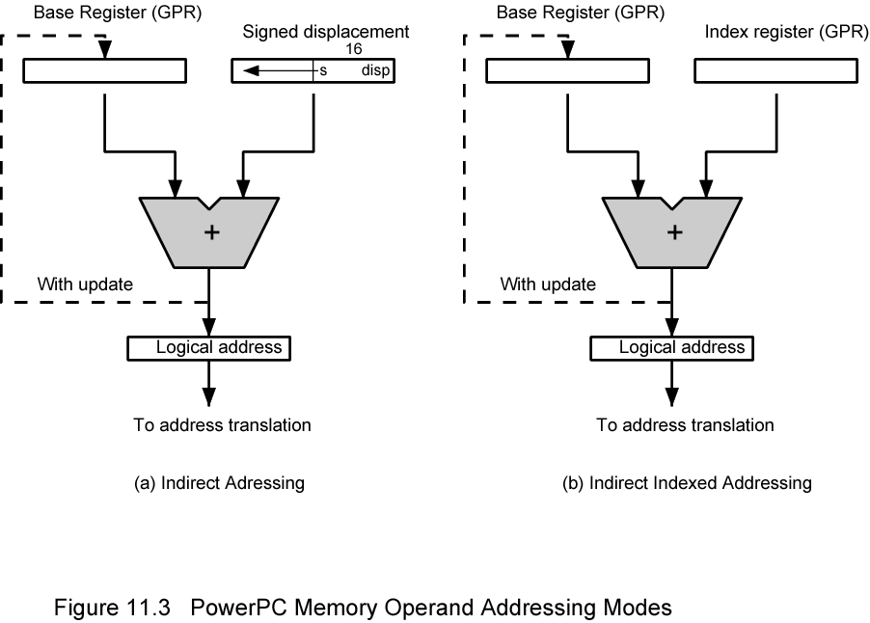
PowerPC Memory Operand Addressing Modes

Slide 36
CPU Function
CPU must:
  Fetch instructions
  Interpret/decode instructions
  Fetch data
  Process data
  Write data
Notes:
22

Slide 37
Registers
CPU must have some working space (temporary storage) - registers
Number and function vary between processor designs - one of the major design decisions
Top level of memory hierarchy
More registers, less memory latency
Dozens (even hundreds) of registers
Notes:
23

Slide 38
Control & Status Registers
Program Counter (PC)
Instruction Register (IR)
Memory Address Register (MAR) – connects to address bus
Memory Buffer Register (MBR) – connects to data bus, feeds other registers
Condition Code Registers (Flags), e.g. Program Status Word
  Sign (of last result), Zero (last result), Carry (multiword arithmetic), Equal (two latest results), Overflow – can be used for conditional branching
  Interrupts enabled/disabled
  Supervisor/user mode
Notes:
30

Slide 39
User Visible Registers
General Purpose
Data – see data types
Address – see addressing modes
Condition Codes (can be read by user processes, but written in kernel mode)
May have registers pointing to:
  Process control blocks (see OS)
  Interrupt Vectors (see OS)
Notes:
24

Slide 40


Slide 41
MC68000 and Intel registers
Motorola:
  Largely general purpose registers – explicit addressing
  Data registers also for indexing
  A7 and A7’ for user and kernel stacks
Intel
  Largely specific purpose registers – implicit addressing
  Segment, Pointer & Index, Data/General purpose
  Pentium II – backward compatibility

Slide 42
More Stages of the Instruction Cycle
Compute Instruction Address (see indirect addressing)
Fetch Instruction
Decode Instruction
Compute (Source) Operand Address
Fetch Operand
Execute Instruction
Compute (Target) Operand Address
Store Result

Slide 43

Instruction Cycle State Diagram

Slide 44
Data Flow (Instruction Fetch)
PC contains address of next instruction
Address moved to MAR
Address placed on address bus
Control unit requests memory read
Instruction placed on data bus, copied to MBR, then to IR
Meanwhile PC incremented by 1

Slide 45

Data Flow (Fetch Diagram)

Slide 46
Data Flow (Indirect Cycle)
IR is examined
If indirect addressing, indirect cycle is performed
  Rightmost n bits of MBR (address part of instruction) transferred to MAR
  Control unit requests memory read
  Result (address of operand) moved to MBR

Slide 47

Data Flow (Indirect Diagram)

Slide 48
Data Flow (Execute)
May take many forms, depends on the nature of the instruction being executed
May include
  Memory read/write
  Input/Output
  Register transfers
  ALU operations

Slide 49
Data Flow (Interrupt)
Current PC saved to allow resumption after interrupt
Contents of PC copied to MBR
Special memory location (e.g., stack pointer) loaded to MAR
MBR written to memory according to content of MAR
PC loaded with address of interrupt handling routine
Next instruction (first of interrupt handler) can be fetched

Slide 50

Data Flow (Interrupt Diagram)

Slide 51
Prefetch
Fetch involves accessing main memory
Execution of ALU operations do not access main memory
Can fetch next instruction during execution of current instruction, cf. assembly line
Called instruction prefetch
Notes:
36

Slide 52
Pipelining (six stages)
Fetch instruction
Decode instruction
Calculate operands (i.e., EAs)
Fetch operands
Execute instruction
Write result
Overlap these operations
Notes:
38

Slide 53
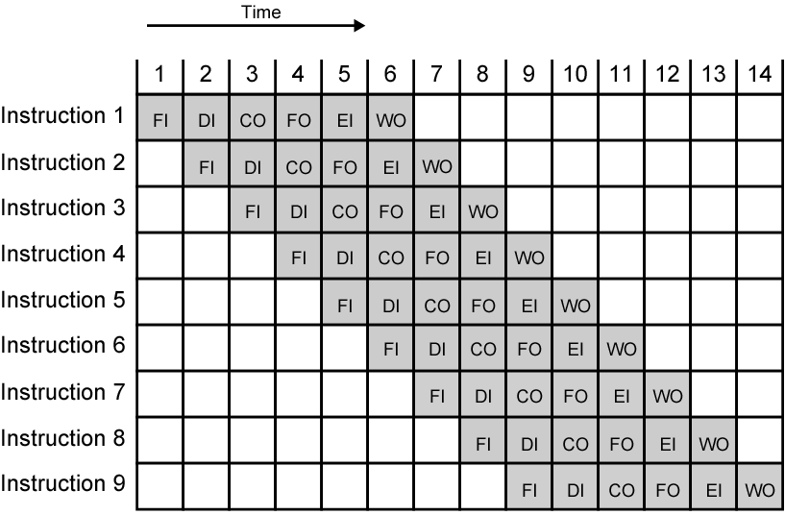
Timing Diagram for Instruction Pipeline Operation (assuming independence)
Notes:
39

Slide 54
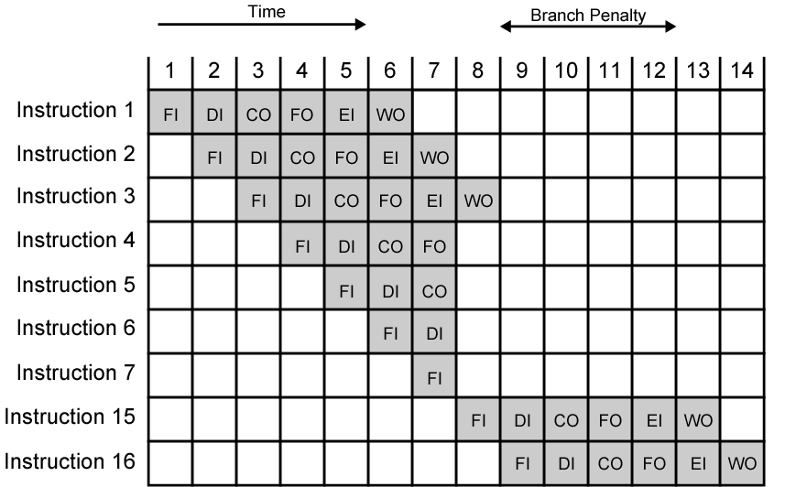
The Effect of a Conditional Branch/Interrupt on Instruction Pipeline Operation
Notes:
40

Slide 55
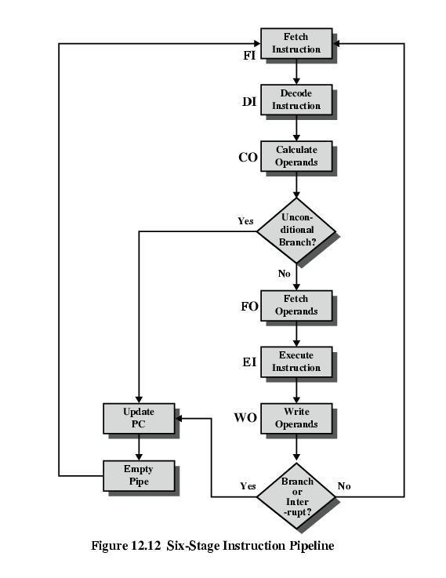
Six Stage
Instruction Pipeline

Slide 56
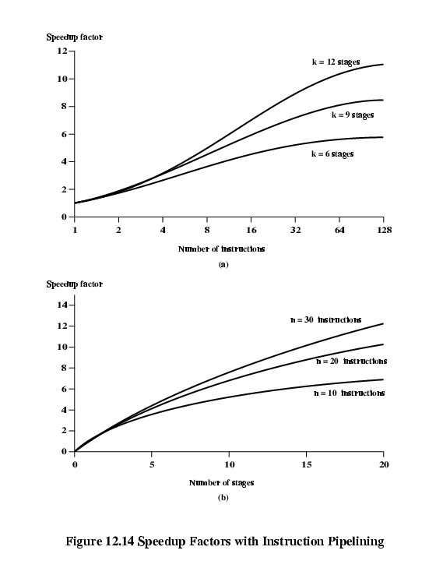
Speedup Factors with Instruction
Pipelining: nk/(n+k-1)
(ideally)

Slide 57
Dealing with Branches
Prefetch Branch Target
Loop buffer
Branch prediction
Delayed branching (see RISC)
Notes:
41

Slide 58
Prefetch Branch Target
Target of branch is prefetched in addition to instructions following branch
Keep target until branch is executed
Used by IBM 360/91
Notes:
43

Slide 59
Loop Buffer
Very fast memory
Maintained by fetch stage of pipeline
Check buffer before fetching from memory
Very good for small loops or jumps
Instruction cache
Notes:
44

Slide 60
Branch Prediction
Predict by Opcode
  Some instructions are more likely to result in a jump than others
  Can get up to 75% success
Taken/Not taken switch
  Based on previous history
  Good for loops
Delayed branch – rearrange instructions (see RISC)
Notes:
46

Slide 61
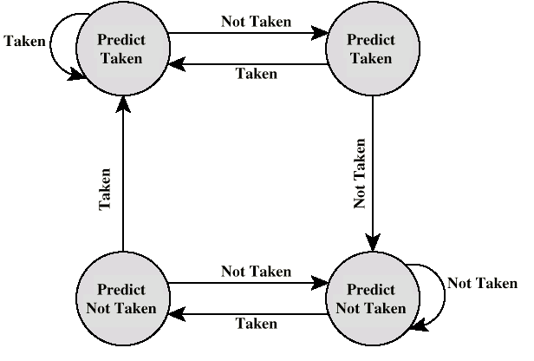
Branch Prediction State Diagram (two bits)

Slide 62
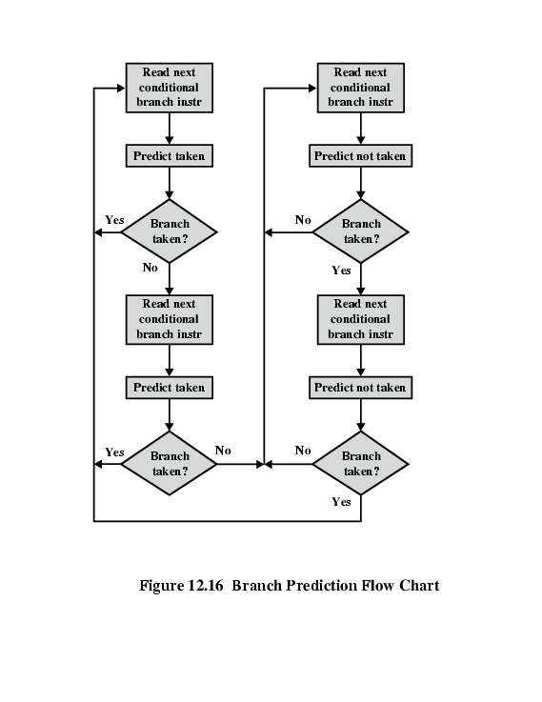
Branch Prediction Flowchart

Slide 63
Intel 80486 Pipelining
Fetch
  Put in one of two 16-byte prefetch buffers
  Fill buffer with new data as soon as old data consumed
  Average 5 instructions fetched per load (variable size)
  Independent of other stages to keep buffers full
Decode stage 1
  Opcode & address-mode info
  At most first 3 bytes of instruction needed for this
  Can direct D2 stage to get rest of instruction
Decode stage 2
  Expand opcode into control signals
  Computation of complex addressing modes
Execute
  ALU operations, cache access, register update
Writeback
  Update registers & flags
  Results sent to cache

Slide 64
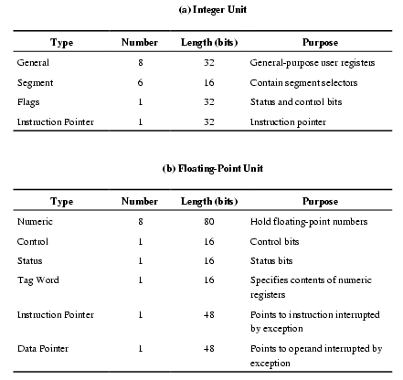
Pentium 4 Registers

Slide 65
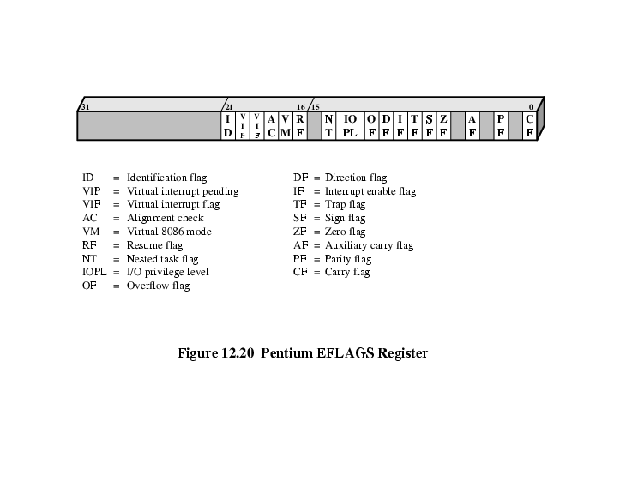
EFLAGS Register

Slide 66
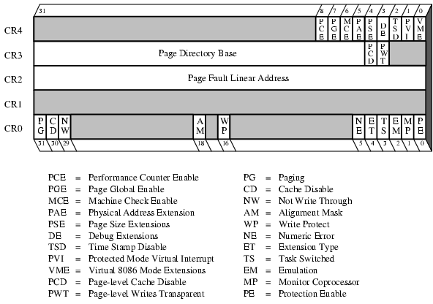
Control Registers

Slide 67
Pentium Interrupt Processing
Interrupts (hardware): (non-)maskable
Exceptions (software): processor detected (error) or programmed (exception)
Interrupt vector table
  Each interrupt type assigned a number
  Index to vector table
  256 * 32 bit interrupt vectors (address of ISR)
5 priority classes: 1. exception by previous instruction 2. external interrupt, 3.-5. faults from fetching, decoding or executing instruction

