Slide 1
Chapters 15 and 16
William Stallings
Computer Organization and Architecture
10th Edition
Instruction-level Parallelism:
Reduced Instruction Set Computers and
Superscalar Processors

Slide 2
Major Advances in Computers
The family concept
  IBM System/360 in 1964
  DEC PDP-8
  Separates architecture from implementation
Cache memory
  IBM S/360 model 85 in 1968
Pipelining
  Introduces parallelism into sequential process
Multiple processors

Slide 3
The Next Step - RISC
Reduced Instruction Set Computer
Key features
  Large number of general purpose registers
  or use of compiler technology to optimize register use
  Limited and simple instruction set
  Emphasis on optimising the instruction pipeline

Slide 4
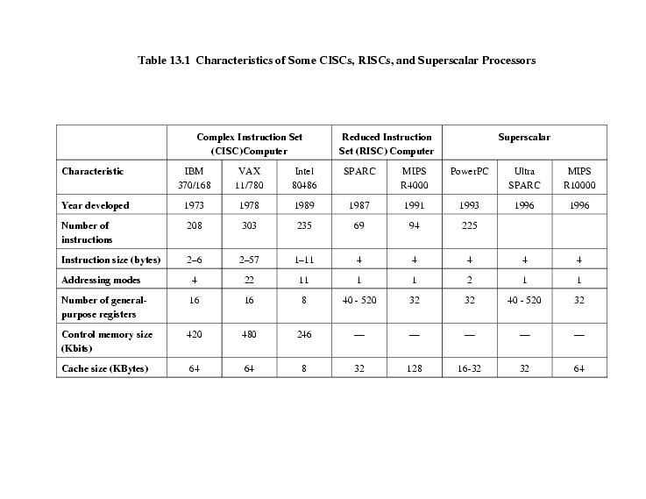
Comparison of processors

Slide 5
Driving force for CISC
Increasingly complex high level languages (HLL) – structured and object-oriented programming
Semantic gap: implementation of complex instructions
Leads to:
  Large instruction sets
  More addressing modes
  Hardware implementations of HLL statements, e.g. CASE (switch) on VAX

Slide 6
Intention of CISC
Ease compiler writing (narrowing the semantic gap)
Improve execution efficiency
  Complex operations in microcode (the programming language of the control unit)
Support more complex HLLs

Slide 7
Execution Characteristics
Operations performed (types of instructions)
Operands used (memory organization, addressing modes)
Execution sequencing (pipeline organization)

Slide 8
Dynamic Program Behaviour
Studies have been done based on programs written in HLLs
Dynamic studies are measured during the execution of the program
Operations, Operands, Procedure calls

Slide 9
Operations
Assignments
  Simple movement of data
Conditional statements (IF, LOOP)
  Compare and branch instructions => Sequence control
Procedure call-return is very time consuming
Some HLL instruction lead to many machine code operations and memory references

Slide 10
Weighted Relative Dynamic Frequency of HLL Operations [PATT82a]
Dynamic Occurrence
Machine-Instruction Weighted
Memory-Reference Weighted
Pascal
C
Pascal
C
Pascal
C
ASSIGN
45%
38%
13%
13%
14%
15%
LOOP
5%
3%
42%
32%
33%
26%
CALL
15%
12%
31%
33%
44%
45%
IF
29%
43%
11%
21%
7%
13%
GOTO
—
3%
—
—
—
—
OTHER
6%
1%
3%
1%
2%
1%

Slide 11
Operands
Mainly local scalar variables
Optimisation should concentrate on accessing local variables
 | Pascal | C | Average
Integer constant | 16% | 23% | 20%
Scalar variable | 58% | 53% | 55%
Array/structure | 26% | 24% | 25%

Slide 12
Procedure Calls
Very time consuming - load
Depends on number of parameters passed
Depends on level of nesting
Most programs do not do a lot of calls followed by lots of returns – limited depth of nesting
Most variables are local

Slide 13
Why CISC (1)?
Compiler simplification?
  Disputed…
  Complex machine instructions harder to exploit
  Optimization more difficult
Smaller programs?
  Program takes up less memory but…
  Memory is now cheap
  May not occupy less bits, just look shorter in symbolic form
    More instructions require longer op-codes
    Register references require fewer bits

Slide 14
Why CISC (2)?
Faster programs?
  Bias towards use of simpler instructions
  More complex control unit
  Thus even simple instructions take longer to execute
It is far from clear that CISC is the appropriate solution

Slide 15
Implications - RISC
Best support is given by optimising most used and most time consuming features
Large number of registers
  Operand referencing (assignments, locality)
Careful design of pipelines
  Conditional branches and procedures
Simplified (reduced) instruction set - for optimization of pipelining and efficient use of registers

Slide 16
RISC v CISC
Not clear cut
Many designs borrow from both design strategies: e.g. PowerPC and Pentium II
No pair of RISC and CISC that are directly comparable
No definitive set of test programs
Difficult to separate hardware effects from compiler effects
Most comparisons done on “toy” rather than production machines

Slide 17
RICS v CISC
No. of instructions: 69 - 303
No. of instruction sizes: 1 - 56
Max. instruction size (byte): 4 - 56
No. of addressing modes: 1 - 44
Indirect addressing: no - yes
Move combined with arithmetic: no – yes
Max. no. of memory operands: 1 - 6

Slide 18
Large Register File
Software solution
  Require compiler to allocate registers
  Allocation is based on most used variables in a given time
  Requires sophisticated program analysis
Hardware solution
  Have more registers
  Thus more variables will be in registers

Slide 19
Registers for Local Variables
Store local scalar variables in registers - Reduces memory access and simplifies addressing
Every procedure (function) call changes locality
  Parameters must be passed down
  Results must be returned
  Variables from calling programs must be restored

Slide 20
Register Windows
Only few parameters passed between procedures
Limited depth of procedure calls
Use multiple small sets of registers
Call switches to a different set of registers
Return switches back to a previously used set of registers

Slide 21
Register Windows cont.
Three areas within a register set
  Parameter registers
  Local registers
  Temporary registers
Temporary registers from one set overlap with parameter registers from the next
  This allows parameter passing without moving data

Slide 22
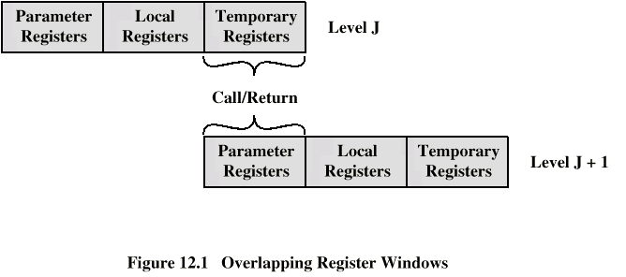
Overlapping Register Windows

Slide 23
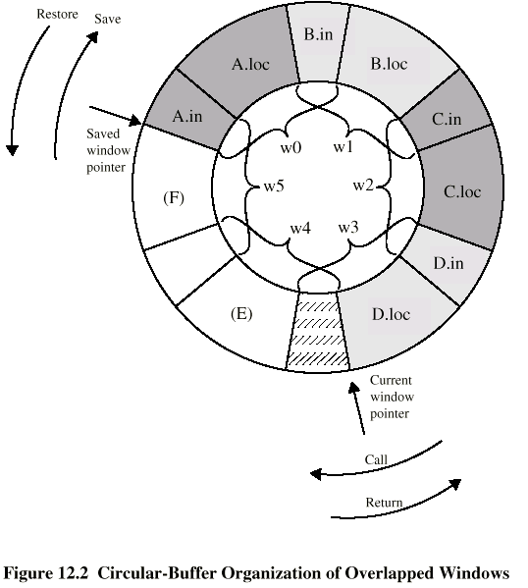
Circular Buffer diagram

Slide 24
Operations of Circular Buffer
When a call is made, a current window pointer is moved to show the currently active register window
If all windows are in use and a new procedure is called:
an interrupt is generated and the oldest window (the one furthest back in the call nesting) is saved to memory

Slide 25
Operations of Circular Buffer (cont.)
At a return a window may have to be restored from main memory
A saved window pointer indicates where the next saved window should be restored

Slide 26
Global Variables
Allocated by the compiler to memory
  Inefficient for frequently accessed variables
Have a set of registers dedicated for storing global variables

Slide 27
SPARC register windows
Scalable Processor Architecture – Sun
Physical registers: 0-135
Logical registers
  Global variables: 0-7
  Procedure A: parameters 135-128
  locals 127-120
  temporary 119-112
  Procedure B: parameters 119-112
  etc.

Slide 28
Compiler Based Register Optimization
Assume small number of registers (16-32)
Optimizing use is up to compiler
HLL programs usually have no explicit references to registers
Assign symbolic or virtual register to each candidate variable
Map (unlimited) symbolic registers to real registers
Symbolic registers that do not overlap can share real registers
If you run out of real registers some variables use memory

Slide 29
Graph Coloring
Given a graph of nodes and edges
Assign a color to each node
Adjacent nodes have different colors
Use minimum number of colors
Nodes are symbolic registers
Two registers that are live in the same program fragment are joined by an edge
Try to color the graph with n colors, where n is the number of real registers
Nodes that can not be colored are placed in memory

Slide 30
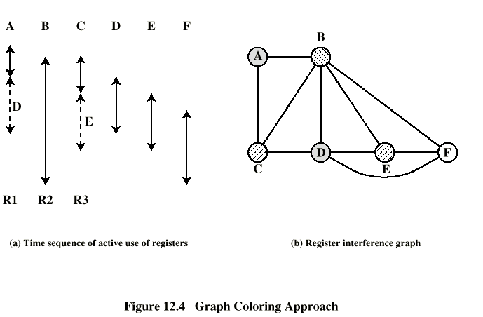
Graph Coloring Approach

Slide 31
RISC Pipelining
Most instructions are register to register
Arithmetic/logic instruction:
  I: Instruction fetch
  E: Execute (ALU operation with register input and output)
Load/store instruction:
  I: Instruction fetch
  E: Execute (calculate memory address)
  D: Memory (register to memory or memory to register operation)

Slide 32
Delay Slots in the Pipeline
Sequential | 1 | 2 | 3 | 4 | 5 | 6 | 7 | 8 | 9 | 10 | 11
LOAD rA, m1 | I | E | D
LOAD rB, m2 |  |  |  | I | E | D
ADD rC, rA, rB |  |  |  |  |  |  | I | E
STORE m3, rC |  |  |  |  |  |  |  |  | I | E | D
Pipelined | 1 | 2 | 3 | 4 | 5 | 6 | 7
LOAD rA, m1 | I | E | D
LOAD rB, m2 |  | I | E | D
ADD rC, rA, rB |  |  | I |  | E
STORE m3, rC |  |  |  | I |  | E | D

Slide 33
Optimization of Pipelining
Code reorganization techniques to reduce data and branch dependencies
Delayed branch
  Does not take effect until the execution of following instruction
  This following instruction is the delay slot
  More successful with unconditional branch
1st approach: insert NOOP (prevents fetching instr., no pipeline flush and delays the effect of jump)
2nd approach: reorder instructions

Slide 34
Normal and Delayed Branch
Address | Normal branch | 1st Delayed branch | 2nd Delayed branch
100 | LOAD rA, X | LOAD rA, X | LOAD rA, X
101 | ADD rA, 1 | ADD rA, 1 | JUMP 105
102 | JUMP 105 | JUMP 106 | ADD rA, 1
103 | ADD rA, rB | NOOP | ADD rA, rB
104 | SUB rC, rB | ADD rA, rB | SUB rC, rB
105 | STORE Z, rA | SUB rC, rB | STORE Z, rA
106 |  | STORE Z, rA

Slide 35
Use of Delayed Branch
Normal branch | 1 | 2 | 3 | 4 | 5 | 6 | 7 | 8
100. LOAD rA, X | I | E | D
101. ADD rA, 1 |  | I |  | E
102. JUMP 105 |  |  |  | I | E
103. ADD rA, rB |  |  |  |  | I
105. STORE Z, rA |  |  |  |  |  | I | E | D
Delayed branch | 1 | 2 | 3 | 4 | 5 | 6
100. LOAD rA, X | I | E | D
102. JUMP 105 |  | I | E
101. ADD rA, 1 |  |  | I | E
105. STORE Z, rA |  |  |  | I | E | D

Slide 36
MIPS S Series - Instructions
All instructions 32 bit; three instruction formats
6-bit opcode, 5-bit register addresses/26-bit instruction address (e.g., jump) plus additional parameters (e.g., amount of shift)
ALU instructions: immediate or register addressing
Memory addressing: base (32-bit) + offset (16-bit)

Slide 37
MIPS S Series - Pipelining
Instruction fetch
Decode/Register read
ALU/Memory address calculation
Cache access
Register write

Slide 38
MIPS – R4000 pipeline
Instruction Fetch 1: address generated
IF 2: instruction fetched from cache
Register file: instruction decoded and operands fetched from registers
Instruction execute: ALU or virt. address calculation or branch conditions checked
Data cache 1: virt. add. sent to cache
DC 2: cache access
Tag check: checks on cache tags
Write back: result written into register

Slide 39
What is Superscalar?
Common instructions (arithmetic, load/store, conditional branch) can be initiated simultaneously and executed independently
Applicable to both RISC & CISC

Slide 40
Why Superscalar?
Most operations are on scalar quantities (see RISC notes)
Improve these operations by executing them concurrently in multiple pipelines
Requires multiple functional units
Requires re-arrangement of instructions

Slide 41
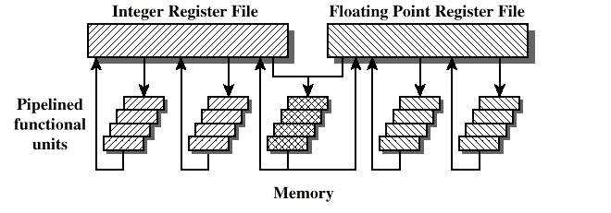
General Superscalar Organization

Slide 42
Limitations
Instruction level parallelism: the degree to which the instructions can be executed parallel (in theory)
To achieve it:
  Compiler based optimisation
  Hardware techniques
Limited by
  Data dependency
  Procedural dependency
  Resource conflicts

Slide 43
True Data (Write-Read) Dependency
ADD r1, r2 (r1 <- r1 + r2)
MOVE r3, r1 (r3 <- r1)
Can fetch and decode second instruction in parallel with first
Can NOT execute second instruction until first is finished

Slide 44
Procedural Dependency
Cannot execute instructions after a (conditional) branch in parallel with instructions before a branch
Also, if instruction length is not fixed, instructions have to be decoded to find out how many fetches are needed (cf. RISC)
This prevents simultaneous fetches

Slide 45
Resource Conflict
Two or more instructions requiring access to the same resource at the same time
  e.g. functional units, registers, bus
Similar to true data dependency, but it is possible to duplicate resources

Slide 46
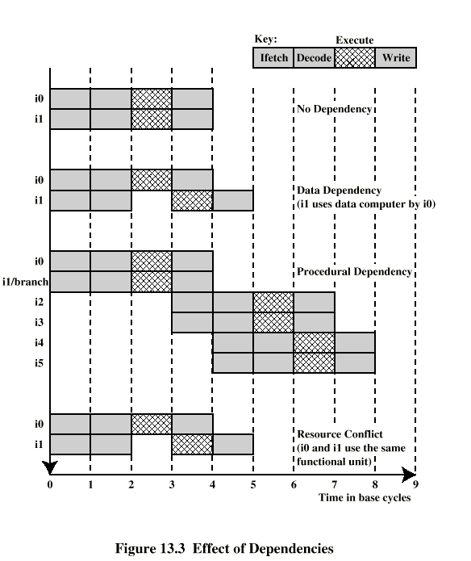
Effect of
Dependencies

Slide 47
Design Issues
Instruction level parallelism
  Some instructions in a sequence are independent
  Execution can be overlapped or re-ordered
  Governed by data and procedural dependency
Machine parallelism
  Ability to take advantage of instruction level parallelism
  Governed by number of parallel pipelines

Slide 48
(Re-)ordering instructions
Order in which instructions are fetched
Order in which instructions are executed – instruction issue
Order in which instructions change registers and memory - commitment or retiring

Slide 49
In-Order Issue
In-Order Completion
Issue instructions in the order they occur
Not very efficient – not used in practice
May fetch >1 instruction
Instructions must stall if necessary

Slide 50
An Example
I1 requires two cycles to execute
I3 and I4 compete for the same execution unit
I5 depends on the value produced by I4
I5 and I6 compete for the same execution unit
Two fetch and write units, three execution units

Slide 51
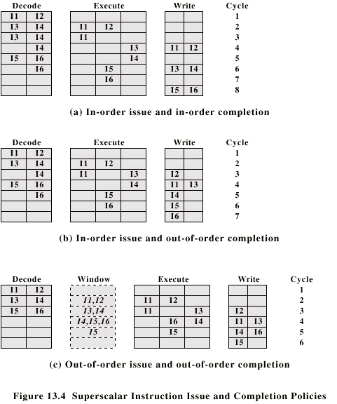
In-Order Issue In-Order Completion (Diagram)

Slide 52
In-Order Issue Out-of-Order Completion (Diagram)

Slide 53
In-Order Issue
Out-of-Order Completion
Output (write-write) dependency
  R3 <- R2 + R5 (I1)
  R4 <- R3 + 1 (I2)
  R3 <- R5 + 1 (I3)
  R6 <- R3 + 1 (I4)
  I2 depends on result of I1 - data dependency
  If I3 completes before I1, the input for I4 will be wrong - output dependency: I1&I3-I6(R3)

Slide 54
Out-of-Order Issue
Out-of-Order Completion
Decouple decode pipeline from execution pipeline
Can continue to fetch and decode until this pipeline is full
When a execution unit becomes available an instruction can be executed
Since instructions have been decoded, processor can look ahead – instruction window

Slide 55
Out-of-Order Issue Out-of-Order Completion (Diagram)

Slide 56
Antidependency
Read-write dependency: I2-I3(R3)
  R3 <- R3 + R5 (I1)
  R4 <- R3 + 1 (I2)
  R3 <- R5 + 1 (I3)
  R7 <- R3 + R4 (I4)
  I3 should not execute before I2 starts as I2 needs a value in R3 and I3 changes R3

Slide 57
Register Renaming
Output and antidependencies occur because register contents may not reflect the correct program flow
May result in a pipeline stall
The usual reason is storage conflict
Registers can be allocated dynamically

Slide 58
Register Renaming example
R3a <- R3a + R5 (I1)
R4 <- R3a + 1 (I2)
R3b <- R5 + 1 (I3)
R7 <- R3b + R4 (I4)
Without label (a,b) refers to logical register
With label is hardware register allocated
Removes antidependency I2-I3(R3) and output dependency I1&I3-I4(R3)
Needs extra registers

Slide 59
Machine Parallelism
Duplication of Resources
Out of order issue
Renaming
Not worth duplicating functions without register renaming
Need instruction window large enough (more than 8)

Slide 60
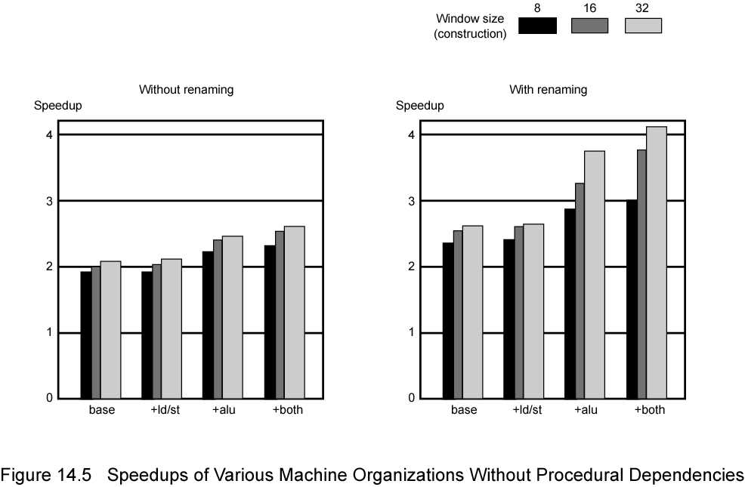
Speedups Without Procedural Dependencies (with out-of-order issue)

Slide 61
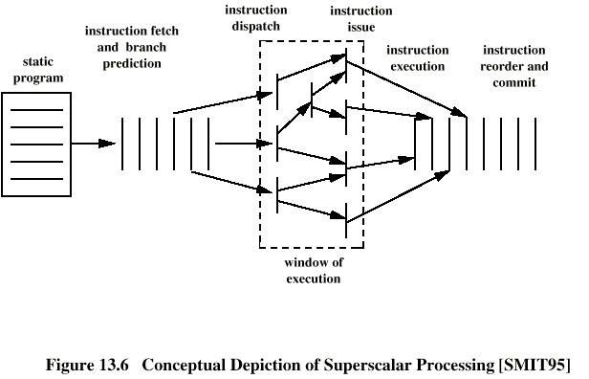
Superscalar Execution

Slide 62
Pentium 4
80486 - CISC
Pentium – some superscalar components
  Two separate integer execution units
Pentium Pro – Full blown superscalar
Subsequent models refine & enhance superscalar design

Slide 63
Pentium 4 Operation
Fetch instructions form memory in order of static program
Translate instruction into one or more fixed length RISC instructions (micro-operations)
Execute micro-ops on superscalar pipeline
  micro-ops may be executed out of order
Commit results of micro-ops to register set in original program flow order
Outer CISC shell with inner RISC core
Inner RISC core pipeline - 20 stages
  Some micro-ops require multiple execution stages
  cf. five stage pipeline on Pentium

Slide 64
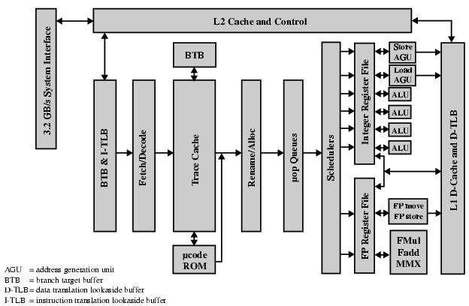
Pentium 4 Block Diagram

Slide 65
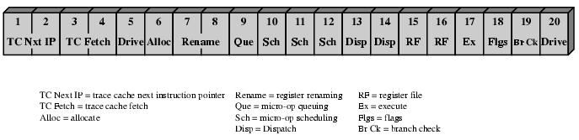
Pentium 4 Pipeline

Slide 66
Stages 1-9
1-2 (BTB&I-LTB, F/t): Fetch (64-byte) instructions, static branch prediction, split into 4 (118-bit) micro-ops
3-4 (TC): Dynamic branch prediction with 4 bits, sequencing micro-ops
5: Feed into out-of-order execution logic
6 (R/a): Allocating resources (126 micro-ops, 128 registers)
7-8 (R/a): Renaming registers and removing false dependencies
9 (micro-opQ): Re-ordering micro-ops

Slide 67
Stages 10-20
10-14 (Sch): Scheduling (FIFO) and dispatching (6) micro-ops whose data is ready towards available execution unit
15-16 (RF): Register read
17 (ALU, Fop): Execution of micro-ops
18 (ALU, Fop): Compute flags
19 (ALU): Branch check – feedback to stages 3-4
20: Retiring instructions

Slide 68
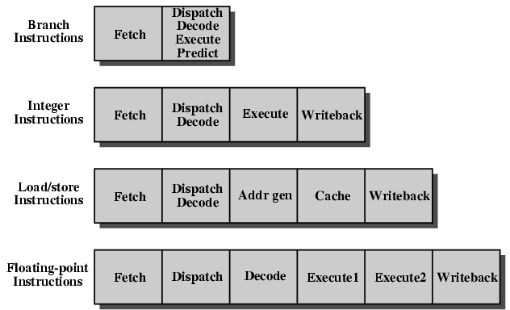
PowerPC 601 Pipeline

Slide 69
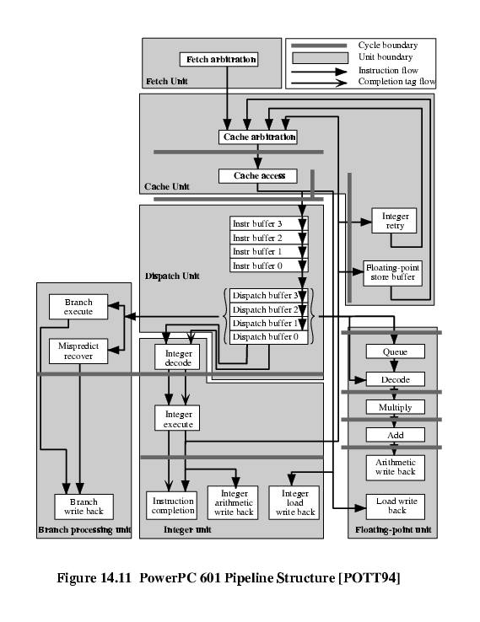
PowerPC 601
Pipeline
Structure

