Slide 1
Coursera Capstone Project - Car Accident Severity
Ioannis Dimopoulos
August 2020

Slide 2
Introduction & Data Source
The aim of the project is to develop a model able to predict the possibility of a car accident and its severity based on external conditions.
The data used for this project were provided by the city of Seattle:
Source: https://data-seattlecitygis.opendata.arcgis.com/datasets/5b5c745e0f1f48e7a53acec63a0022ab_0/data
Description: https://www.seattle.gov/Documents/Departments/SDOT/GIS/Collisions_OD.pdf

Slide 3
Data Cleaning
Original dataset: 40 variables, 220,937 records.
First, I removed the variables, where over half of the records had missing (NaN) values.
Next, I kept only variables relevant to the project. The were:
Target variable: SEVERITYCODE
Candidate feature variables: WEATHER, ROADCOND, LIGHTCOND
Afterwards, I removed any remaining records with NaN and the records where SEVERITYCODE was “0” and WEATHER, ROADCOND or LIGHTCOND were “Unknown”
Final dataset: 4 variables, 175,292 recotds.

Slide 4
Methodology
Feature Evaluation:
Visual Evaluation: Bar plots
Statistical Evaluation: Chi-squared test
Machine Learning Algorithms:
Three Classification Machine Learning Algorithms:
K Nearest Neighbours (KNN) (tested Ks from 1 to 50 to find the best K)
Decision Tree
Logistic Regression

Slide 5
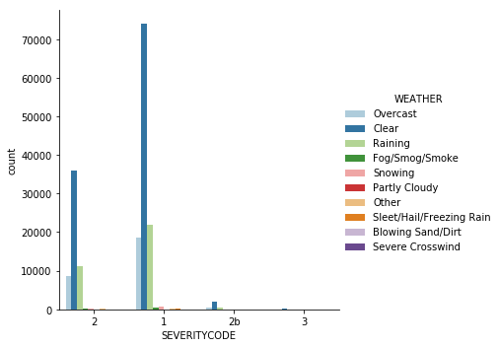
Results – Bar Plots
Figure 1. Distribution of accidents of different level of severity across different weather conditions

Slide 6
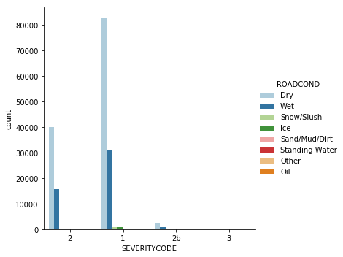
Results – Bar Plots
Figure 2. Distribution of accidents of different level of severity across different road conditions.

Slide 7
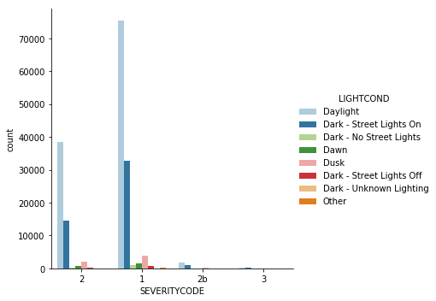
Results – Bar Plots
Figure 3. Distribution of accidents of different level of severity across different light conditions.

Slide 8
Results – Chi-squared Test
The chi-squared test of association between SEVERITYCODE and WEATHER, ROADCOND, LIGHTCOND produced p-values < 0.5
All three associations were significant
All three candidate feature variables were included in the machine learning algorithms

Slide 9
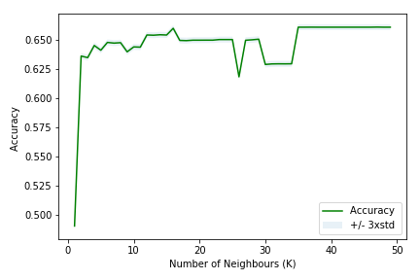
Results – Best K for KNN
Figure 4. The K that produced the best accuracy (66%) was 47.

Slide 10
Results – Machine Learning Accuracy Metrics
Algorithm | Jaccard | F1-score | LogLoss
KNN | 0.661342 | 0.526620 | N/A
Decision Tree | 0.661086 | 0.526724 | N/A
Logistic Regression | 0.661257 | 0.526421 | 0.720668

Slide 11
Discussion
The three algorithms produced very similar metrics.
Logistic Regression produced an estimate of the possibility of the accident prediction.
Therefore the Logistic Regression model is more informative and more appropriate to meet the aim of this project.

