Slide 1
Multiple Dispatch in Practice (OOPSLA2008)
Author: Radu Muschevici, etc.
Presented by:
Liquan Pei
Department of Physics, UMass

Slide 2
Outline
Overview
Single v.s. Double dispatch
Methodology
Modeling Dynamic Dispatch
Metrics
Multiple dispatch languages
Multiple dispatch in Java
Discussion
Conclusion

Slide 3
Overview
An empirical study of multiple dispatch in existing languages, try to answer “How much multiple dispatch is used or could be used?”
Define six metrics based on a language-independent model to measure the use of multiple dispatch.
Analysis of metrics for a corpus of six multiple dispatch languages: CLOS, Dylan, Cecil, Diesel, Nice, MultiJava.
Comparison with Java on the use of double dispatch pattern and cascaded instanceof expressions.

Slide 4
Single v.s. Multiple Dispatch
abstract class Vehicle {
void drive() { print(“Brmmm!!!”); }
void collide(Vehicle v) {
print(“Unspecified vehicle collision”);
}
}
class Car extends Vehicle{
void drive() { print(“Driving a car!”);}
void collide(Vehicle v) { print(“Car crash!”);}
void collide (Bike b) { print(“Car hits bike!” );}
}
Vehicle car = new Car();
Vehicle bike = new Bike();
car.collide(bike);
In single dispatch language like Java, the code will print
Car crash!
In multiple dispatch language, the code will print
Car hits bike!
Cetting to Car.collide(Bike) from Vehicle.collide(Vehicle) requires two dynamic choices-This is called multiple dispatch.
Notes:
On the type of the type of “this” object and on the type of the second argument.

Slide 5
Single v.s. Multiple Dispatch-continued
Single dispatch syntax: receiver.method(args)
This syntax does not work for multiple dispatch since a concrete method body can be specialized on a combination of classes
Some multiple dispatch languages declare method separately, outside the class hierarchy while others consider them part of none, one or several classes.
Multiple dispatch: symmetric syntax like collide(mycar, yourbike)

Slide 6
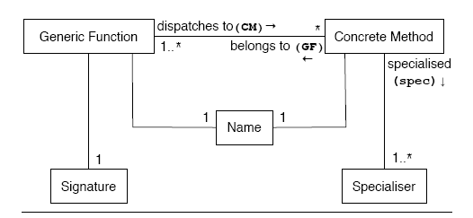
Modeling Dynamic Dispatch
In Java,
Generic Function(GF): Method call
Concrete Method(CM): Method bodies
Name: Method name
Signature: Static type of arguments and number of arguments
Specialiser: Dynamic type of “this” argument
Notes:
Generic Function: A function that may be dynamically dispatched, e.g. Java method call. Generic function are identified by a name and signature.
Signature: The permissible arguments to a generic function are defined by that function’s signature. Static type and number of argurments.
Concrete Method: A code body for execution of a GF.
Dispatch: When a generic method is called at run time, it must select concrete method to run. In this model, it is a dynamic dispatch from the generic function to concrete method

Slide 7


Metrics: definition
Dispatch Ratio(DR): DR(g) = |CM(g)|
Choice Ratio(CR): Total number of concrete methods belonging to all the generic functions to which a certain method belongs.
Degree of Specialization (DoS): DoS(m) = |spec(m)|
Rightmost Specialiser (RS): RS = max(spec(m))
Degree of Dispatch: (DoD): DoD(g) = |P|
Rightmost Dispatch: (RD): RD(g) = max(P)
Notes:
CR: counts how many alternative concrete methods could have been reached by a dispatch.

Slide 8
Metrics: example in Gwydion Dylan
define class <vehicle>;
define class <car> (<vehicle>)…;
define class <sports-car> (<car>)…;
//DR = 2, DoD = 1, RD = 2
define generic collide (v1 :: <vehicle>, v2 :: <vehicle>);
//CR = 2, DoS = 1, RS = 1
define method collide (sc :: <sports-car>, v :: <vehicle>)…;
//CR = 2, DoS = 1, RS = 2
define method collide (v :: <vehicle>, c:: <car>)…;

Slide 9
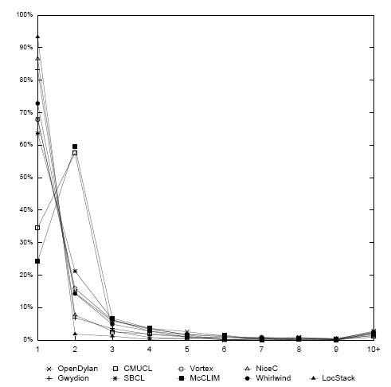
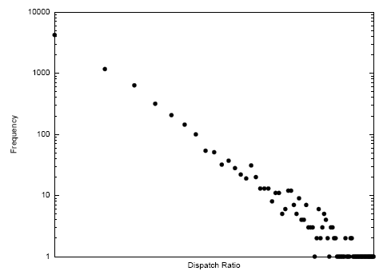
Multiple Dispatch Languages-DR
DR frequency distribution

Slide 10
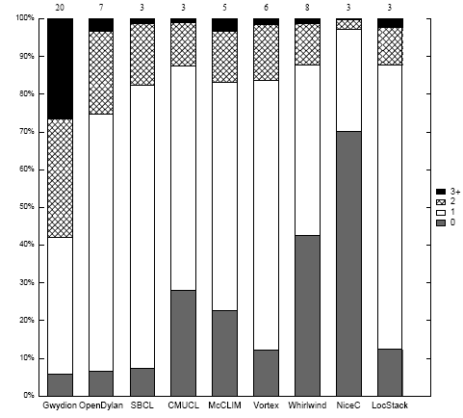
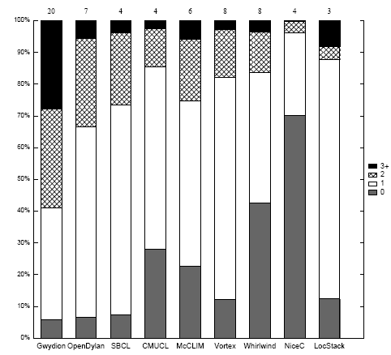
Multiple Dispatch Languages-Specialiser
DoS frequency distribution
RS frequency distribution

Slide 11
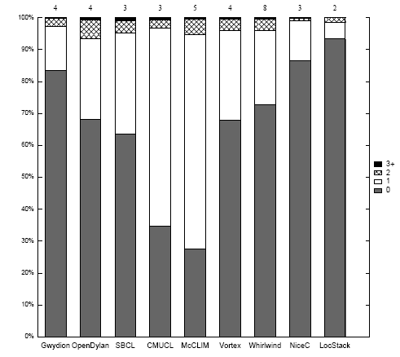
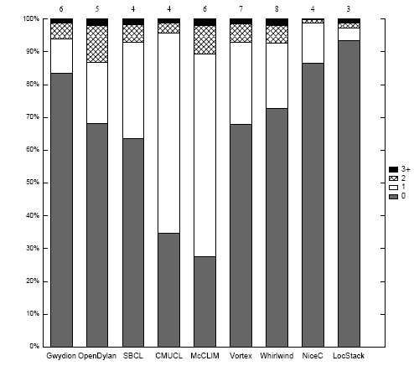
Multiple Dispatch Languages-Dispatch
DoD frequency distribution
RD frequency distribution

Slide 12
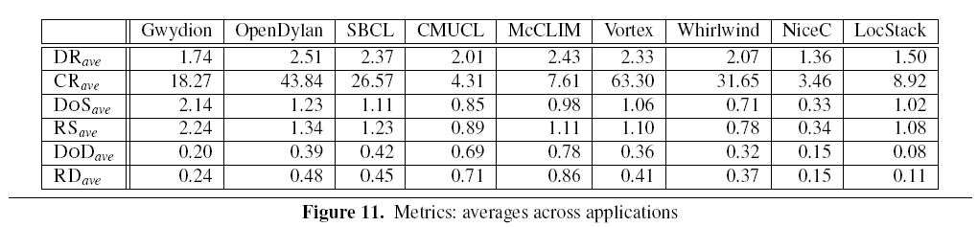
Multiple Dispatch Languages-Summary

Slide 13
Multiple Dispatch in Java-Double Dispatch Pattern
class Car extends Vehicle {
void collide(Vehicle v) {v.collideWithCar(this);}
void collideWithCar (Car c) { print(“Car hits car”); }
void collideWithBike (Bike b) { print(“Bike hits car”);}
}
class Bike extends Vehicle { void collide(Vehicle v) {v.collideWithBike(this);}
void collideWithCar (Car c) { print(“Car hits bike”);}
void collideWithBike (Bike b) { print(“Bike hits bike”);}
}
Vehicle car = new Car();
Vehicle bike = new Bike();
car.collide(bike); //print out “Car hits bike”
bike.collide(car);// print out “Car hits bike”
car.collide(car);// print out “Car hits car”
bike.collide(bike);//print out “Bike hits bike”

Slide 14
Visitor Pattern is Double Dispatch Pattern
In Visitor Pattern, we have
interface CarElement {
void accept(CarElementVisitor visitor);
}
interface CarElementVisitor {
void visit(Wheel wheel);
void visit(Engine engine);
void visit(Body body);
}
void accept(CarElementVistor vistor){
visitor.visit(this);
}//Implemented in each concrete class

Slide 15
Characteristics of Double Dispatch Pattern
The this object is passed as an actual parameter to a method invoked on one of the formal parameters to the double dispatch candidate.
The type of the formal parameter of the invoked method is different from the actual parameter passed.
There is more than one child (either through extends or implements ) of the formal parameter of the invoked method containing the same method.

Slide 16
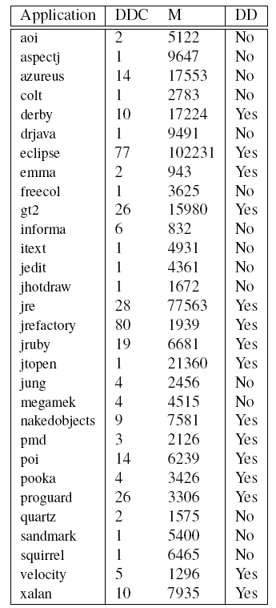
Results for double dispatch
Notes:
Yes only means that at least one candidate could be used as a double dispatch pattern

Slide 17
Multiple Dispatch in Java-Cascaded instanceof
class Car extends Vehicle {
void collide(Vehicle v) {
if (v instanceof Car) { print(“Car hits car”); return;}
if (v instanceof Bike) { print(“Car hits Bike”);return;}
throw Error(“missing case: should not happen”);
}
}
class Bike extends Vehicle{
void collide(Vehicle v) {
if( v instanceof Car) { print(“Car hits bike”); return;}
if (v instanceof Bike) { print(“Bike hits bike”; return;}
throw Error(“missing case: should not happen”);
}
}

Slide 18
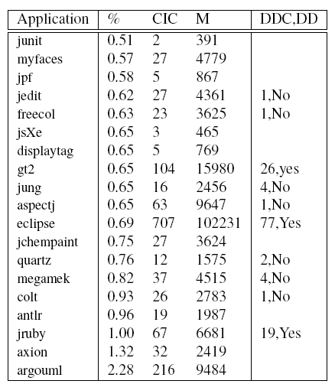
Results for cascaded instanceof
Note : Consider a method to be a cascaded instanceof if it contains two applications of instanceof to the same formal parameter of a method.
Notes:
Application with more than .5% methods being cascaded instanceof . Multiple dispatch is more often be simulated as cascaded instanceof

Slide 19
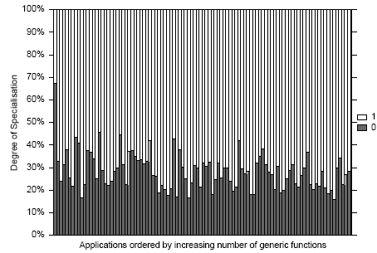
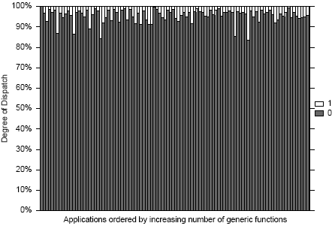
Metrics Results-Specialiser and Dispatch
DoS of Java Applications, proportional to total CM
DoD of Java Applications, proportional to total GF
Note: Can consider the use of double dispatch pattern or cascaded instanceof as providing specialization on the on a second parameter, RS = 2. But this is rare, less than 1%. Only consider RS=0,1. The above two figures only show DoS =0, 1 and DoD = 0, 1. Application ordered by increasing number of generic functions.

Slide 20
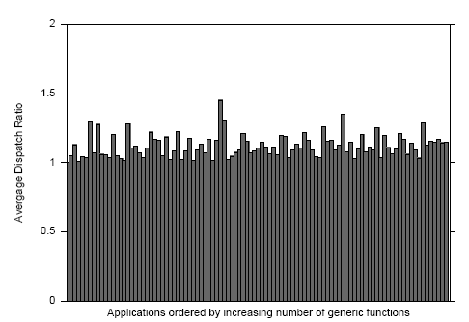
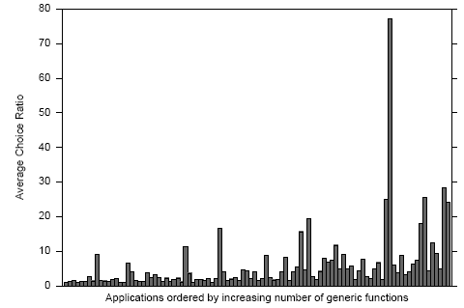
Multiple Dispatch in Java-DR and CR
Average DR for Applications
Average CR for Applications

Slide 21
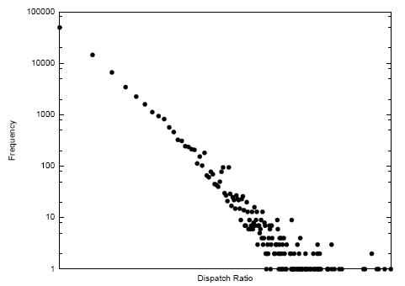
Multiple Dispatch in Java-DR (log-scale)

Slide 22
Discussions
Many of the metric values are low. DR_ave(Multi)< 2.5
DR_ave (Multi) > DR_ave(Java)
Mature Application such as CMUCL and McCLIM exibhit the most dynamic dispatch(around 70%)
CR_ave(Multi) > CR_ave(Java) ??

Slide 23
Conclusion
For multiple dispatch languages
3% generic functions utilize multiple dispatch
30% generic functions utilize single dispatch
For Java
Cascaded instanceof expression uses more than double dispatch. When using double dispatch, it is in implementation of the Visitor pattern(Why?)
Both together are used much less than multiple dispatch in any multiple dispatch language
Java programs could scope to use more multiple dispatch were it supported in the language!
Notes:
Instanceof is more straightforward to code and localized in a single class….

