Slide 1
Integrating Nominal and Structural Subtyping
Authors:
Donna Malayeri and Jonathan Aldrich
Presented by: John Altidor

Slide 2
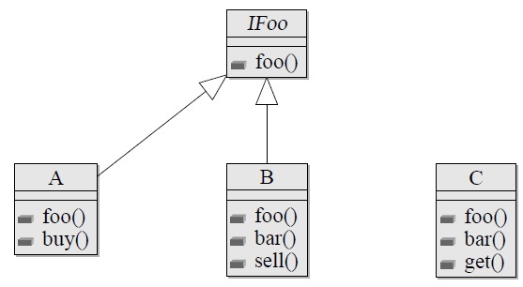
Nominal Subtyping
A type U is a subtype of another type T if and only if it is declared to be.
Subtyping relationships from example:
A ≤ IFoo, B ≤ IFoo

Slide 3
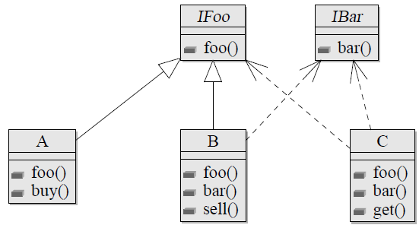
Structural Subtyping
A type U is a subtype of another type T if the methods and fields of U are a superset of T's methods and fields.
Subtyping relationships from example:
A ≤ IFoo, B ≤ IFoo
B ≤ IBar, C ≤ IBar, C ≤ IFoo

Slide 4
Benefits of Structural Subtyping
Easier on library developers
  Allows unanticipated reuse.
  Subtyping relationships do not need to be declared.
Concise type requirements with much fewer declared types.
Reuse benefits:
callFoo(obj) = obj.foo()

Slide 5
Benefits of Nominal Subtyping
Enforce design intent explicitly
Prevents “accidental” subtyping relationships.
  Circle.draw() and Cowboy.draw()
Enables efficient implementation of external dispatch (more on this later).

Slide 6
Solution: Unity
A language from CMU that provides both nominal and structural subtyping.
Remaining organization:
  Introduce Unity syntax and semantics
  How Unity addresses some problems that occur when only one kind of subtyping is available.
  Case study on Java API.
  Limitations of approach.

Slide 7
Unity: Brand Definitions
brand Point(x:int, y:int, foo():unit = ...)
extends Top
brand 3DPoint(z:int) extends Point
Brand definitions specify fields & methods supported by instances.
Sub-brand relationship enable nominal subtyping.
Enable discrimination between Cowboy.draw() and Circle.draw().

Slide 8
Unity Types: Brands w/ Records
var w = Point(x=3, y=4, color=blue)
w: Point({x:int, y:int, color:Color})
Brand
Record type
Unity type
Record types specify additional required fields and methods.
Record subtyping induces structural subtyping.

Slide 9
Unity Subtyping
A Unity type is a subtype B(R) of another type B′(R′), denoted B(R) ≤ B′(R′), if and only if:
B is a sub-brand of B′, denoted B ⊑ B′.
R is a sub-record of R′, denoted R <: R′.

Slide 10
Sub-Branding Rules
B ⊑ B′ if there is a declaration:
brand B(...) extends B′
Reflexive: B ⊑ B.
Transitive: If B ⊑ B′ and B′ ⊑ B′′, then B ⊑ B′′.
Examples:
brand Animal(speak():unit) extends Top
brand Dog(speak():unit) extends Animal
brand PrettyDog(speak():unit) extends Dog
Dog ⊑ Animal
PrettyDog ⊑ Animal

Slide 11
Sub-Record Rules
If:
1) {l1, . . . , lm} ⊆ {l1, . . . , lm, lm+1, . . ., ln}
2) T1 ≤ T′1, . . . , Tm ≤ T′m
Then:
{l1 : T1, . . . , lm : Tm, lm+1 : Tm+1, . . ., ln : Tn}
<: {l1 : T′1 , . . . , lm : T′m}.
Examples:
{x:int, y:int, z:int} <: {x:int, y:int}
{name:string, pet:Dog({speak():unit})}
<: {name:string, pet:Animal({speak():unit})}

Slide 12
Subtyping Examples
brand Animal(speak():unit) extends Top
brand Dog(speak():unit) extends Animal
brand HashDog(hash():int, speak():unit) extends Dog
Dog({speak():unit}) ≤ Animal({speak():unit})
HashDog({hash():int, speak():unit}) ≤ Dog({speak():unit})
HashDog({hash():int, speak():unit}) ≤ Top({hash():int})
Dog({speak():unit, hash():int}) ≤ Dog({speak():unit})
multiple subtyping w/o
multiple inheritance problems
nor interfaces just for multiple subtyping

Slide 13
Internal & External Methods
Internal methods: Defined within a brand definition.
External methods: Defined outside a brand definition.
External methods are part of class hierarchy by enabling multi-dispatch – dynamic dispatch on arguments.

Slide 14
Internal Methods Example
abstract brand Expr(toStr():str) extends Top
brand Sum(l:Expr, r:Expr,
toStr():str = format("Sum(%s, %s)", l.toStr(),
r.toStr())
) extends Expr
brand Mult(l:Expr, r:Expr,
toStr():str = format("Mult(%s, %s)", l.toStr(),
r.toStr())
) extends Expr
brand Num(n:int,
toStr():str = extends ("Num(%d)", n)) extends Num

Slide 15
Internal Method Dispatch
val e:Expr = Sum(l=Mult(l=Num(3),r=Num(2)),
r=Num(1))
What does e.toStr() return?
Sum(Mult(Num(3), Num(2)), Num(1))

Slide 16
External Methods Example
eval(e: Expr):int = 0
eval(s: Sum):int = eval(s.l) + eval(s.r)
eval(m: Mult):int = eval(m.l) * eval(m.r)
eval(num: Num):int = num.n

Slide 17
Method Dispatch Examples
val e:Expr = Sum(l=Mult(l=Num(3),r=Num(2)),
r=Num(1))
Assuming like Java, no dynamic dispatch on args, what does eval(e) return?

Slide 18
Method Dispatch Examples
val e:Expr = Sum(l=Mult(l=Num(3),r=Num(2)),
r=Num(1))
Assuming like Java, no dynamic dispatch on args, what does eval(e) return?
0

Slide 19
Method Dispatch Examples
val e:Expr = Sum(l=Mult(l=Num(3),r=Num(2)),
r=Num(1))
Assuming dynamic dispatch on args, what does eval(e) return?

Slide 20
Method Dispatch Examples
val e:Expr = Sum(l=Mult(l=Num(3),r=Num(2)),
r=Num(1))
Assuming dynamic dispatch on args, what does eval(e) return?
7

Slide 21
Alternatives to external methods
use the “Visitor” design pattern
  have to plan ahead, or modify existing hierarchy.
  makes it difficult to add new classes
  hard to read double-dispatch code
manually do a typecase (e.g., “instanceof” tests

Slide 22
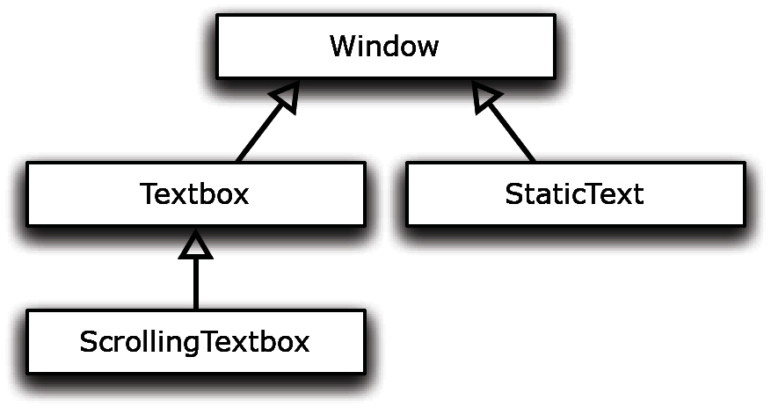
Intuition behind Unity
abstract brand Window (title : str) extends Top
brand Textbox(title : str, pos : int) extends Window
brand StaticText(title : str, text : string
extends Window
brand ScrollingTextbox( title : string, curPos : int,
getScroll(): Scrollbar) extends Textbox

Slide 23
Writing External Methods
abstract brand Window (title : str) extends Top
brand Textbox(title : str, pos : int) extends Window
brand StaticText(title : str, text : string
extends Window
brand ScrollingTextbox( title : string, curPos : int,
getScroll(): Scrollbar) extends Textbox
By default, no scroll bar on Windows.
scroll(w: Window({getScroll():ScrollBar}) =
... // code that performs the scrolling.

Slide 24
Writing External Methods
fixed number of characters
unlimited characters; scrolls if needed
insertChar(b: Textbox({getCurPos():int})): unit =
// insert a character only if it will fit in the window
insertChar(b: ScrollingTextbox({getCurPos():int})):
unit =
// overrides insertChar(Textbox({getCurPos():int}))
// insert the character, scrolling if necessary
getCurPos() is not defined within any brand definitions.

Slide 25
Writing External Methods
fixed number of characters
unlimited characters; scrolls if needed
getCurPos(b: Textbox({pos:int})) : int = ...
Adding the external method
getCurPos(b: Textbox({pos:int})) implies
Textbox({pos:int}) = Textbox({pos:int, getCurPos():int})

Slide 26
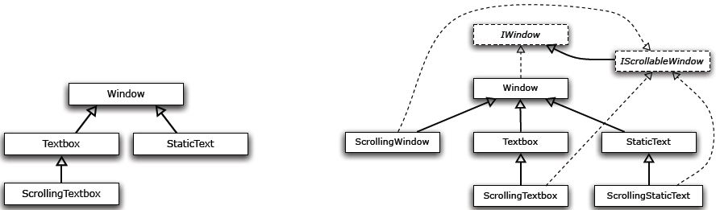
Avoided Proliferation of Types
Unity type hierarchy
required for example
Java type hierarchy
required for example

Slide 27
Case Study: Java Collections API
java.util.Collection has several “optional” methods:
add, addAll, clear, remove, removeAll, and retainAll
These methods in many implementing abstract classes throw UnsupportedOperationException:
e.g., AbstractCollection, AbstractList, AbstractSet
A hack to avoid a proliferation of classes in the collections API.

Slide 28
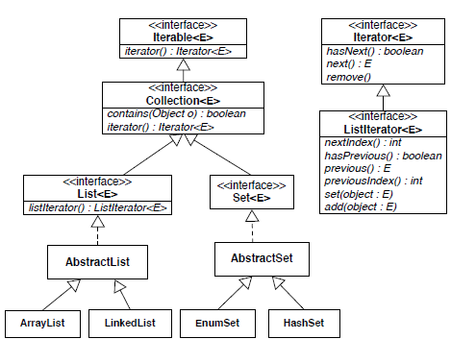
Case Study: Java Collections API

Slide 29
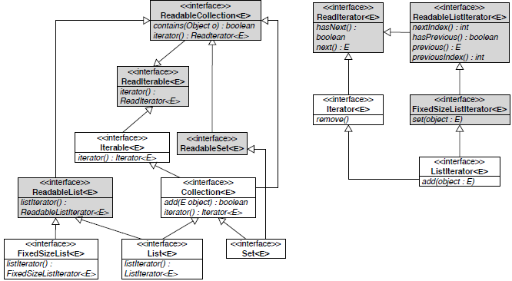
Case Study: Java Collections API

Slide 30
Case Study: Java Collections API
Unity stops proliferation by not needing all interesting combinations in advance.
MutableList ==> List({add(), remove(), ...})
use type abbreviations
Concise type representations:
  Set({mutableOps}), where:
  mutableOps = add(), remove(), ...

Slide 31
Limitations
Lack of analysis on if methods sharing the same name but not interface are usually semantically similar.
If not, structural subtyping does not help can lead to bugs.
  Remember Circle.draw() and Cowboy.draw()

