Slide 1

Mechanism design augmented with output advice
George Christodoulou, Aristotle University of Thessaloniki, Archimedes/RC Athena
Alkmini Sgouritsa, Athens University of Economics and Business, Archimedes/RC Athena
Ioannis Vlachos, Athens University of Economics and Business, Archimedes/RC Athena
ACAC ‘24

Slide 2
Learning Augmented Framework
“Algorithms with predictions” , survey by M Mitzenmacher, S Vassilvitskii 2022
ALPS (algorithms-with-predictions.github.io)
prediction
Worst case analysis
ML prediction
Robustness = worst case guarantee when prediction is arbitrarily wrong
Consistency = worst case guarantee when prediction is perfect
Best of both worlds

Slide 3
Mechanism Design with Predictions
Extra requirement:
Truthfulness
What kind of prediction?
Input?
Scheduling [Balkanski et al, 2022], [Xu, Lu, 22]
Competitive auctions [Lu et al, 2023]
Output?
Facility location [Agrawal et al, 2022]
Generalized Assignment Problem [Colini-Baldeschi et al, 2024]
2-facility location [Xu, Lu, 2022]
Quality of the prediction measure ???
e.g. L1 norm
Prediction to Opt ratio[Colini-Baldeschi et al, 2024]

Slide 4




Our Model
Output Prediction
Quality of recommendation $\hat{ρ}=\frac{cost(\text{recommendation})}{cost(\text{opt})}$
E.g. Facility Location (cost minimization)
recommendation
$$d_{2}$$
$$d_{1}$$
e.g. max objective
$\hat{ρ}=\frac{d_{1}}{d_{2}}$ $≥1$
opt

Slide 5
Our Contribution
We propose a unified model
We apply the model on:
Facility Location
House Allocation
Combinatorial Auctions
Scheduling

Slide 6
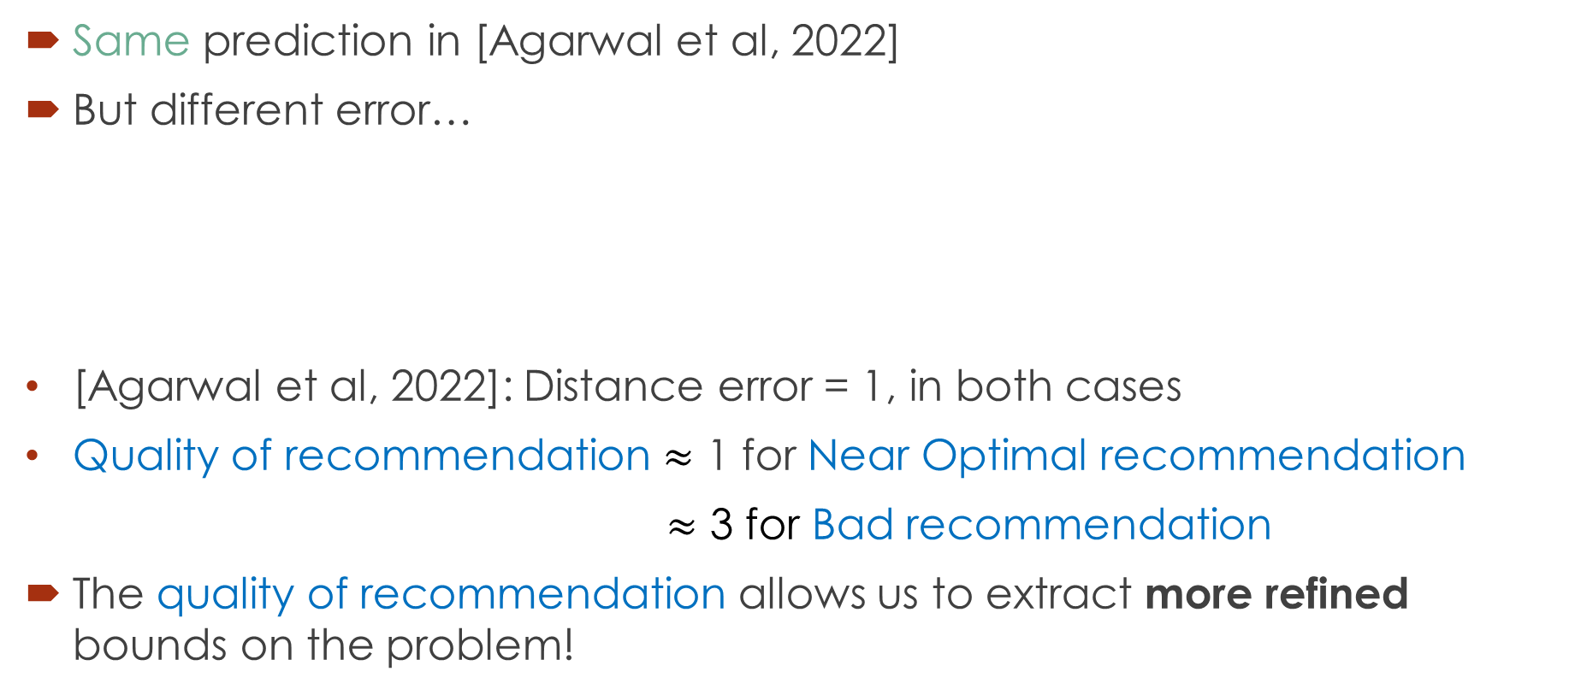
Facility Location
Same prediction in [Agarwal et al, 2022]
But different error…
[Agarwal et al, 2022]: Distance error = 1, in both cases
Quality of recommendation $≈$ 1 for Near Optimal recommendation
$≈$ 3 for Bad recommendation
The quality of recommendation allows us to extract more refined bounds on the problem!
Bad recommendation
opt
Near Optimal recommendation
1
1
M
M-1

Slide 7


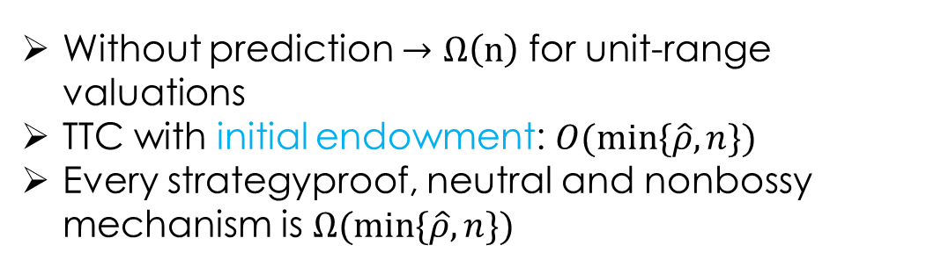


Warm up 1: House Allocation
Maximize Social welfare
Assign $n$ houses to $n$ agents
Recommended matching
$$t_{ij}$$
Without prediction $Ω\left(n\right)$ for unit-range valuations
TTC with initial endowment: $O(min⁡\{\hat{ρ}, n\})$
Every strategyproof, neutral and nonbossy mechanism is $Ω(min⁡\{\hat{ρ}, n\})$

Slide 8


Warm up 2: Combinatorial Auctions
Maximal in range (MIR) mechanism + prediction -> truthful
Plug-and-play
recommendation
e.g. Multi-Unit auctions
Add it to feasible allocations and remain truthful
All possible allocations
$$min⁡(2, \hat{ρ})−approx$$
Mechanism Feasible allocations
Allocate after splitting items into bundles,
$$2−approx$$

Slide 9







Scheduling
N machines, M jobs
Processing times
Goal: minimize Μakespan = max total processing time
 | 5 | 2 | 3 | 10
 | 2 | 20 | 9 | 6
 | 4 | 6 | 6 | 7

Slide 10
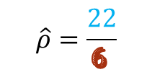
Scheduling
N machines, M jobs
Processing times
Goal: minimize Μakespan = max total processing time
$$\hat{ρ}=\frac{22}{6 }$$
 | 5 | 2 | 3 | 10
 | 2 | 20 | 9 | 6
 | 4 | 6 | 6 | 7
Optimal allocation (MS = 6)
Recommended allocation (MS = 22)

Slide 11

Scheduling
VCG selects minimum processing time per task
Ignores prediction
$n$-consistent, $n$-robust
VCG MS = 8
 | 5 | 2 | 3 | 10
 | 2 | 20 | 9 | 6
 | 4 | 6 | 6 | 7
Optimal allocation (MS = 6)
Recommended allocation (MS = 22)

Slide 12
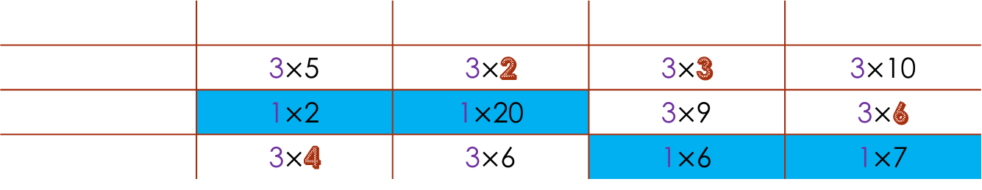

Scheduling
Inspired by [Balkanski et al. 22]
They use input predictions
Simple mechanism: Give priority to recommendation via weights and apply weighted VCG per task (weight = $n$ or 1)
Weighted VCG MS = 13
 | 3$×$5 | 3$×$2 | 3$×$3 | 3$×$10
 | 1$×$2 | 1$×$20 | 3$×$9 | 3$×$6
 | 3$×$4 | 3$×$6 | 1$×$6 | 1$×$7
Optimal allocation (MS = 6)
Recommended allocation (MS = 22)

Slide 13
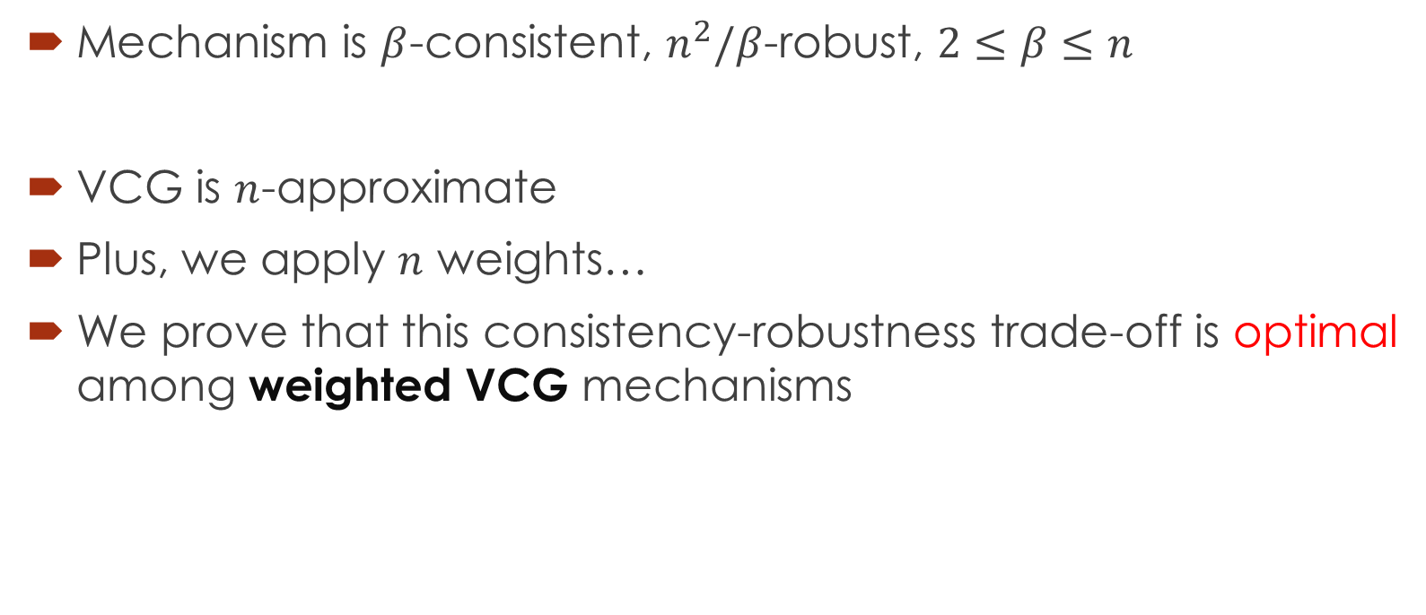
Optimality among weighted-VCG
Mechanism is $β$-consistent, $n^{2}/β$-robust, $2≤β≤n$
VCG is $n$-approximate
Plus, we apply $n$ weights…
We prove that this consistency-robustness trade-off is optimal among weighted VCG mechanisms

Slide 14
Conclusions
Unified model
Quality of recommendation:
wide range of application
avoids overly pessimistic guarantees
Natural + optimal mechanisms
Plug-and-play fashion, e.g. MIR mechanisms

Slide 15
Future Directions
Apply on other mechanism design problems
Prove optimality among all mechanisms in scheduling (not just weighted VCG) and combinatorial auctions
Input – Output prediction trade-off

