Slide 1
High-Dimensional Financial Data
Analysis with Tensor Attention-Based
Neural Networks
I. P. Zioulis
22/06/2026

Slide 2
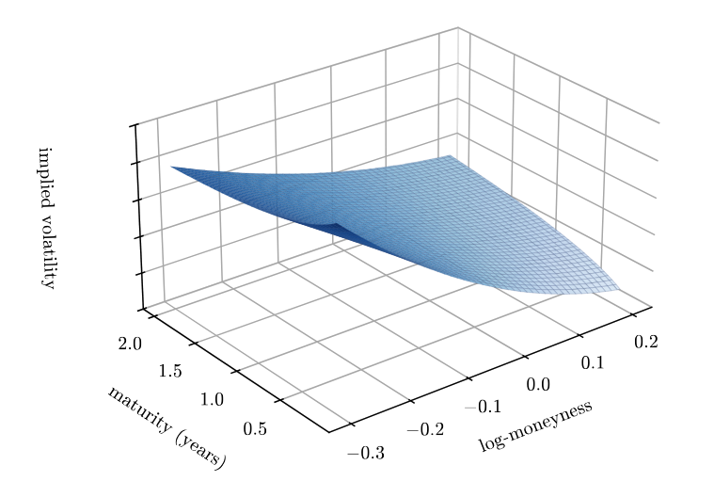
Forecasting the Implied Volatility Surface
Options are insurance against market moves — their price reveal the market’s expected risk.
Collected across strikes (moneyness levels) and maturities, option quotes form the implied volatility surface.
IV surfaces are primarily used for pricing, hedging and risk management; the latter two depend on how the surface moves, rather than where it sits today.
Multi-step forecasting of the full IV surface is unaddressed by the literature reviewed.
Research Question:
Is a model that respects the surface's structure better able to forecast the IV surface, multiple steps ahead, from its own history?
Notes:
Options are insurance against market moves — their price, on a common scale, is implied volatility.
Across strikes and maturities = IV surface — a daily snapshot of expected risk.
Options desks price, hedge, manage risk — and hedging and risk depend on how it moves, not today's.
Forecasting the full surface ahead is the open gap.
(RQ) Is a model that respects the surface's structure better able to forecast it, multiple steps ahead, from its own history?

Slide 3
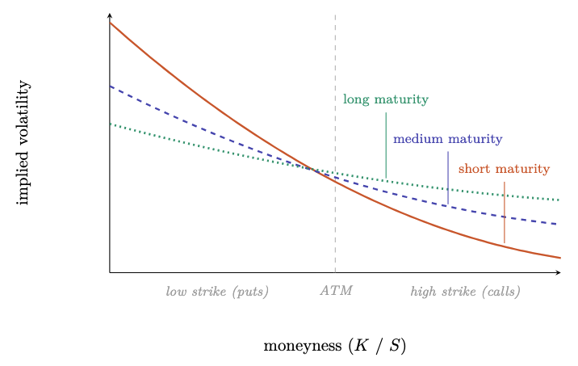
IV Surface Structure
Static structure:
Equity indices fall faster and harder than they rise → low-strike options (downside protection) are pricier → the skew.
Longer-dated options usually imply higher vol → the term structure typically slopes up (and can invert under stress).
Dynamic structure:
Short-term: highly persistent — tomorrow ≈ today.
Most daily evolution is a shared level shift (>90% of the variance).
Longer-term: both level and shape mean-revert.
Notes:
Indices fall faster than they rise → downside insurance (low strikes) costs more → the skew.
Longer-dated usually implies higher vol → term structure slopes up (can invert under stress).
Short-term: highly persistent, tomorrow ≈ today.
Most daily movement = one shared level shift (>90% of variance).
Longer-term: level and shape mean-revert.
Hand-off: surface is structured → does respecting that structure help forecast it?

Slide 4
Building the Dataset
The market gives a daily scatter of option quotes — irregular strikes & maturities, changing day to day.
Data
SPX index options (via OptionMetrics),
~ 20 years (2004–2023),
~ 37M quotes
Filtering
drop unreliable and illiquid quotes (low vega, zero volume)
Keeping the OTM side
puts below the forward, calls above — only time value, measured more precisely
Smoothing:
Vega-weighted Nadaraya-Watson
Resulting surface:
Notes:
Data
Filter: drop low-vega and zero-volume quotes.
Vega (1 of greeks) = price's sensitivity to vol = how reliable its implied vol is; low vega → tiny price error becomes huge vol error. (Dc/dsigma)
Zero volume → not traded.
OTM side: keep puts below the forward, calls above — pure time value, more liquid, tighter spreads. Put-call parity → the dropped ITM side has the same IV, so no loss.
Smoother: scattered quotes → regular grid. Nadaraya–Watson:
at each grid point, a weighted average of nearby quotes — closer counts more (Gaussian kernel)
weight by vega too, so trustworthy quotes count more.

Slide 5
Representative constructed surfaces

Slide 6
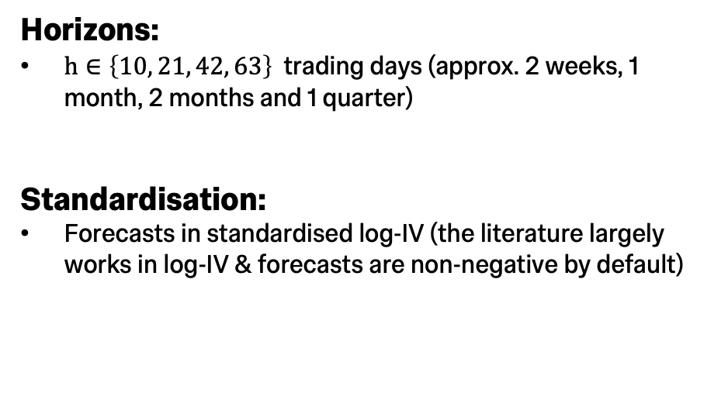
The Forecasting Task
Task:
Forecasting the full surface (all 110 cells)
A multi-step path, all steps from base date to horizon.
Data split:
Chronological 70/10/20 split, with stress episodes present in each set
Horizons:
$h∈\left\{10, 21, 42, 63\right\}$ trading days (approx. 2 weeks, 1 month, 2 months and 1 quarter)
Standardisation:
Forecasts in standardised log-IV (the literature largely works in log-IV & forecasts are non-negative by default)
Notes:
Full path all 110 cells
70/10/20 split, stress in all sets (2008, covid)
2 weeks, month, 2 months, 1 quarter
Train-set per-cell standardization plus log-iv

Slide 7
Classical Benchmarks
Persistence
All horizon forecasts are the last seen surface:
Persistence is the optimal forecast under the assumption that the surface is a martingale.
IV surfaces are characterised as persistent and near-martingale in short horizons.
Polynomial-Coefficient VAR
OLS fits the 5-dimensional polynomial on every day in the training set:
A vector autoregression is fitted on the training set – lag 2 (BIC).
In the test set, path forecasts are rolled out step-by-step.
Notes:
Persistence = predict no change,
optimal forecast under assumpt. that surface is a martingale
VAR – from a classical paper on the predictability of iv surfaces
fits 5-coeff polynomial on every training day via ols
VAR (BIC selects lag=2)
forecasts are rolled out

Slide 8
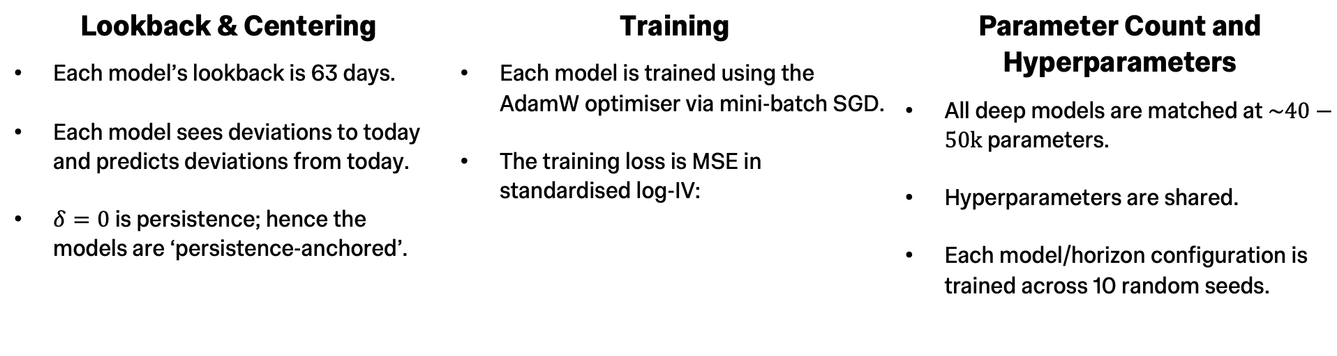
Model Implementation: the Shared Pipeline
Lookback & Centering
Each model’s lookback is 63 days.
Each model sees deviations to today and predicts deviations from today.
$δ=0$ is persistence; hence the models are ‘persistence-anchored’.
Training
Each model is trained using the AdamW optimiser via mini-batch SGD.
The training loss is MSE in standardised log-IV:
Parameter Count and Hyperparameters
All deep models are matched at $\sim 40−50k$ parameters.
Hyperparameters are shared.
Each model/horizon configuration is trained across 10 random seeds.
Notes:
Fixed lookback 63 days
models see deviations to today and forecast deviations from today. (delta = 0 is persistence)
AdamW – mini-batch SGD, minimizing MSE.
Matched at 40-50k params
no tuning per model/horizon
10 random seeds

Slide 9
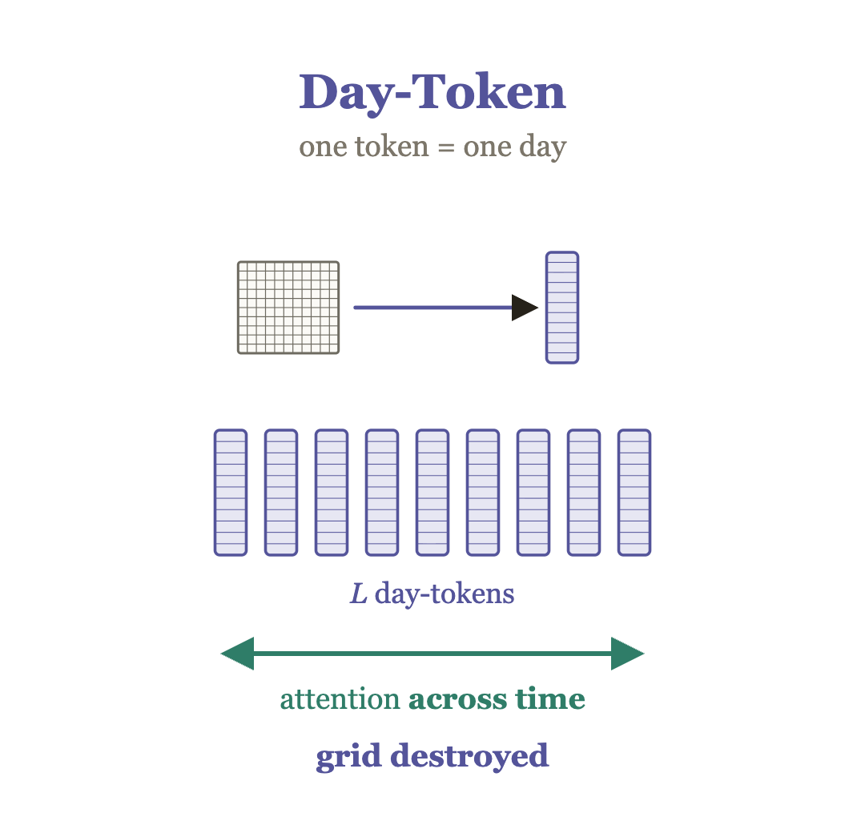
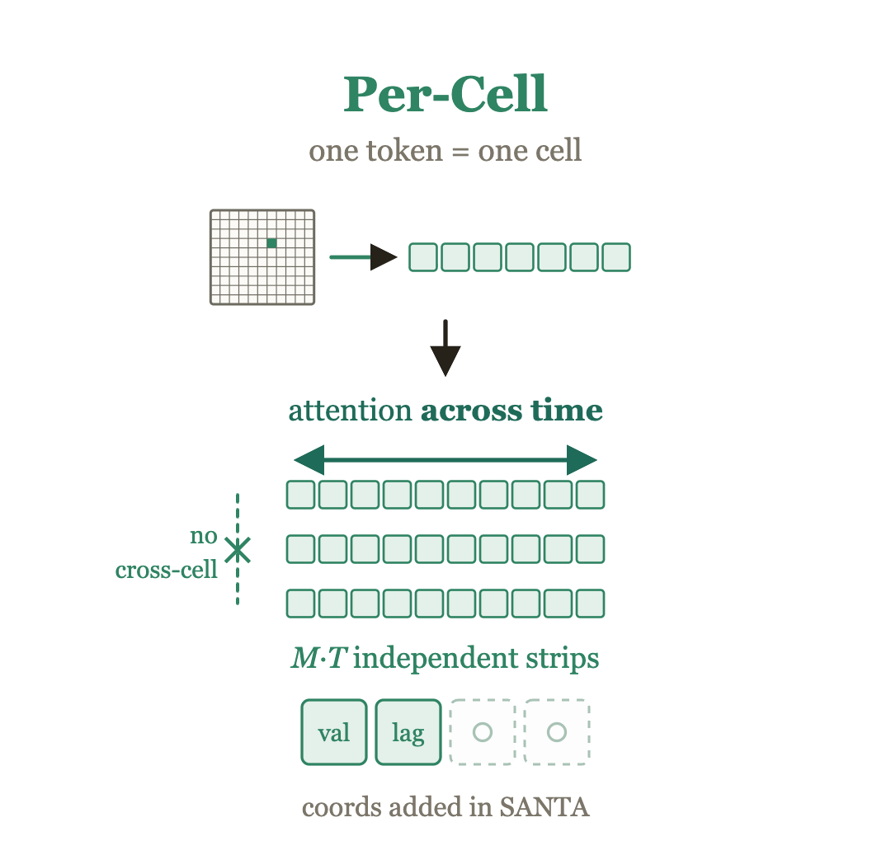
Linear Floor and Plain Transformers
NLinear:
A single linear layer connecting deviations to today and deviations from today. (Identical response in all regimes.)
Each day’s surface flattened to a single token.
Each cell of every day is its own token.
Notes:
Nlinear – from a famous paper where linear models outperform sota transformers – identical response to all regimes.
Day-token, surfaces in lookback flattened. (vanilla)
Per-cell, each cell is a token. Attends across a time series of tokens per cell. Each cell contributes, but weights shared.
Each token only has value and lag

Slide 10
Surface-aware Embeddings
What’s added?
Each cell’s moneyness and maturity positions, learned as coordinate embeddings, are summed into its token.
What does this offer?
The models now know from where on the surface each token comes from, on top of knowing from which lag position.
The surface-aware embeddings remain identical for all SANTA variants.
Notes:
Moneyness and maturity positions learned embeddings
Models able to learn to tell apart tokens coming from different cells in the surface

Slide 11
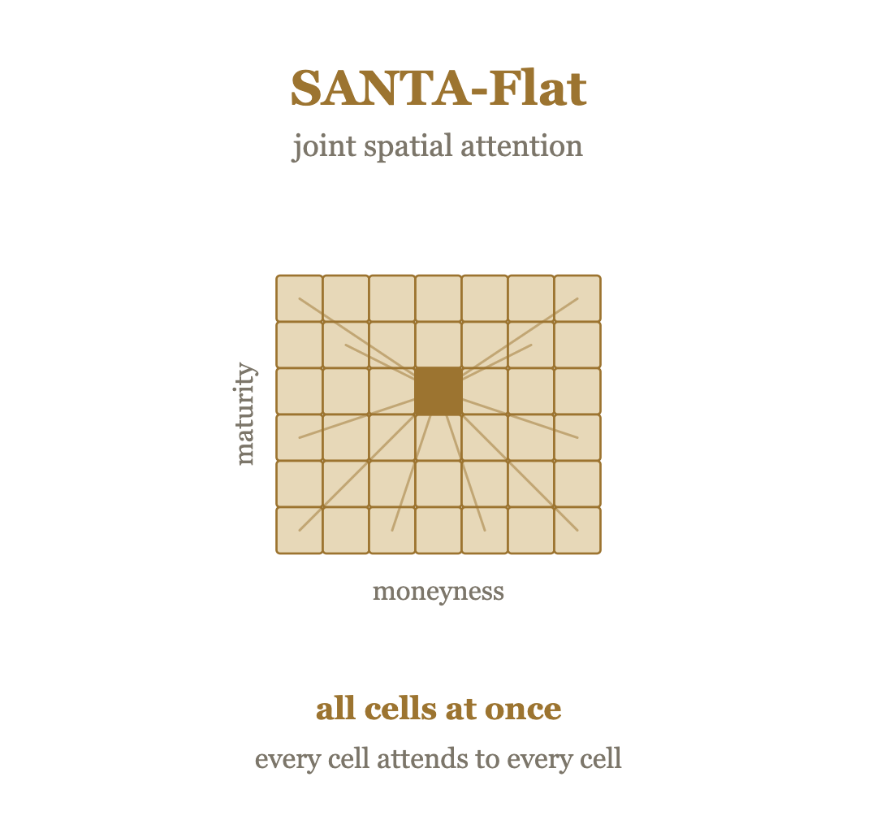
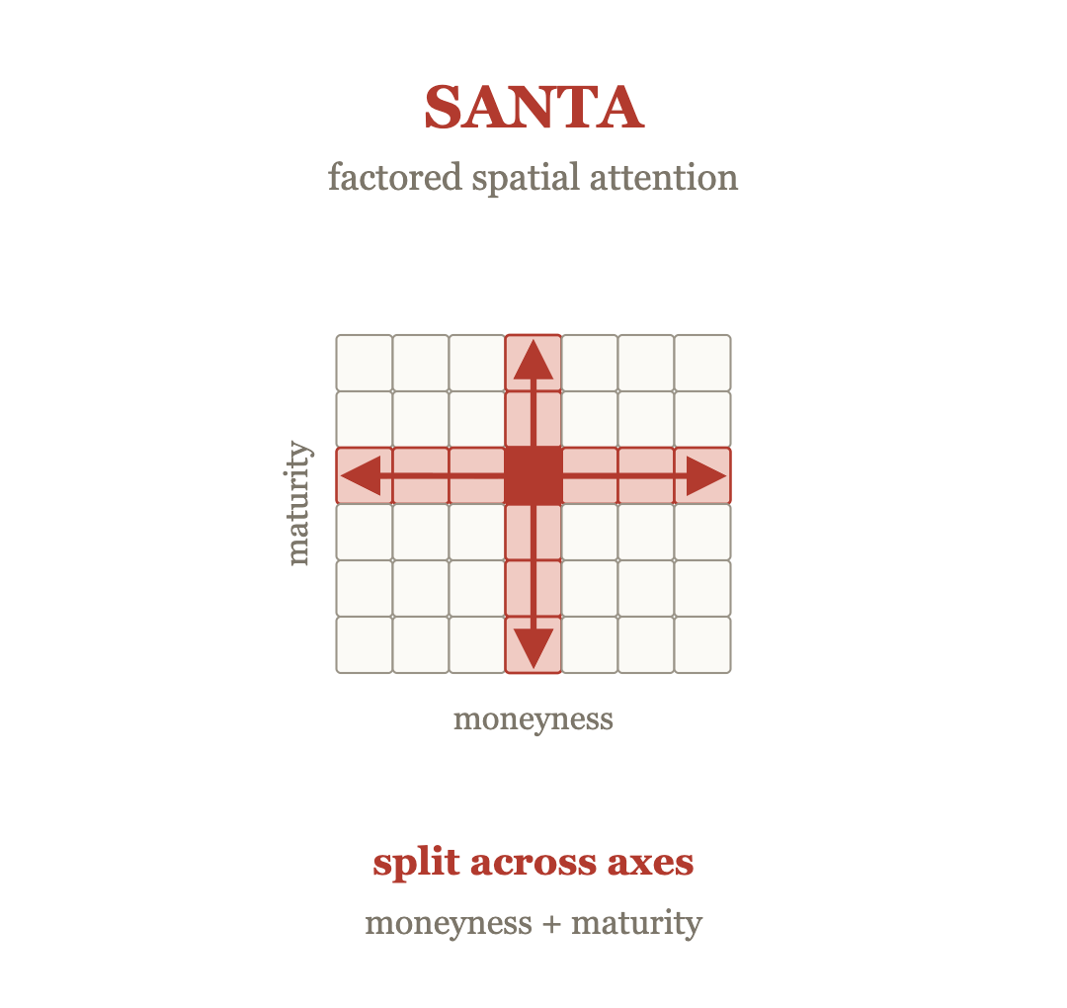
Surface-aware Neural Tensor-attention (SANTA) Variants
SANTA-Temporal:
Identical to the Per-Cell transformer in everything apart from the learned coordinate embeddings.
Unconstrained spatial attention, followed by temporal attention.
Attention across moneyness, then across maturity and finally across time.
Notes:
SANTA-T identical to Per-cell apart from learned coord embeddings.
SANTA-F applies spatial attention (as if it flattens the surfaces in lookback), able to mix information from any cell to any other cell.
SANTA constrains the spatial mixing of information to acting along the axes – moneyness then maturity then time.

Slide 12
Evaluation Metrics
Point-wise Error
MSE:
The error metric the models were trained to minimise.
MAE:
Surface cells are highly correlated — daily changes are mostly a shared level shift.
MSE / MAE mostly score the level: a level miss lands on every cell, so it dominates the summed error.
Cross-sectional Correlation
Cross-sectional Rank IC:
Forecasted and realised change vs today, per cell:
Ranking changes of 110 cells, and correlating:
IC is invariant to a level shift, scoring only the shape: whether a model predicts which cells move most, relative to the rest of the surface.
All reported metrics are calculated in the standardised log-IV space in which the models were trained.
Notes:
MSE/MAE (point-wise): summed over 110 correlated cells → dominated by the level.
A level error lands identically on all 110 cells, so it adds up and dominates the sum;
a shape error is spread across cells as smaller, varying pieces, so it contributes far less. So MSE/MAE mostly score the level.
Cross sectional rank IC
ranks forecasted and realised changes of each cell
takes the spearman correlation of the ranks
is invariant to a level shift, evaluates whether a model is able to predict which cells rise/fall most relative to the rest.
Results in standardised log-iv in which models were trained.

Slide 13
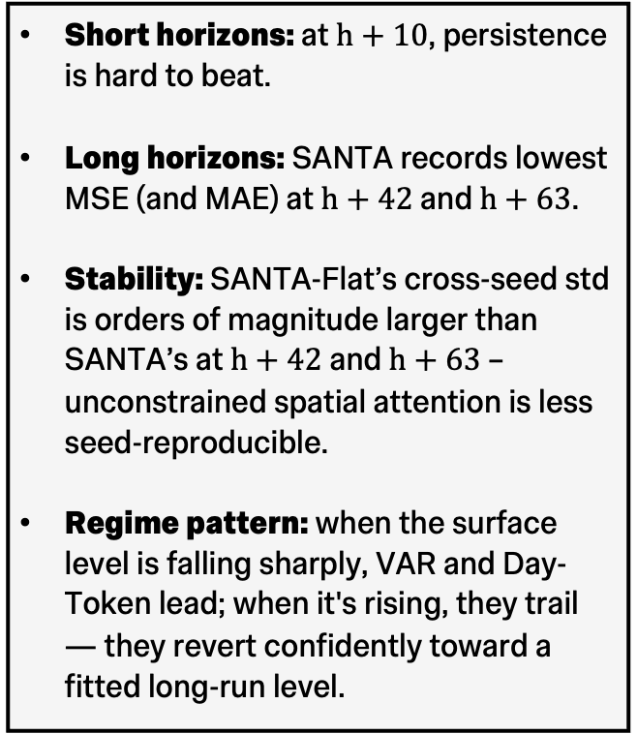
MSE Post-crisis Results
Short horizons: at $h+10$, persistence is hard to beat.
Long horizons: SANTA records lowest MSE (and MAE) at $h+42$ and $h+63$.
Stability: SANTA-Flat’s cross-seed std is orders of magnitude larger than SANTA’s at $h+42$ and $h+63$ – unconstrained spatial attention is less seed-reproducible.
Regime pattern: when the surface level is falling sharply, VAR and Day-Token lead; when it's rising, they trail — they revert confidently toward a fitted long-run level.
Notes:
Only showing post-crisis mse. mae yields similar model rankings, and crisis period results are in the report.
Bottom panel
persistence hard to beat at h+10,
santa records lowest mse at the 2 longest horizon configs
santa-flat has cross-seed std orders of magnitude larger than santa at h+42 and h+63.
Top panel, comparing the error timeseries with the upcoming overlaid level,
when the models have to predict a sharply falling level, var and day-token lead the group, and fall behind when level is rising or sustained high.

Slide 14
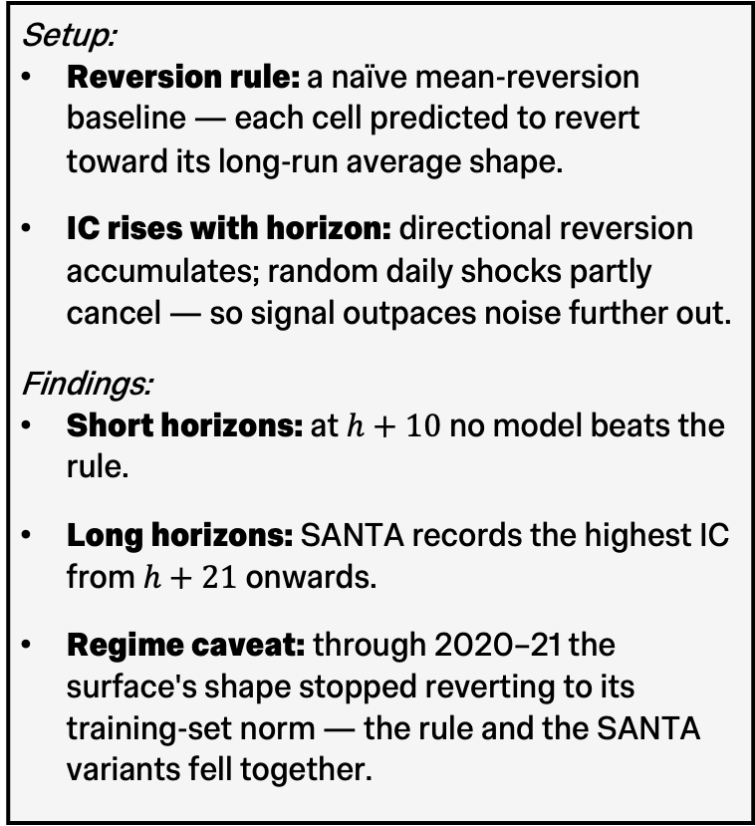
Cross-sectional Rank IC Results
Setup:
Reversion rule: a naïve mean-reversion baseline — each cell predicted to revert toward its long-run average shape.
IC rises with horizon: directional reversion accumulates; random daily shocks partly cancel — so signal outpaces noise further out.
Findings:
Short horizons: at $h+10$no model beats the rule.
Long horizons: SANTA records the highest IC from $h+21$onwards.
Regime caveat: through 2020–21 the surface's shape stopped reverting to its training-set norm — the rule and the SANTA variants fell together.
Notes:
The rule is parameter-free and has no horizon argument — one fixed prediction, scored at every horizon.
So its IC rising with horizon, comes from the target.
The reversion signal is directional, accumulating with horizon, whereas daily idiosyncratic shape-shocks are mixed sign and accumulate slower.
The mean reversion rule is not a forecaster to test against, merely a tool to make sense of results.
Mean reversion beats all models at h+10 (better picking up the signal than the trained models)
SANTA leads from h+21 onwards.
August 2020 to august 2021, the mean reversion rule falls – the surface assumed a shape different to the long-run shape and didn’t revert back.
SANTA variant which usually lead fall with it. SANTA tracks the same reversion pattern, when it failed, SANTAs fell with it.
Caveat: no model was trained to optimise this metric, it’s a by-product of wat each representation encodes. SA embeddings let SANTA variants represent where each cell sits, so it picks up the cross-cell shape pattern better.
Day-token which flattens every day’s surface is the only model whose ic doesn’t rise.

Slide 15
Conclusions
Research Question:
Is a model that respects the surface's structure better able to forecast the IV surface, multiple steps ahead, from its own history?
Yes – but selectively.
SANTA is best on every metric at the two longest horizons — uniquely strong on both level and shape.
The ladder isolates which structure earned its place:
Anchoring on persistence — the persistent behaviour is built in; every model beats persistence from the first step.
Coordinate embeddings — carry most of the cross-sectional shape skill, separating the SANTA variants from the field; spatial
attention adds little more.
Axial attention — SANTA-Flat's joint attention isn't seed-reproducible; factoring along the two axes restores stability — the
better-matched prior
Notes:
Back to RQ, the entire ladder of models helps answer the question.
Answer is yes, SANTA leads in all 3 metrics at the 2 longest horizons, but respecting the structure has many definitions.
Anchoring on persistence lets every anchored model outperform persistence from the first day on average, whereas VAR only catches up to persistence by day 11.
Coord embeddings help the SANTA variants differentiate from the field in IC, with spatial attention adding little more.
Axial spatial attention of SANTA is the better matched prior due to the much poorer reproducibility of SANTA-Flat (it has to learn to mix information across the axes from scratch)

Slide 16
Limitations and Future Work
Limitations
One index, one 4-year window — the findings hold in this period, not a general rule.
No hyperparameter tuning — results are a floor; the ladder's ordering is unproven under a search.
No economic evaluation — the edge is small, and untested against transaction costs.
Future Work
Conditioning on external drivers — forecasts conditioned on exogenous variables (e.g., index returns) could lift performance beyond the history-only setting employed here.
Broadening the test — repeating the study on other underlyings (other equity indices, single-name equities, FX) would test whether the rankings generalise.
Notes:
Limitations:
1 underlying, 1 4-yr test period. No proof of whether the performance and model rankings hold for different underlyings (other equity indexes, single stocks or FX)
No tuning. Lower bound on absolute performance, but no guarantee that model rankings will remain under thorough hyperparameter search.
No economic evaluation – no proof of whether performance gains survive transaction costs.
Future work:
addressing the limitations.
1 genuine next direction which was dictated by the scope was the lack of forecasts conditioned on exogenous parameters. This study serves as a lower bound in this sense too.

Slide 17
Thank you
High-Dimensional Financial Data Analysis with Tensor Attention-Based Neural Networks
22/06/2026

Slide 18
Appendix A: Sample Forecasts

Slide 19
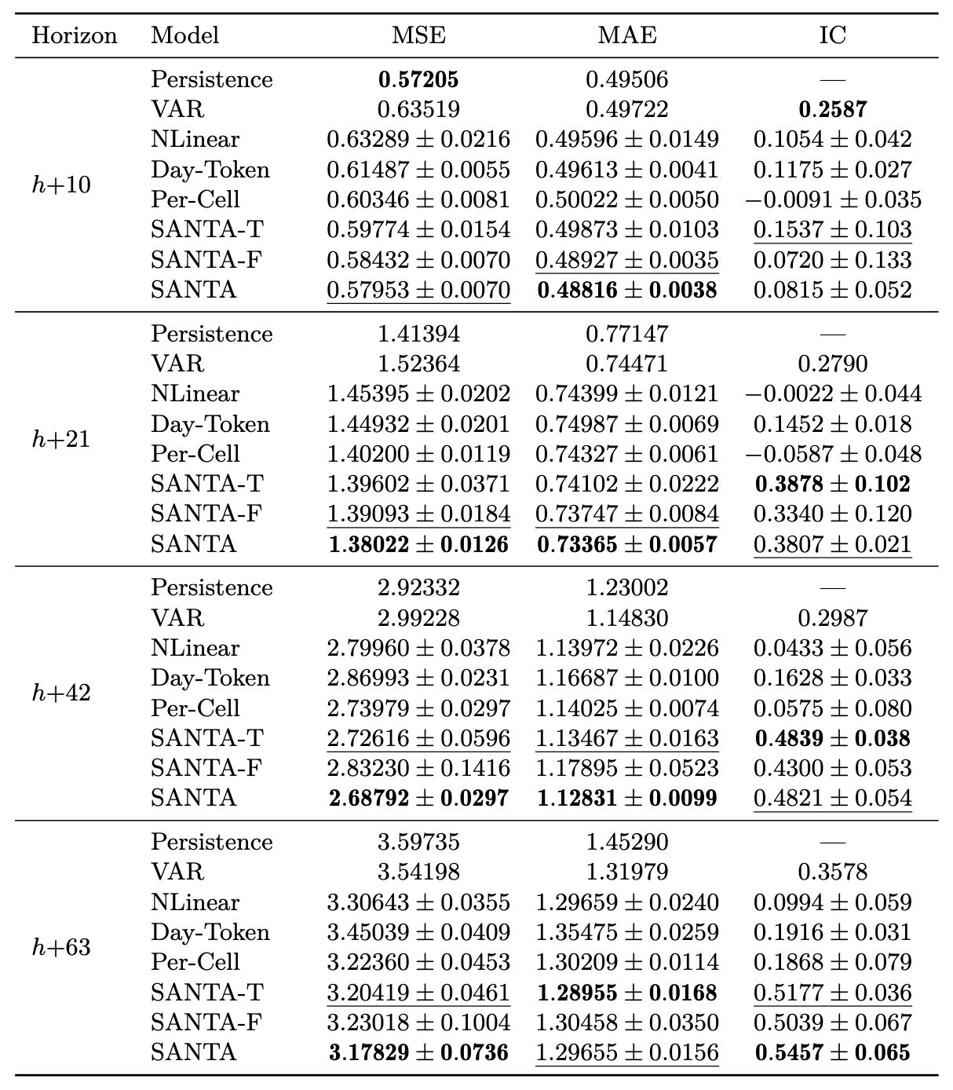
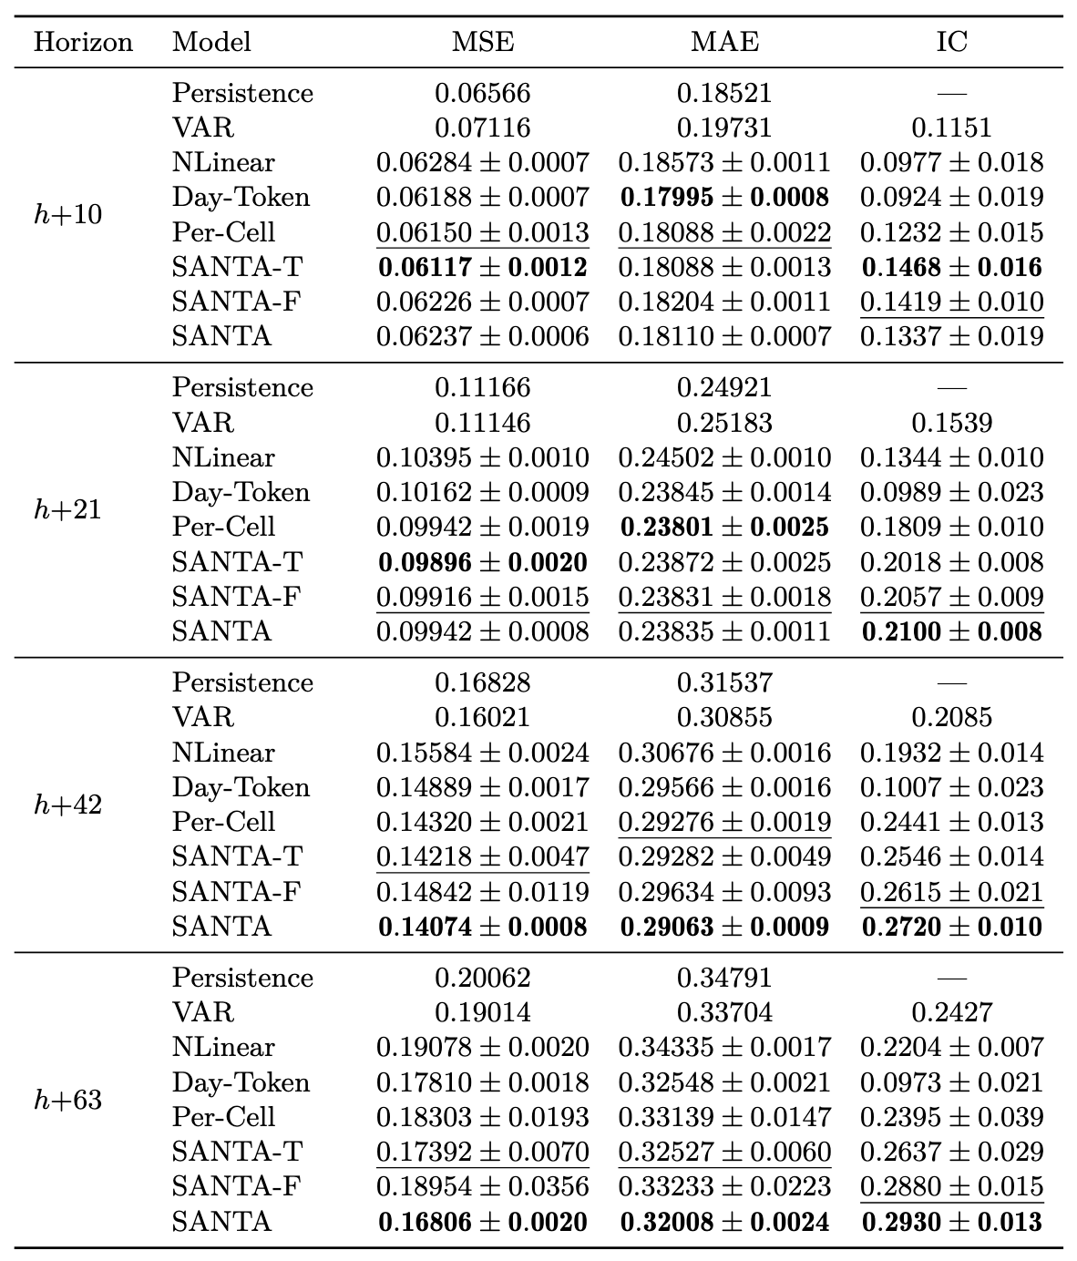
Appendix B: In-depth Results Tables
COVID Crisis Period
Post-crisis Period

