Slide 1
Journey of a Public Deed
Electronic
Draft
Scan for client
Entry into Registry
Signature
Register
Third parties
Client

Slide 2
Journey of a Public Deed
Electronic
Draft
Signature
Register
Entry into Registry
Machine-readable and human-readable document
Deed needs to be archivable (50yrs +)
Signature on file
Notes:
.xml: plain text (human readable), fields can be inserted (formalizad and semi-formalized), standards (no lock-in with a specific software)

Slide 3
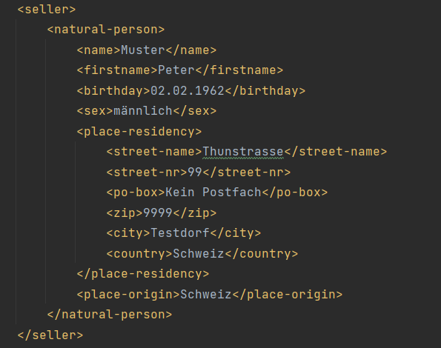

Slide 4
Journey of a Public Deed
Electronic
Draft
Signature
Register
Entry into Registry
Form
Machine-readable and human-readable document
Deed needs to be archivable (50yrs +)
Signature on file
Notes:
.xml: plain text (human readable), fields can be inserted (formalizad and semi-formalized), standards (no lock-in with a specific software)

Slide 5
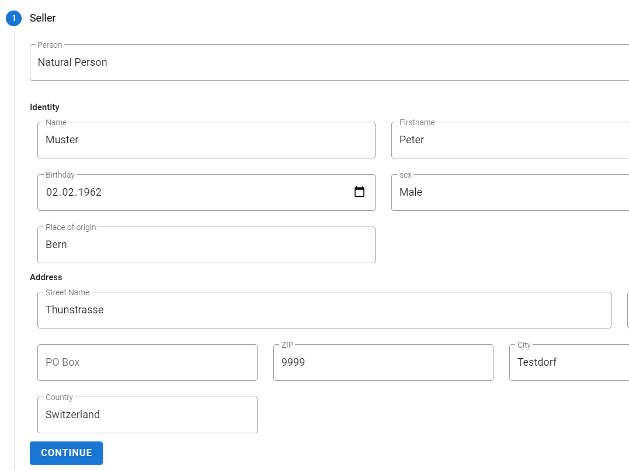

Slide 6
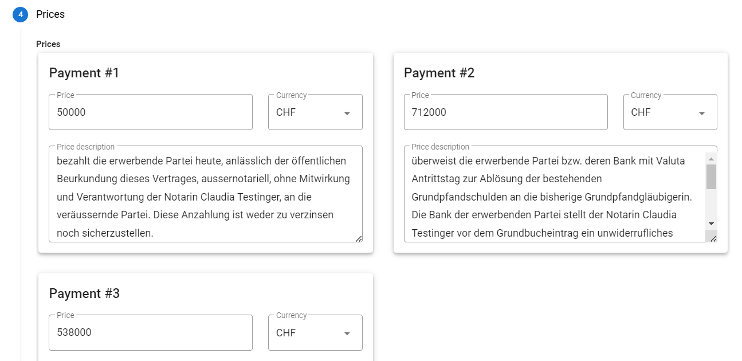

Slide 7
Journey of a Public Deed
Electronic
Draft
Signature
Register
Entry into Registry
Form
Client
Visualisation
Third parties
Machine-readable and human-readable document
Deed needs to be archivable (50yrs +)
Signature on file
Notes:
.xml: plain text (human readable), fields can be inserted (formalizad and semi-formalized), standards (no lock-in with a specific software)

Slide 8
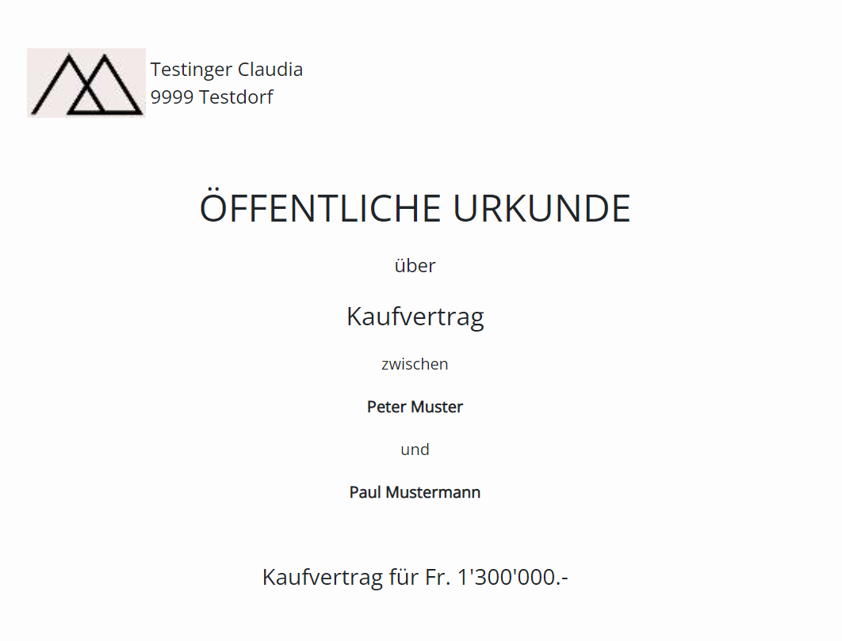

Slide 9
Journey of a Public Deed
Electronic
Draft
Signature
Register
Entry into Registry
Form
Client
Visualisation
Third parties
Machine-readable and human-readable document
Deed needs to be archivable (50yrs +)
Signature on file
Notes:
.xml: plain text (human readable), fields can be inserted (formalizad and semi-formalized), standards (no lock-in with a specific software)

