Slide 1
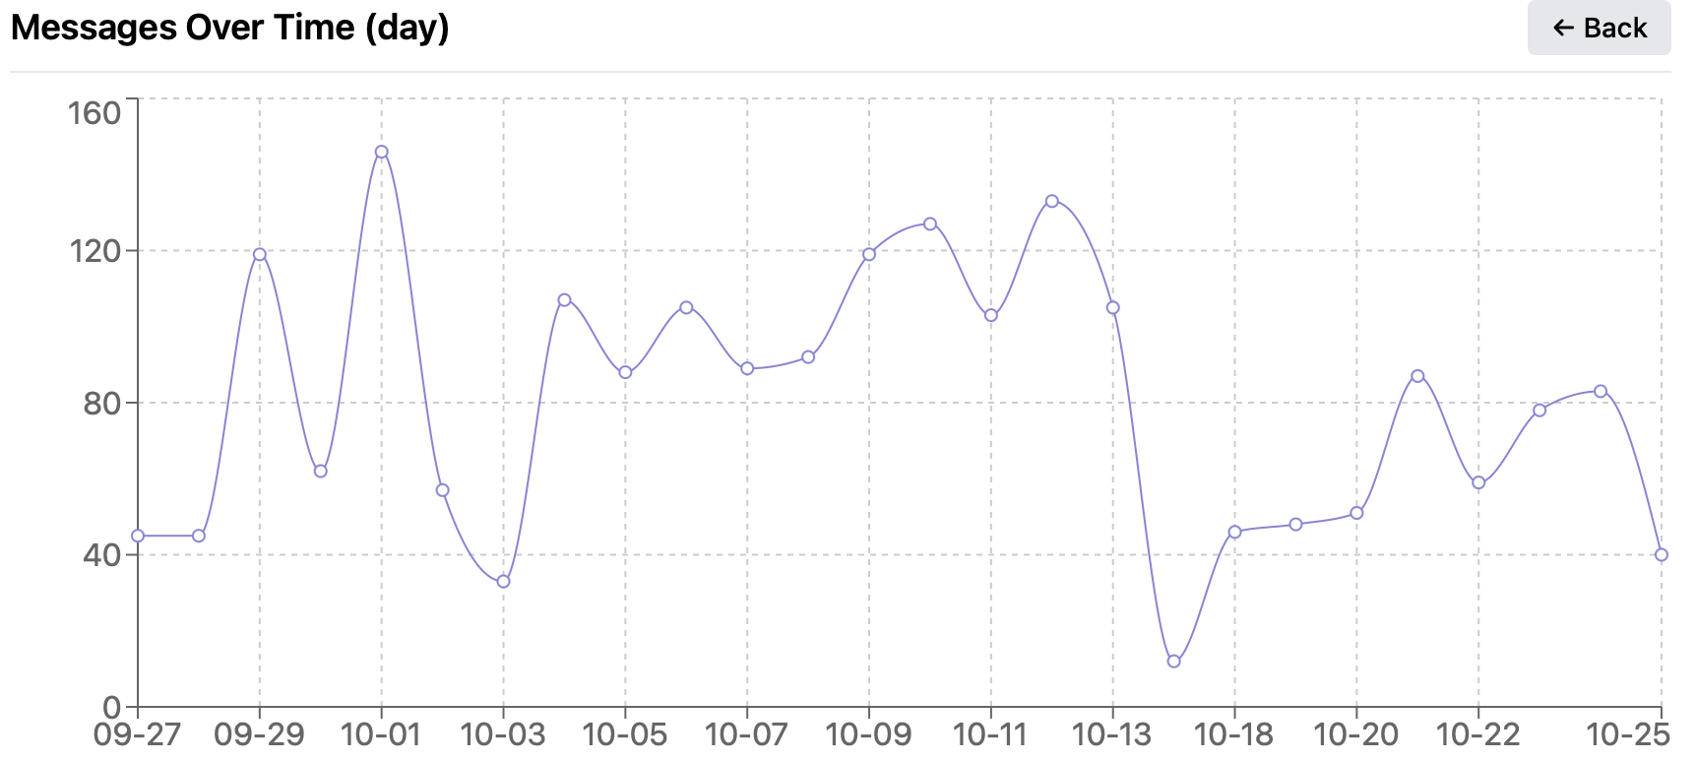
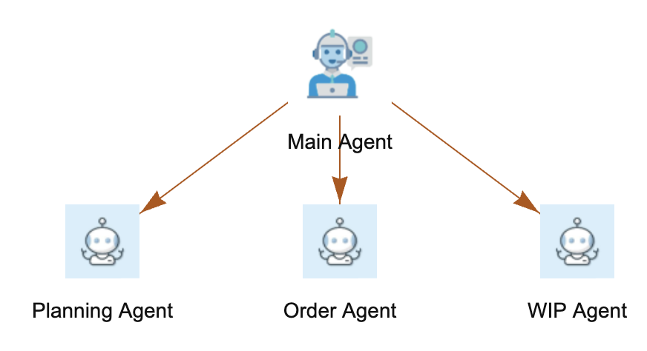
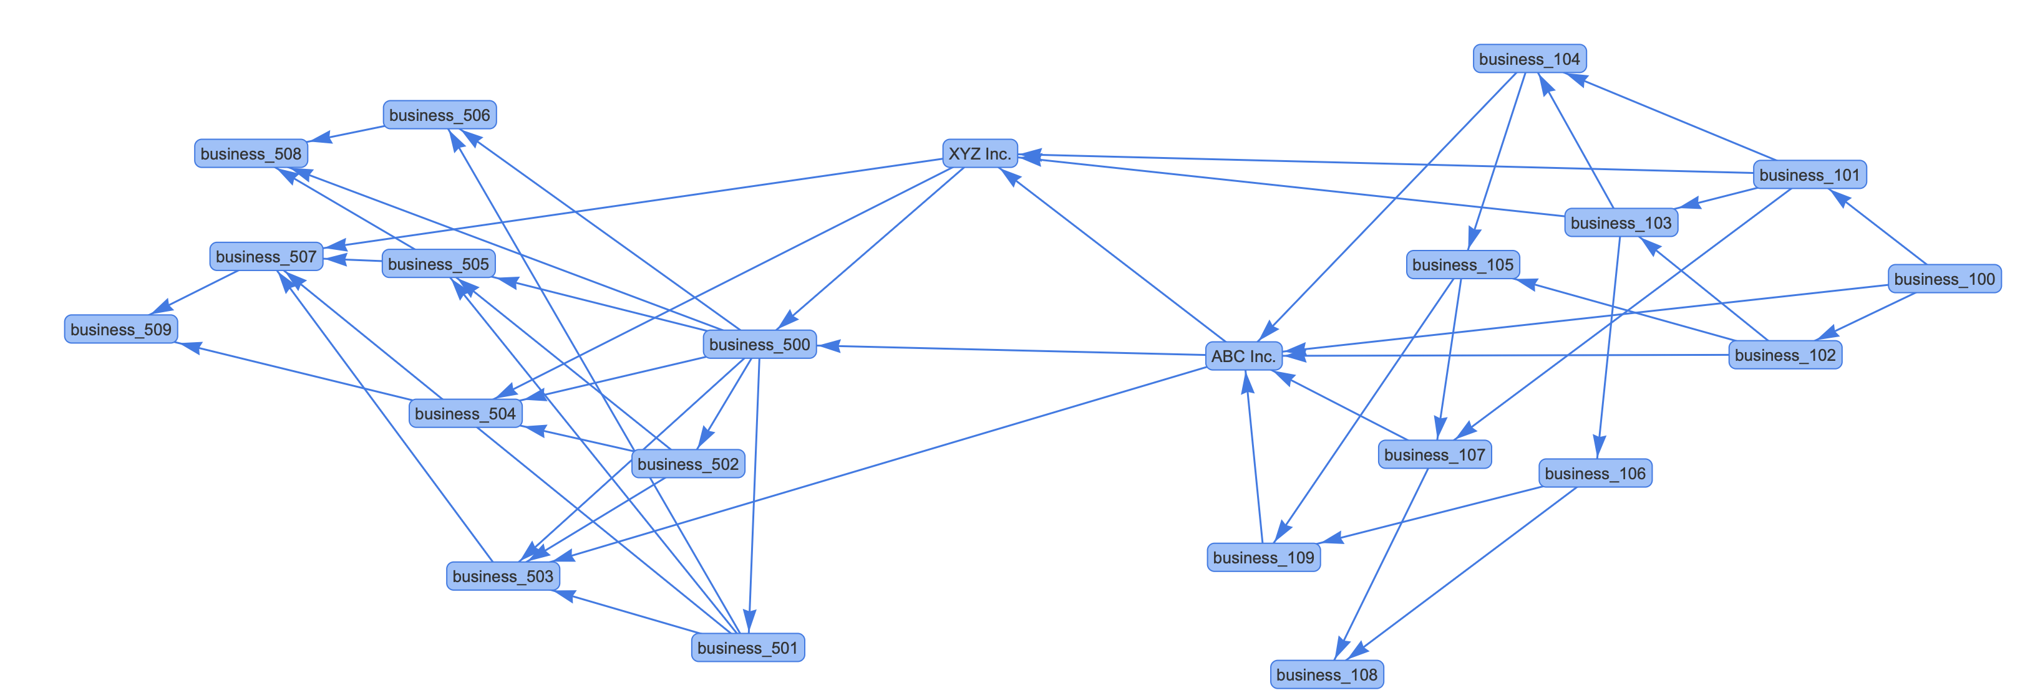



Global Events:
gov. bulletin
weather
social media
SCIN Architecture
Cloud-Deployed SCIN
AI Agents
Tooling
Audit
Master/Sub
Pattern Recognition
local
local
MCP client
Causality LLM (e.g., tariff vs demand, port closed vs delivery delay)
MCP client
{Source: Tariff, Product: TR-S900, Impact: demand slashed 50%}
{Source: Typhon, Location: Shanghai, Impact : raw supply delayed 10 days}
{Source: Supplier, Product: UV-K100, Location: TW, Impact : delivery delayed 20 days}
Global
Network
Global inbound
Channels
Global outbound
Business Inbound
Business Outbound
Legacy Adaptors
email
MCP-Wrapped Supply Chain Engine
MCP-Wrapped Legacy System
Local Events:
shopfloor
support
Business XYZ

Slide 2

物料智能体
订单智能体
排程智能体
物料更新
If Impact HIGH
If Impact HIGH

