Slide 1

Fusion du visible et de l’invisible
Yann Ducruy
Rémi Segretain
M2GI - M2M - 2019
Notes:
Hello

Slide 2

Matériels utilisés
Raspberry pi 3B
Caméra de raspberry pi V1.3
Capteur thermique : SparkFun Grid-EYE Infrared Array Breakout
Notes:
Bachelor in science, master in science
4 internships but none with a real company culture !
Ares : got me the hang of doing research work
Link to next : I wanted to find a internship with a company that have a good work culture, and learn new techs

Slide 3
Utilisation du capteur thermique
Difficultés à trouver les librairies nécessaire
Transformation d’une librairie Arduino en librairie Raspberry (via utilisation de WiringPi) pour le capteur thermique
Notes:
Bachelor in science, master in science
4 internships but none with a real company culture !
Ares : got me the hang of doing research work
Link to next : I wanted to find a internship with a company that have a good work culture, and learn new techs

Slide 4
Algorithme de fusion
On prend une photo en niveaux de gris de 256*256 pixels (via raspistill) et on lit le fichier généré.
Notes:
Bachelor in science, master in science
4 internships but none with a real company culture !
Ares : got me the hang of doing research work
Link to next : I wanted to find a internship with a company that have a good work culture, and learn new techs

Slide 5
Algorithme de fusion
On récupère une image de température de 8*8 pixels
21.75 22.25 23.00 21.00 19.25 18.50 18.00 18.25
24.00 24.00 23.50 20.75 14.25 13.50 16.25 19.00
25.50 24.50 23.00 20.50 15.25 10.25 14.75 20.00
23.00 23.00 22.75 20.50 23.75 24.25 21.25 21.00
22.25 22.75 22.75 21.50 32.25 43.75 25.50 21.00
24.00 25.50 24.75 24.50 23.00 24.50 23.00 21.25
24.00 26.25 25.00 24.25 21.25 21.75 21.75 21.25
21.50 26.00 25.00 22.75 20.00 20.75 20.50 20.25
Notes:
Bachelor in science, master in science
4 internships but none with a real company culture !
Ares : got me the hang of doing research work
Link to next : I wanted to find a internship with a company that have a good work culture, and learn new techs

Slide 6

Algorithme de fusion
Pour chaque pixel de température on associe une valeurs de rouge
L’image visible est découpé en bloc 64 blocs de 32*32 pixels, chaque pixel d’un bloc se voit attribuer en niveau de rouge la valeur calculée par rapport à la température.
Notes:
Bachelor in science, master in science
4 internships but none with a real company culture !
Ares : got me the hang of doing research work
Link to next : I wanted to find a internship with a company that have a good work culture, and learn new techs

Slide 7
Algorithme de fusion
Écriture de l’image dans un nouveau fichier.
Récupérable via SFTP.
Lecture et écriture des images via les librairies stb : https://github.com/nothings/stb
Notes:
Bachelor in science, master in science
4 internships but none with a real company culture !
Ares : got me the hang of doing research work
Link to next : I wanted to find a internship with a company that have a good work culture, and learn new techs

Slide 8
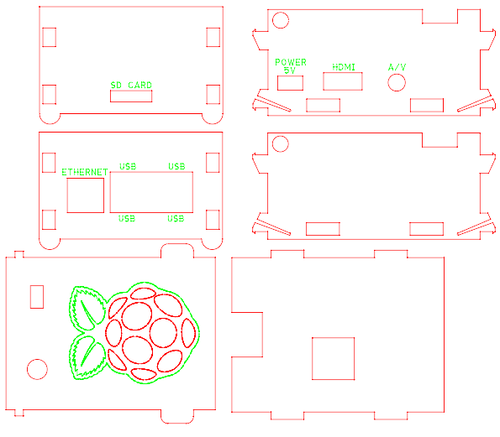
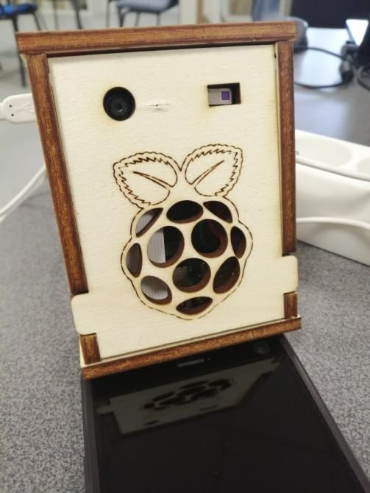
Le boîtier

Slide 9
Images résultat

Slide 10
Conclusion
Amélioration : convolution de l’information de température pour éviter l’effet pixel

