Slide 1

2017
EventBus 分享
王沛焮

Slide 2

Event Bus
EventBus is an open-source library for Android using the publisher/subscriber pattern for loose coupling. EventBus enables central communication to decoupled classes with just a few lines of code – simplifying the code, removing dependencies, and speeding up app development.
02/18

Slide 3
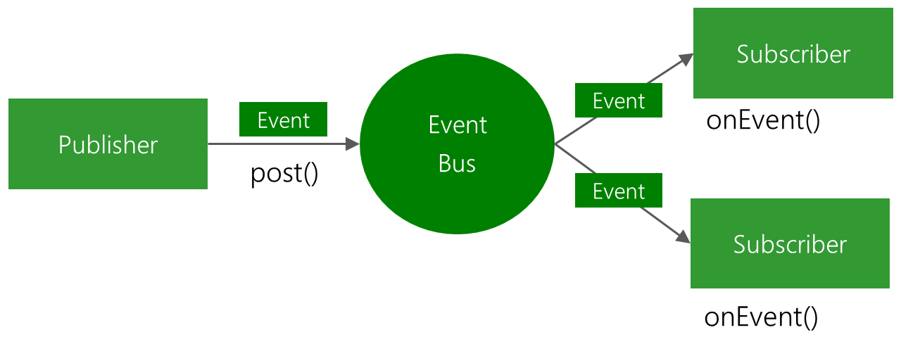
03/18

Slide 4
Event Bus 使用
项目引用
Gradle:
compile 'org.greenrobot:eventbus:3.0.0'
Maven:
<dependency>
<groupId>org.greenrobot</groupId>
<artifactId>eventbus</artifactId>
<version>3.0.0</version>
</dependency>
JAR DownLoad
04/18

Slide 5
Event Bus 使用
Step 1： Define events
public class MessageEvent {
public final String message;
public MessageEvent(String message) {
this.message = message;
}
}
/* Events are POJO (plain old Java object) without any specific requirements. */
05/18

Slide 6
Event Bus 使用
Step 2： Prepare subscribers
i. Subscribers implement event handling methods
// This method will be called when a MessageEvent is posted (in the UI thread for Toast)
@Subscribe(threadMode = ThreadMode.MAIN)
public void onMessageEvent(MessageEvent event) {
Toast.makeText(getActivity(), event.message, Toast.LENGTH_SHORT).show();
}
ii. Subscribers also need to register themselves to and unregister from the bus.
EventBus.getDefault().register(this);
EventBus.getDefault().unregister(this);
06/18

Slide 7
Event Bus 使用
Step 3： Post events
Post an event from any part of your code. All currently registered subscribers matching the event type will receive it
EventBus.getDefault().post(new MessageEvent("Hello everyone!"));
EventBus.getDefault().postSticky(new MessageEvent("Hello everyone!"));
07/18

Slide 8
@Subscribe 参数
/**
* Each event handler method has a thread mode, which determines in which thread the method is to be called by EventBus.
* EventBus takes care of threading independently from the posting thread. */
ThreadMode threadMode() default ThreadMode.POSTING;
/**
* If true, delivers the most recent sticky event (posted with
* {@link EventBus#postSticky(Object)}) to this subscriber (if event available). */
boolean sticky() default false;
/** Subscriber priority to influence the order of event delivery.
* Within the same delivery thread ({@link ThreadMode}), higher priority subscribers will receive events before
* others with a lower priority. The default priority is 0. Note: the priority does *NOT* affect the order of
* delivery among subscribers with different {@link ThreadMode}s! */
int priority() default 0;
08/18

Slide 9
ThreadMode 类型
POSTING
Subscriber will be called in the same thread, which is posting the event. This is the default. Event delivery implies the least overhead because it avoids thread switching completely. Thus this is the recommended mode for simple tasks that are known to complete is a very short time without requiring the main thread. Event handlers using this mode must return quickly to avoid blocking the posting thread, which may be the main thread.
09/18

Slide 10
ThreadMode 类型
MAIN
Subscriber will be called in Android's main thread (sometimes referred to as UI thread). If the posting thread is the main thread, event handler methods will be called directly. Event handlers using this mode must return quickly to avoid blocking the main thread.
10/18

Slide 11
ThreadMode 类型
BACKGROUND
Subscriber will be called in a background thread. If posting thread is not the main thread, event handler methods will be called directly in the posting thread. If the posting thread is the main thread, EventBus uses a single background thread, that will deliver all its events sequentially. Event handlers using this mode should try to return quickly to avoid blocking the background thread.
11/18

Slide 12
ThreadMode 类型
ASYNC
Event handler methods are called in a separate thread. This is always independent from the posting thread and the main thread. Posting events never wait for event handler methods using this mode. Event handler methods should use this mode if their execution might take some time, e.g. for network access. Avoid triggering a large number of long running asynchronous handler methods at the same time to limit the number of concurrent threads. EventBus uses a thread pool to efficiently reuse threads from completed asynchronous event handler notifications.
12/18

Slide 13
Event Bus Builder
Builder
Creates EventBus instances with custom parameters and also allows to install a custom default EventBus instance.
Create a new builder using EventBus#builder().
13/18

Slide 14
源码解析
register
unregister
Post / postSticky
14/18

Slide 15
Subscriber Index
The subscriber index is a new feature of EventBus 3. It is an optional optimization to speed up initial subscriber registration.
The subscriber index can be created during build time using the EventBus annotation processor. While it is not required to use an index, it is recommended on Android for best performance. When EventBus cannot use an index, it will automatically fallback to reflection at run time. Thus it will still work, just a bit slower.
16/18

Slide 16
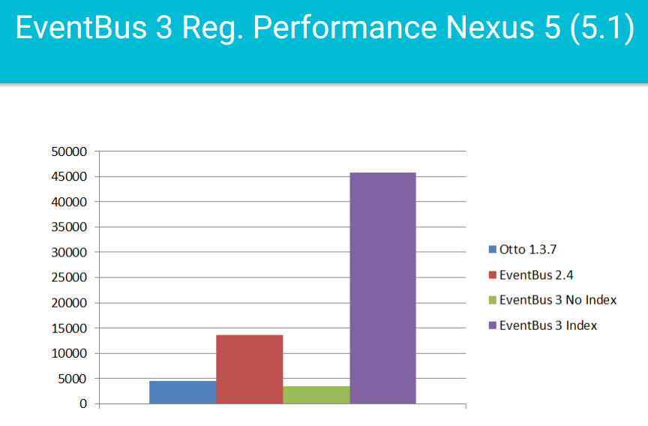
Subscriber Index
16/18

Slide 17
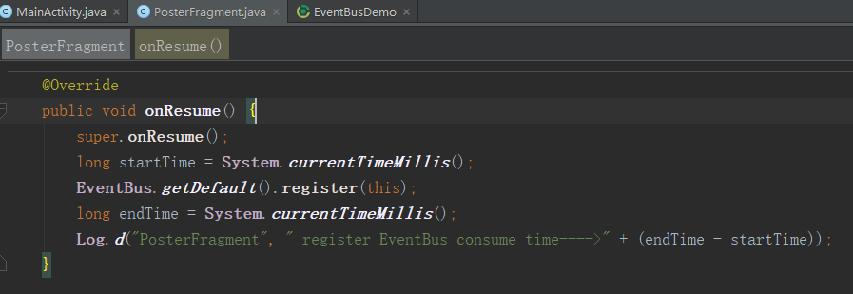
Practical
16/18

Slide 18
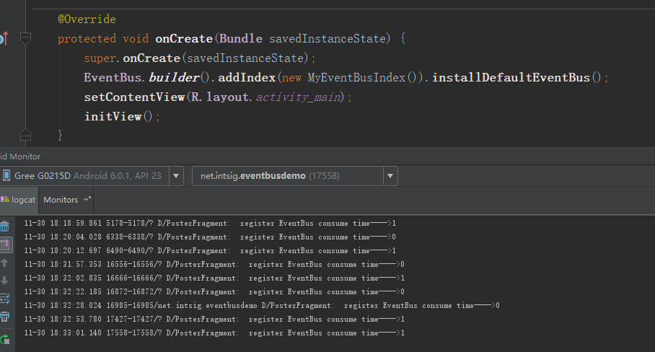
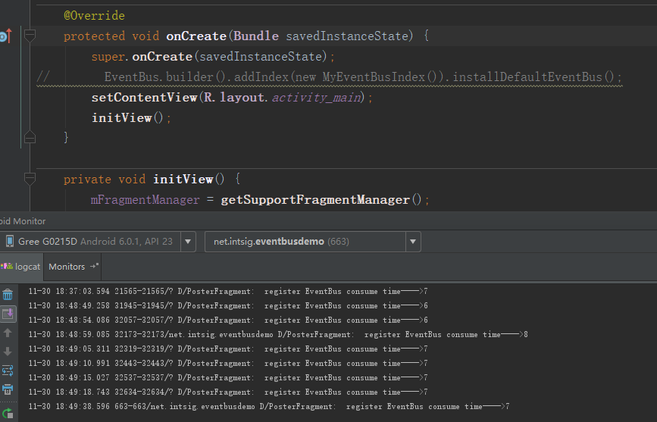
Practical
16/18

Slide 19
How to generate the index
Using annotationProcessor
If you are not using Android Gradle Plugin version 2.2.0 or higher, use the configuration with android-apt.
6 7 8 9 10 11 12 13 14 | android { defaultConfig { javaCompileOptions { annotationProcessorOptions { arguments = [ eventBusIndex : 'com.example.myapp.MyEventBusIndex' ] } } } } dependencies { compile 'org.greenrobot:eventbus:3.0.0' annotationProcessor 'org.greenrobot:eventbus-annotation-processor:3.0.1' }
16/18

Slide 20
How to generate the index
Using kapt
If you want to use EventBus within Kotlin code, you need to use kapt instead of annotationProcessor.
3 4 5 6 7 8 9 10 11 12 | apply plugin: 'kotlin-kapt' // ensure kapt plugin is applied dependencies { compile 'org.greenrobot:eventbus:3.0.0' kapt 'org.greenrobot:eventbus-annotation-processor:3.0.1' } kapt { arguments { arg('eventBusIndex', 'com.example.myapp.MyEventBusIndex') } }
16/18

Slide 21
How to generate the index
Using android-apt
If the above does not work for you, you can add the EventBus annotation processor to your build using the android-apt Gradle plugin.
7 8 9 10 11 12 13 14 15 16 17 18 | buildscript { dependencies { classpath 'com.neenbedankt.gradle.plugins:android-apt:1.8' } } apply plugin: 'com.neenbedankt.android-apt' dependencies { compile 'org.greenrobot:eventbus:3.0.0' apt 'org.greenrobot:eventbus-annotation-processor:3.0.1' } apt { arguments { eventBusIndex "com.example.myapp.MyEventBusIndex" } }
16/18

Slide 22
How to use the index
1 | EventBus eventBus = EventBus.builder().addIndex(new MyEventBusIndex()).build();
2 3 | EventBus.builder().addIndex(new MyEventBusIndex()).installDefaultEventBus(); // Now the default instance uses the given index. Use it like this: EventBus eventBus = EventBus.getDefault();
16/18

Slide 23
SOURCE Code Analysis
索引的生成
索引的使用
16/18

Slide 24
索引的生成
public class EventBusAnnotationProcessor extends AbstractProcessor {
/** 被注解表示的方法信息 */
private final ListMap<TypeElement, ExecutableElement> methodsByClass = new ListMap<>();
@Override
public boolean process(Set<? extends TypeElement> annotations, RoundEnvironment env) {
Messager messager = processingEnv.getMessager();
try {
String index = processingEnv.getOptions().get(OPTION_EVENT_BUS_INDEX);
if (index == null) { // gradle中配置apt的argument
messager.printMessage(Diagnostic.Kind.ERROR, "No passed to annotation processor");
return false;
}
collectSubscribers(annotations, env, messager); // 根据注解拿到所有订阅者的回调方法信息
/**Subscriber classes should be skipped if their class or any involved event class are not visible to the index. */
checkForSubscribersToSkip(messager, indexPackage); // 筛掉不符合规则的订阅者
if (!methodsByClass.isEmpty()) {
createInfoIndexFile(index); // 生成索引类java文件
}
}
16/18

Slide 25
AbstractProcessor
在某些代码元素上（如类型、函数、字段等）添加注解，在编译时编译器会检查AbstractProcessor的子类，并且调用该类型的process函数，然后将添加了注解的所有元素都传递到process函数中，使得开发人员可以在编译器进行相应的处理，例如，根据注解生成新的Java类，这也就是EventBus，Retrofit，Dragger等开源库的基本原理。
16/18

Slide 26
FAQ
不支持多进程
合理使用(考虑项目维护)
维持单例
其他？
15/18

Slide 27
相关资料
Git地址：https://github.com/greenrobot/EventBus.git
包含源码、测试例子
17/18

Slide 28

That’s All

Slide 29
多个构造器参数考虑使用构建器
Builder模式
将一个复杂对象的构建与它的表示分离，使得同样的构建过程可以创建不同的表示。
17/18

Slide 30
多个构造器参数考虑使用构建器
优点：
提高可读性和可维护性
缺点：
多余的Builder对象
重复定义模板代码（InnerBuilder）
17/18

