Slide 1
Représentation compacte d’espaces d’états
Yann Thierry-Mieg
Décembre 2017
Sécurité et Fiabilité
M2 SAR – UPMC

Slide 2
Outline
Decision Diagrams for Model-checking:
Binary Decision Diagrams :
Symbolic approach to model-checking
Saturation
A more effective fixpoint strategy
Hierarchical Set Decision Diagrams
Introduce structured descriptions
Instantiable Transition Systems
A framework to exploit SDD
Binary
Decision
Diagrams
Set
Decision
Diagrams
Instantiable
Transition
System
Saturation

Slide 3
Reduced Ordered Binary Decision Diagrams
(RO)BDD
BDD for
Model-checking
BDD
extensions

Slide 4
Binary Decision Diagrams
Most cited document in computer science according to citeseer [in 2005, in 2017 down to place 61]: 1. Graph-Based Algorithms for Boolean Function Manipulation – Bryant (1986) In this paper we present a new data structure for representing Boolean functions and an associated set of...
Introduces Reduced Ordered Binary Decision Diagrams (RO)BDD
What is a (RO)BDD ?
A compact data structure to represent boolean functions

Slide 5
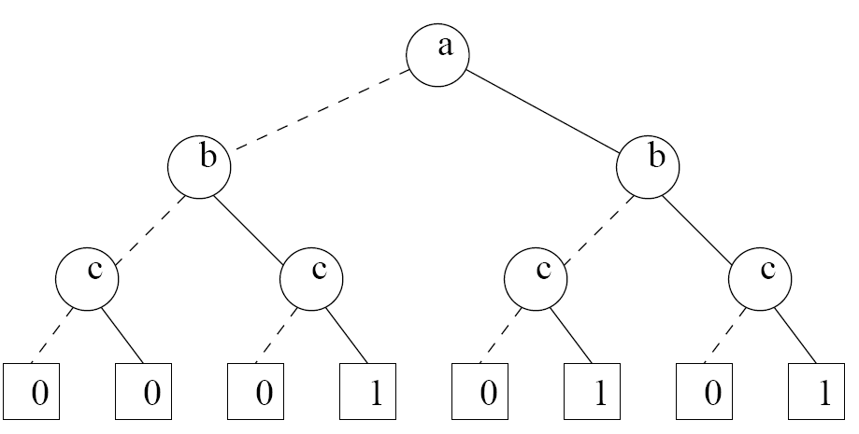
BDD : an example : f = ( a OR b) AND c
An ordered (a<b<c) binary decision diagram for f :

Slide 6
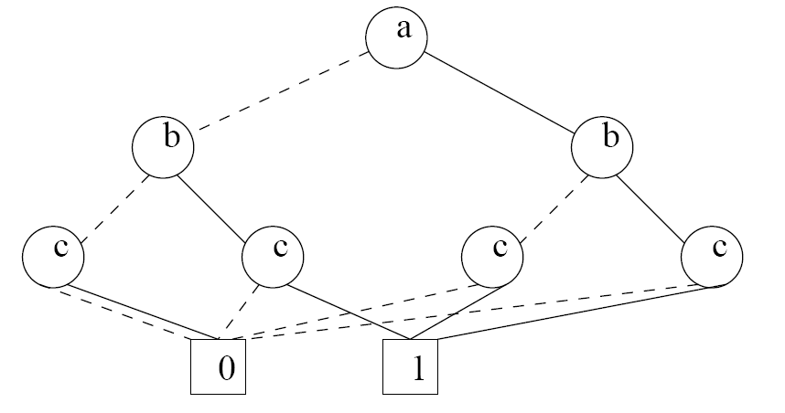
BDD : an example : f = ( a OR b) AND c
Reduction : single occurrence of terminals

Slide 7
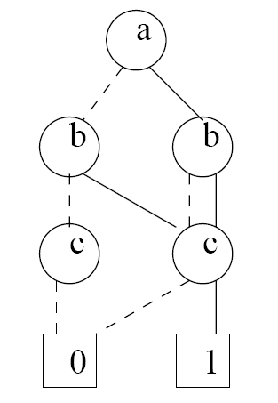
BDD : an example : f = ( a OR b) AND c
Recursively from terminals : single occurrence of any node
Uses a unicity table for nodes (hash table)
Node hash key based on : node + hash key of sons

Slide 8
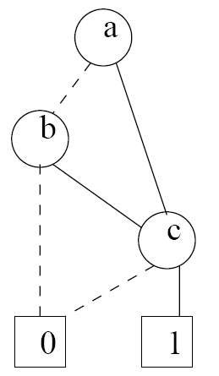
BDD : an example : f = ( a OR b) AND c
Remove useless nodes
Criterion : variable value does not influence truth value of formula
<=> both son arcs point to same node
a | b | c | f
0 | 0 | 0 | 0
0 | 0 | 1 | 0
0 | 1 | 0 | 0
0 | 1 | 1 | 1
1 | 0 | 0 | 0
1 | 0 | 1 | 1
1 | 1 | 0 | 0
1 | 1 | 1 | 1

Slide 9

BDD : an example : f = ( a OR b) AND c
Zero-suppressed variant :
Remove paths that lead to 0 (false)
Represents the set of “true” values of f
a | b | c | f
0 | 0 | 0 | 0
0 | 0 | 1 | 0
0 | 1 | 0 | 0
0 | 1 | 1 | 1
1 | 0 | 0 | 0
1 | 0 | 1 | 1
1 | 1 | 0 | 0
1 | 1 | 1 | 1

Slide 10
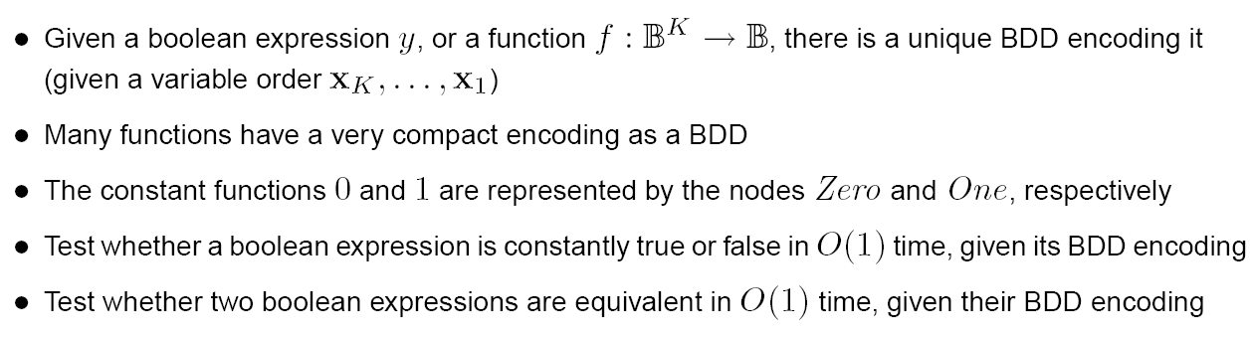
Properties of ROBDD

Slide 11
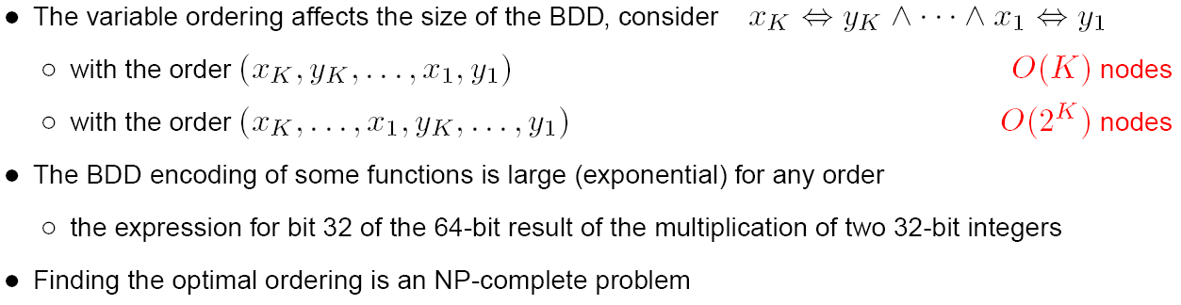
Properties of BDD : Choice of an order

Slide 12
Model checking and BDD
BDD for
Model-checking
BDD
extensions
(RO)BDD

Slide 13
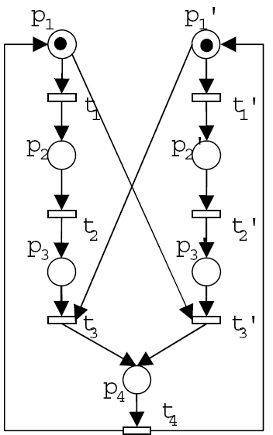
Representing a state-space using DD
Principle :
A path in the structure represents a reachable state
A state S is described by the value of its state variables
Example :
A mutual exclusion protocol
for 2 process p and p’

Slide 14
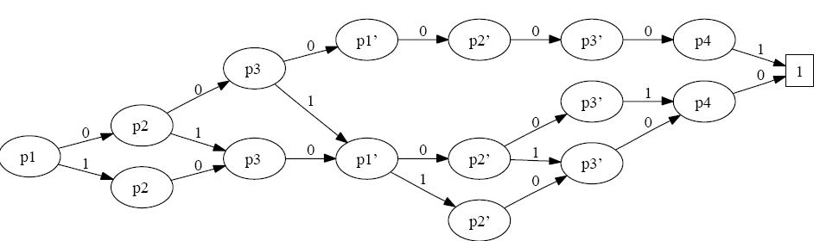
Example

Slide 15
Example
P
P’
Good representation for Globally Asynchronous Locally Synchronous (GALS) systems :
Independence of local actions (t1 and t2) is well captured

Slide 16
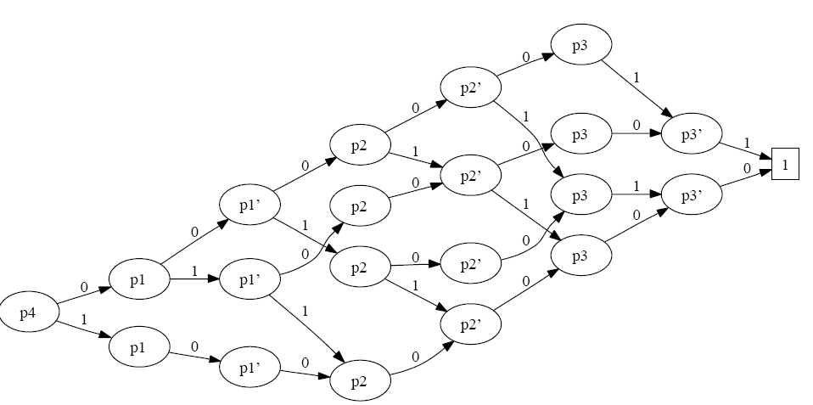
Variable Ordering issues
P’
P
P
P’

Slide 17
Growth in node size w.r.t. order
Nb Proc | Nb States | Consecutive order | Interlaced order
2 | 10 | 16 | 21
5 | 244 | 40 | 260
10 | 59050 | 80 | 13321
15 | 1.434e+07 | 120 | 589838
20 | 3.486e+09 | 160 | -out of ram-
Linear growth vs exponential growth for poor ordering clearly visible
Linear growth of representation but exponential growth of state-space size with appropriate ordering !!
For some problems BDD based techniques allow to go much further than explicit representation techniques

Slide 18
Efficiency of BDD
Computations on BDD use a cache to limit complexity
Cache is of the form
Key:<operation, operand_1,..,operand_n >-> value:result
Where operands and result are BDD nodes
Example :
Cache : contains <union, a, b > -> c if (a U b) = c

Slide 19
union of BDD
union (a,b)
If (a=0 or b=1) return b;
If (a=1 or b=0) return a;
If (a=b) return a;
If ( <union,a,b> -> r in cache ) return r;
BDD r= createBDD(
0 => union(a[0],b[0]),
1=> union(a[1],b[1]) )
Cache.add( <union,a,b> -> r)
Return r;

Slide 20
Complexity of BDD operations
createBDD uses a unicity table based on node structure
Hash on value of son nodes
Operation cache =>
complexity proportional to #nodes(a) x #nodes(b) => number of nodes
Without it complexity would be proportional to number of PATHS in the structure
Intersection differs from union only in terminal cases
If (a = 1 or b = 0) return b
If (a = 0 or b = 1) return a

Slide 21

State space computation
Classic algorithm is based on Breadth-first exploration BFS
Consider a system composed of k state variables (i.e. state space represented as a k-level BDD)
Transition relation represented using 2k variables
(i,j) = (i1,j1, ..ik,jk)
System can go from i to j in one step
A special synchronized product (relational product) operation is defined to apply such a transition to a system
p1
1
New p1
0
Transition BDD for Next(t1)
Paths to 0 terminal not represented
Useless variables removed
p2
0
New p2
1
1

Slide 22
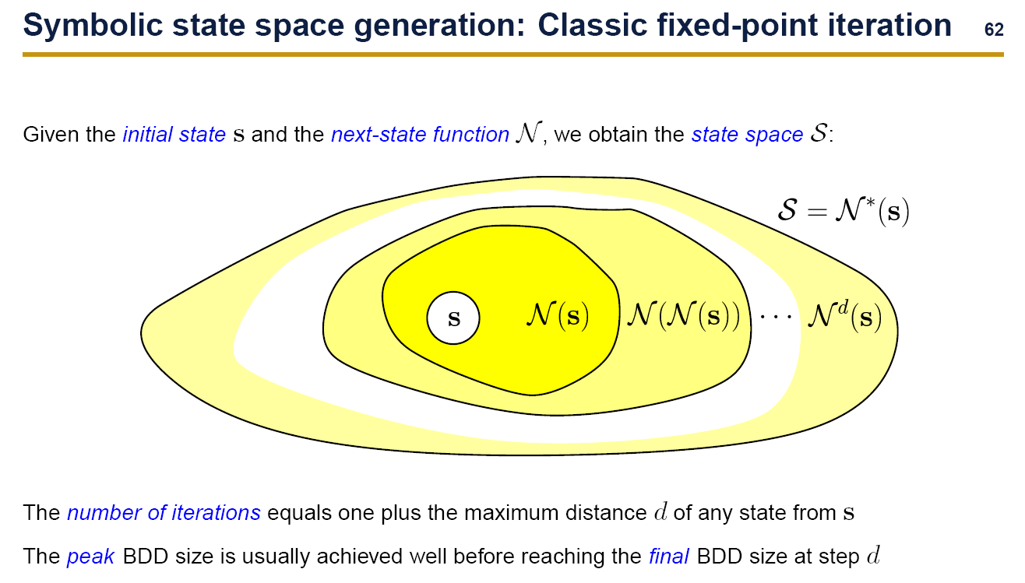
Slide by G. Ciardo

Slide 23
Combining transitions
BDD representing transitions can be combined using union
Full transition relation
NextAll = union ( Next(t1)+..+Next(tn) )
Algorithm for BFS(s0)
S := S0
N := 0
While (N != S)
N := S
S := S U NextAll(S)
Return S
“Symbolic Model Checking: 10 20 States and Beyond” (LICS’1990) Burch, Clarke, McMillan, Dill, Hwang

Slide 24
State space representation size
BFS performs better than the “intuitive algorithm”
Size of representation is not directly linked to number of states manipulated
Re-evaluating a transition on an already reached state is likely to ctose a cache-hit thus has experimentally low cost.
Algorithm for newBFS(s0)
S := S0
N := S0
While (N != 0)
N := NextAll(U) \ S
S := S U N
Return S
Only computes NextAll on newly
reached states

Slide 25
Decomposing the transition relation [Roig’95]
The idea is to cluster some transitions but keep an expression of the transition relation in parts
Next(i) for I in 1..nbClusters = union ( Next(tj),..Next(tj+k))
Create one cluster for each process (requires structural information)
Not quite BFS anymore as chainings may occur
Solves problems experienced with the size of NextAll BDD
Algorithm for chainBFS(s0)
S := S0
N := 0
While (N != S)
N := S
For (i in 1..nbClusters)
S := S U Next(i) (S)
Return S

Slide 26
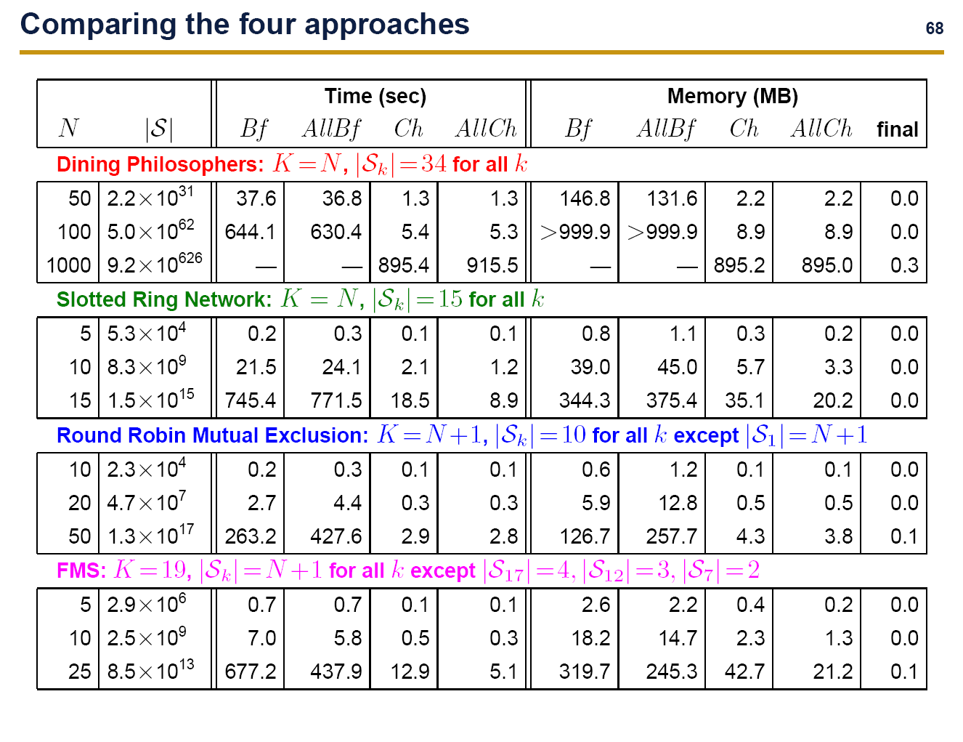
Compared performances (Ciardo’05)
Slide by G. Ciardo
Performances using Smart
New
BFS
New
BFS
BFS
New
Chain
Chain
BFS
New
Chain
Chain

Slide 27
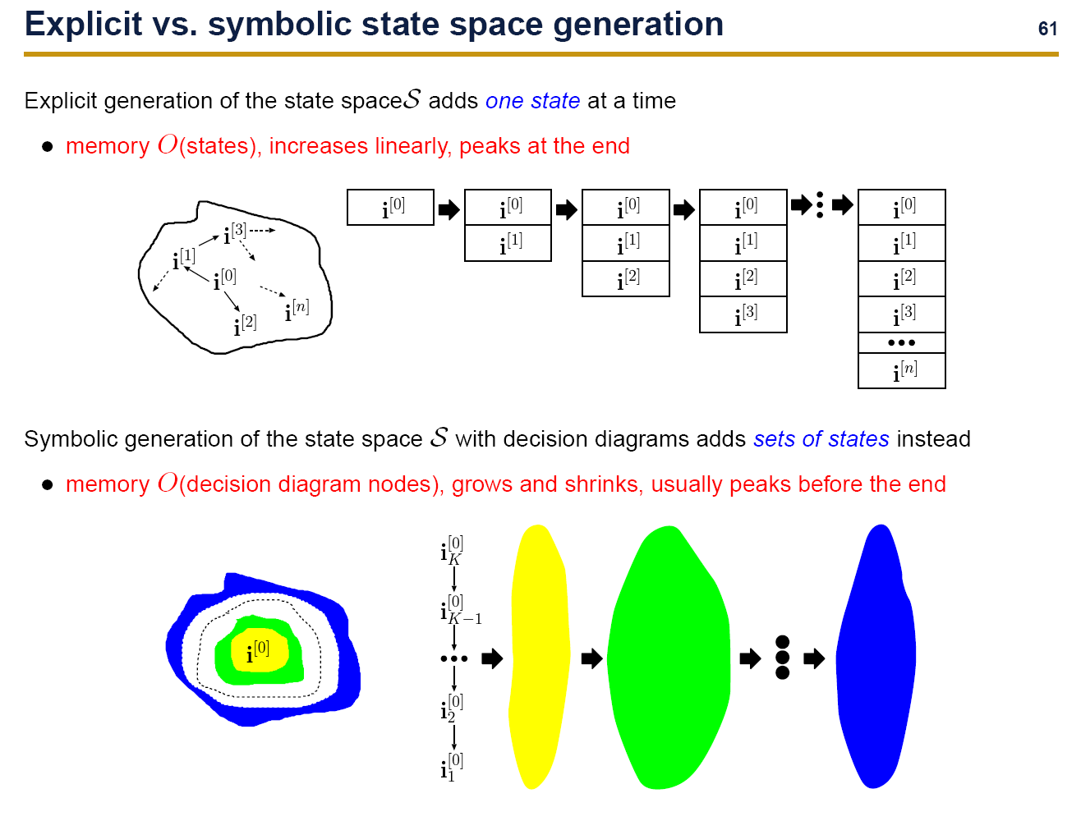

Slide 28
Using the state space representation
The state space representation allows to easily verify safety properties
Can we reach a “bad” state
Can A and B both be true simultaneously
State space generation is the basis for more complex temporal logic properties such as CTL
CTL properties can be expressed as nested fix points of the transition relation and its reverse Next⁻¹

Slide 29
Some BDD extensions
BDD for
Model-checking
BDD
extensions
(RO)BDD

Slide 30
Decision Diagrams : Widely accepted in verification tools
SMV (US):
FSM/Kripke structure
emblematic first symbolic enabled verification tool. Now uses (NuSMV 2-Italy) library Cudd.
Uppaal (Den-Nor):
Hybrid systems
uses Difference Bounded Matrix diagrams to represent clocks
Prism (UK) :
Stochastic process algebra
uses Matrix DD and Multi-terminal DD for stochastic verification
Smart (US) :
Stochastic Petri nets
uses integer valued DD, both CTL and stochastic solution engine (+saturation)
Red (Taiwan) :
Timed automata
Specific solution for real time systems

Slide 31
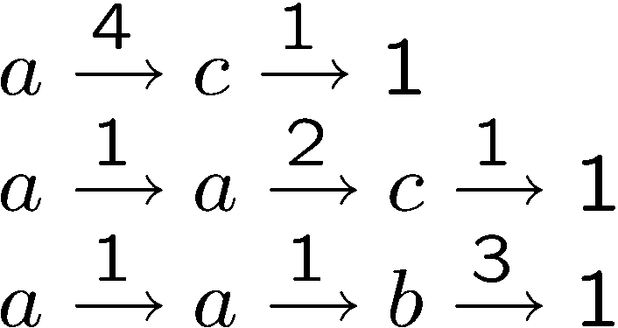
Integer valued Decision Diagrams
Some variants:
Multi-way DD (Ciardo&Miner Icatpn’99)
Data Decision Diagrams (Couvreur et al. Icatpn’02)
Variables may have an integer domain instead of boolean domain
Usually zero-suppressed, to allow arbitrary variable domains provided the actual reachable set is finite
Using BDD, one has to decode integer state variables into their log_2(n) bit representation
Problem : complexity also linked to nb arcs/node, not only number of nodes
Data Decision Diagram
No variable order (handled in the union operation to handle incompatibilities)
Homomorphisms to define the transition relation
a
1
4
a
2
1
b
c
3
1
1

Slide 32
Multi terminal Decision Diagrams
Multi-terminal (MTDD [Fujita+ ‘97] or Algebraic DD [Bahar+ ‘93]):
Instead of single terminal 1, use several terminals
Allows to give a correspondence between a state and a characteristic it has
Not just presence or absence of a state
Example 1: integer terminal
Terminal gives the distance (number of steps) from initial state of any state
union handles same path with different terminals => keep the smallest terminal
Useful for finding shortest witness or counter-example traces
Example 2: Real valued terminal
Used in stochastic/probabilistic systems, gives the probability of being in a state
union handles the approximation (2 terminals x and y considered equal if |x-y| < epsilon)

Slide 33
The Saturation Algorithm for Decision diagrams
Binary
Decision
Diagrams
Set
Decision
Diagrams
Instantiable
Transition
System
Saturation

Slide 34
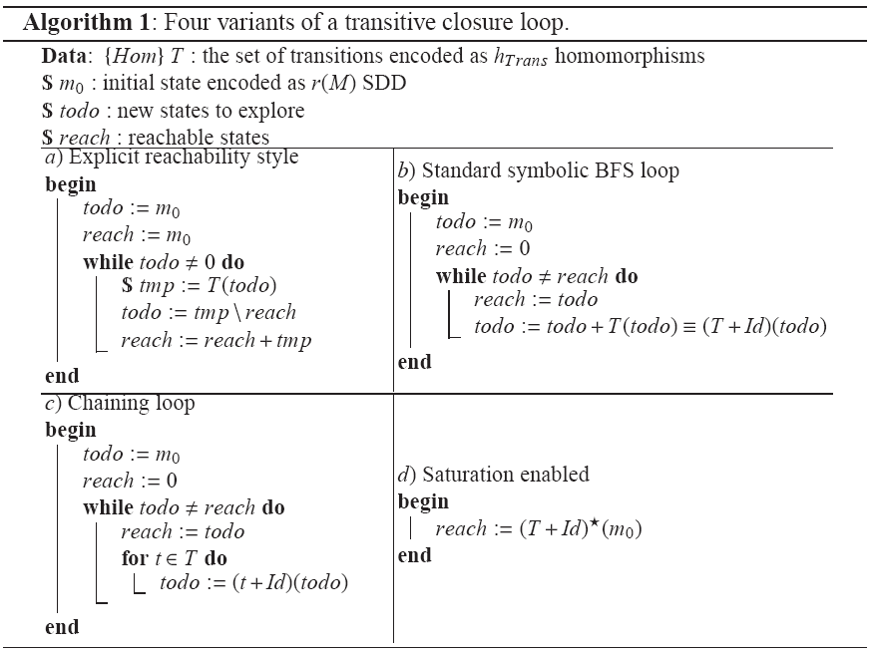
Transitive Closure : Fixpoint

Slide 35
Saturation
Model-checking using decision diagrams => (nested) transitive closures over the transition relation
Optimizing complexity of this operation critical to efficiency
[BCM’92] based on BFS style iterations, n iterations required where n is depth of “deepest” state
[Roig’95] Chaining may converge faster, based on clusters of transitions, no longer strict BFS
[Ciardo’01] Saturation is empirically 1 to 3 orders of magnitude better
s0
N(s0)
N²(s0)
s0
t1(s0)
t2(t1(s0))
t2(t1(t2(t1…(s0)))..))

Slide 36
Saturation vs BFS
Saturation algorithm: [Ciardo et al. TACAS’01]
Fire transitions from the leaves (terminals) up to root
Go to ancestor of a node iff. The current node is saturated : all events that only affect this variable and variables below it have been fired until a fixpoint is reached
Each time a node is affected by an event, resaturate it.
Not BFS anymore, firing order of events follows data structure
Huge reduction of time and space complexity
Good tackling of intermediate peak size effect
However :
Definition of saturation algorithm is complex
Cannot be implemented directly with public API of DD libraries
Our contribution : Automatic saturation

Slide 37
Transitive Closure
The transitive closure or fixpoint noted * is a unary operator
Evaluated by h*(d):
repeat : d = h(d)
until : d == h(d)
Evaluation may not terminate
depends on the homomorphism
if it does, evaluation described as finite composition :
h* (d) = h o h o ... h (d)
Thus h* is a homomorphism
To cumulate states, use of a common construction :
(h + id)*
Allows to implement a leaf to root saturation strategy

Slide 38
Fixpoint : an example
h* o e ^{x} > Id if v=e
e ^{x} > Seek(h,v) otherwise
Seek(h,v)(e,x) =
Seek(h,v)(1) = T
e ^{x} > Id if x<z
0 otherwise
Max(z)(e,x) =
Max(z)(1) = T
h = Max(3)o Inc(d) // Increment d up to 2
Seek(h+Id,d)
a
1
b
2
c
3
d
0
1

Slide 39
Fixpoint : an example
h* o e ^{x} > Id if v=e
e ^{x} > Seek(h,v) otherwise
Seek(h,v)(e,x) =
Seek(h,v)(1) = T
e ^{x} > Id if x<z
0 otherwise
Max(z)(e,x) =
Max(z)(1) = T
h = Max(3)o Inc(d) // Increment d up to 2
a single traversal of these nodes
a
1
b
2
c
3
Seek(h+Id,d)
d
0
1

Slide 40
Fixpoint : an example
h* o e ^{x} > Id if v=e
e ^{x} > Seek(h,v) otherwise
Seek(h,v)(e,x) =
Seek(h,v)(1) = T
e ^{x} > Id if x<z
0 otherwise
Max(z)(e,x) =
Max(z)(1) = T
h = Max(3)o Inc(d) // Increment d up to 2
Id
a
1
b
2
c
3
*
+
Max(3)
Inc(d)
d
0
1

Slide 41
Fixpoint : an example
h* o e ^{x} > Id if v=e
e ^{x} > Seek(h,v) otherwise
Seek(h,v)(e,x) =
Seek(h,v)(1) = T
e ^{x} > Id if x<z
0 otherwise
Max(z)(e,x) =
Max(z)(1) = T
h = Max(3)o Inc(d) // Increment d up to 2
Id
a
1
b
2
c
3
*
+
Max(3)
Inc(d)
d
0
1
1

Slide 42
Fixpoint : an example
h* o e ^{x} > Id if v=e
e ^{x} > Seek(h,v) otherwise
Seek(h,v)(e,x) =
Seek(h,v)(1) = T
e ^{x} > Id if x<z
0 otherwise
Max(z)(e,x) =
Max(z)(1) = T
h = Max(3)o Inc(d) // Increment d up to 2
Id
2
a
1
b
2
c
3
*
+
Max(3)
Inc(d)
d
0
1
1

Slide 43
Fixpoint : an example
h* o e ^{x} > Id if v=e
e ^{x} > Seek(h,v) otherwise
Seek(h,v)(e,x) =
Seek(h,v)(1) = T
e ^{x} > Id if x<z
0 otherwise
Max(z)(e,x) =
Max(z)(1) = T
h = Max(3)o Inc(d) // Increment d up to 2
2
a
1
2
3
d
0
b
c
1
1

Slide 44
Fixpoint conclusions
Transitive closure or fixpoint allows:
single traversal of the top of the tree
less intermediate nodes
a
1
2
3
d
0
b
c
1
+
h
Iteration 1
a
1
2
3
d
1
b
c
1
a
1
2
3
d
0
b
c
1
BFS style iterations
1
h
+
a
1
2
3
d
1
b
c
1
2
Iteration 2
2
a
1
2
3
d
0
b
c
1
1

Slide 45
Fixpoint conclusions
Transitive closure or fixpoint allows:
single traversal of the top of the tree => cost of + and h
less intermediate nodes
a
1
2
3
d
0
b
c
1
+
h
Iteration 1
a
1
2
3
d
1
b
c
1
a
1
2
3
d
0
b
c
1
BFS style iterations
1
h
+
a
1
2
3
d
1
b
c
1
2
Iteration 2
Useless intermediate nodes !!
2
a
1
2
3
d
0
b
c
1
1

Slide 46
Saturation effect
Nested transitive closure or fixpoint = saturation allows:
single traversal of the top of the tree => cost of + and h
less intermediate nodes
a
1
2
3
d
0
b
c
1
+
h
Iteration 1
a
1
2
3
d
1
b
c
1
1
2
3
[0,1]
a
b
c
d
1
BFS style iterations
h
+
[1,2]
a
1
b
2
c
3
d
1
Iteration 2
Useless intermediate nodes !!
[0,1,2]
a
1
b
2
c
3
d
1

Slide 47
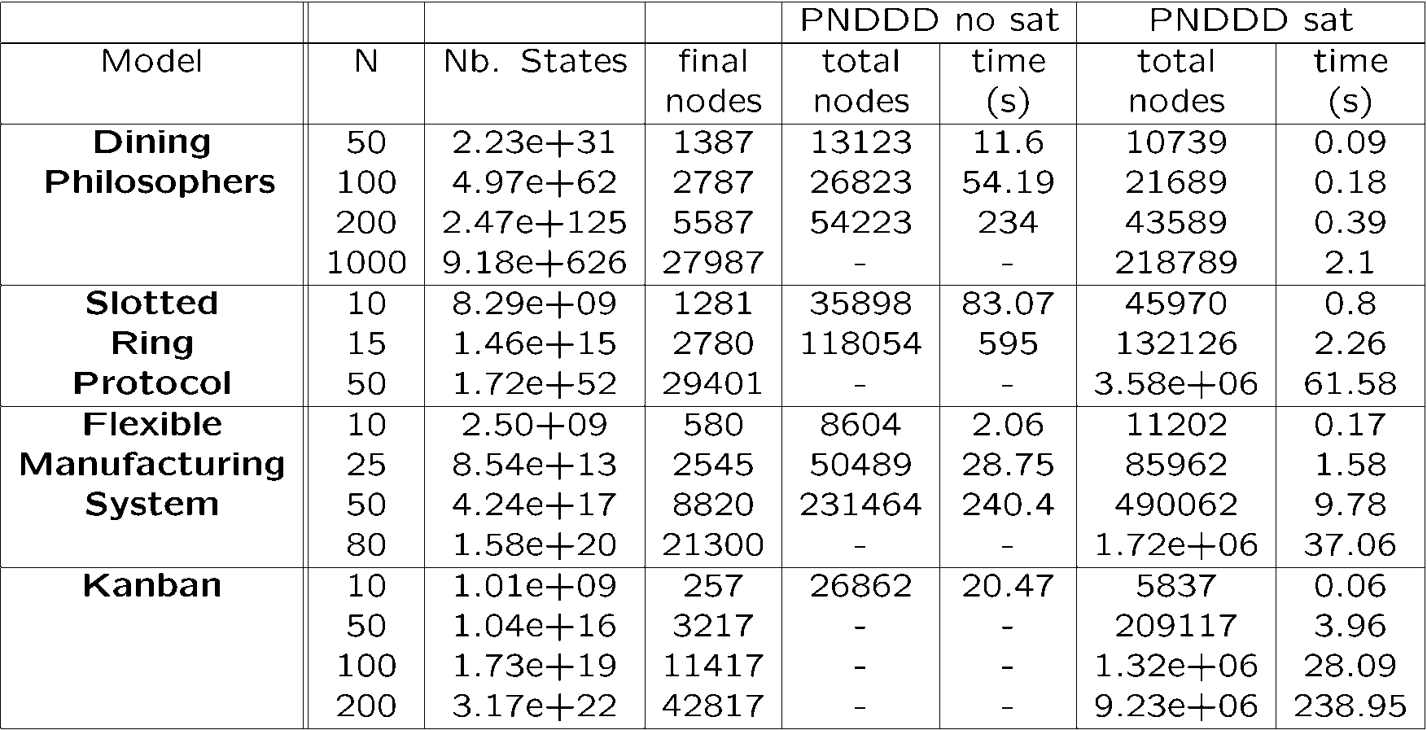
Performance measures : effect of saturation
Transitive closure allows more efficiency
Manual Saturation "à la Ciardo" (Tacas'01 and '03) using * operator
Organize events by highest variable affected

Slide 48
CTL Model checking

Slide 49
CTL
Computation Tree Logic
(infinite) tree of all possible executions of a system
Superset of Boolean first order logic
AND, OR, NOT, TRUE, FALSE
Additional temporal operators
G : Generally (p holds in all states)
X p: neXt (p holds in a successor state by one step)
F p: Future (p holds in a state reachable in arbitrary number of steps)
p U q: Until (p holds until q holds)
Modalities : Exists, Always

Slide 50
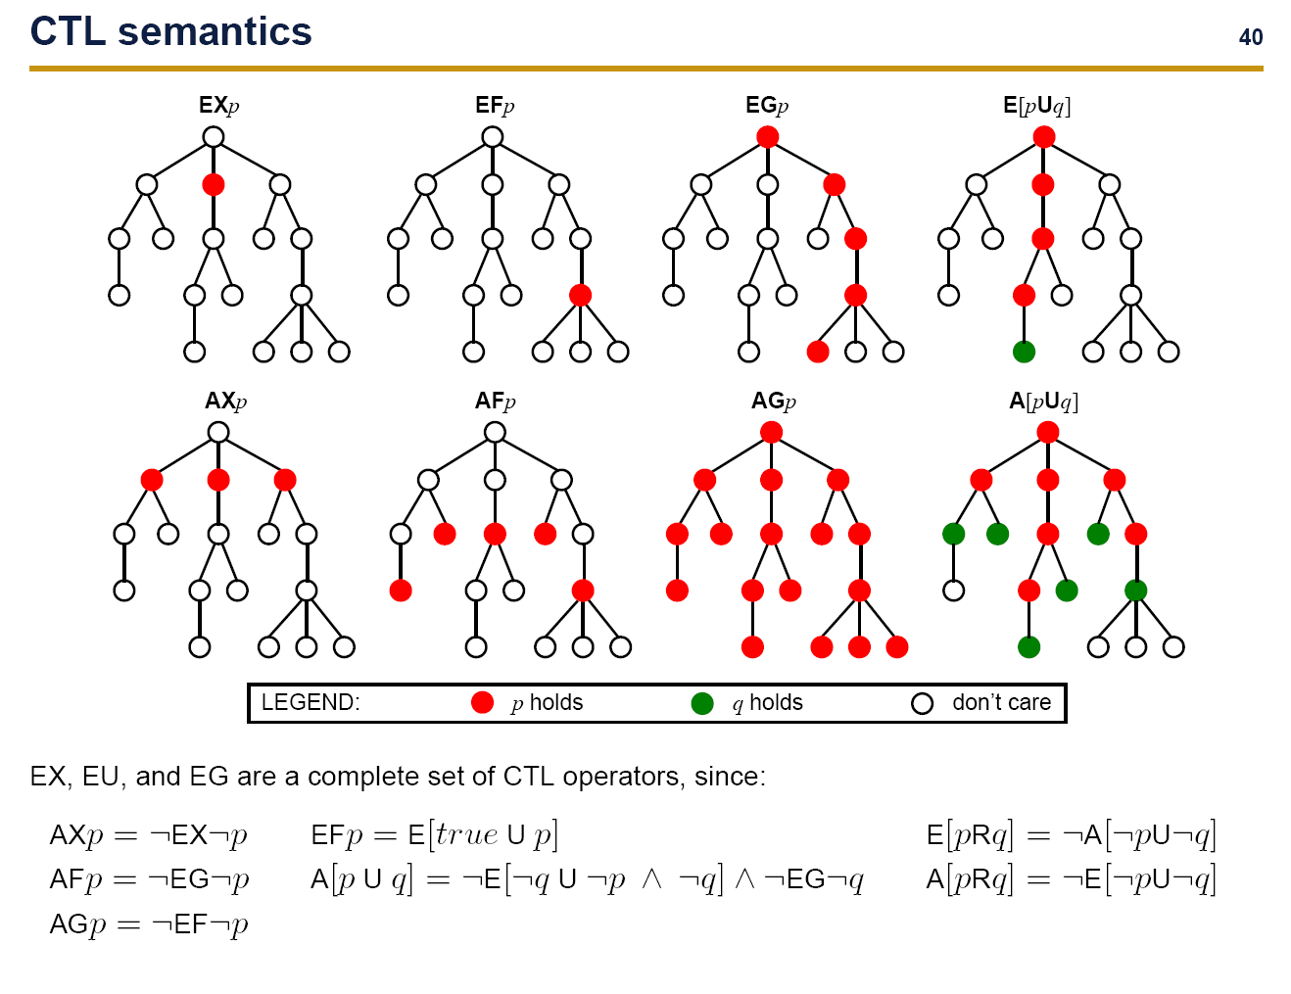

Slide 51
Reminder Symbolic Tools
We have
A compact representation for sets of states
A representation of transition relations, as a set of pairs of states
A model provides (So,Next,Lab)
An initial state So
A successor relation Next, that gives the set of successors reachable in one step from a set of states
A labeling function, that tags individual states with the truth value of atomic propositions (e.g. x<3)

Slide 52
Model-checking CTL
Start from syntactic tree of the formula
Compute all states S(p) satisfying a formula p recursively
Terminal cases :
p=True : all reachable states
p=False : empty set of states
p=Atomic predicate (e.g. x<3): all reachable states satisfying p
Boolean cases :
p AND q : intersect states S(p) and S(q)
p OR q : union states S(p) and S(q)
NOT p : all reachable states set minus S(p)
Temporal operators :
Reduce to EX, EU, EG using equivalences
Algorithms on next slides

Slide 53
EX p: next
Given states satisfying p, S(p)
Compute predecessors of S(p)
If a state is a predecessor of a state satisfying p, it satisfies neXt p
Requires Pred, i.e. the invert of Next
Easy in classic model, just revert pairs of states in the representation
Can be more difficult if computed dynamically : risk of unreachable states
Still possible in general by intersection with forward reachable set

Slide 54
BDD based algorithm for EX(f)
Let F be the set of states satisfying “f”
F can be built by selecting states from the full state space
EX(F)
S := Next⁻¹ (F)
Return S

Slide 55
Operator EG for EG (f)
Let F be the set of states satisfying “f”
EG(F)
S := F
N := 0
While (N != S)
N := S
S := S ∩ Next⁻¹ (S)
Return S
Initialize with states that verify f
Potentially all these states verify Gf
Remove some potential candidates state
If s verifies Gf, s verifies f
and successor verifies “f”
F

Slide 56
Operator EG for EG (f)
Let F be the set of states satisfying “f”
EG(F)
S := F
N := 0
While (N != S)
N := S
S := S ∩ Next⁻¹ (S)
Return S
Initialize with states that verify f
Potentially all these states verify Gf
Remove some potential candidates state
If s verifies Gf, s verifies f
and successor verifies “f”

Slide 57
Operator EG for EG (f)
Let F be the set of states satisfying “f”
EG(F)
S := F
N := 0
While (N != S)
N := S
S := S ∩ Next⁻¹ (S)
Return S
Initialize with states that verify f
Potentially all these states verify Gf
Remove some potential candidates state
If s verifies Gf, s verifies f
and successor verifies “f”
EGf
(Next⁻¹ ∩ Id)* o F

Slide 58
Illustration for EG y
{z}
∅
{x, y, z}
{x}
{y}
{x, z}
{y, z}
{x, y}
π⁰(S) = S

Slide 59
Illustration for EG y
{z}
∅
{x, y, z}
{x}
{y}
{x, z}
{y, z}
{x, y}
States not satisfying y have been excluded
π¹(S) = S_{K}(y) ∩ pre(S)

Slide 60
Illustration for EG y
{z}
∅
{x, y, z}
{x}
{y}
{x, z}
{y, z}
{x, y}
States having all its successors outside π¹ have been excluded
π²(S) = S_{K}(y) ∩ pre(π¹(S))

Slide 61
Illustration for EG y
{z}
∅
{x, y, z}
{x}
{y}
{x, z}
{y, z}
{x, y}
π³(S) = S_{K}(y) ∩ pre(π²(S))
The fixed point has been reached

Slide 62
Operator EU for E(f U g)
Let F and G be the set of states satisfying “f” and “g”
EU(F,G)
S := G
N := 0
While (N != S)
N := S
S := S U ( F o Next⁻¹ (S))
Return S
Initialize with states that verify g
Keep only predecessors that verify f
( F o Next⁻¹ + Id )* o G

Slide 63
Illustration for z EU y
{z}
∅
{x, y, z}
{x}
{y}
{x, z}
{y, z}
{x, y}
ξ ⁰(∅) = ∅

Slide 64
Illustration for z EU y
{z}
∅
{x, y, z}
{x}
{y}
{x, z}
{y, z}
{x, y}
ξ ¹(∅) = S_{K}(y) ∪ (S_{K}(z) ∩ pre(ξ ⁰(∅)))
States satisfying y have been added

Slide 65
Illustration for z EU y
{z}
∅
{x, y, z}
{x}
{y}
{x, z}
{y, z}
{x, y}
States satisfying z and having at least a successor in ξ ¹ have been added
ξ ²(∅) = S_{K}(y) ∪ (S_{K}(z) ∩ pre(ξ ¹(∅)))

Slide 66
Illustration for z EU y
{z}
∅
{x, y, z}
{x}
{y}
{x, z}
{y, z}
{x, y}
ξ ³(∅) = S_{K}(y) ∪ (S_{K}(z) ∩ pre(ξ ²(∅)))
The fixed point has been reached

Slide 67
Conclusion on CTL
CTL (Branching time) can specify safety properties and some liveness properties
CTL can be efficiently implemented (linear complexity w.r.t. to the Kripke structure), provided a good management of sets of states.
Fairness needs to augment the capability of CTL model checkers (SCC searches are needed).
CTL fair model checkers can be used to verify CTL and also LTL formula.
CTL does not provide a single counter example when the property does not hold. The output is the set of states that satisfy the formula (maybe huge).
Witness paths or counter examples can still be exhibited
CTL model checkers cannot answer before labeling the initial state with the truth value of the formula.

Slide 68
A Guarded Action Language to express system semantics
Yann Thierry-Mieg
Joint work with
S. Baarir, B. Berard, M.Colange, F. Kordon, D. Poitrenaud
Nov. 2013 – ENS Cachan
Journée AFSEC

Slide 69
Model Driven Development and Model-checking
In MDD approaches
Build a Domain Specific Language
Use model transformation for specific targets
Choosing a target formalism
Expressive enough to capture your semantics
Efficient solution engine
We propose ITS/GAL formalism
Allows to express discrete state semantics
Symbolic model-checking

Slide 70
Guarded Action Language
GAL : a « DSL to express Semantics »
Simple to use, easy C-like syntax
Straightforward Petri net style concurrent semantics
Integer variables and arrays + arbitrarily nested array expressions
Efficient symbolic solution engine
Subsumed by Instantiable Transition Systems (ITS), allowing hierarchical composition of GAL modules
Meant to be a back-end target in a transformation process.
Define your semantics in GAL.

Slide 71
GAL example
GAL system {
// Variable declarations
int variable = 5 ;
array [2] tab = (1, 2) ;
transition t1 [variable > 9] {
tab [0] = tab [1] * tab [0] ;
variable = variable * 5 ;
}
transition t2 [variable == 23] label "a" {
tab [1] = 0 ;
}
}

Slide 72
GAL Variables
All variables are 32 bit integers or arrays of fixed size.
Any variable must be initialized
int a = 0;
array [3] tab = (0,0,0);

Slide 73
Arithmetic and Boolean
Terminal expressions are signed constants, parameters, variables, array access with arbitrary index expression
3,-2,$MAX,x,tab[x+1],tab[tab[$MAX-x]]
All C operators supported
Bitwise : &, |, ^, <<, >>, ~
Integer : +, -, *, /, %, **
Boolean expressions
Basics : true, false, &&, ||, !
Comparisons of integers: ==,!=, <,<=, >,>=
x = (y == 255) * 100; // x is 0 or 100

Slide 74
GAL Statements
<lhs=rhs> assign integer expression rhs to variable designated by lhs.
<s1;..;sn> sequence of statements, <nop> the empty sequence
<ite(c,t,f)> an if-then-else statement
<for(min, max, b)> a limited form of iteration
<abort> return the empty set (!)
<call(a)> call a label (i.e. an arbitrary transition with label a) of « self »
<fixpoint(b)> fixpoint statement

Slide 75
GAL Transitions
Tuple : <label, guard, body>
Fire : In any state where guard is enabled, process body statement(s) atomically
Tau (empty) label for local transitions
Labeled transitions are not fireable by Locals outside of call or synchronization
Guard is a boolean expression
Body is a statement

Slide 76
System Parameters
Allow easier configuration of a model
GAL paramSystem ($N = 2, $K = 1) {
int variable = $N ;
array [2] tab = ($N + $K, $N - 1) ;
transition t1 [variable > $N] {
tab [$K] = tab [1] * tab [0] ;
variable = variable * 5 ;
}
transition t2 [variable == $N] label "a" {
tab [1] = 0 ;
}
}

Slide 77
Range Type definitions & Transition parameters
GAL paramDef ($N=2) {
typedef paramType = 0..$N;
typedef paramType2 = 0..1;
int variable = 0;
// a transition compactly modeling ($N+1)*2
// basic transitions
transition trans (paramType $p1, paramType2 $p2) [$p1 != $p2] {
variable = $p1 + $p2;
}
}

Slide 78
If then else
GAL iteExample {
int variable = 0 ;
transition invert [variable == 0 || variable == 1] {
if (variable == 0) {
variable = 1;
} else {
variable = 0;
}
}
}
Equivalent to xor : variable = variable ^ 1

Slide 79
For loop
Limited iteration
GAL forLoop { typedef Dom = 0..2; array [3] tab = (0,0,0); transition forExample [true] { for ($i : Dom) { tab[$i] = $i; } } }
GAL forLoop_inst {
array [3] tab = (0, 0, 0) ;
transition forExample [true] {
tab [0] = 0 ;
tab [1] = 1 ;
tab [2] = 2 ;
}
}

Slide 80
Call
GAL callExample {
int variable = 0 ;
transition NDassignX [variable == 0 || variable == 1] {
self."setX" ;
}
transition callee1 [true] label "setX" {
variable = 1 ;
}
transition callee2 [true] label "setX" {
variable = 0 ;
}
}

Slide 81
Abort
GAL abortExample ($EFT = 1, $LFT = 3) {
int a = 1 ;
int b = 0 ;
int t.clock = 0 ;
transition t [a >= 1 && t.clock >= $EFT] {
a = a - 1 ;
b = b + 1 ;
t.clock = 0 ;
}
t
a
[EFT,LFT]
b

Slide 82
Abort (2)
transition elapse [true] label "elapse" {
// is t enabled ?
if (a >= 1) {
// is t's clock strictly less than
// its latest firing time ?
if (t.clock < $LFT) {
// if yes increment t clock
t.clock = t.clock + 1 ;
} else {
// otherwise, time cannot elapse,
// kill exploration
abort ;
}
}
}
}

Slide 83
Fixpoint : sort example
GAL sortEx {
typedef index = 0..3; // 0 to n-2
array [5] tab = (3,1,2,4,5);
int tmp = 0;
transition swap (index $i) [ tab[$i] > tab[$i+1] ] label "sort"
{ tmp = tab[$i]; tab[$i] = tab[$i+1]; tab[$i+1] = tmp; tmp = 0; }
transition sorted label "sort" [true] {
for ($i : index) {
if (tab[$i] > tab[$i+1]) { abort; } } }
transition sort [true] {
fixpoint { self."sort"; }
}
}
Fonction de Canonisation…

Slide 84
Transient
GAL loopTransient {
int i = 0 ;
array [4] tab = (0, 0, 0, 0) ;
transition t1 [i < 4] {
tab [i] = i ;
if (i < 3) {
i = i + 1 ;
} else {
i = 0 ;
}
}
TRANSIENT = (i != 0) ;
}

Slide 85
Some applications of GAL
Petri nets
Discrete Time Petri nets
Colored Petri Nets
Divine (Promela-like) models
CCSL clock logic
…

Slide 86
Encoding Petri nets
Each place => a variable
Each transition => a transition
Guard tests enabling conditions
Actions update state variables
Easy to support many extensions of PN
Test arcs
Reset arcs
Inhibitor
Capacity places
…

Slide 87
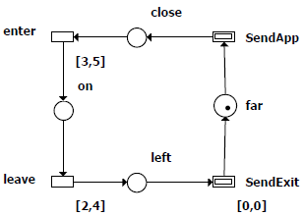
Labeled Discrete TPN model of a train

Slide 88
Discrete Time Petri Net Semantics
Place -> integer variable,
initial value=initial marking
Transitions -> define variable t.clock
unless [0,0] or [0,inf[
Time elapse -> additional transition labeled « elapse »
Sequence, for each transition t
If (enabled(t)) {
If ( t.clock < lft(t) ) {
t.clock=t.clock+1;
} else {
abort;
}
}
General case
If (enabled(t)) {
abort;
}
[0,0] urgent case
If (enabled(t)) {
If ( t.clock < eft(t) ) {
t.clock=t.clock+1;
}
}
[a,inf[ infinite lft case

Slide 89
DTPN : Transitions
Transition t -> transition <l,g,b>
l: Label is copied from input transition,
g: enabled(t) and t.clock >= eft(t)
b:
update place markings according to arc types and inscriptions,
reset current clock,
reset any disabled transition clocks (call(reset))
Reset disabled transitions: <reset,true,b> for each transition t :
If (! enabled(t)) {
t.clock=0;
}
General case
If no clock do nothing

Slide 90
Train Example, GAL
transition enter [ close >= 1 && enter.clock >= 3 ] {
close = close - 1 ;
self.reset ;
on = on + 1 ;
enter.clock = 0 ;
}

Slide 91
Using a fixpoint
Essential states construction [Popova]
Letting time elapse cannot disable transitions
Let time progress, only consider states that immediately follow a discrete transition
Time Elapse
Discrete Transition
Essential State
Compute green set :
let time elapse if it can
cumulate states
Fire transitions (succ) from resulting set

Slide 92
Fixpoint for « Essential States » of TPN
GAL tpnModel ($EFT = 3, $LFT = 5) {
int a = 1 ;
int b = 0 ;
int t.clock = 0 ;
transition t [a >= 1 && t.clock >= $EFT] label "succ"
{
a = a - 1 ;
b = b + 1 ;
t.clock = 0 ;
}

Slide 93
Essential States (2)
transition elapseIfpossible
[ a >= 1 && t.clock < $LFT] label "elapseIP" {
t.clock = t.clock + 1 ;
}
transition id [true] label "elapseIP" {
}
transition nextState [true] {
fixpoint {
self."elapseIP" ;
}
self."succ" ; // Any discrete transition
}
}

Slide 94
Colored Petri nets
Each place => an array of dimension proportional to domain
Uncolored places => size 1
Formal parameters => typedef of a range
Each transition => transition with parameters

Slide 95
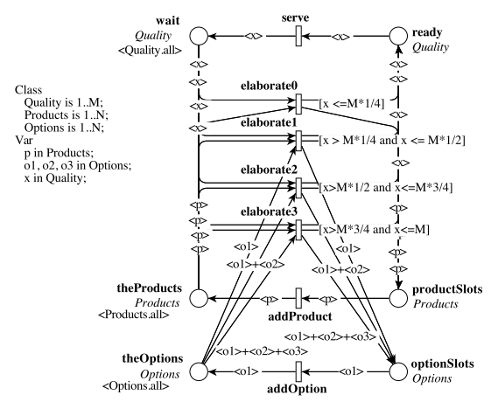
An example

Slide 96
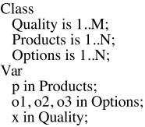
CPN example
GAL DrinkVending2 {
typedef Options = 0 .. 1 ;
typedef Products = 0 .. 1 ;
typedef Quality = 0 .. 7 ;
array [8] ready = (0, 0, 0, 0, 0, 0, 0, 0) ;
array [8] wait = (1, 1, 1, 1, 1, 1, 1, 1) ;
array [2] theProducts = (1, 1) ;
array [2] productSlots = (0, 0) ;
array [2] theOptions = (1, 1) ;
array [2] optionSlots = (0, 0) ;
Color Domains
M=8, N=2
Places

Slide 97

CPN example (2)
transition serve (Quality $x) [ready [$x] >= 1] {
ready [$x] = ready [$x] - 1 ;
wait [$x] = wait [$x] + 1 ;
}

Slide 98
Divine : a language for concurrent process
byte id;
byte t[3] = { 255 ,255 ,255 };
process P_0 {
state NCS, try, wait, CS;
init NCS;
trans
NCS -> try
{ guard id == 0; effect t[0] = 2;},
try -> wait
{ effect t[0] = 3, id =0 +1; },
wait -> wait
{ guard t[0] == 0; effect t[0] = 255;}, …
Global Variables
Process + Channels

Slide 99
Analyzing Divine models
Translate Divine concepts to GAL
Process state => variable
Divine variables and arrays => GAL equivalent
Guards, Instructions => GAL equivalent
Synchronizations => use GAL call semantics
Channels => GAL arrays + variable for size

Slide 100
Symbolic analysis of expressions
Symbolic data structures: BDD, MDD
k boolean variables => 2^{k}
Encode transitions with sets : 2^{k x} 2^{k}
Use the support (only k’ vars) of transitions
Build clusters of transitions
Reorder evaluations in fixpoint computation (chaining, saturation)
But :
Exponential worst case complexity when k’ grows
In general, necessary to invoke an explicit solver for each new state in 2^{k’}

Slide 101
LTSMin PINS interface
A system to relate explicit and symbolic engines
Interface :
System is a fixed set of integer variables
A transition is declared as an opaque function through its support, i.e. set of variables impacted
Algorithm for each transition :
Store as a DD projection of encountered states on support
Execute (explicit) transitions on new states only, store resulting states and transition DD

Slide 102
DDD support high level transition relations (NEW CAV’2013)
Computing the support
A[x + y] => pessimistic assumptions
x=x+1; y=y+1 => Atomic sequence of updates produce artificially large support
What if we could compute this on the fly ?
Carry the expression in a dedicated operation
Traverse a state -> path
Resolve variables as they are encountered
Drop pessimistic assumptions ASAP
But we must still reason with sets !

Slide 103
An equivalence relation ?
Partial expression evaluation
f = a + b
States : s1:(a=1, b=0) s2:(a=0,b=1)
If both a and b are known : f(s1)=f(s2), s1 and s2 are equivalent
If only a is known, f(s1)=1+b f(s2)=0+b s1 and s2 are NOT equivalent
Algorithm discovers variable values and builds equivalence classes on the fly
Split a node into a partition w.r.t the value of the expression
Cache the partition to reuse result in different computations

Slide 104
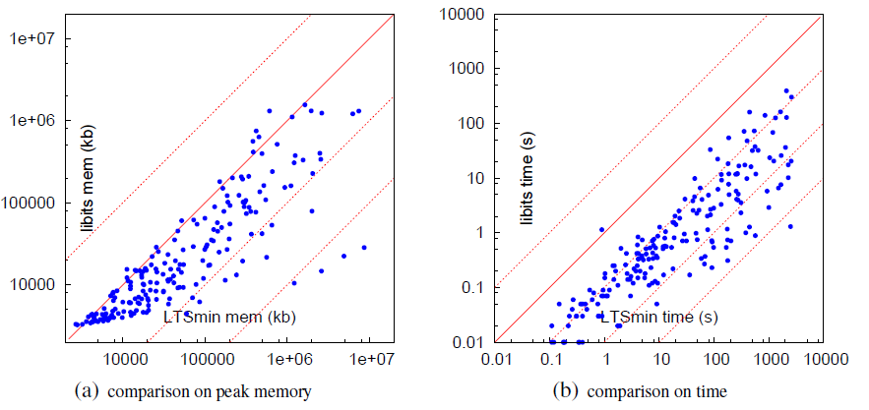
Performance evaluation (BEEM)

Slide 105
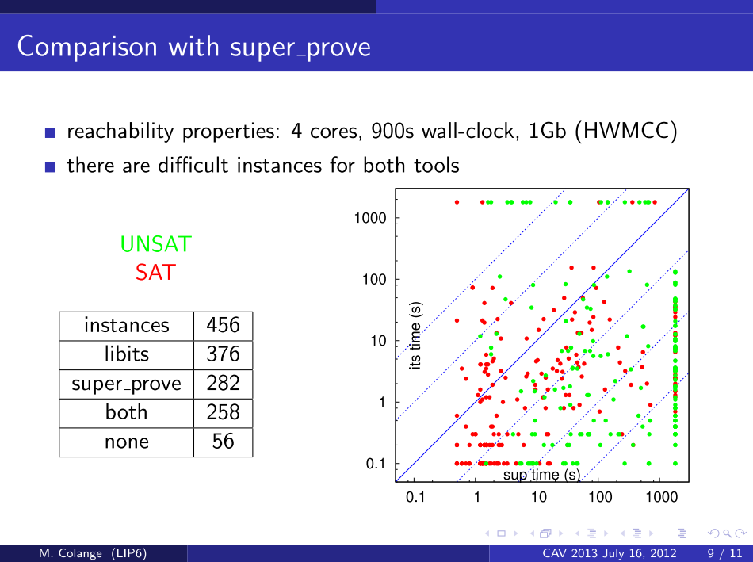

Slide 106
Conclusion
GAL modeling
A natural model for many discrete semantics
Efficient symbolic solution :
More transparency = more optimizations
ITS Composite for compositional modeling
Modular and hierarchical specifications
Efficient support for symmetric models
Model checking engine
Reachability (shortest traces)
CTL (Forward algorithms, traces)
LTL with Spot (Fully symbolic or hybrid)

Slide 107
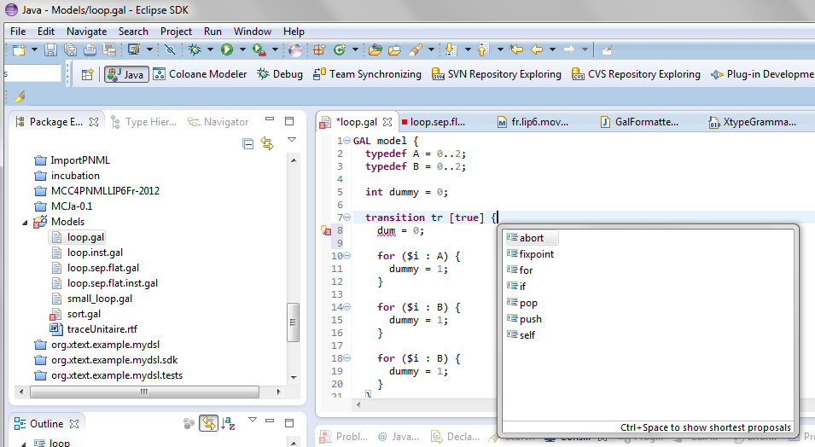
GAL Eclipse plugin (Thanks Xtext !)

Slide 108
Thank you for your attention !
SDD and ITS-tools are distributed as an open-source LGPL/GPL C++ source and pre-compiled tools :
http://ddd.lip6.fr
Eclipse plugin for GAL/ITS manipulation and CTL model-checking
http://coloane.lip6.fr/night-updates

