Slide 1
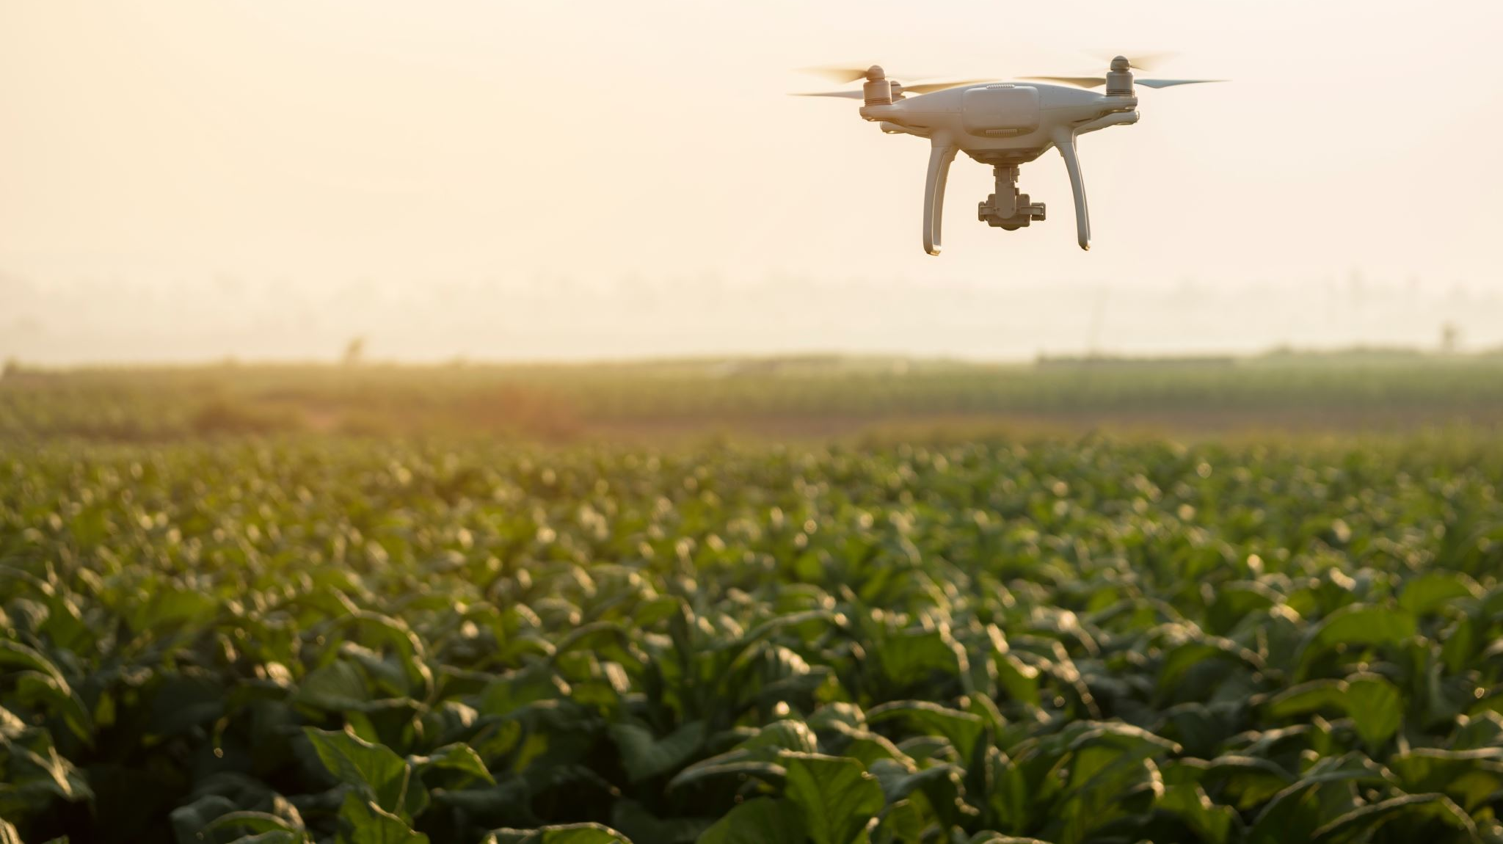
IT Technology in Agriculture
Yano shota

Slide 2
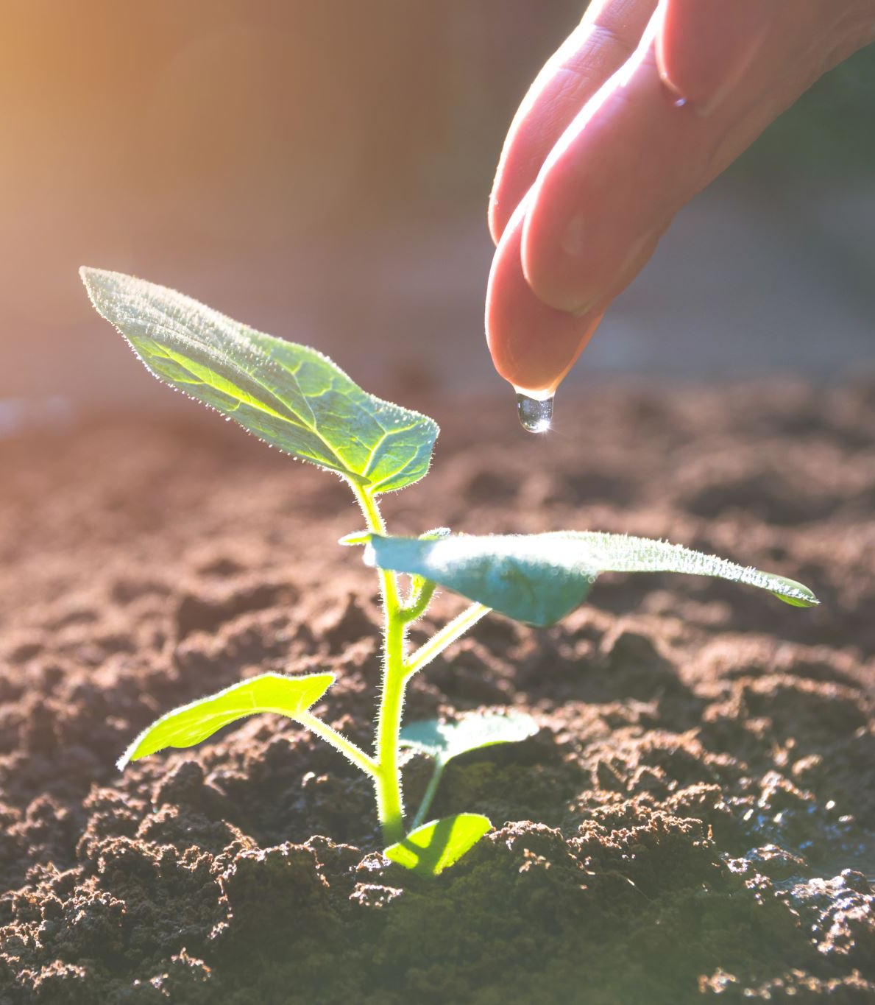
Human Resource Shortage
•The world of agriculture is now facing a serious shortage of human resources.
•Another factor contributing to labor shortages in agriculture is the instability of workloads.
•Agriculture dose not have a stable workload throughout the year, requiring more labor only during limited periods.
Outside of the season of plowing,sowing,and harvesting,the amount of work tends to decrease,and the work is not stable

Slide 3
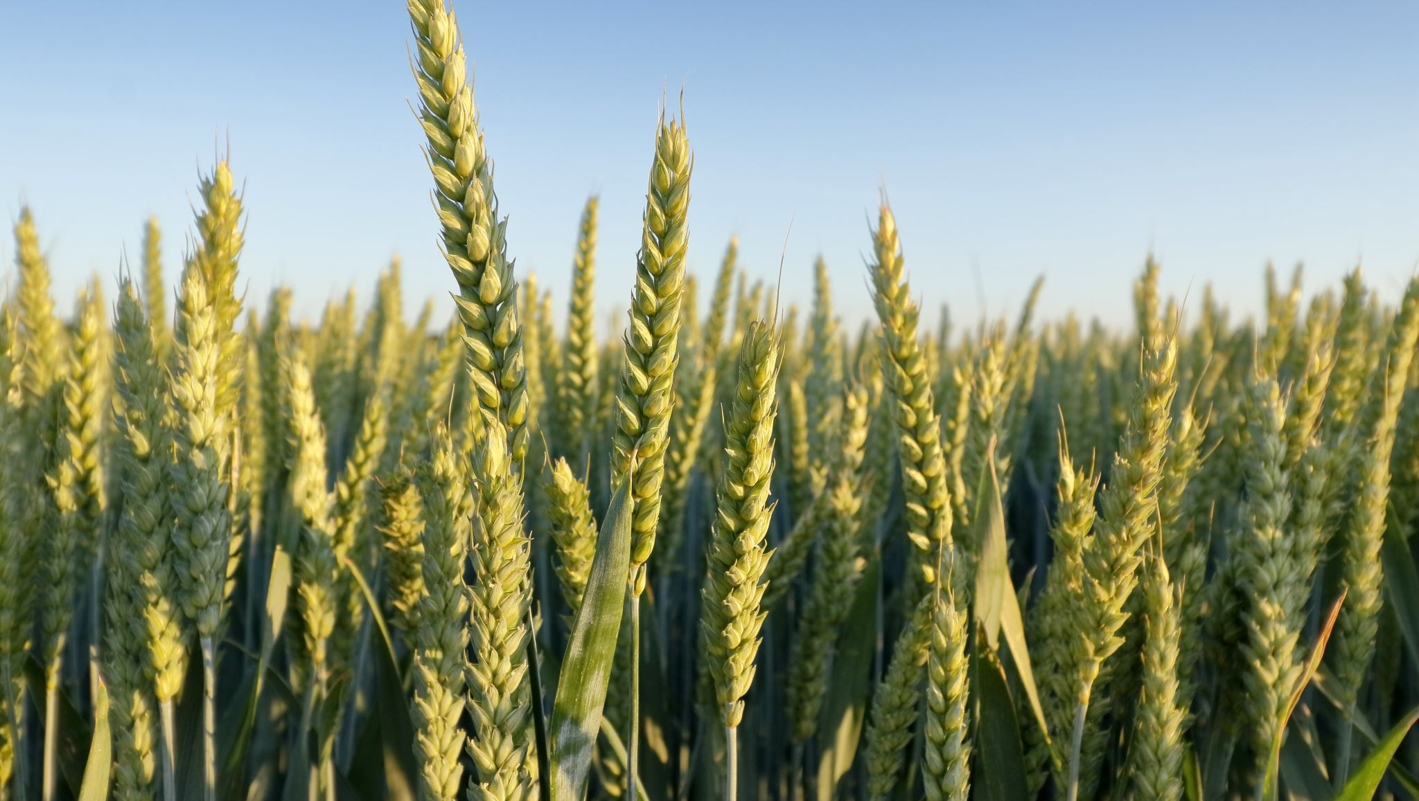
Giving Back to Agriculture
I graduated from an agricultural high school.
Eventually, I would like to solve various problems in agriculture with the power of IT.

Slide 4

Thank you for listening

