Slide 1
TIES4911 Deep-Learning for Cognitive Computing for Developers Demo2
Yanren Qu

Slide 2
Intro
https://github.com/yanren1/DLFCCP_Demo2

Slide 3
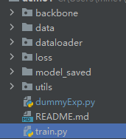
Structure
Backbone
Data
Dataloader
Loss
Model_saved
Utils
Train.py

Slide 4
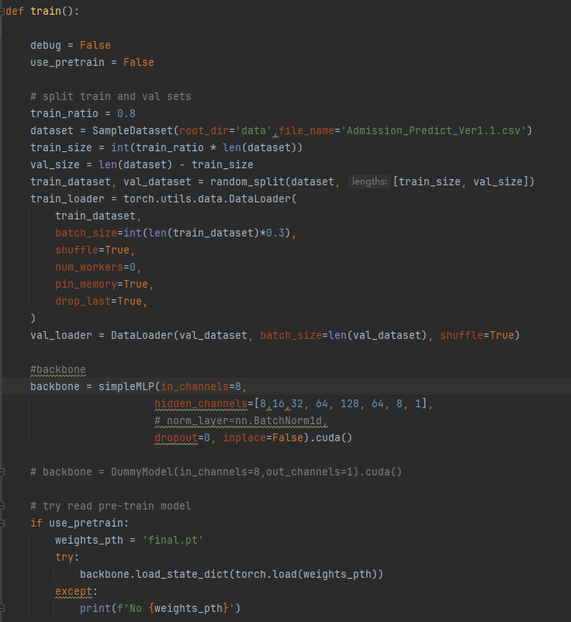
Train
Train and Val set
Batch size, shuffle, multi threads ...
Backbone initialization
Training resume

Slide 5
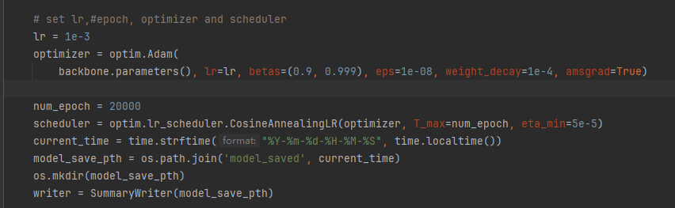
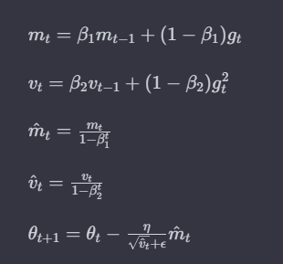
Optimizer
Adam
Hyperperameters:
lr, betas, eps, weight_decay, amsgrad
CosineAnnealing
Tensorboard initialization

Slide 6
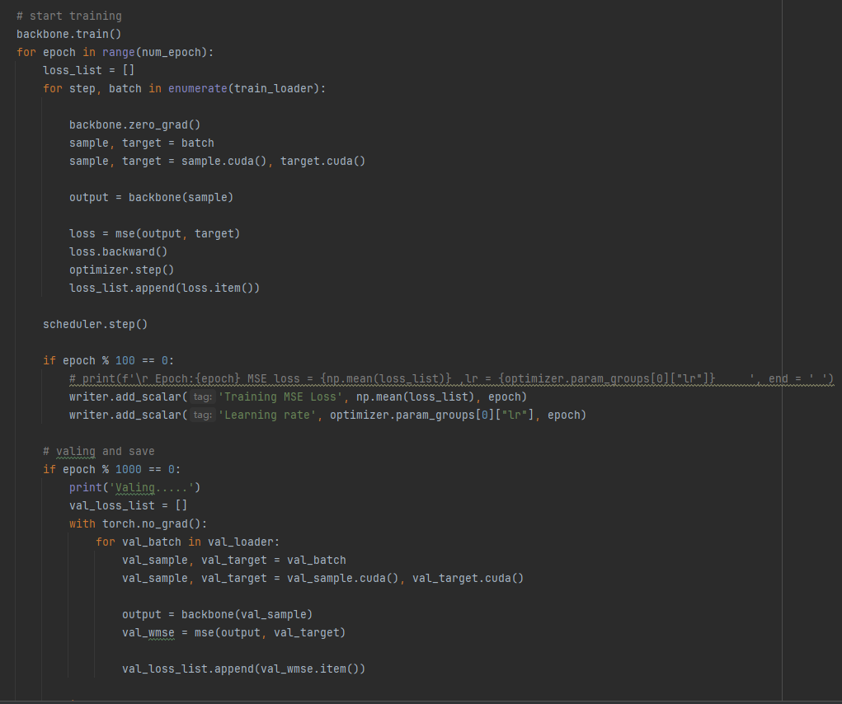
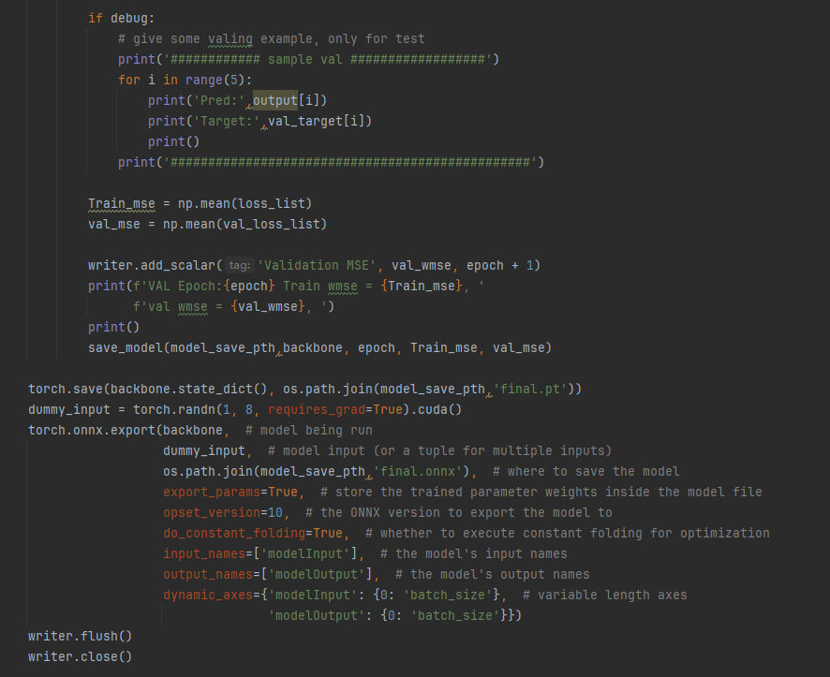
Trainning pipeline
Trainning and Valing
Save mse loss in Tensorboard
Model saving and onnx format support

Slide 7
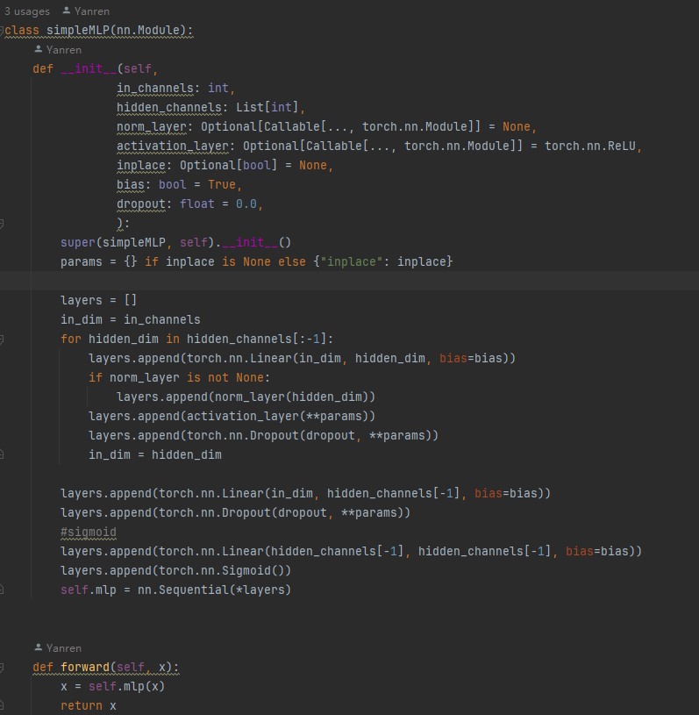
Backbone
Basic MLP model
Customizable hidden layers
NormLayers
Activation layers
Dropout

Slide 8
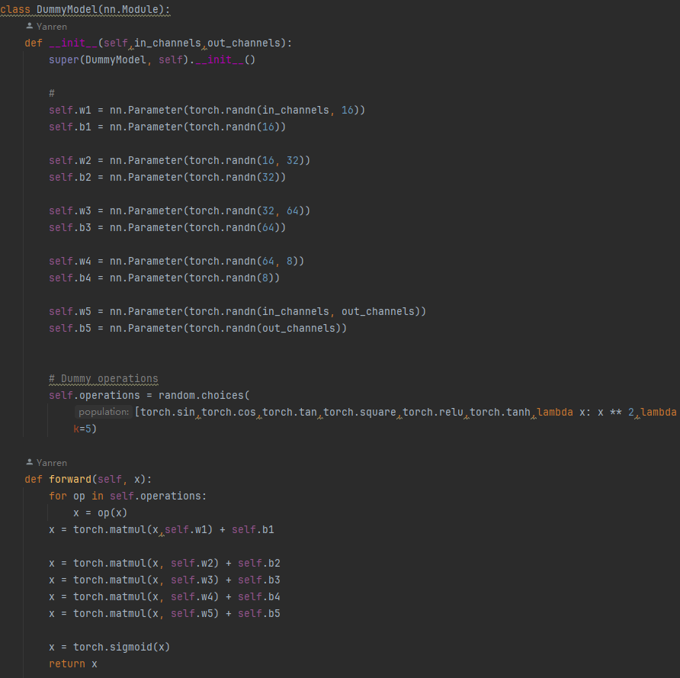
Backbone
GhostNetv2
Resnet18
3 Layer CNN

Slide 9
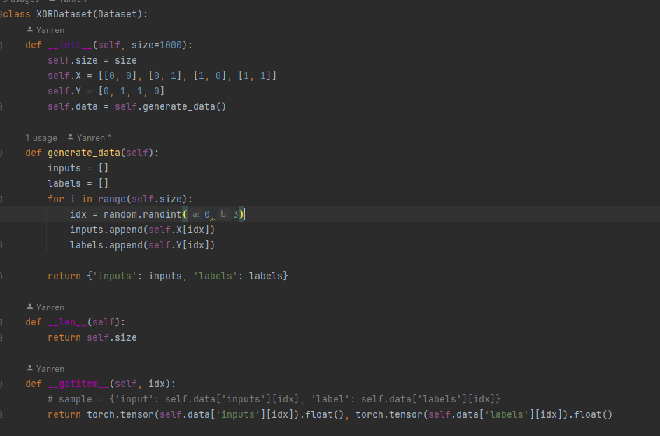
Data and Dataloader
Data :
1. FashionMnist
2. CIFAR10
https://www.cs.toronto.edu/~kriz/cifar.html
3. Customized XOR dataset

Slide 10
Loss
Softmax CE
MSE

Slide 11
Task2-1 Results
Adam Lr1e-4 - 1e-7 epoch 100
betas=(0.9, 0.999), eps=1e-08, weight_decay=1e-5
Loss CE
Model | Train CE | Val Acc
Single layer NN with dropout | 0.77841 | 74.7%
MLP (shallow) | 0.39018 | 86.9%
MLP (deep) | 0.16393 | 89.5%
resnet18 | 0.000103 | 90.4%

Slide 12
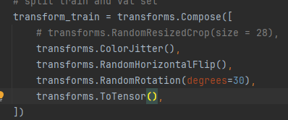
Task2-2 Results CIFAR10
Adam Lr 1e-3 epoch 50
betas=(0.9, 0.999), eps=1e-08, weight_decay=1e-5
Loss CE
Image Preprocessing
Model | Train CE | Val Acc
Single layer NN | 1.685 | 40.7%
Single layer NN with preprocessing | 1.7912 | 39.0%
MLP (shallow) | 0.32 | 50.9%
MLP (shallow) with preprocessing | 0.64 | 60.5%

Slide 13
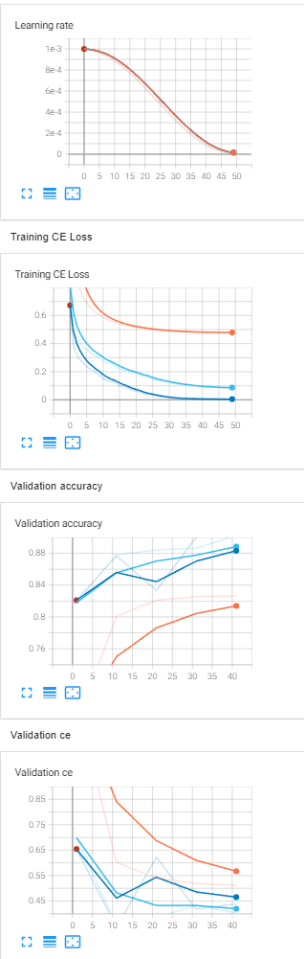
Task2-3 Results Fashion Mnist
Adam Lr 1e-3 epoch 50
betas=(0.9, 0.999), eps=1e-08, weight_decay=1e-5
Loss CE
Image Preprocessing
Dropout = 0.1
Model | Train CE | Val Acc
Single layer NN without dropout | 0.4793 | 82.6%
MLP without dropout | 0.00478 | 90.04%
MLP with dropout | 0.0874 | 90.26%

Slide 14
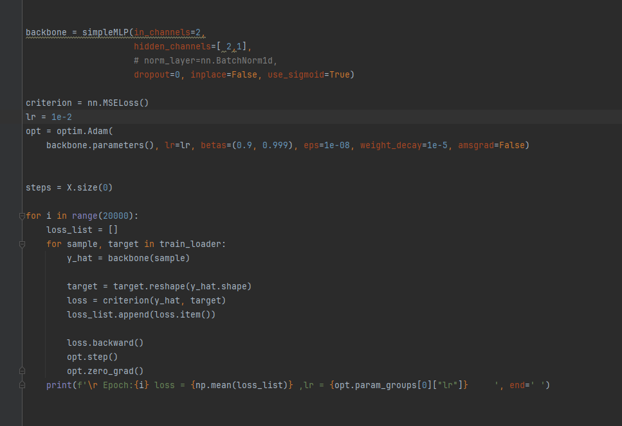
XOR Gate
1. Backbone MLP
2. Customized XOR dataset
3. loss: MSE
Single Layer NN cannot handle this problem

