Slide 1
TIES4911 Deep-Learning for Cognitive Computing for Developers Demo3
Yanren Qu

Slide 2
Intro
https://github.com/yanren1/DLFCCP_Task3

Slide 3

Structure
Backbone
Data
Dataloader
Loss
Model_saved
Utils
Train.py

Slide 4
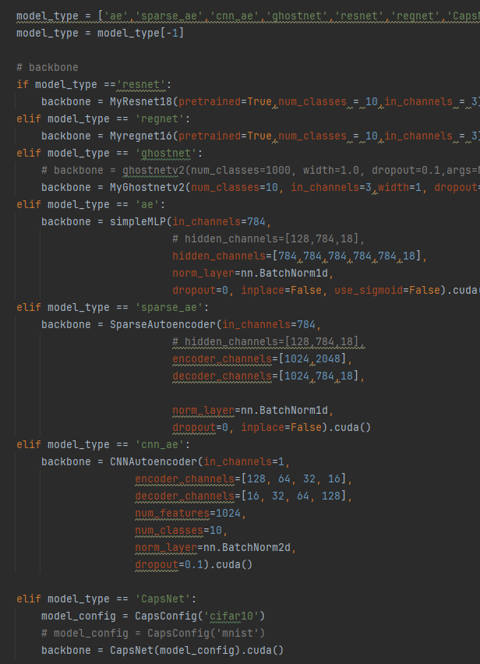
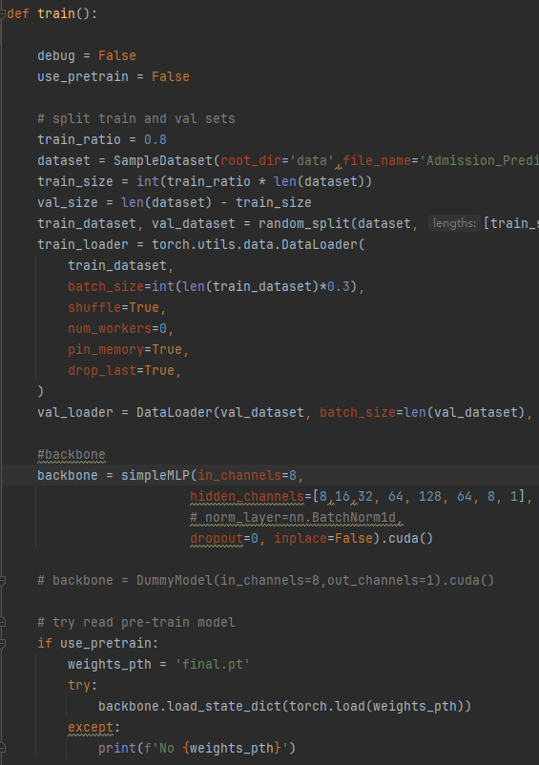
Train
Train and Val set
Batch size, shuffle, multi threads ...
Backbone initializations
Training resume

Slide 5
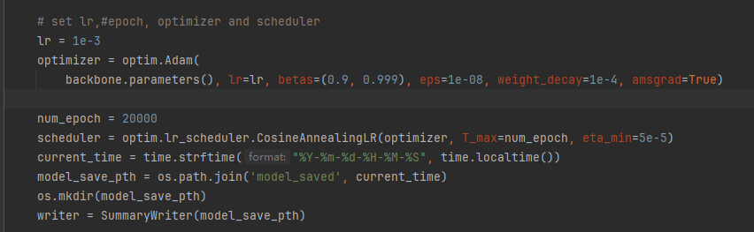
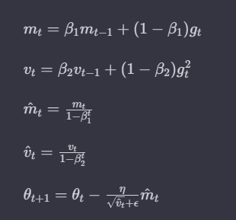
Optimizer
Adam
Hyperperameters:
lr, betas, eps, weight_decay, amsgrad
CosineAnnealing
Tensorboard initialization

Slide 6
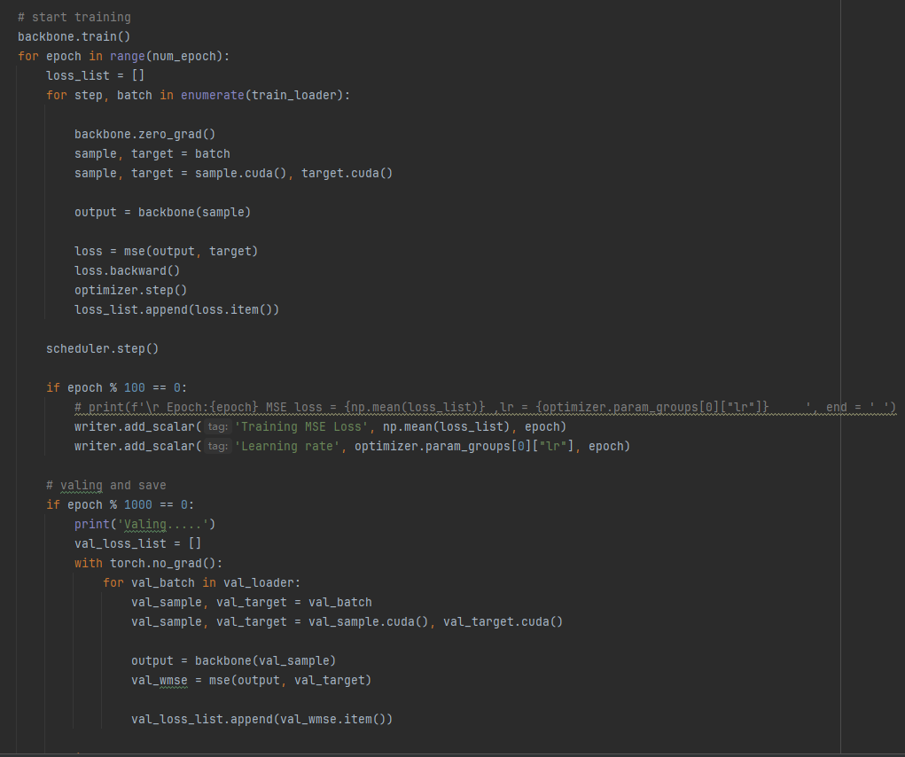
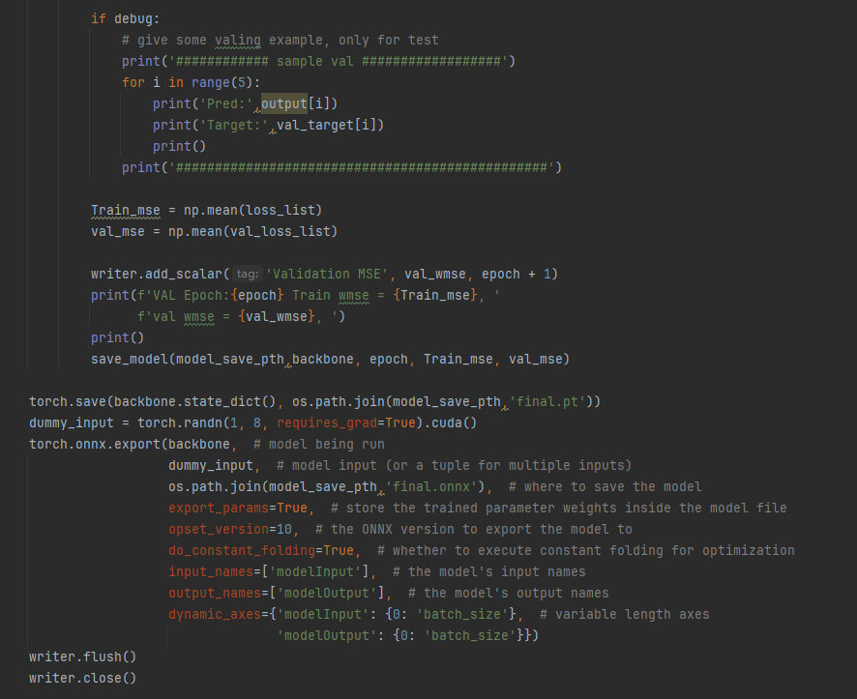
Trainning pipeline
Trainning and Valing
Save mse loss in Tensorboard
Model saving and onnx format support

Slide 7
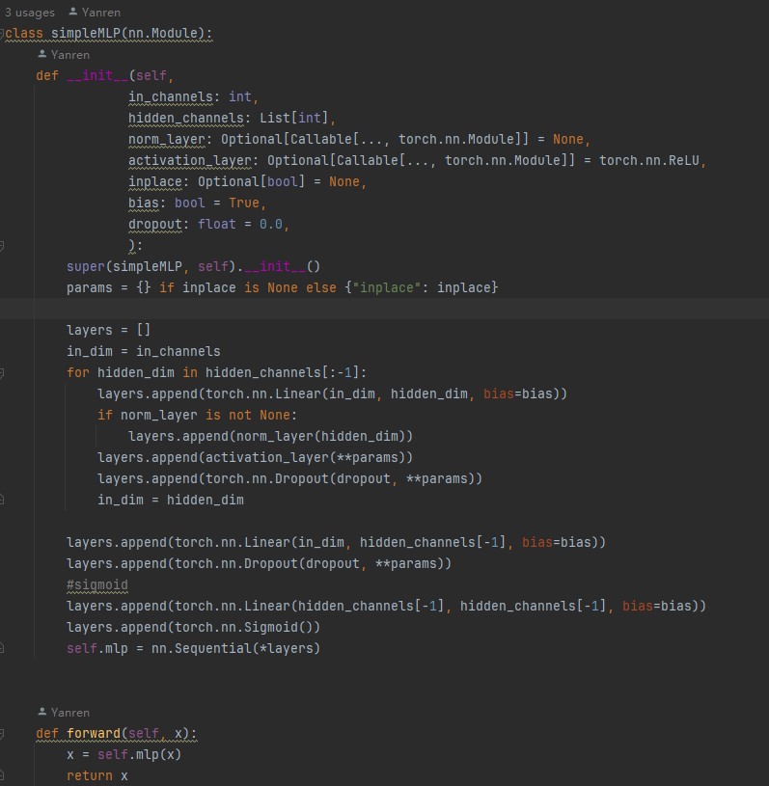
Backbone
Basic MLP model, AutoEncoder
Customizable hidden layers
NormLayers
Activation layers
Dropout

Slide 8
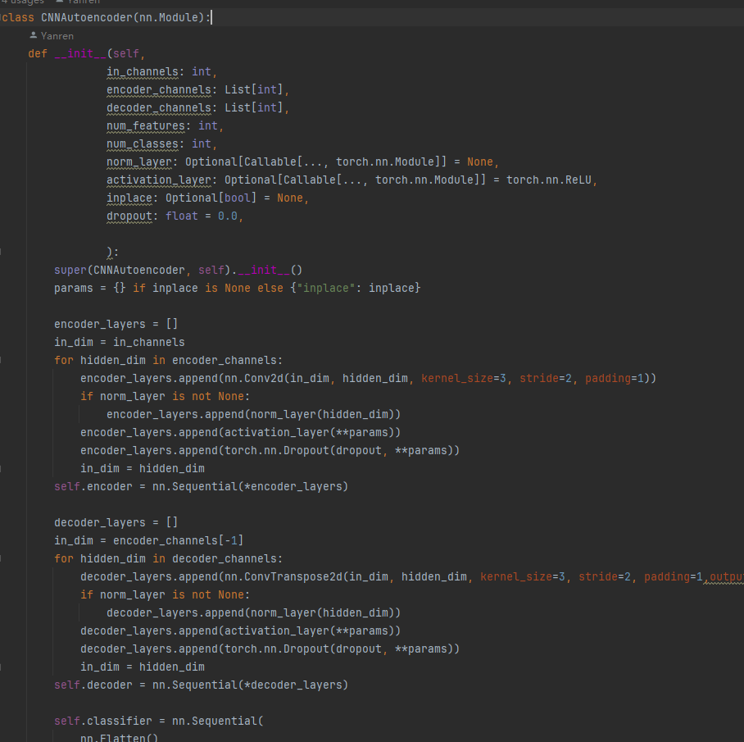
Backbones
GhostNetv2
Resnet18
regnet_y_1_6gf
Sparse-AE
CNN-AE (FCN-UNet)
CapsuleNet

Slide 9
Data and Dataloader
Data :
1. FashionMnist
2. CIFAR10
https://www.cs.toronto.edu/~kriz/cifar.html

Slide 10
Loss
Softmax CE
MarginLoss + ReconstructionLoss
Sparse Loss

Slide 11
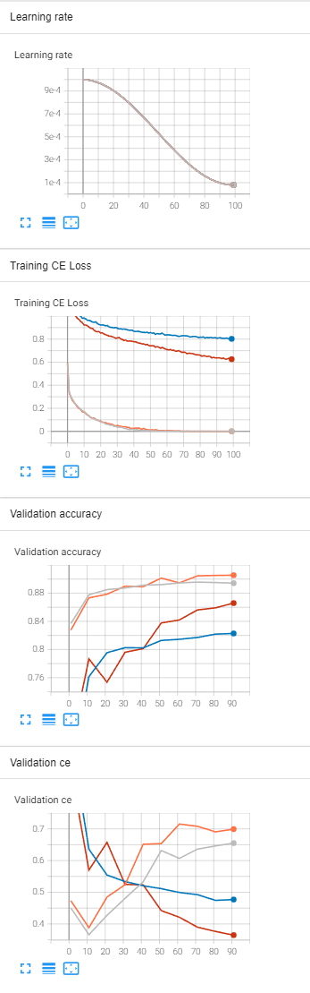
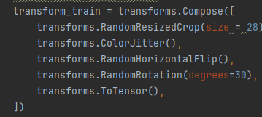
Task3-1 Results AE
Lr 1e-3 ~ 8e-5, epoch 100, batch size 1024
Adam betas=(0.9, 0.999), eps=1e-08, weight_decay=1e-5
Loss CE
Image Augmentations
Model | Train CE | Val Acc Top1
Vanilla AE 784-128-784-18 | 7.78e-4 | 89.4%
Deep AE 784-4096-2048-1024-2048-4096-18 | 5.24e-4 | 90.1%
Vanilla AE With image augmentation 784-128-784-18 | 0.8036 | 82.3%
Deep AE With image augmentation 784-4096-2048-1024-2048-4096-18 | 0.6258 | 86.6%

Slide 12
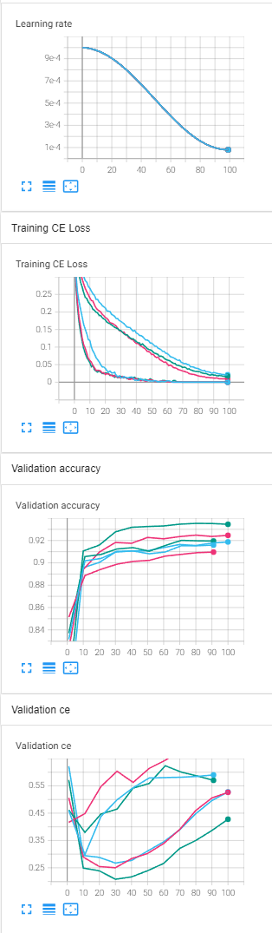
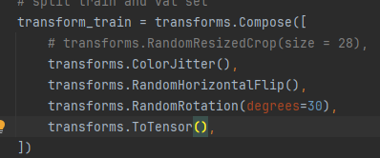
Task3-2 Results CNN
Lr 1e-3 ~ 8e-5, epoch 100, batch size 1024(512 for GhostnetV2)
Adam betas=(0.9, 0.999), eps=1e-08, weight_decay=1e-5
Loss CE
Image Augmentations
Model | Train CE | Val Acc Top1
Resnet18 (pretrained on ImageNet 1k) | 3.0132e-5 | 91.59%
Regnet1.6gf(pretrained on ImageNet 1k) | 2.4177e-5 | 90.96%
GhostNetV2 (width = 1.0 , without pretraining) | 4.2568e-5 | 91.95%
Resnet18 (pretrained on ImageNet 1k) With Image Augmentations | 0.02116 | 91.87%
Regnet1.6gf(pretrained on ImageNet 1k) With Image Augmentations | 9.2882e-3 | 92.46%
GhostNetV2 (width = 1.0 , without pretraining) With Image Augmentations | 0.01716 | 93.45%

Slide 13
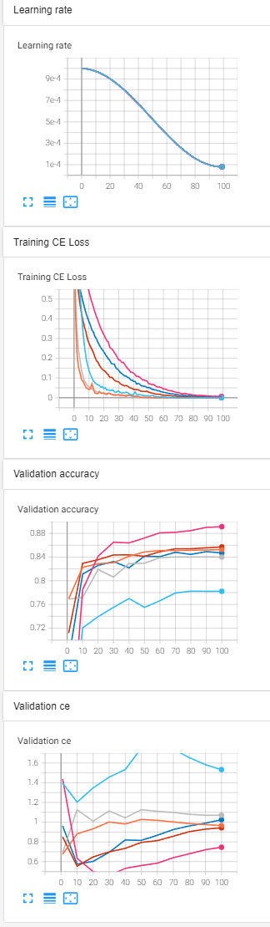
Task3-3 Results CNN Cifar10
Lr 1e-3 ~ 8e-5, epoch 100, batch size 1024(512 for GhostnetV2)
Adam betas=(0.9, 0.999), eps=1e-08, weight_decay=1e-5
Loss CE
Image Augmentations
Model | Train CE | Val Acc Top1
Resnet18 (pretrained on ImageNet 1k) | 3.0059e-5 | 84.00%
Regnet1.6gf(pretrained on ImageNet 1k) | 2.7273e-5 | 83.66%
GhostNetV2 (width = 1.0 , without pretraining) | 4.2537e-5 | 78.22%
Resnet18 (pretrained on ImageNet 1k) With Image Augmentations | 3.0284e-3 | 85.26%
Regnet1.6gf(pretrained on ImageNet 1k) With Image Augmentations | 1.3705e-3 | 85.72%
GhostNetV2 (width = 1.0 , without pretraining) With Image Augmentations | 6.3434e-3 | 89.14%

Slide 14
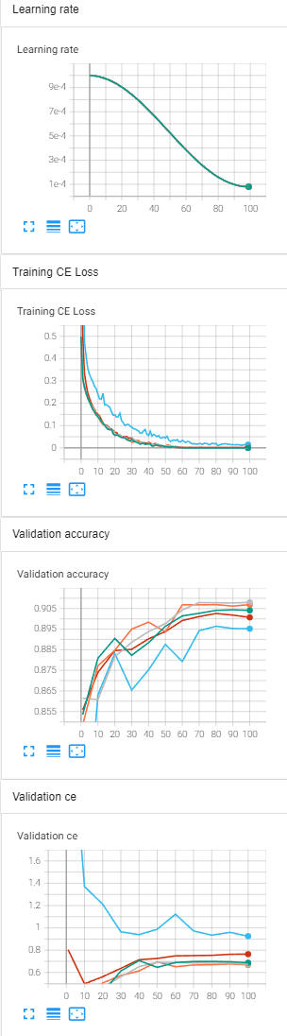
Task3-4 Results AE
Lr 1e-3 ~ 8e-5, epoch 100, batch size 1024
Adam betas=(0.9, 0.999), eps=1e-08, weight_decay=1e-5
Loss CE
Model | Train CE | Val Acc
Sparse AE (undercomplete) 784-512-128-512-784 | 1.5377e-3 | 90.07%
Sparse AE (overcomplete) 784-1024-2048-1024-784 | 0.0143 | 89.52%
Denoising AE 784-512-512-512-512-512-18 | 4.7232e-5 | 90.41%
Denoising AE 784-1024-1024-1024-1024-1024-18 | 4.8498e-5 | 90.80%
Denoising AE 784-784-784-784-784-784-18 | 4.6531e-5 | 90.69%

Slide 15
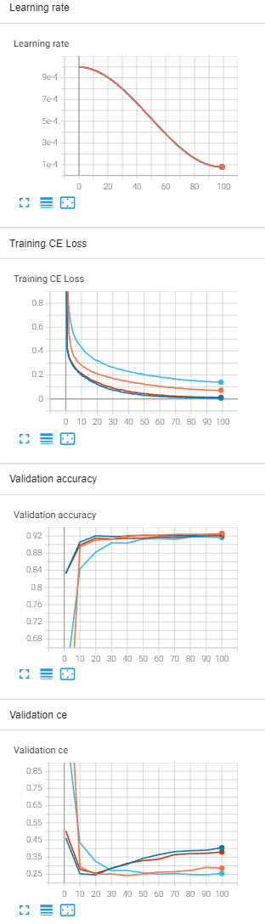
Task3-5 Results CNN-AE on FashionMnist
Lr 1e-3 ~ 8e-5, epoch 100, batch size 1024
Adam betas=(0.9, 0.999), eps=1e-08, weight_decay=1e-5
Loss CE
Model | Train CE | Val Acc
CNN-AE 16-32-64-128-128-64-32 | 0.07274 | 92.58%
CNN-AE 16-32-32-16 | 7.257e-3 | 92.51%
CNN-AE 32-16-16-32 | 0.01281 | 92.08%
CNN-AE 128-64-32-16-16-32-64-128 | 0.1397 | 91.63%

Slide 16
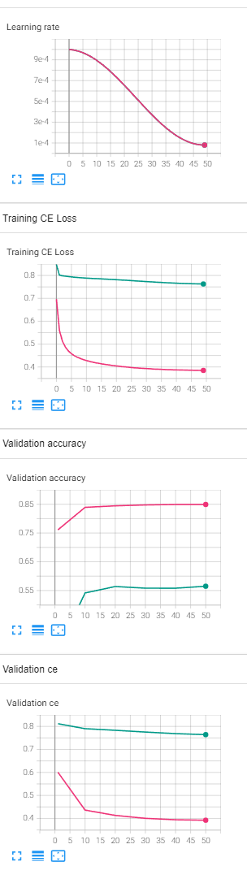
Task3-6 CapsuleNet
Lr 1e-3 ~ 8e-5, epoch 50, batch size 1024 (512 for Cifar10)
Adam betas=(0.9, 0.999), eps=1e-08, weight_decay=1e-5
MarginLoss + ReconstructionLoss
The performance of this network on cifar10 is bad, it is incomparable with the previous backbones.
No pretrained model on Pytorch on large dataset, Comparison on general tasks is not available.
Normalization is crucial for this model, if there’s no Data Normalization, model will stop to converge on very early stage.
Ref: https://github.com/jindongwang/Pytorch-CapsuleNet
Model | Train CE | Val Acc
CapsuleNet FashionMnist | 0.385 | 84.92%
CapsuleNet Cifar10 | 0.76428 | 56.49%

