Slide 1
TIES4911 Deep-Learning for Cognitive Computing for Developers Demo3
Yanren Qu

Slide 2
Intro
https://github.com/yanren1/DLFCCP_Task3

Slide 3

Structure
Backbone
Data
Dataloader
Loss
Model_saved
Utils
Train.py

Slide 4
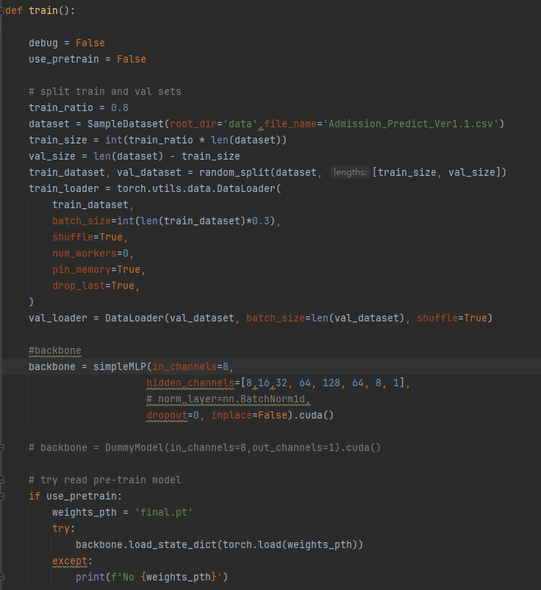
Train
Train and Val set
Batch size, shuffle, multi threads ...
Backbone initialization
Training resume

Slide 5
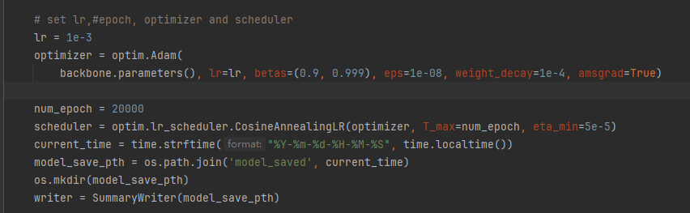
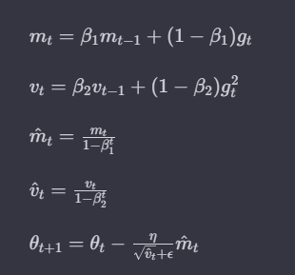
Optimizer
Adam
Hyperperameters:
lr, betas, eps, weight_decay, amsgrad
CosineAnnealing
Tensorboard initialization

Slide 6
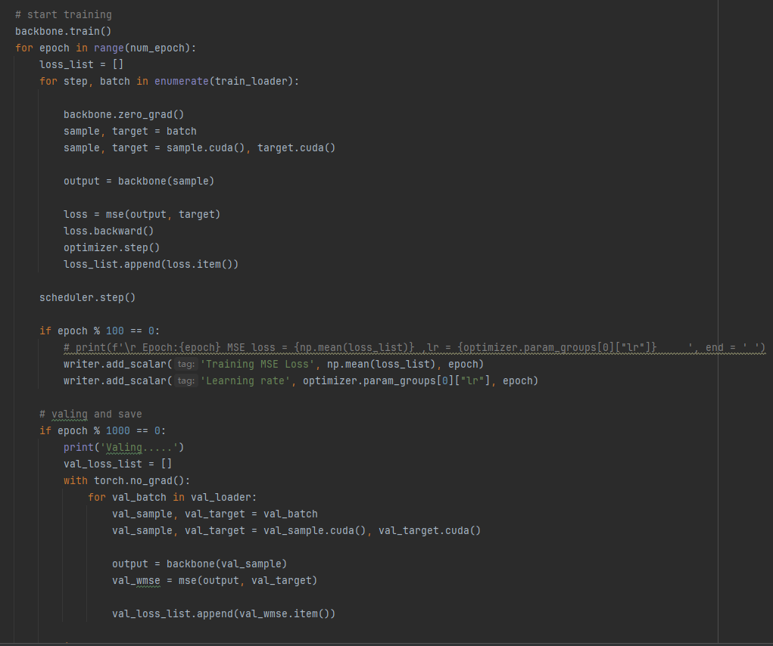
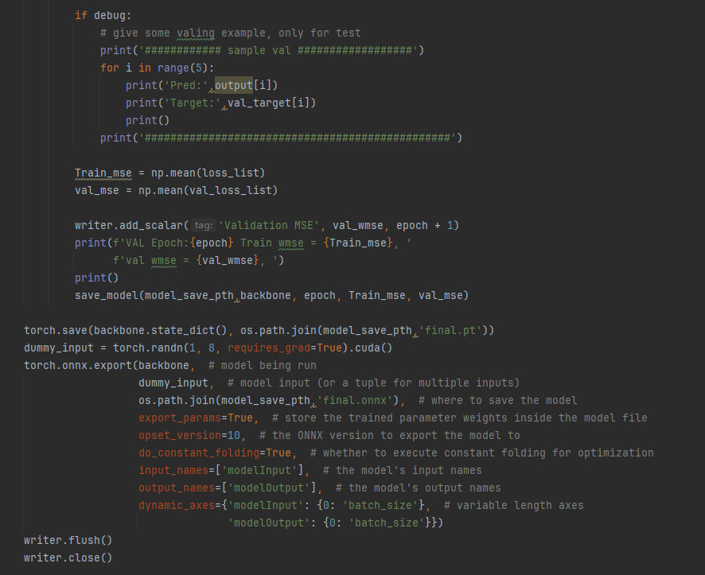
Trainning pipeline
Trainning and Valing
Save mse loss in Tensorboard
Model saving and onnx format support

Slide 7
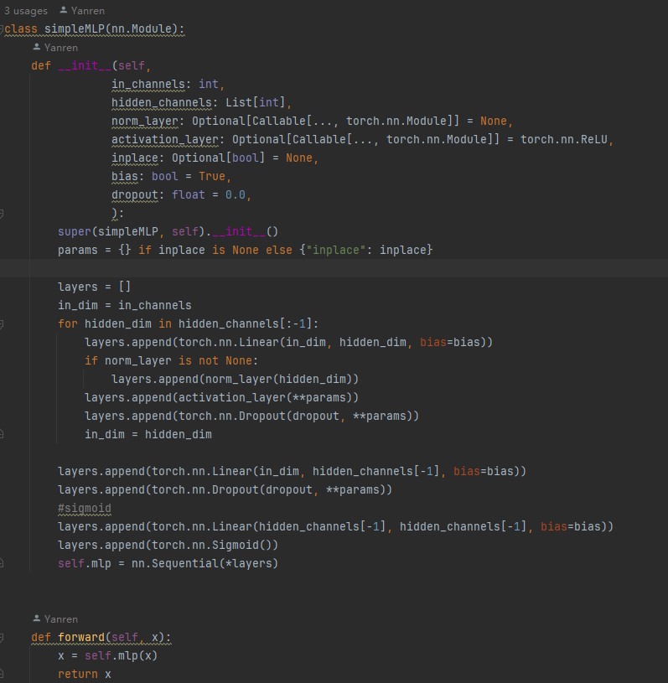
Backbone
Basic MLP model, AutoEncoder
Customizable hidden layers
NormLayers
Activation layers
Dropout

Slide 8
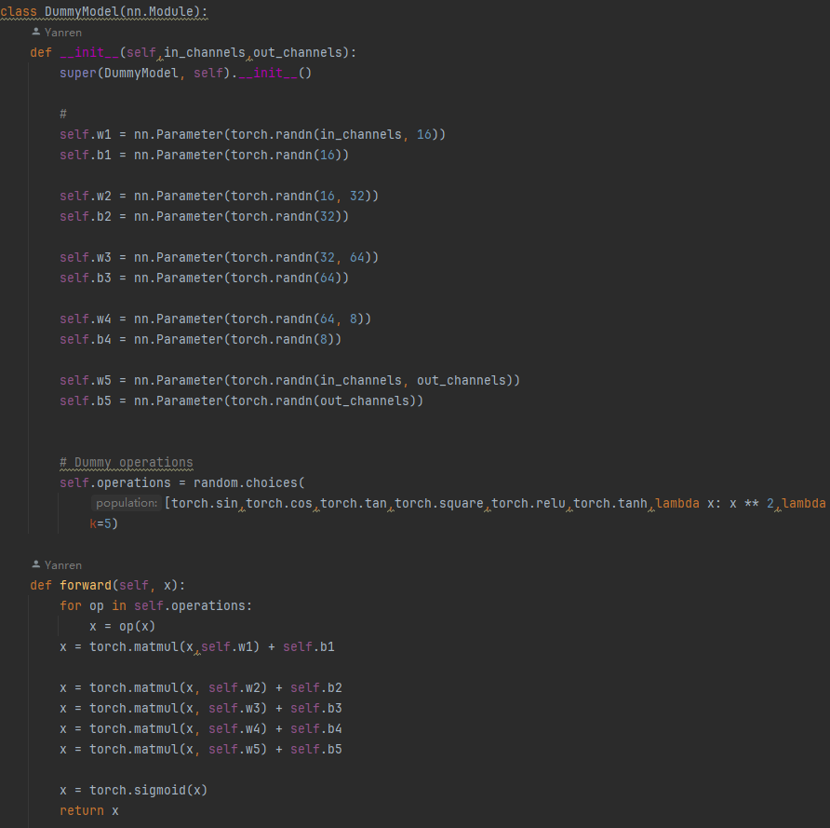
Backbones
GhostNetv2
Resnet18
regnet_y_1_6gf

Slide 9
Data and Dataloader
Data :
1. FashionMnist
2. CIFAR10
https://www.cs.toronto.edu/~kriz/cifar.html

Slide 10
Loss
Softmax CE

Slide 11
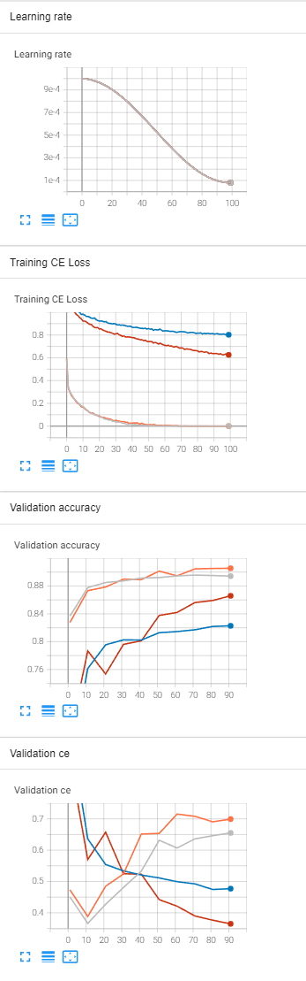
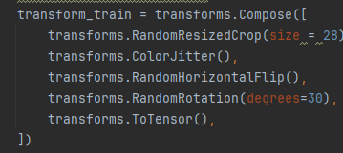
Task3-1 Results AE
Lr 1e-3 ~ 8e-5, epoch 100, batch size 1024
Adam betas=(0.9, 0.999), eps=1e-08, weight_decay=1e-5
Loss CE
Image Augmentations
Model | Train CE | Val Acc Top1
Vanilla AE 784-128-784-18 | 7.78e-4 | 89.4%
Deep AE 784-4096-2048-1024-2048-4096-18 | 5.24e-4 | 90.1%
Vanilla AE With image augmentation 784-128-784-18 | 0.8036 | 82.3%
Deep AE With image augmentation 784-4096-2048-1024-2048-4096-18 | 0.6258 | 86.6%

Slide 12
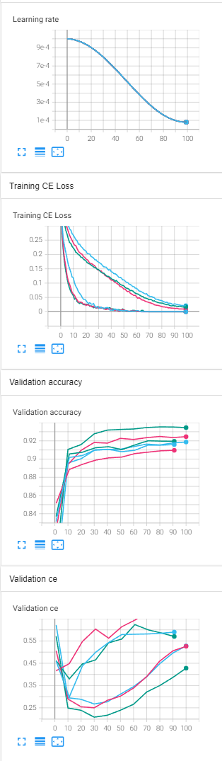
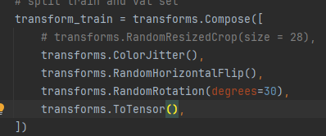
Task3-2 Results CNN
Lr 1e-3 ~ 8e-5, epoch 100, batch size 1024(512 for GhostnetV2)
Adam betas=(0.9, 0.999), eps=1e-08, weight_decay=1e-5
Loss CE
Image Augmentations
Model | Train CE | Val Acc Top1
Resnet18 (pretrained on ImageNet 1k) | 3.0132e-5 | 91.59%
Regnet1.6gf(pretrained on ImageNet 1k) | 2.4177e-5 | 90.96%
GhostNetV2 (width = 1.0 , without pretraining) | 4.2568e-5 | 91.95%
Resnet18 (pretrained on ImageNet 1k) With Image Augmentations | 0.02116 | 91.87%
Regnet1.6gf(pretrained on ImageNet 1k) With Image Augmentations | 9.2882e-3 | 92.46%
GhostNetV2 (width = 1.0 , without pretraining) With Image Augmentations | 0.01716 | 93.45%

Slide 13
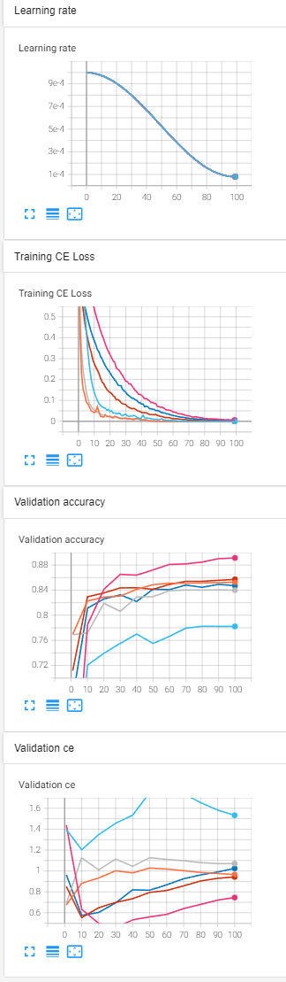
Task3-3 Results CNN Cifar10
Lr 1e-3 ~ 8e-5, epoch 50, batch size 1024(512 for GhostnetV2)
Adam betas=(0.9, 0.999), eps=1e-08, weight_decay=1e-5
Loss CE
Image Augmentations
Model | Train CE | Val Acc Top1
Resnet18 (pretrained on ImageNet 1k) | 3.0059e-5 | 84.00%
Regnet1.6gf(pretrained on ImageNet 1k) | 2.7273e-5 | 83.66%
GhostNetV2 (width = 1.0 , without pretraining) | 4.2537e-5 | 78.22%
Resnet18 (pretrained on ImageNet 1k) With Image Augmentations | 3.0284e-3 | 85.26%
Regnet1.6gf(pretrained on ImageNet 1k) With Image Augmentations | 1.3705e-3 | 85.72%
GhostNetV2 (width = 1.0 , without pretraining) With Image Augmentations | 6.3434e-3 | 89.14%

Slide 14
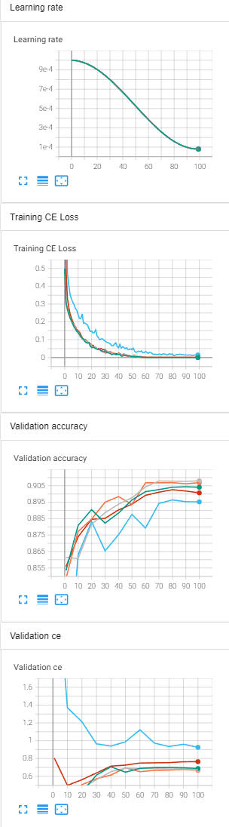
Task3-4 Results AE on Cifar10
Lr 1e-3 ~ 8e-5, epoch 100, batch size 1024
Adam betas=(0.9, 0.999), eps=1e-08, weight_decay=1e-5
Loss CE
Model | Train CE | Val Acc Top1
Sparse AE (undercomplete) 784-512-128-512-784-18 | 1.5377e-3 | 90.07%
Sparse AE (overcomplete) 784-1024-2048-1024-784-18 | 0.0143 | 89.52%
Denoising AE 784-512-512-512-512-512-18 | 4.7232e-5 | 90.41%
Denoising AE 784-1024-1024-1024-1024-1024-18 | 4.8498e-5 | 90.80%
Denoising AE 784-784-784-784-784-784-18 | 4.6531e-5 | 90.69%

Slide 15
Task3-5 Results CNN-AE on Cifar10
Lr 1e-3 ~ 8e-5, epoch 100, batch size 1024
Adam betas=(0.9, 0.999), eps=1e-08, weight_decay=1e-5
Loss CE
Model | Train CE | Val Acc Top1
CNN-AE 16-32-64-128-128-64-32-16 | 0.07274 | 92.58%
CNN-AE 16-32-32-16 | 7.257e-3 | 92.51%
CNN-AE 32-16-16-32 | 0.01281 | 92.08%
CNN-AE 128-64-32-16-16-32-64-128 | 0.1397 | 91.63%

