Slide 1
TIES4911 Deep-Learning for Cognitive Computing for Developers Task4
Yanren Qu

Slide 2
Intro
https://github.com/yanren1/DLFCCP_Task4

Slide 3
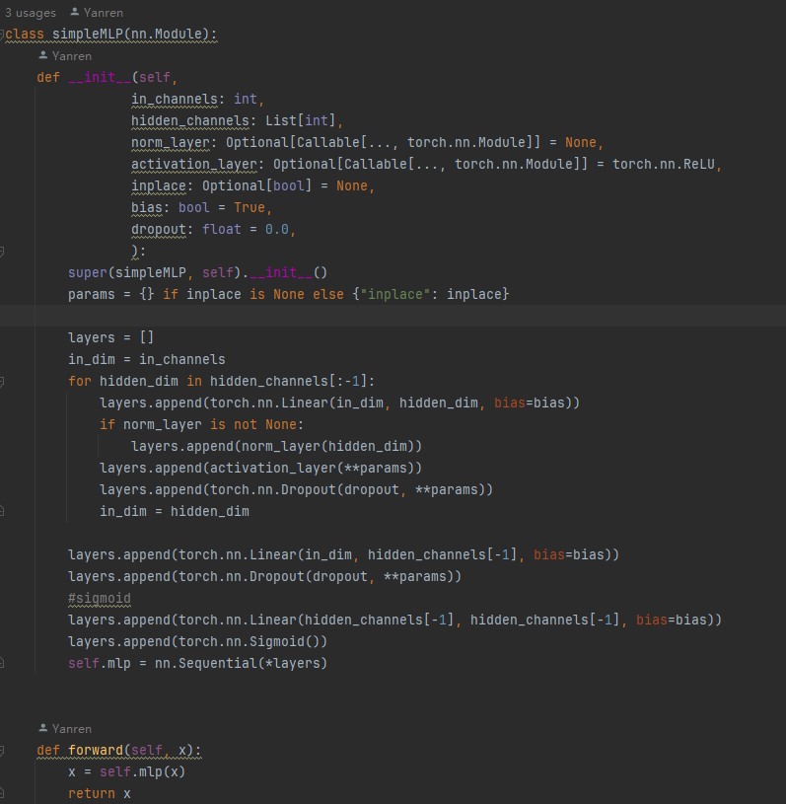
Backbone
Resnet18
Efficientnet_b0
Efficientnet_v2_m
Mobilenet_v3_large
GhostNetV2

Slide 4
Data and Dataloader
Data :
1. Caltech256 https://data.caltech.edu/records/nyy15-4j048
2.CoCo https://cocodataset.org/#home

Slide 5
Loss
Softmax CE
BCE loss

Slide 6
Task4-1 Pretrained Model
Model | Acc@1 | Acc@5
Resnet18 (pretrained on ImageNet 1k) | 69.758% | 89.078%
EfficientNet_B0 (pretrained on ImageNet 1k) | 77.692% | 93.532%
MobileNet_V3_Large (pretrained on ImageNet 1k) | 74.042% | 91.34%

Slide 7

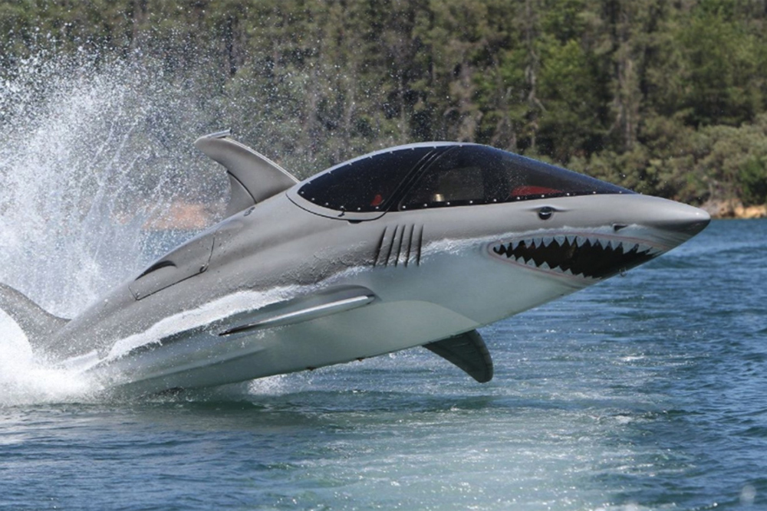
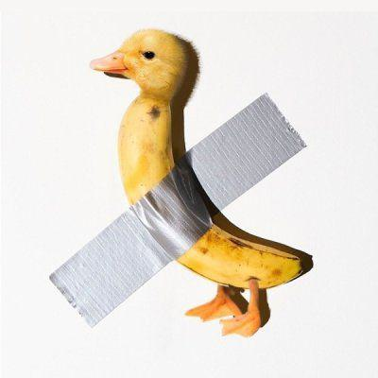
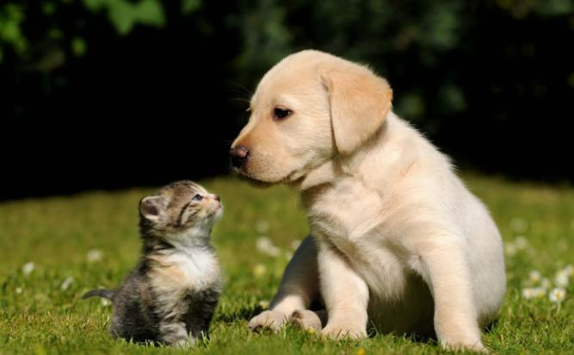

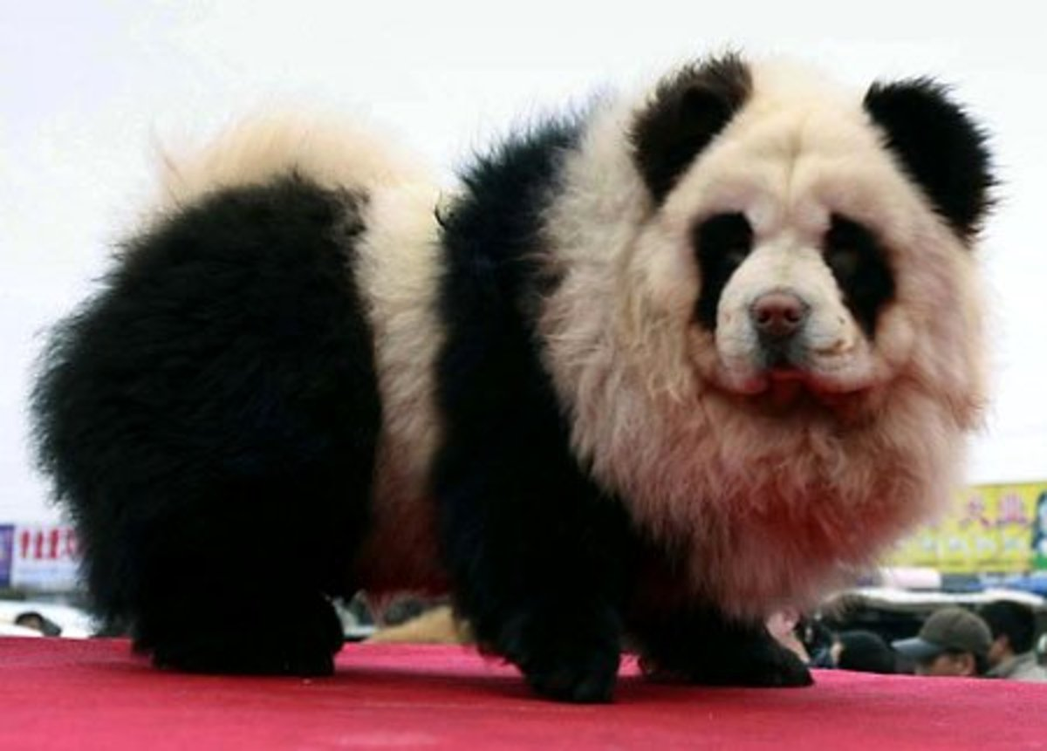
Task4-1 Tricky Image Results
Model | Predict
Resnet18 | tennis ball: 64.9%
EfficientNet_B0 | Chihuahua: 12.8%
MobileNet_V3_Large | rock beauty: 8.1%
Model | Predict
Resnet18 | Killer whale: 64.2%
EfficientNet_B0 | Killer whale: 41.1%
MobileNet_V3_Large | Killer whale: 46.3%
Model | Predict
Resnet18 | goldfinch: 68.3%
EfficientNet_B0 | cleaver: 36.1%
MobileNet_V3_Large | brambling: 6.1%
Model | Predict
Resnet18 | Labrador retriever: 38.4%
EfficientNet_B0 | Labrador retriever: 64.5%
MobileNet_V3_Large | golden retriever: 30.6%
Model | Predict
Resnet18 | pickelhaube: 15.3%
EfficientNet_B0 | pickelhaube: 11.9%
MobileNet_V3_Large | pickelhaube: 24.6%
Model | Predict
Resnet18 | giant panda: 70.7%
EfficientNet_B0 | giant panda: 15.1%
MobileNet_V3_Large | giant panda: 9.3%

Slide 8
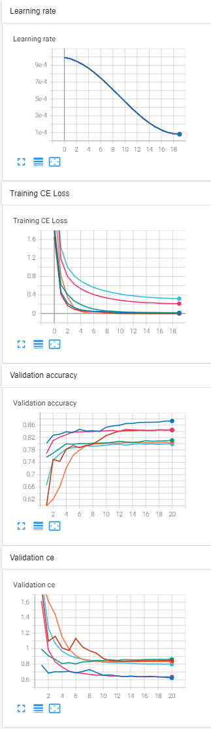
Task4-2 Training with Frozen Layer
Lr 1e-3 ~ 8e-5, epoch 20, batch size=256
Adam betas=(0.9, 0.999), eps=1e-08, weight_decay=1e-5
Loss CE
Dataset Caltech256, image size = 224
Model | Train CE | Acc@1
Resnet18 (pretrained on ImageNet 1k) | 9.7485e-4 | 80.25%
EfficientNet_B0 (pretrained on ImageNet 1k) | 2.9763e-3 | 87.32%
MobileNet_V3_Large (pretrained on ImageNet 1k) | 4.8167e-4 | 84.37%
Resnet18 (pretrained on ImageNet 1k) with Frozen Layer except classifier | 0.3208 | 79.88%
EfficientNet_B0 (pretrained on ImageNet 1k) with Frozen Layer except classifier | 0.2127 | 84.45%
MobileNet_V3_Large (pretrained on ImageNet 1k) with Frozen Layer except classifier | 0.01626 | 81.05%

Slide 9
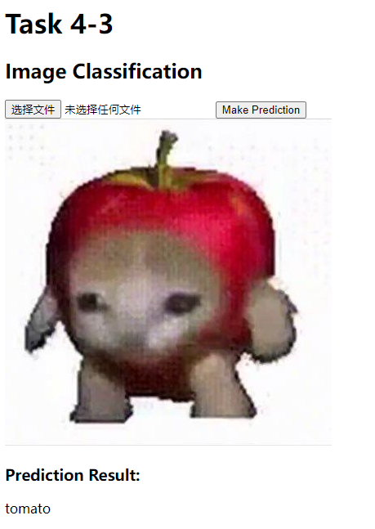
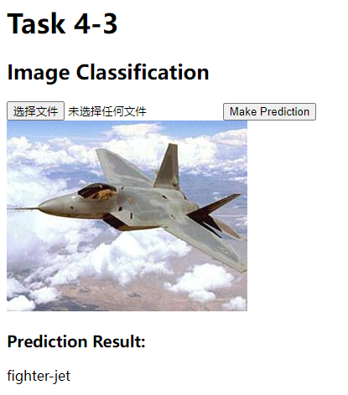
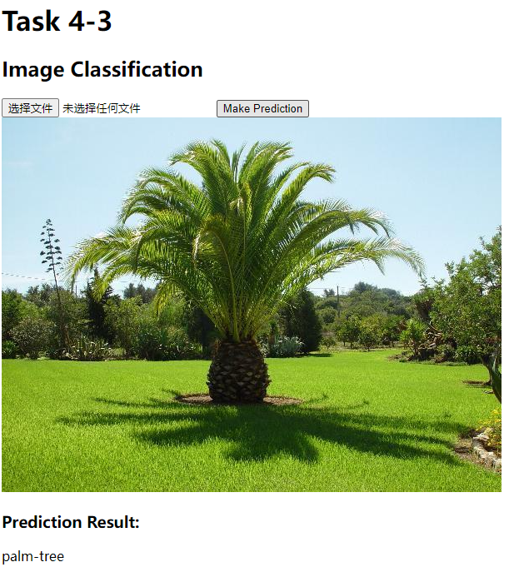
Task4-3 Classification on Restful API
Coded by flask , imgclf_api.py
Model trained on Caltech256

Slide 10
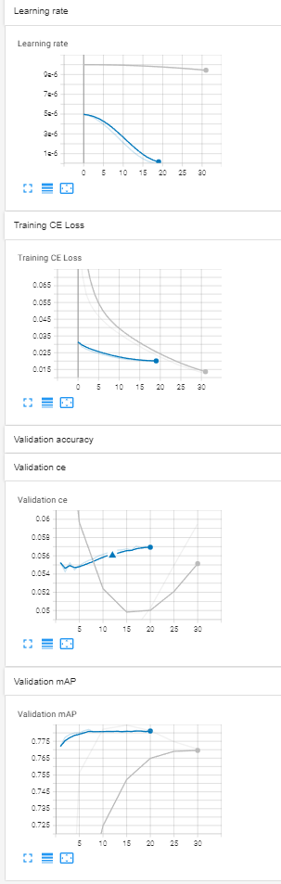
Task4-4 Multi-Label Classification
Model modified from previous pretrained modelChange
loss function from Softmax CE to BCE with logits(BCE with sigmoid)
Evaluation method changes from Acc to mAP
Trained on CoCoDetection2017 https://cocodataset.org/#home
Choose Pretrained EfficientNetC2_m as baseline (without Frozen layer)
First training Lr 1e-5, epoch 30, batch size=64 , mAP~77.0%
Finetune training Lr 5e-6~1e-8, epoch 20, batch size=64 , mAP~78.2%

Slide 11
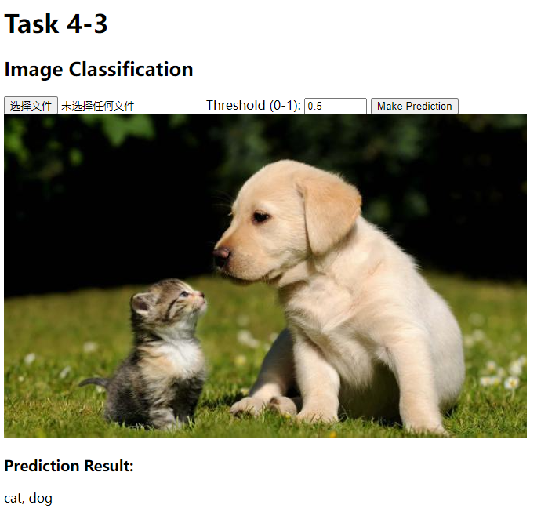
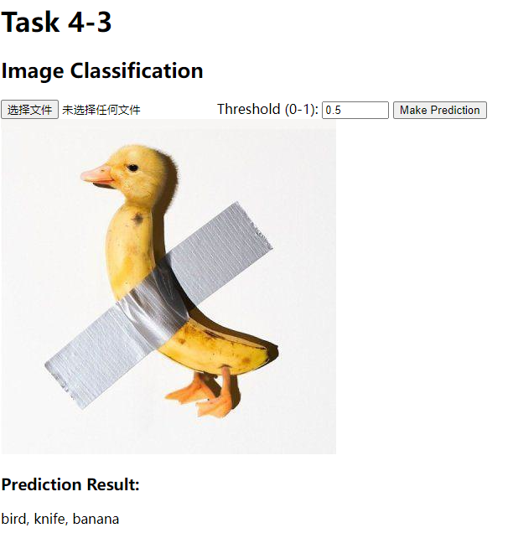
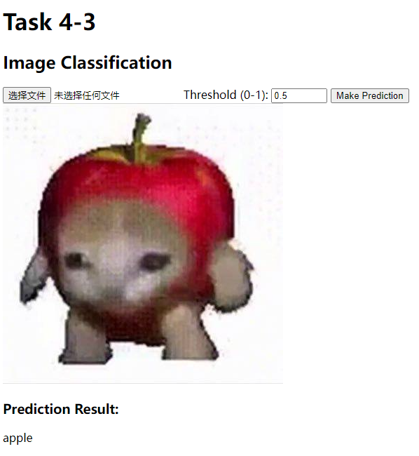
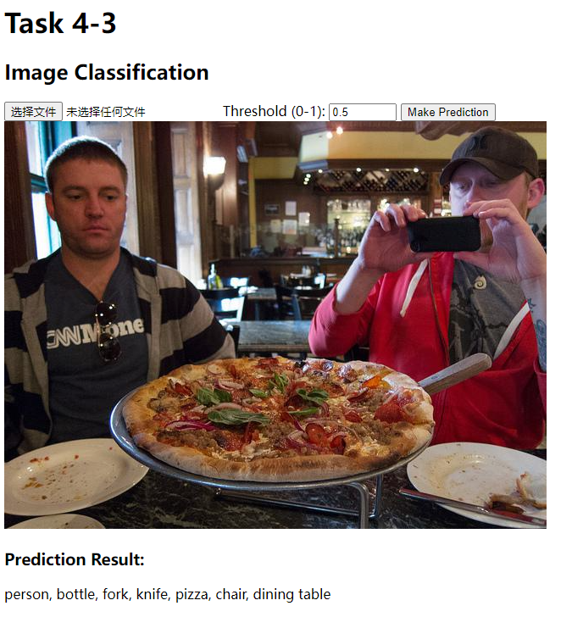
Task4-4 Multi-Label Classification
Coded by flask , imgclf_api.py
Model trained on CoCoDetection2017

