Slide 1
TIES4911 Deep-Learning for Cognitive Computing for Developers Task4
Yanren Qu

Slide 2
Intro
https://github.com/yanren1/DLFCCP_Task4

Slide 3
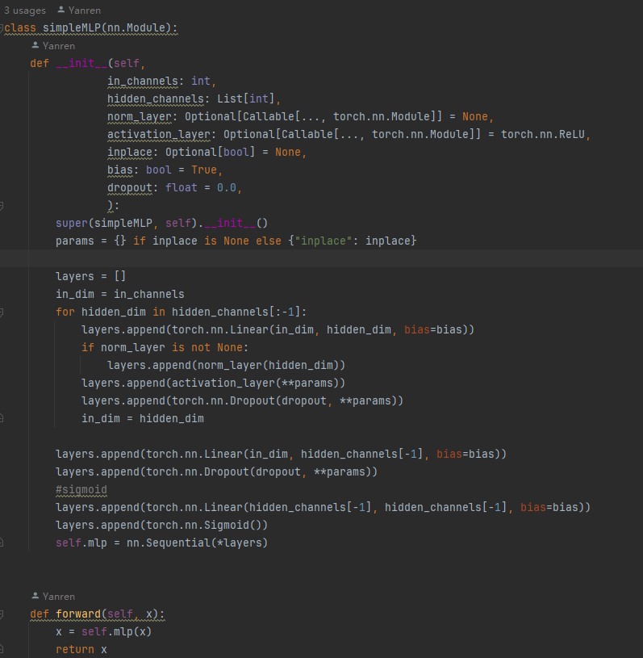
Backbone
Resnet18
Efficientnet_b0
Efficientnet_v2_m
Mobilenet_v3_large
GhostNetV2

Slide 4
Data and Dataloader
Data :
1. Caltech256 https://data.caltech.edu/records/nyy15-4j048
2.CoCo https://cocodataset.org/#home

Slide 5
Loss
Softmax CE
BCE loss

Slide 6
Task4-1 Pretrained Model
Model | Acc@1 | Acc@5
Resnet18 (pretrained on ImageNet 1k) | 69.758% | 89.078%
EfficientNet_B0 (pretrained on ImageNet 1k) | 77.692% | 93.532%
MobileNet_V3_Large (pretrained on ImageNet 1k) | 74.042% | 91.34%

Slide 7

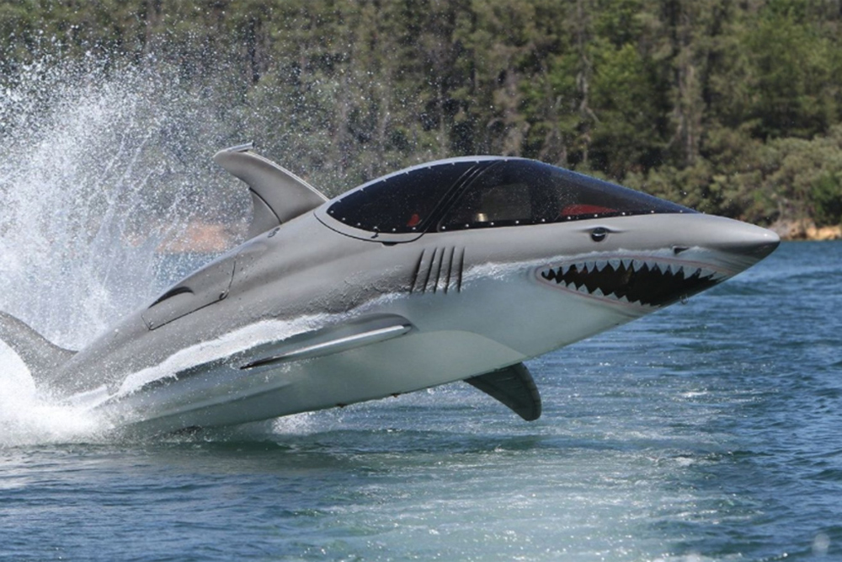
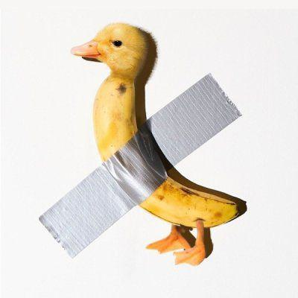
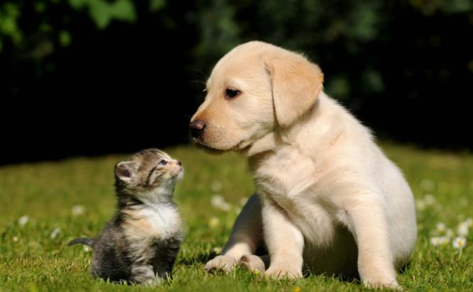

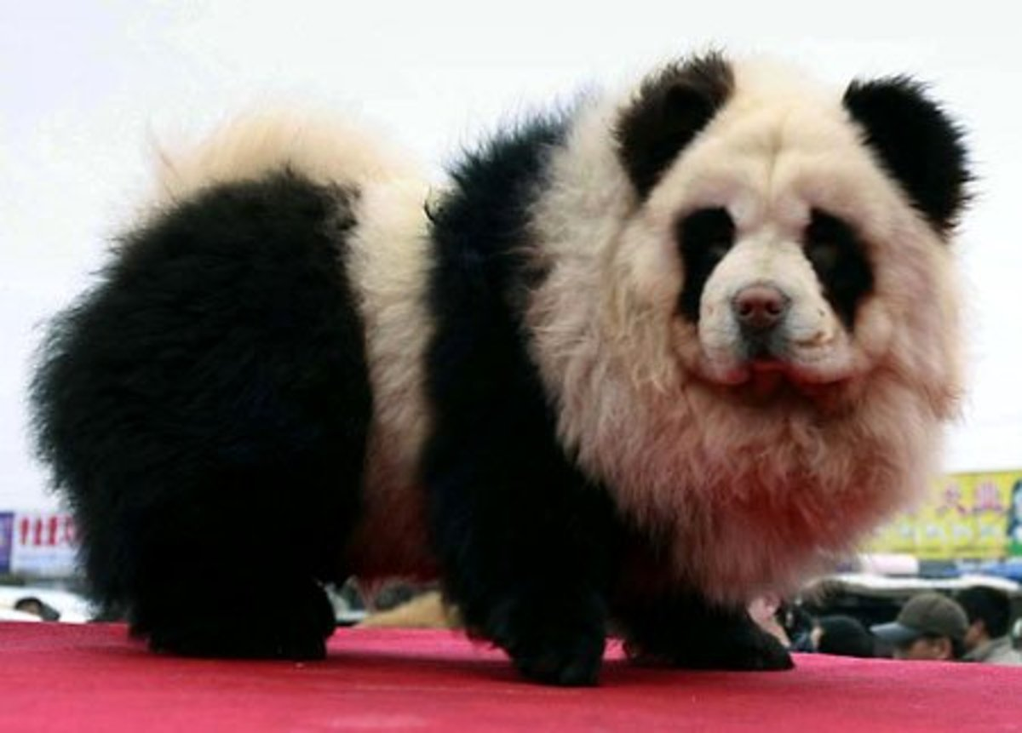
Task4-1 Tricky Image Results
Model | Predict
Resnet18 | tennis ball: 64.9%
EfficientNet_B0 | Chihuahua: 12.8%
MobileNet_V3_Large | rock beauty: 8.1%
Model | Predict
Resnet18 | Killer whale: 64.2%
EfficientNet_B0 | Killer whale: 41.1%
MobileNet_V3_Large | Killer whale: 46.3%
Model | Predict
Resnet18 | goldfinch: 68.3%
EfficientNet_B0 | cleaver: 36.1%
MobileNet_V3_Large | brambling: 6.1%
Model | Predict
Resnet18 | Labrador retriever: 38.4%
EfficientNet_B0 | Labrador retriever: 64.5%
MobileNet_V3_Large | golden retriever: 30.6%
Model | Predict
Resnet18 | pickelhaube: 15.3%
EfficientNet_B0 | pickelhaube: 11.9%
MobileNet_V3_Large | pickelhaube: 24.6%
Model | Predict
Resnet18 | giant panda: 70.7%
EfficientNet_B0 | giant panda: 15.1%
MobileNet_V3_Large | giant panda: 9.3%

Slide 8
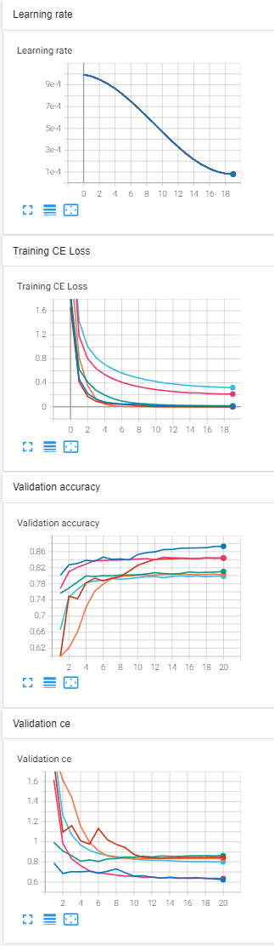
Task4-2 Training with Frozen Layer
Lr 1e-3 ~ 8e-5, epoch 20, batch size=256
Adam betas=(0.9, 0.999), eps=1e-08, weight_decay=1e-5
Loss CE
Dataset Caltech256, image size = 224
Model | Train CE | Acc@1
Resnet18 (pretrained on ImageNet 1k) | 9.7485e-4 | 80.25%
EfficientNet_B0 (pretrained on ImageNet 1k) | 2.9763e-3 | 87.32%
MobileNet_V3_Large (pretrained on ImageNet 1k) | 4.8167e-4 | 84.37%
Resnet18 (pretrained on ImageNet 1k) with Frozen Layer except classifier | 0.3208 | 79.88%
EfficientNet_B0 (pretrained on ImageNet 1k) with Frozen Layer except classifier | 0.2127 | 84.45%
MobileNet_V3_Large (pretrained on ImageNet 1k) with Frozen Layer except classifier | 0.01626 | 81.05%

Slide 9
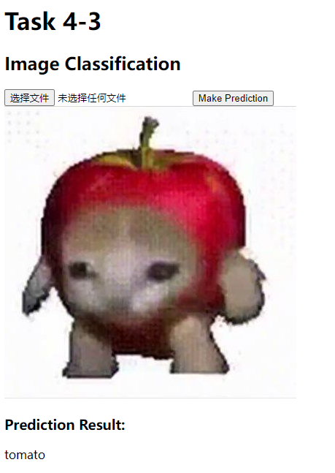
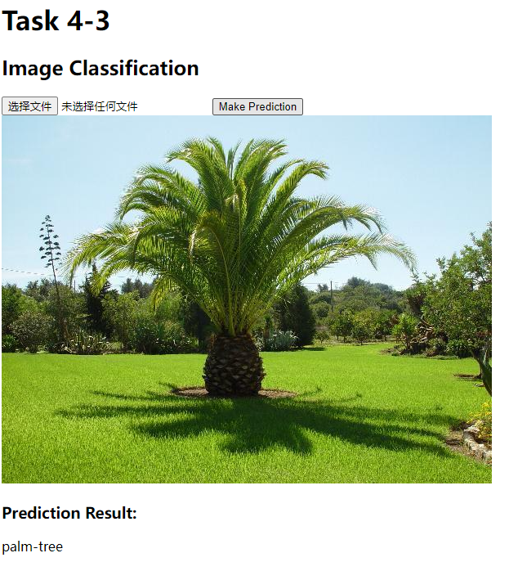
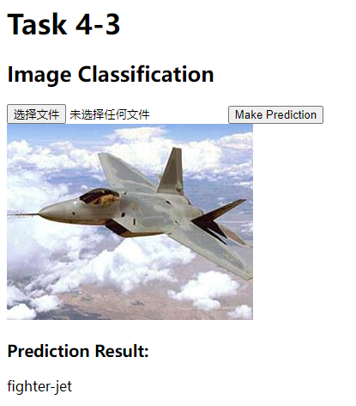
Task4-3 Classification on Restful API
Coded by flask , imgclf_api.py
Model trained on Caltech256

Slide 10
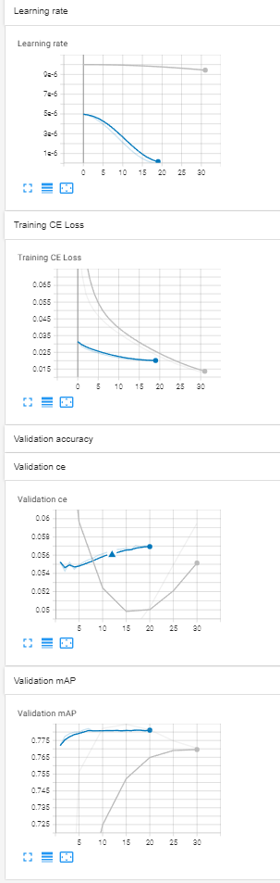
Task4-4 Multi-Label Classification
Model modified from previous pretrained model
Change loss function from Softmax CE to BCE with logits(BCE with sigmoid)
Evaluation method changes from Acc to mAP
Trained on CoCoDetection2017 https://cocodataset.org/#home
Choose Pretrained EfficientNetC2_m as baseline (without Frozen layer)
First training Lr 1e-5, epoch 30, batch size=64 , mAP~77.0%
Finetune training Lr 5e-6~1e-8, epoch 20, batch size=64 , mAP~78.2%

Slide 11
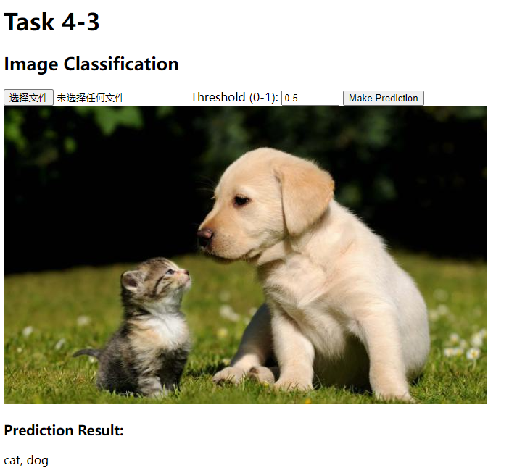
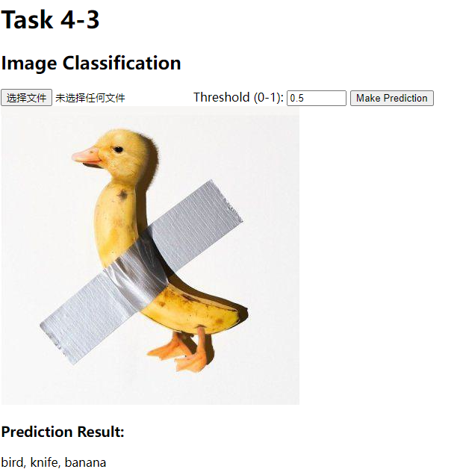
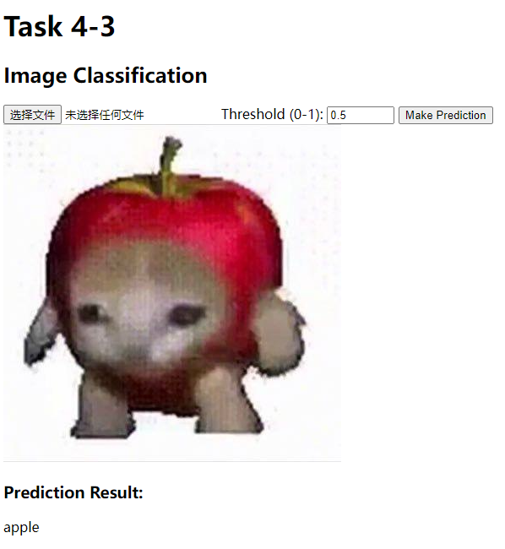
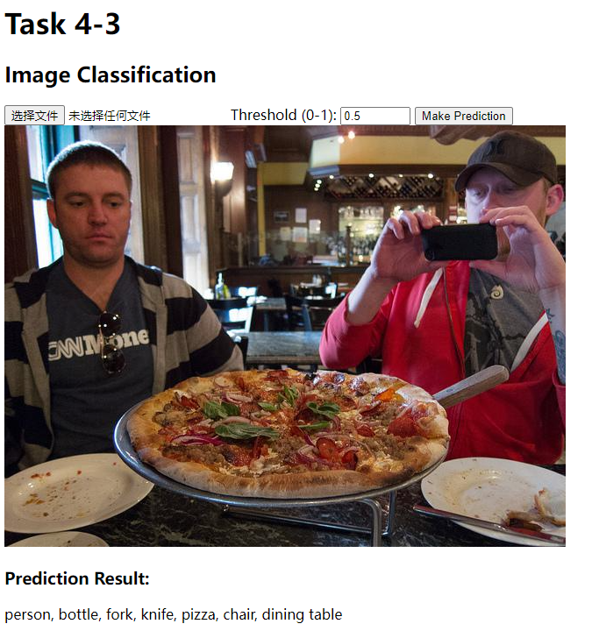
Task4-4 Multi-Label Classification
Coded by flask , imgclf_api.py
Model trained on CoCoDetection2017

