Slide 1
Task-1-2 (individual): A Simple Client to SOAP Web Services
Name: Yanren Qu Course Name: TIES 4560 (2023)

Slide 2
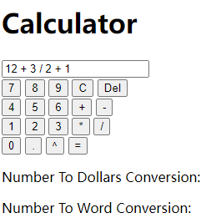
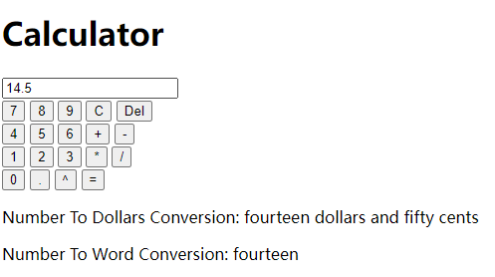
Introduction of my demo
This project is a web calculator involves accessing a SOAP Web service using Python and the Zeep library to do calculation and convert numbers into their corresponding words.
Implement basic calculator UI frontend and calculation logic.
Support continuous addition, subtraction, multiplication, division and power operations of multiple numbers. The calculation method and number conversion method uses SOAP web service.
To use this project, please install zeep library by
pip install zeep under your python environment.

Slide 3
User interface
This web calculator implements basic operations, numbers as well as decimal points buttons and operators input and delete buttons, clear button and calculation button.
There is also Number to Dollars and Number to words display below.
Web UI Html file is in templates directory named calculator.html.
Logic of this UI is in demo_client.py, It implements the input logic of each button and requests the calculation and conversion method of the remote SOAP service.

Slide 4
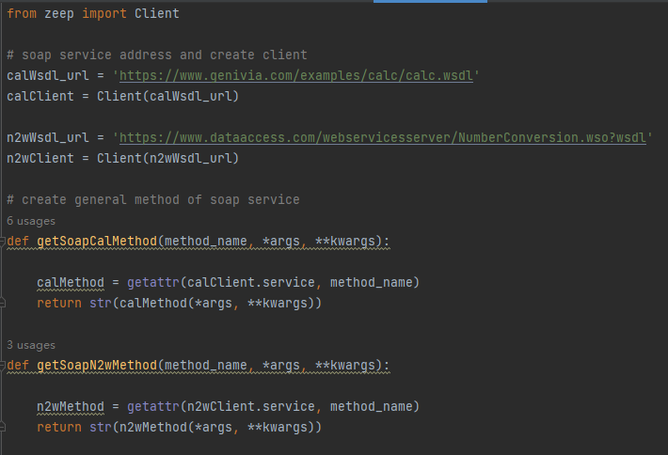
Remote SOAP Service List and description
WSDL Address
1. Calculator : 'https://www.genivia.com/examples/calc/calc.wsdl’
2. Number Conversion : 'https://www.dataaccess.com/webservicesserver/NumberConversion.wso?wsdl'
All SOAP Service client is created in get_soap.py file.
get_soap.py defines 2 general functions to use soap service. The two functions request the corresponding method in the soap service to input parameters and obtain its response.

Slide 5
Main logic of Calculations
The calculate function is defined in cal.py. It contains the main calculation logic.
Input type: string
Output type: string
In order to correctly solve the formula input of string type, it defines the decoding method and four arithmetic operations and power operation logic.
four arithmetic operations and power operation used the method defined in get_soap.py. Which means it request the corresponding operation method in the soap service and obtain its response.

Slide 6
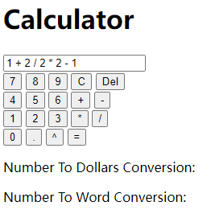
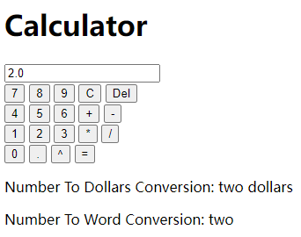
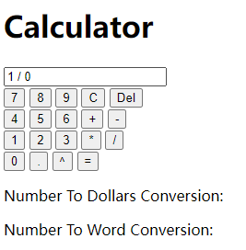
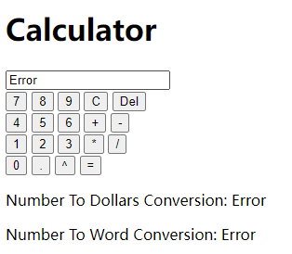
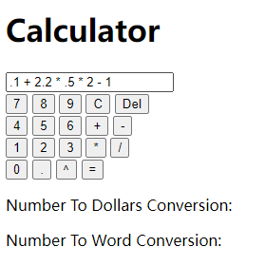
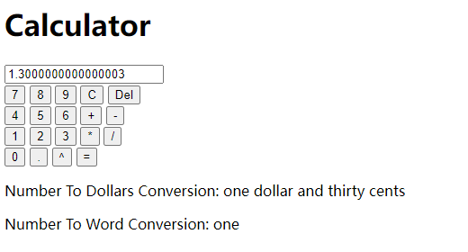
Sample Inputs and Answers
Input: 1 + 2 / 2 * 2 - 1
Output: 2.0
Number To Dollars Conversion: two dollars
Number To Word Conversion: two
Input: 1 / 0
Output: Error
Number To Dollars Conversion: Error
Number To Word Conversion: Error
Input: .1 + 2.2 * .5 * 2 - 1
Output: 1.3000000000000003 ,
Number To Dollars Conversion: one dollar and thirty cents,
Number To Word Conversion: one

