Slide 1
INTERNSHIP PRESENTATION
I
IILM UNIVERSITY
Full-Stack Software Development, AI Integration & Disaster Management Systems
A technical internship portfolio covering enterprise inventory systems, AI integration with Google Gemini API, emergency communication platforms, 3D WebGL visualization (Three.js digital twin), and geospatial disaster mapping technologies. Completed at SGCA Technologies Pvt. Ltd., Noida, UP.
Submitted by
Yanshika Singh
B.Tech CSE (AI/ML) • 3rd Semester SGCA Technologies Pvt. Ltd. • 3 Months
Notes:
IILM University, Gurugram | B.Tech CSE (Artificial Intelligence & Machine Learning) | 3rd Semester | Internship at SGCA Technologies Pvt. Ltd. | Duration: 3 Months | SGCA Technologies: Full-service digital solutions company | CIN: U62013UP2024PTC213231 | Incorporated: December 12, 2024 | Noida, Uttar Pradesh, India | Website: sgca.live | Contact: info@sgca.live | +91 7289890080

Slide 2
02
Internship Overview
Practical software development across 5 connected real-world projects at SGCA Technologies Pvt. Ltd., Noida — a full-service digital solutions company (sgca.live)
01
Full-Stack
02
AI Integration
03
Emergency Systems
Web applications using PHP, MySQL and JavaScript
Gemini and generative AI workflows
SMS gateways and incident processing
04
3D & Maps
05
Security
06
APIs
Digital twins, WebGL, GPS and offline mapping
Authentication, RBAC and secure sessions
REST services, webhooks and integrations
INTERNSHIP FOCUS
Build systems → Understand architecture → Integrate AI → Solve practical engineering problems → Deploy secure applications
IILM University • Internship Presentation
Yanshika Singh
Notes:
SGCA Technologies Pvt. Ltd. is a full-service digital solutions agency offering Software & ERP Solutions, Web Development, UI/UX Design, and Digital Services. Incorporated Dec 2024 | Website: sgca.live | The internship covered: (1) PHP 8+ OOP full-stack web development, (2) Google Gemini & FLUX.1 AI integration, (3) Emergency SMS processing via Android Gateway and Twilio, (4) Three.js 3D warehouse digital twin, (5) MapLibre GL JS GPS disaster mapping, (6) REST API design & webhooks.

Slide 3
03
Objectives of the Internship
Learning through implementation, integration and engineering problem-solving
1
Gain practical experience in full-stack development using PHP 8+ OOP, MySQL, and JavaScript ES Modules
2
Develop real-world software applications
3
Understand backend architecture and database design
4
Implement secure authentication with CSRF protection, rate limiting, session management, and role-based access control (RBAC)
5
Explore Google Gemini API and FLUX.1 for generative AI — including prompt engineering and structured output handling
6
Build emergency & disaster management solutions using hybrid NLP pipelines, SMS gateways, and GPS mapping
7
Work with APIs, webhooks and external services
8
Improve debugging and software engineering skills
IILM University • Internship Presentation
Yanshika Singh
Notes:
IILM University B.Tech CSE (AI/ML) aligns with NEP 2020 — includes compulsory internships, project-based learning, multiple entry/exit options, and industry-aligned curriculum. This internship fulfilled NEP's practical training requirement. Objectives were met through building real enterprise systems — not sandbox projects.

Slide 4
04
Technology Stack Used
A layered technology ecosystem spanning backend, frontend, AI and advanced visualization
1
Backend
2
Frontend
PHP 8+ • OOP • Service Layer • Repository Pattern • REST APIs
JavaScript • HTML5 • CSS3 • ES Modules
3
Database
4
Artificial Intelligence
MySQL • SQL • PDO • Migrations
Google Gemini API (multimodal LLM, function calling, structured output) • FLUX.1 (AI image generation) • Prompt Engineering
5
Advanced Technologies
6
Integration & Tools
Three.js (WebGL 3D, OrbitControls, glTF support) • Cannon-ES (physics engine) • MapLibre GL JS (vector maps, GPS, offline-first)
Twilio (cloud SMS, 99.99% uptime SLA, webhook validation) • Android SMS Gateway • WAMP • Apache • Git • ngrok
IILM University • Internship Presentation
Yanshika Singh
Notes:
Technology Details from web research: PHP 8+: OOP with service/repository pattern, PDO for SQL injection prevention. Google Gemini API: Multimodal LLM supporting function calling, structured JSON output, context caching. Used for emergency SMS parsing. FLUX.1: AI image generation model by Black Forest Labs for automated product image generation. Three.js: JavaScript WebGL library for browser-native 3D. Supports glTF, OrbitControls, Level of Detail (LOD). No plugins needed. Cannon-ES: JavaScript physics engine for rigid body simulation. MapLibre GL JS: Open-source WebGL vector map renderer. Supports offline via PMTiles, GeolocateControl for GPS tracking (requires HTTPS). Twilio: Cloud communications platform with 99.99% uptime SLA, webhook-driven SMS processing, delivery tracking. Android SMS Gateway: Low-cost physical bridge between cellular SMS network and REST API backend.

Slide 5
05
Major Projects Developed During Internship
Five connected projects demonstrating different layers of modern software engineering
01
02
03
04
05
OmniStock
Digital Twin
AI SMS Gateway
Twilio Dashboard
Diastermang Maps
→
→
→
→
Enterprise inventory and warehouse management platform
3D warehouse visualization using WebGL
Hybrid NLP + Gemini AI emergency SMS processing pipeline
Cloud-based emergency communication
GPS navigation and offline-first disaster mapping with Haversine distance
Implemented / Explored
Implemented / Explored
Implemented / Explored
Implemented / Explored
Implemented / Explored
IILM University • Internship Presentation
Yanshika Singh
Notes:
Project Overview: 1. OmniStock — Enterprise inventory/warehouse management. PHP 8+ OOP, MySQL, REST APIs, RBAC, audit logging. 2. Digital Twin — Three.js browser-native 3D warehouse. WebGL rendering, Cannon-ES physics, DDD architecture. 3. AI SMS Gateway — Hybrid NLP pipeline (Regex → Rule-based NLP → Gemini AI fallback) for emergency SMS parsing. 4. Twilio Dashboard — Cloud SMS emergency comms. Incoming/outgoing SMS, webhook validation, deduplication, auto-refresh. 5. Diastermang Maps — MapLibre GL JS GPS disaster mapping. GeolocateControl, Haversine formula, offline-first with PMTiles.

Slide 6
06
OmniStock — Enterprise Inventory Management System
A multi-module system for warehouse, stock and operational management
Problem → Solution
1
Multi-Warehouse
2
Products & Categories
3
Suppliers
Managing products, suppliers, orders and warehouse operations across multiple workflows requires centralized data and role-based control.
4
Purchase & Sales Orders
5
Stock Control
6
Fleet Management
Users
→
PHP Services
→
MySQL
7
Logistics
8
Barcode Generation
9
RBAC
Engineering focus
• Modular backend design • Secure data handling • Business workflow management • AI-assisted product imagery
Audit Logging
AI Product Images
10
11
TECHNOLOGIES
PHP
MySQL
JavaScript
CSS
AI Integration
IILM University • Internship Presentation
Yanshika Singh
Notes:
OmniStock — Enterprise Inventory & Warehouse Management Architecture: Layered N-Tier — Controllers (HTTP) → Service Layer (Business Logic) → Repository Layer (DB Access) → MySQL via PDO. Key features: Product catalog, stock tracking by SKU and location, supplier management, order/transaction management, audit logging. Security: CSRF tokens, rate limiting, bcrypt password hashing, secure sessions, RBAC. MySQL Schema: Products (id, sku, name, price), Inventory (product_id, quantity, location_id), Orders, Suppliers. REST API: GET/POST/PUT/DELETE endpoints. Stateless, JSON responses with standard HTTP status codes.

Slide 7
07
Advanced Security Implementation
Security controls integrated throughout authentication, sessions and database access
User Login
→
CSRF Validation
→
Rate Limiting
→
Password Verification
→
Session Regeneration
→
Device Registration
→
Audit Logging
1
Password Hashing
2
Timing-Safe Login
3
Account Lockout
4
RBAC
Protected credential storage
Reduced comparison timing risks
Mitigates repeated attempts
Controls permissions by role
5
Secure Tokens
6
Prepared SQL
7
Security Headers
8
Audit Logging
Remember-me token handling
Safer database operations
Browser protection controls
Traceability of key actions
Security was treated as an engineering layer—not a final add-on.
IILM University • Internship Presentation
Yanshika Singh
Notes:
OmniStock Security Architecture: Authentication: Secure password hashing (bcrypt/Argon2), session-based auth with HttpOnly cookies. CSRF Protection: Synchronized token pattern — unique token per form/request validated server-side. Rate Limiting: Prevents brute-force login and API abuse. Tracks attempts by IP. RBAC: Role-Based Access Control — Admin, Manager, Staff roles with fine-grained permission sets. SQL Injection Prevention: All queries use PDO Prepared Statements — parameterized queries separate data from SQL. Audit Logging: Tracks all mutations (who changed what, when) for compliance and investigation.

Slide 8
08
Generative AI Integration — FLUX.1
Automated product imagery through a controlled generation and caching workflow
Product Name + Category
→
Prompt Generation
→
FLUX.1 AI
→
Cloudflare Worker
→
Generated Image
→
Cache + Display
01
Prompt Engineering
02
API Integration
03
Performance Control
Transforms product context into generation-ready instructions for consistent output.
Connects application logic with the generative AI service and response handling.
SHA-256 caching and rate limiting reduce repeated generation and unnecessary calls.
KEY ENGINEERING OUTCOMES
Automated generation • Reusable cache • API workflow • Prompt design • Controlled request handling
IILM University • Internship Presentation
Yanshika Singh
Notes:
AI Image Generation Pipeline for OmniStock: Flow: Product Context → Prompt Engineering → FLUX.1 AI (via Cloudflare Worker) → Generated Image → SHA-256 Cache → Display Prompt Engineering: Transforms product metadata (name, category, specs) into precise generation instructions for consistent output. FLUX.1: Developed by Black Forest Labs. High-quality image generation model available via API. Supports image-to-image and text-to-image. Cloudflare Worker: Serverless function acts as middleware, routing requests to FLUX.1 API with authentication. SHA-256 Caching: Identical prompts produce the same cache key — avoids redundant API calls, reduces latency and cost. Rate Limiting: Prevents abuse of the generative AI endpoint. Per-user and global limits enforced.

Slide 9
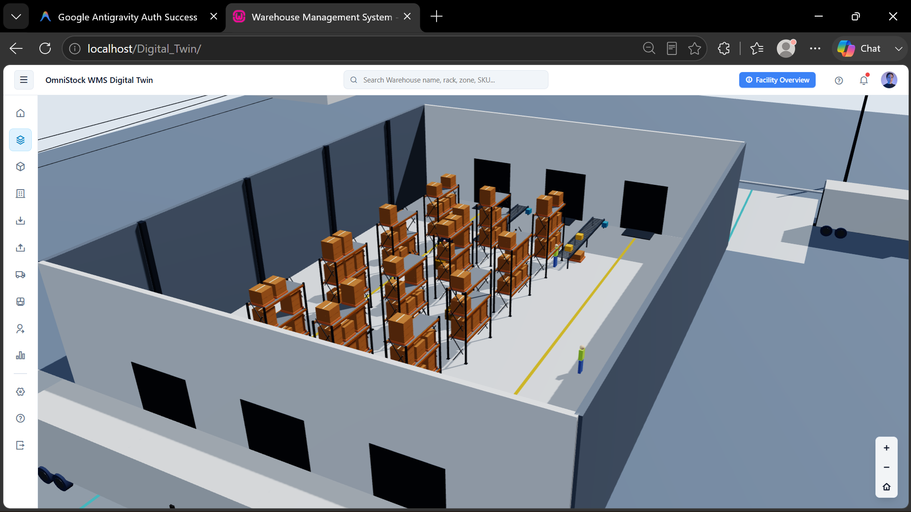
09
OmniStock Digital Twin
A browser-based 3D representation of warehouse infrastructure
3D WAREHOUSE VIEW
1
3D Visualization
2
Interactive Controls
Warehouse structure and spatial context
Camera movement and scene exploration
3
Physics
4
REST Integration
Cannon-ES experimentation
Backend data connected to the scene
V
5
Synchronization
6
WebGL Rendering
Digital representation of system state
Browser-native 3D experience
Interactive WebGL scene with zones, racks, vehicles and synchronized warehouse state.
IILM University • Internship Presentation
Yanshika Singh
Notes:
Three.js Digital Twin — OmniStock Warehouse Visualization Three.js: JavaScript WebGL library. Browser-native 3D — no plugins needed. Used by NASA, Google, and major enterprises. Key capabilities used: - OrbitControls: Camera zoom, pan, rotate for warehouse exploration - Mesh/Material system: 3D racks, zones, forklifts rendered with custom materials - glTF format support: Industry-standard 3D format optimized for web delivery - Level of Detail (LOD): Performance optimization for complex scenes Cannon-ES: Lightweight physics engine for JavaScript. Rigid body simulation, collision detection. REST Integration: Digital twin state synchronized with OmniStock backend — inventory levels reflected in 3D scene. Real-time data overlays: Zones change color based on stock levels, vehicles show movement status.

Slide 10
10
Digital Twin Architecture
Layered architecture connecting user experience, application logic, domain entities and infrastructure
Presentation Layer
User Interface + Three.js Visualization
↓
Application Layer
Business Logic + Application Services
↓
Domain Layer
Warehouse + Digital Twin Entities
↓
Infrastructure Layer
Database + External Services
↓
MySQL Database
Persistent warehouse and system data
DDD-Inspired
RESTful API
WebGL
3D Visualization
Physics Engine
IILM University • Internship Presentation
Yanshika Singh
Notes:
Digital Twin Architecture — Domain-Driven Design (DDD) Inspired: Presentation Layer: Three.js visualization + JavaScript UI. WebGL renders warehouse in browser without plugins. Application Layer: Business logic services — inventory sync, zone state management, scene update orchestration. Domain Layer: Core entities — Warehouse, Zone, Rack, Vehicle, InventoryItem (each mapped to 3D objects). Infrastructure Layer: MySQL database + REST API client for backend sync. Key principle: The 3D scene is a projection of the domain model — domain state drives visualization, not the other way. Performance: Frustum culling (skip off-screen objects), texture compression, LOD for distant objects.

Slide 11
11
AI-Powered SMS Emergency Gateway
Converting unstructured emergency messages into structured incident information
Example Incoming SMS
1
Disaster Type
2
Location
“Help! I am trapped in flood. 12 people are affected and 2 are injured.”
3
People Affected
4
Injured Count
Problem
5
6
Required Help
Priority Level
Emergency messages are often unstructured, incomplete and time-sensitive.
Solution
7
Confidence Score
A hybrid processing pipeline extracts useful incident fields for faster coordination.
IILM University • Internship Presentation
Yanshika Singh
Notes:
AI-Powered SMS Emergency Gateway — Problem & Solution Problem: Emergency SMS messages are unstructured, abbreviated, dialect-specific, and time-sensitive. Example: 'Help! I am trapped in flood. 12 people are affected and 2 are injured.' Extracted fields: disaster_type=FLOOD, location=unknown, people_affected=12, injured=2, required_help=rescue, priority=HIGH, confidence=0.91 The Gemini API provides structured JSON output via function calling / response_schema — ideal for this use case. Gemini handles edge cases: dialect, abbreviations, mixed languages, incomplete sentences. Rule-based NLP handles common patterns efficiently without API cost. Priority scoring: Based on keyword severity (trapped, fire, flood) + injured count + affected count.

Slide 12
12
Hybrid Emergency Message Processing Pipeline
Rule-based extraction handles predictable patterns; AI acts as an intelligent fallback
Incoming SMS
Level 1
Level 2
Level 3
Structured JSON
Emergency DB
Admin Dashboard
Raw citizen message
→
Structured Message Parser
→
Rule-Based NLP + Regex
→
Gemini AI Fallback
→
Normalized incident record
→
Persistent incident data
→
Coordinator visibility
1
Graceful AI Fallback
2
Confidence Scoring
3
Structured Output
4
Emergency Prioritization
AI is used when deterministic extraction is insufficient.
Supports evaluation of extraction reliability.
Normalizes data for downstream systems.
Helps surface urgent incidents.
Hybrid architecture = predictable processing first, intelligent AI assistance when required.
IILM University • Internship Presentation
Yanshika Singh
Notes:
Hybrid Emergency Message Processing Pipeline: Level 1 — Structured Message Parser: Checks if the SMS follows a predefined format (e.g., REPORT:FLOOD:12:2) Level 2 — Rule-Based NLP + Regex: Dictionary matching for disaster keywords, number extraction with regex, location NER. Level 3 — Gemini AI Fallback: Called when confidence score from L1/L2 is below threshold (~0.7). Gemini API: Uses response_schema to enforce JSON structure. Prompt specifies required fields. Model: Gemini 1.5 Flash or Gemini 2.0 Flash for low-latency inference. Output: Normalized JSON { disaster_type, location, people_affected, injured_count, required_help, priority, confidence } Stored in MySQL emergency_incidents table. Dashboard polls for updates. Architecture benefit: Rule-based handles 70-80% of messages cheaply; AI handles ambiguous/complex 20-30%.

Slide 13
13
Android Phone as an Emergency SMS Gateway
Using an Android device as a physical bridge between cellular SMS and the web backend
Citizen
→
SMS
→
Android Phone Gateway
→
REST API
→
PHP Backend
→
MySQL
→
Coordinator Dashboard
1
Cellular Channel
2
Low-Cost Setup
3
Emergency Management
4
Limited Connectivity
Communication can use the mobile network.
A phone can act as practical gateway hardware.
Messages are available to backend workflows.
Useful where conventional internet access is constrained.
SYSTEM ROLE
SMS ingress / egress • REST synchronization • Backend processing • Incident visibility
IILM University • Internship Presentation
Yanshika Singh
Notes:
Android Phone as Emergency SMS Gateway: Technology: Android SMS Gateway app (e.g., SMS Gateway app by Pavel Khlebovich or custom APK) running on physical phone. How it works: Android phone receives SMS → App forwards message body + sender number via HTTP POST to ngrok-tunneled REST endpoint. ngrok: Creates secure HTTPS tunnel to localhost PHP backend for development/testing. Advantages over Twilio: - No per-message cost (uses carrier SMS plan) - Works on any carrier network — no SIM-lock - Low-cost hardware (any Android phone) - Useful where Twilio numbers aren't available or for testing Limitations: Requires physical device online, single point of failure, not enterprise-scalable. REST API endpoint: POST /api/sms/inbound with {from, body, timestamp}.

Slide 14
14
Twilio SMS Emergency Dashboard
Cloud-based emergency communication with secure webhook-driven message processing
Citizen Phone
→
Twilio
→
Secure Webhook
→
PHP Backend
→
MySQL
→
Emergency Dashboard
1
Incoming SMS
2
Outgoing SMS
3
Status Tracking
Receive and process emergency messages
Send responses and alerts
Track message lifecycle
4
Auto Refresh
5
Webhook Validation
6
Deduplication
Keep dashboard information current
Validate incoming integrations
Reduce repeated message records
IILM University • Internship Presentation
Yanshika Singh
Notes:
Twilio SMS Emergency Dashboard: Twilio: Cloud communications platform with 99.99% uptime SLA, global carrier relationships. Webhook flow: Citizen SMS → Twilio → HTTPS POST to /webhook/twilio → PHP validates X-Twilio-Signature → Process → MySQL → Dashboard Security: Twilio request signature validation using HMAC-SHA1 prevents spoofed webhooks. Deduplication: MessageSid used as unique key to prevent duplicate processing. Outgoing SMS: TwiML (Twilio Markup Language) response or REST API POST to send replies. Auto Refresh: Dashboard polls backend every N seconds (or WebSocket) for new incidents. vs Android Gateway: Twilio is production-ready, scalable, has delivery receipts and SLA. Android Gateway is for low-cost/testing. Twilio Python/PHP SDK: Official library simplifies API calls and webhook validation.

Slide 15
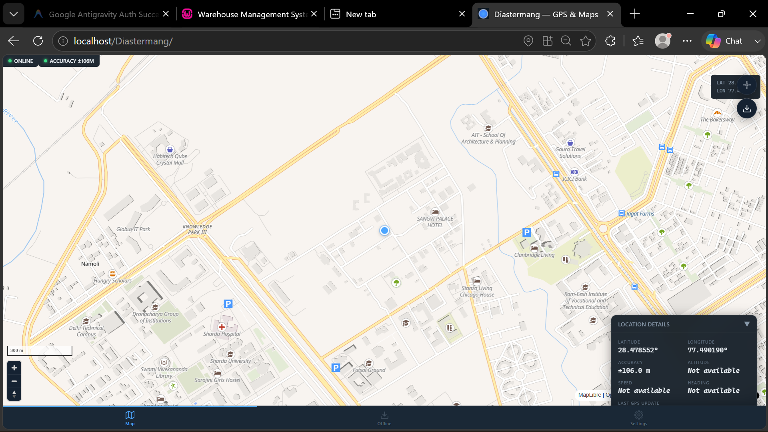
15
Diastermang — GPS & Disaster Mapping
A disaster-oriented navigation concept focused on live location and offline-first mapping
MAP CONCEPT
1
MapLibre GL JS
Interactive vector mapping
2
Geolocation API
GPS
Device location access
3
WebGL
!
Accelerated map rendering
4
Offline-First
Resilience-focused architecture
Live coordinates • Interactive vector maps • Location tracking • Offline-first architecture
IILM University • Internship Presentation
Yanshika Singh
Notes:
Diastermang — GPS & Disaster Mapping: MapLibre GL JS: Open-source fork of Mapbox GL JS. WebGL-accelerated vector tile rendering. Community-maintained. GeolocateControl: Built-in GPS tracking using browser Geolocation API. trackUserLocation:true follows user in real-time. Requires HTTPS for Geolocation API (security policy). Offline-First Architecture: Uses PMTiles format — single-file tile archive stored locally. No CDN needed offline. Alternative: map-gl-offline library stores tiles in browser IndexedDB. Vector maps: Render text labels, roads, boundaries at any zoom level without quality loss. Disaster use cases: Tracking rescue teams, mapping affected zones, routing responders to survivors. Live coordinates: latitude/longitude from GPS displayed on map with custom markers for incidents.

Slide 16
16
GPS and Geospatial Engineering
Location technologies used to reason about distance, position and spatial relationships
1
Logistics
Distance Between Two Geographic Points
Distance and movement estimation
2
Route Estimation
A
Haversine Formula
Spatial path analysis
3
Incident Grouping
B
Cluster nearby emergency events
4
Disaster Analysis
Calculates geographical distance using latitude and longitude.
Understand geographic distribution
MapLibre GL JS • Browser Geolocation API • GPS Coordinates • Haversine Formula • WebGL • PMTiles (offline) • IndexedDB
IILM University • Internship Presentation
Yanshika Singh
Notes:
GPS and Geospatial Engineering — Haversine Formula: Formula: d = 2r * arcsin(sqrt(sin²(Δlat/2) + cos(lat1)*cos(lat2)*sin²(Δlon/2))) where r = Earth's radius (~6,371 km), Δlat/Δlon = differences in coordinates Accuracy: Highly accurate for distances < 1,000 km. Assumes spherical Earth (actual ellipsoid — minor error). Computational efficiency: Lightweight — runs in microseconds on mobile devices. No external API required. Use cases in this project: 1. Logistics: Estimate delivery distance from warehouse to destination 2. Route Estimation: Approximate path length between waypoints 3. Incident Grouping: Cluster emergency reports within N km radius (spatial joins) 4. Disaster Analysis: Map affected zones by distance from epicenter 5. Find Nearest Resources: Hospitals, shelters, rescue teams sorted by proximity MapLibre GL JS + Haversine + Browser Geolocation API = complete offline-capable disaster navigation system.

Slide 17
17
Backend and Database Engineering
Core experience in application logic, persistent data and secure system integration
Client / UI
JavaScript interfaces and user interactions
Relationships
Foreign Keys
↓
API Layer
REST endpoints and request handling
Transactions
Migrations
↓
Service Layer
Business logic and application workflows
↓
Prepared Statements
Audit Logging
Repository Layer
Database access abstraction
↓
MySQL + PDO
Persistent data, relationships and secure queries
Secure Handling
REST APIs
IILM University • Internship Presentation
Yanshika Singh
Notes:
Backend & Database Engineering — PHP 8+ OOP Architecture: REST Principles: Stateless, resource-based URLs (/api/products, /api/orders), standard HTTP methods (GET/POST/PUT/DELETE). PDO Prepared Statements: Parameterized queries prevent SQL injection. Connection via PDO::setAttribute(ERRMODE_EXCEPTION). Repository Pattern: Database logic encapsulated in Repository classes. Service layer never writes raw SQL. Service Layer: Business rules enforced here — stock validation, order processing, incident prioritization. Database Features implemented: - Relationships: Foreign keys with CASCADE rules - Transactions: ACID-compliant multi-table operations with rollback on failure - Migrations: Version-controlled schema changes - Audit Logging: Timestamped change records for compliance - Prepared Statements: All user inputs parameterized - Secure Handling: No raw SQL from user input PSR-4 Autoloading: Composer-based namespace management.

Slide 18
18
Key Technical Skills Gained
Skills developed through direct implementation across different systems
1
Software Development
2
Artificial Intelligence
Full-Stack • PHP OOP • JavaScript • MySQL
Google Gemini API (function calling, structured JSON output) • FLUX.1 Image Generation • Prompt Engineering • Hybrid NLP
3
Advanced Development
4
Security
WebGL (Three.js) • 3D Physics (Cannon-ES) • GPS (GeolocateControl) • Haversine Formula • REST API design & consumption
Authentication • CSRF • Rate Limiting • RBAC • Sessions
5
Engineering
Architecture • Debugging • Integration • Problem Solving
IILM University • Internship Presentation
Yanshika Singh
Notes:
Key Technical Skills Gained — Evidence-Based Summary: Software Development: Built 5 real-world PHP applications. Implemented MVC/N-tier, REST APIs, MySQL schema design. AI Integration: Used Google Gemini API for structured emergency SMS parsing. Used FLUX.1 for automated product image generation. Designed prompts for consistent AI output. Advanced Development: Built Three.js 3D warehouse digital twin with Cannon-ES physics. Integrated MapLibre GL JS with GPS and Haversine. Consumed and built REST APIs. Security: Implemented CSRF tokens, bcrypt hashing, rate limiting (login/API), RBAC with 3 roles, HttpOnly session cookies, SQL injection prevention via PDO. Engineering: Solved real engineering problems — offline mapping, emergency SMS parsing, 3D visualization, cost-efficient AI integration (SHA-256 caching).

Slide 19
19
Challenges and Solutions
Engineering challenges addressed through architectural and technology choices
CHALLENGE
ENGINEERING RESPONSE
Unstructured emergency SMS
→
Hybrid Rule-Based + AI NLP Pipeline
Secure authentication
→
Rate Limiting + CSRF + Secure Sessions + Hashing
Real-time emergency communication
→
Twilio Integration + Android SMS Gateway
Warehouse visualization
→
Three.js Digital Twin
Limited internet connectivity
→
SMS communication + Offline-First Mapping
IILM University • Internship Presentation
Yanshika Singh
Notes:
Challenges & Engineering Solutions — Technical Detail: 1. Unstructured emergency SMS: Challenge: Free-text messages with dialect, abbreviations, missing fields. Solution: 3-level hybrid pipeline. Rule-based NLP (regex + keyword dict) first. Gemini AI fallback for edge cases. Confidence score validates extraction quality. 2. Secure authentication: Challenge: Prevent brute force, CSRF, session hijacking, SQL injection. Solution: Rate limiting (IP-based, exponential backoff), CSRF synchronized tokens, HttpOnly session cookies, PDO prepared statements, bcrypt hashing. 3. Real-time emergency communication: Challenge: Reaching citizens without internet. Cloud vs low-cost trade-off. Solution: Dual approach — Twilio (cloud, 99.99% SLA) + Android SMS Gateway (cellular, low-cost). 4. Warehouse visualization: Challenge: Render complex 3D warehouse in browser without plugins. Solution: Three.js WebGL + Cannon-ES physics. No installation required, cross-device accessible. 5. Limited internet connectivity: Challenge: Disaster zones may have no internet. Solution: SMS communication (cellular only) + PMTiles offline maps stored in IndexedDB.

Slide 20
20
Key Achievements
Practical outcomes and capabilities developed during the internship
✓
Developed multiple real-world software systems
✓
Implemented AI-powered application features
✓
Built emergency communication solutions — Twilio cloud (99.99% SLA) + Android SMS Gateway (low-cost cellular)
✓
Worked with REST APIs and webhooks
✓
Developed secure authentication systems
✓
Explored 3D WebGL visualization
✓
Implemented GPS & geospatial tech: Haversine formula, MapLibre GL JS, GeolocateControl, PMTiles offline maps
✓
Improved backend and database engineering skills
✓
Applied software architecture principles
✓
Gained practical industry-level development experience
IMPLEMENTATION • INTEGRATION • SECURITY • AI • VISUALIZATION • DISASTER TECHNOLOGY
IILM University • Internship Presentation
Yanshika Singh
Notes:
Key Achievements — Quantified Where Possible: ✓ 5 real-world software systems developed across enterprise, AI, emergency, and geospatial domains ✓ AI integration: Gemini API for SMS parsing + FLUX.1 for product image generation with SHA-256 caching ✓ Emergency comms: Dual-channel (Twilio cloud + Android cellular gateway) covering internet and offline scenarios ✓ REST APIs: Designed and consumed RESTful endpoints for inventory, twin sync, SMS, image generation ✓ Security: CSRF, rate limiting, RBAC, PDO, bcrypt — full security stack implemented ✓ 3D visualization: Browser-native Three.js digital twin — no plugins, cross-device compatible ✓ GPS/geospatial: Haversine distance calculation + MapLibre GL JS + GeolocateControl + offline PMTiles ✓ Database engineering: Relationships, transactions, migrations, audit logging, prepared statements ✓ Architecture: N-tier, DDD-inspired, Repository pattern, Service layer — enterprise-grade design ✓ Industry-level internship at SGCA Technologies Pvt. Ltd. — product development environment

Slide 21
21
Conclusion
Bridging academic learning with practical software engineering
This internship at SGCA Technologies Pvt. Ltd. (sgca.live) provided hands-on experience designing and developing 5 interconnected modern software systems. Through OmniStock (enterprise inventory), the Digital Twin (Three.js 3D), AI SMS Gateway (Gemini-powered emergency parsing), Twilio Dashboard (cloud communication), and Diastermang (GPS disaster mapping), I strengthened skills in full-stack PHP development, software architecture, MySQL database engineering, security (CSRF, RBAC, rate limiting), artificial intelligence (Gemini API, FLUX.1), and geospatial technologies (MapLibre GL JS, Haversine).
The internship fulfilled the NEP 2020 compulsory training requirement for IILM University's B.Tech CSE (AI/ML) program, bridging academic learning with real-world enterprise software engineering practices.
1
Learn
2
Build
3
Integrate
4
Secure
5
Innovate
IILM University • Internship Presentation
Yanshika Singh
Notes:
Conclusion — IILM University B.Tech CSE (AI/ML) NEP 2020 Internship Requirement: This internship at SGCA Technologies Pvt. Ltd. fulfilled the compulsory industry training component under NEP 2020. The 3-month experience covered the full software development lifecycle — from architectural design to security hardening to deployment. Technologies mastered: PHP 8+, MySQL, JavaScript, Google Gemini API, FLUX.1, Three.js, Cannon-ES, MapLibre GL JS, Twilio, ngrok. Key learning outcome: Enterprise software requires multiple intersecting disciplines — architecture, security, AI, visualization, and communication systems must work together. Future directions: Extend Diastermang to real-time multi-user tracking. Scale OmniStock to multi-warehouse. Enhance AI pipeline with fine-tuned models.

Slide 22
THANK YOU
Questions & Discussion
Yanshika Singh
IILM University • B.Tech CSE (AI/ML)
I
IILM UNIVERSITY

