Slide 2
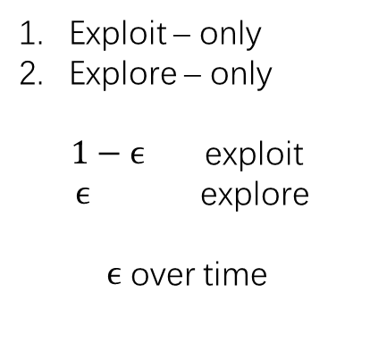
Application
Exploit – only
Explore – only
$1−ϵ$ exploit
$ϵ$ explore
$ϵ$ over time
Model
h/w
vertically integer

Slide 3



Service
Query
$$t_{rep}$$
$$t_{resp}$$
respond
prediction
different version of the same model
$${t_{resp}− t}_{req}⋍10 ms$$
Data -> train(algo1) -> Model1
Data -> ... -> Model1
Data -> train(algo2) -> Model2
-> Model2

Slide 4
Apps
predictions
RPCs
feedback
Model selection
Decide to select “good” model to predict
Multiple models , combine results
Simple API, optimizations
caching
Batching
Model selection
cache
Clipper
Model abstraction
Adap batching
Model containers
MC
Model1
Spark
MC
Model2
TF
MC
Model3
TF
Spark
(Batch jobs)
GPU
int()
predict-batch()
elastically scale

Slide 5

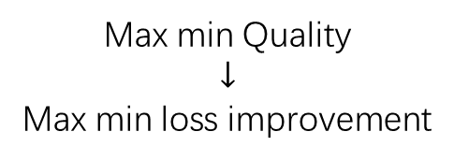

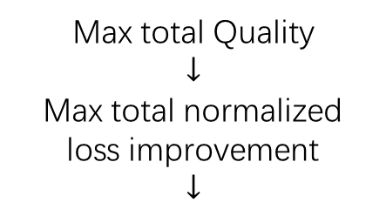
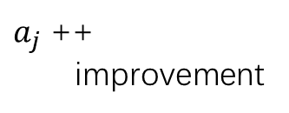
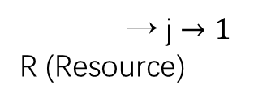
$J_{1}$ ………… $J_{2}$
allloc
Max total Quality
$$↓$$
Max total normalized
loss improvement
$$↓$$
SLAQ
$$k^{−1}$$
$$k^{−2}$$
→ j $→1$
R (Resource)
$a_{j}$ ++
improvement
Max min Quality
$$↓$$
Max min loss improvement
greedily pick job with greatest expected improvement

