Slide 1
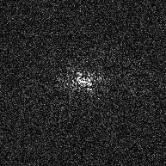
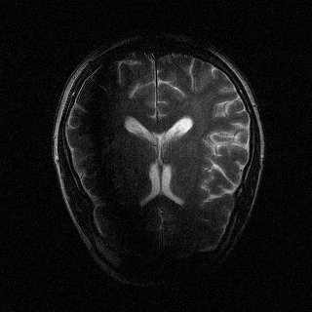
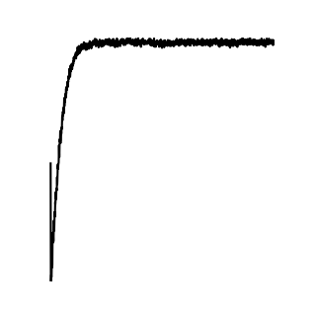
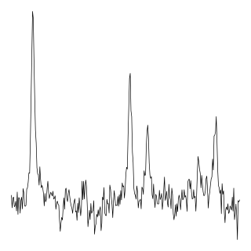


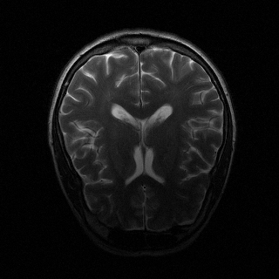
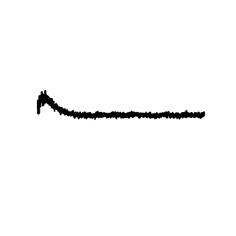
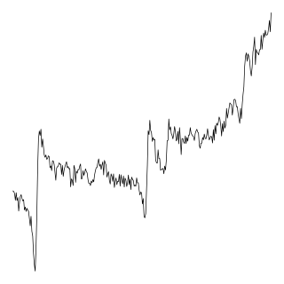

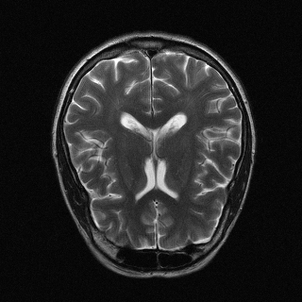
MRI Reconstruction
MRI Accelerated Reconstruction
MRS Denoised Reconstruction
N ch
N ch
AFTNet-I
N ch
Mean
AFT
RSS
AFTNet-K
RSS
AFTNet-I
AFTNet-KI
N ch
N ch
N ch
FT
IFT
AFT
IFT
MSE
AFT
CUNet
Undersample
MSE
AFT
CUNet
Average Over Repetitions
MAE

