Slide 1
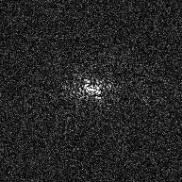
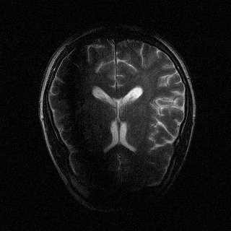


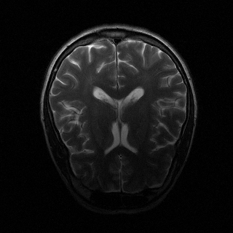

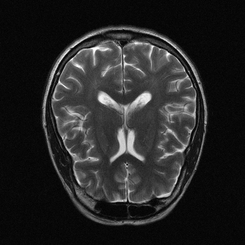
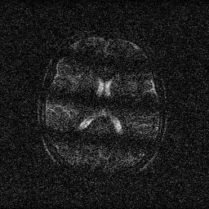
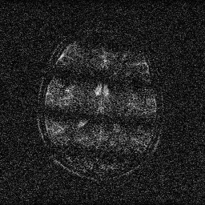
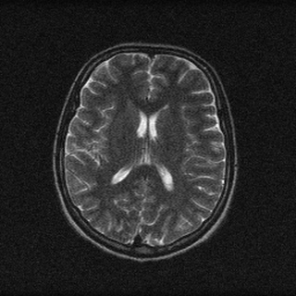
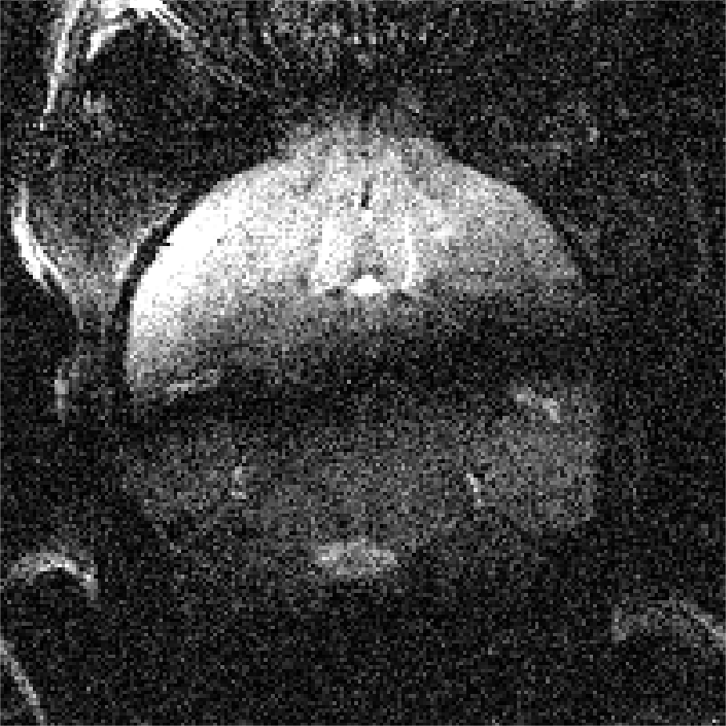
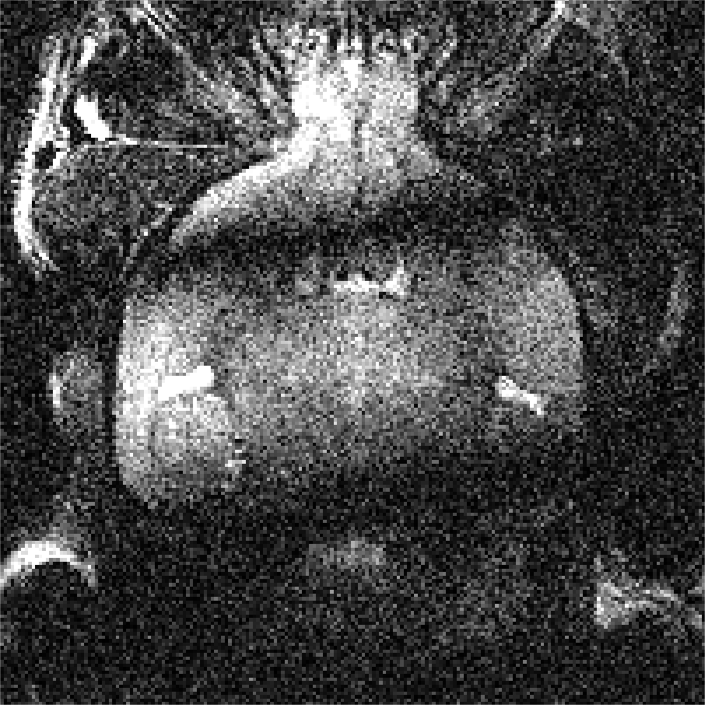
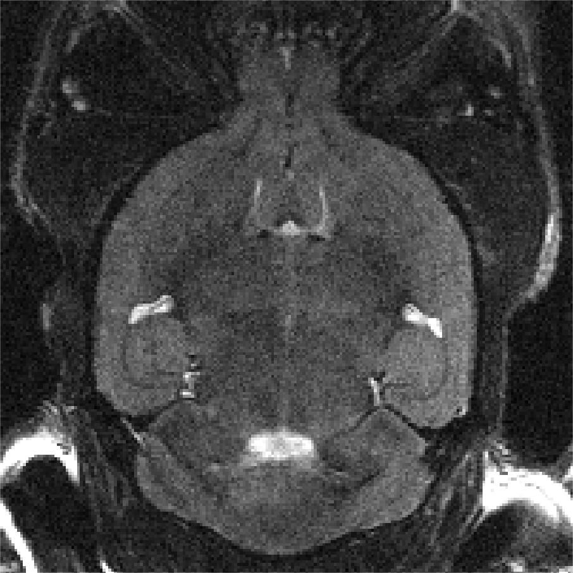
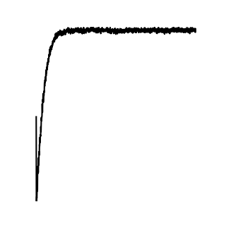
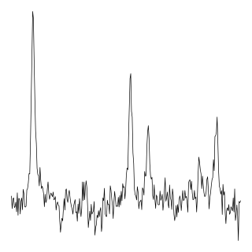
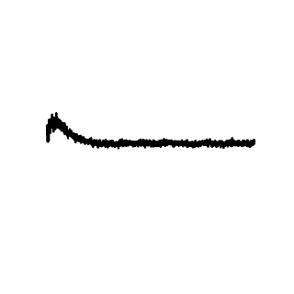
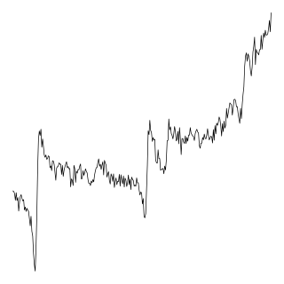
Human 1.5/3T MRI
Recon
Accelerated
Recon
Denoised
Recon
N ch
N ch
AFT-Net (I)
N ch
AFT-Net (I)
AFT
RSS
AFT-Net (K)
RSS
AFT-Net (K)
RSS
AFT-Net (KI)
AFT-Net (KI)
N ch
N ch
N ch
IFT
IFT
AFT
IFT
MSE
AFT
CUNet
Undersample
MSE
AFT
CUNet
Add Noise
MSE
Human 0.3T MRI
Recon
Accelerated
Recon
Denoised
Recon
N ch
N ch
AFT-Net (I)
N ch
AFT-Net (I)
AFT
RSS
AFT-Net (K)
RSS
AFT-Net (K)
RSS
AFT-Net (KI)
AFT-Net (KI)
N ch
N ch
N ch
IFT
IFT
AFT
IFT
MSE
AFT
CUNet
Undersample
MSE
AFT
CUNet
Average Over Repetitions
MSE
Mouse 9.4T MRI
Recon
Accelerated
Recon
Denoised
Recon
N ch
N ch
AFT-Net (I)
N ch
AFT-Net (I)
AFT
RSS
AFT-Net (K)
RSS
AFT-Net (K)
RSS
AFT-Net (KI)
AFT-Net (KI)
N ch
N ch
N ch
IFT
IFT
AFT
IFT
MSE
AFT
CUNet
Undersample
MSE
AFT
CUNet
Average Over Repetitions
MSE
Human 3T PRESS MRS
Recon
Accelerated
Recon
Denoised
Recon
N ch
Mean
N ch
Mean
N ch
Mean
AFT-Net (I)
AFT-Net (I)
AFT-Net (I)
N ch
N ch
FT
N ch
FT
FT
MAE
AFT
CUNet
AFT
CUNet
Average Over Repetitions
MAE
AFT
CUNet
Average Over Repetitions
MAE

