Slide 1
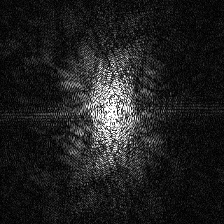
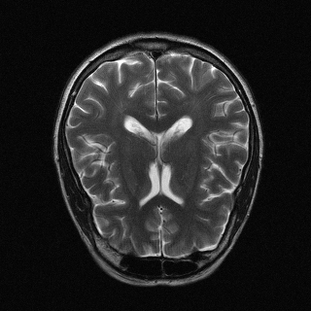
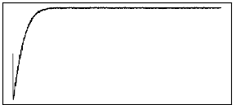
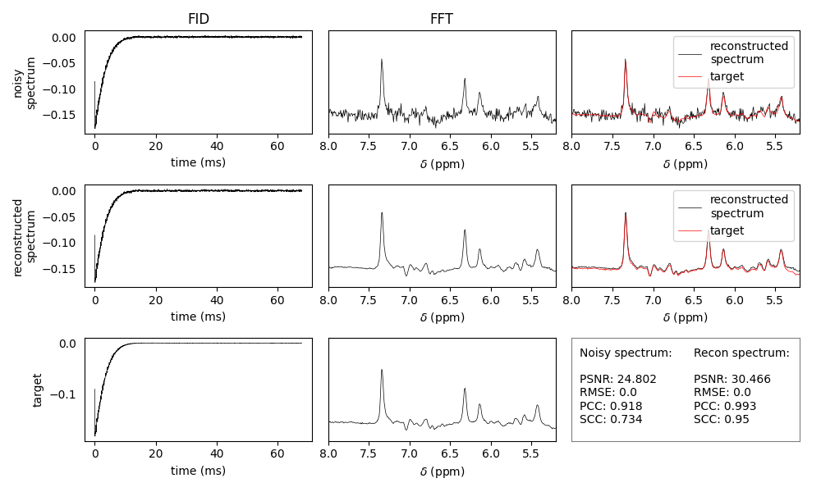
Applications
Raw Inputs
AFTNet Reconstruction
Outputs
Cross-species
Human
Mouse
K-space (C)
Image (R)
Cross-modalities
T1w MRI
T2w MRI
FLAIR MRI
PRESS MRS
FID (C)
Spectrum (R)
Cross-fields
Low: 0.3 T
Normal:1.5/3 T
High: 9.4 T
Time (ms)
AFT (C)
RAUNet (C)
Frequency (ppm)

