Slide 1
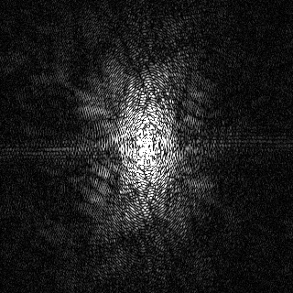
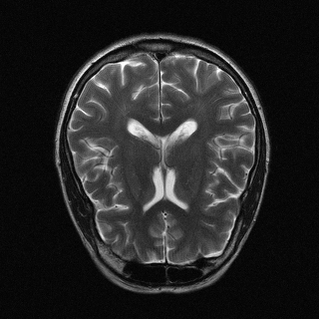
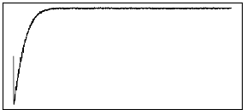
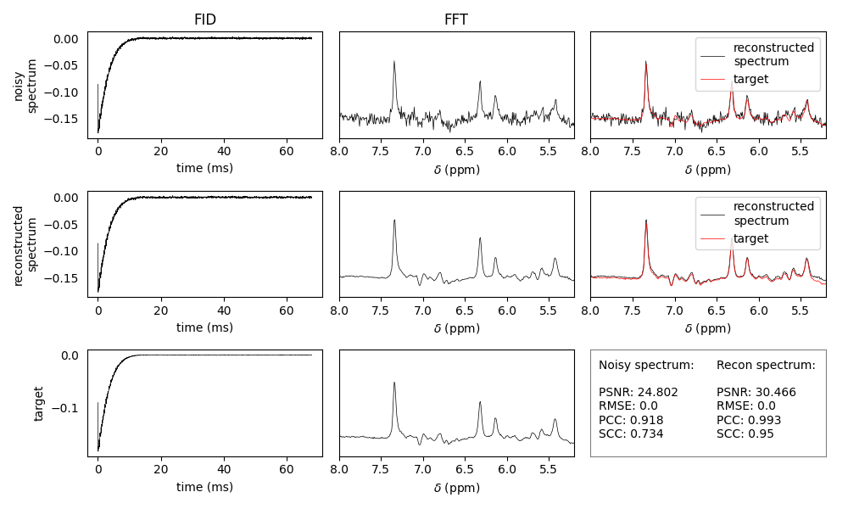
Applications
Raw Inputs
AFTNet Reconstruction
Outputs
Cross-fields
1.5T
3T
K-space (C)
Image (R)
Cross-modalities
T1w MRI
T2w MRI
PRESS MRS
FID (C)
Spectrum (R)
AFT (C)
CUNet (C)
Time (ms)
Frequency (ppm)

