Slide 1
AI-POWERED CAREER DECISION INTELLIGENCE
CAREER SIGNAL
CareerX-Ray
74
/100
Discover hidden career risks
before they become career regrets.
4 hidden risks
3 future paths
Detect
→
Simulate
→
Act
A decision intelligence platform for navigating career change with evidence, foresight, and a clear next move.
Stop guessing.
Start navigating.
01

Slide 2
THE PROBLEM
Career mistakes reveal themselves years after the decision.
People rarely know a career choice is wrong while they are making it.
Switch careers?
Pursue a Master's?
1
→
2
→
3
Learn AI?
Stay in this role?
DECISION
YEARS PASS
REGRET
Feels reversible
Cost compounds
Now obvious
The insight arrives late. The consequences do not.
02

Slide 3
WHY NOW
Career planning cannot keep pace with workforce disruption.
AI is reshaping roles faster than annual reviews, degree cycles, or traditional coaching can adapt.
22%
170M
92M
+78M
of jobs will change
new roles created
roles displaced
net jobs
Structural labor-market transformation expected by 2030
Growth opportunities emerge in new skill clusters
Existing work is reconfigured or eliminated
But the transition risk is personal.
The challenge is no longer:
The challenge is:
"How do I get a job?"
"How do I avoid becoming irrelevant?"
Source: World Economic Forum, The Future of Jobs Report 2025
03

Slide 4
MARKET GAP
Existing solutions optimize career transactions, not career decisions.
PLATFORM
OPTIMIZES
ANSWERS
LinkedIn
Networking
Who can I reach?
JobStreet
Job search
What roles are open?
Resume builders
CV creation
How do I present myself?
Career coaches
Advice
What should I consider?
CareerX-Ray
Risk detection • Decision simulation • Regret prevention
The missing intelligence layer
04

Slide 5
THE PRODUCT
CareerX-Ray turns uncertainty into a navigable system.
Four connected moments move a user from fragmented evidence to confident action.
01
→
02
→
03
→
04
Understand
Detect
Simulate
Act
Where am I now?
What can I not see?
What happens next?
What should I do?
One continuous loop
New evidence updates risk. New risk reshapes simulations. Every simulation updates the prescription.
05

Slide 6
WORKFLOW
Evidence powers every stage of the CareerX-Ray journey.
1
Career X-Ray Scan
Build Career DNA
CAREER EVIDENCE ENGINE
A living foundation,
not a one-time questionnaire.
2
Blind Spot Detection
Rank hidden risks
→
Decision Lab
Projects
Proof of applied skill
3
Model future paths
Certifications
Verified capability
Experience
Scope and trajectory
4
Career Prescription
Sequence action
Achievements
Signals of distinction
More evidence → better risk confidence → more credible decisions
06

Slide 7
DIAGNOSTIC
The scan turns fragmented experience into a measurable Career DNA.
Resume
CAREER DNA
Career Profile
Skills
1
Strengths, scope, velocity
Experience
74
→
Health Score
2
Projects
Current career resilience
Certifications
Career Health
Risk Baseline
3
Evidence-backed profile
Exposure and stagnation
07

Slide 8
RISK INTELLIGENCE
Blind spots become actionable when impact and response are explicit.
RISK
SIGNAL
IF IGNORED
RECOMMENDED ACTION
CRITICAL
AI disruption risk
Core tasks lose market value
Shift toward AI oversight + applied projects
HIGH
Leadership gap
Promotion stalls at current scope
Lead one cross-functional initiative
HIGH
Skill stagnation
Mobility narrows over 12–18 months
Refresh one market-facing skill cluster
MEDIUM
Salary gap
Underpayment compounds
Benchmark, evidence, negotiate or move
08

Slide 9
DECISION LAB
See the future tradeoffs before making the commitment.
Compare salary, market demand, promotion potential, and risk across multiple career paths.
Stay current
Move into AI
Master's
MEET YOUR FUTURE SELF
Future B
You move into AI-enabled product work.
$162k
Low
68%
5-year salary
career risk
promotion odds
Best long-term upside, with a 9–14 month transition investment.
Now
Year 1
Year 3
Year 5
09

Slide 10
PRESCRIPTION
Insight only matters when it becomes a timed action plan.
30 DAYS
90 DAYS
6 MONTHS
Build the signal
Create the proof
Make the move
1
2
3
✓
Choose AI skill
✓
Ship portfolio project
✓
Benchmark market
✓
Start certification
✓
Lead visible initiative
✓
Apply or negotiate
Every action is ranked by risk reduction, effort, and evidence gained.
10

Slide 11
DIFFERENTIATION
The category shift: from finding jobs to navigating careers.
CURRENT PLATFORMS
CAREERX-RAY
Help users
find jobs.
Helps users make
better decisions.
→
Job search
Career navigation
Information
Decision intelligence
Reactive
Predictive
11

Slide 12
VISION
Stop Guessing.
CAREER OS
Evidence
Start Navigating.
Risk
Simulation
Action
CareerX-Ray aims to become the decision intelligence layer of the future Career OS.
12

Slide 13
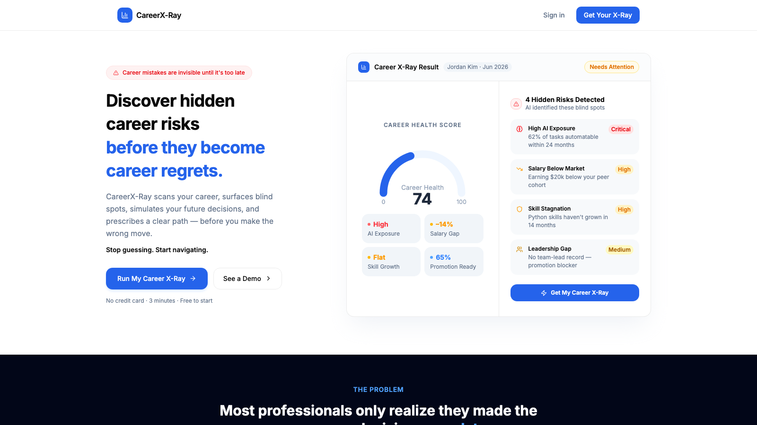
PRODUCT APPENDIX
Landing Page
Career risk made tangible at first glance.
13

Slide 14
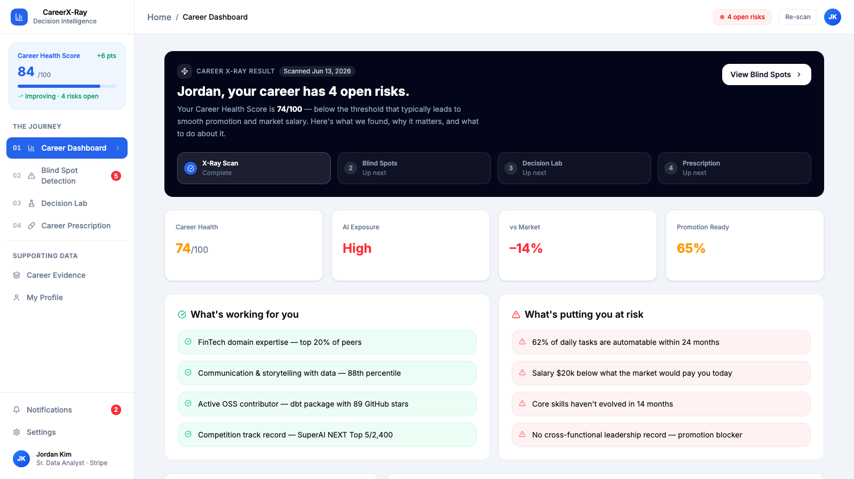
PRODUCT APPENDIX
Career Dashboard
A single view of health, exposure, salary, and readiness.
14

Slide 15
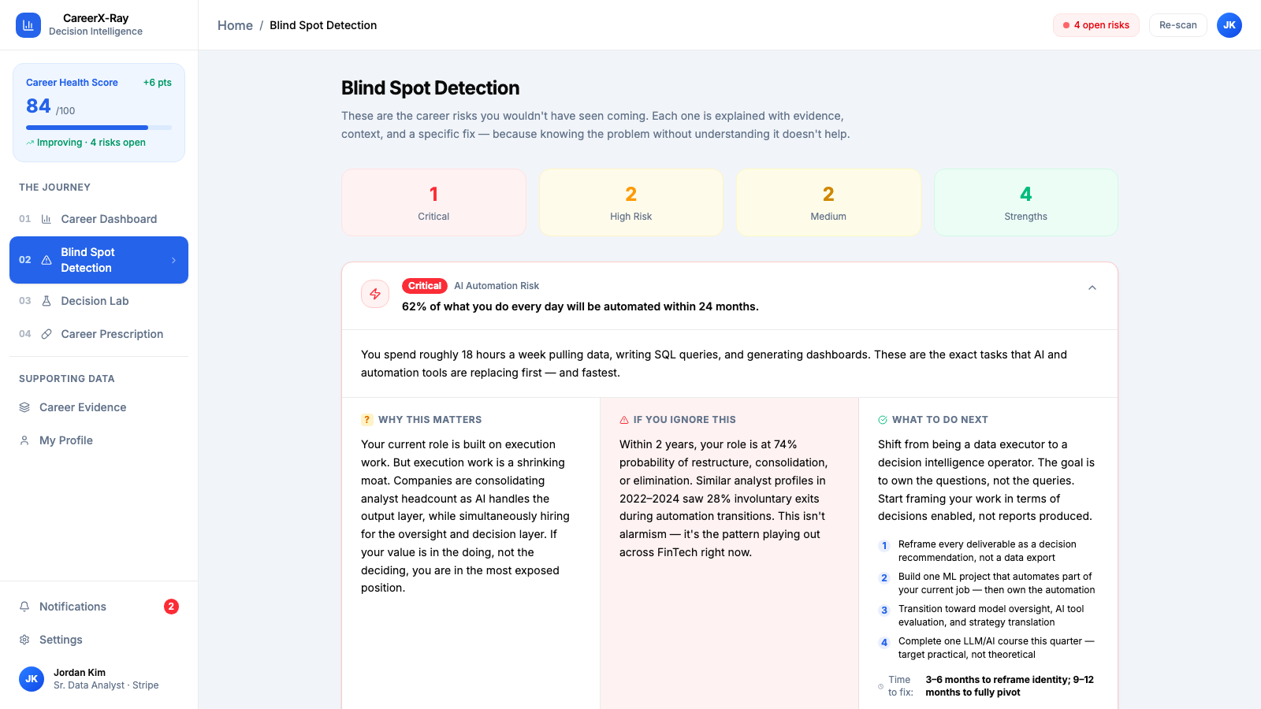
PRODUCT APPENDIX
Blind Spot Detection
Risks ranked by severity, evidence, and next action.
15

Slide 16
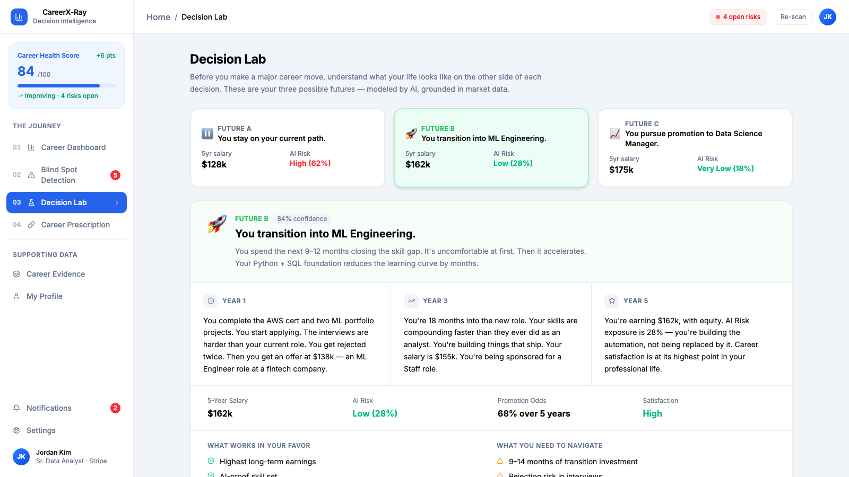
PRODUCT APPENDIX
Decision Lab
Three futures compared before the user commits.
16

Slide 17
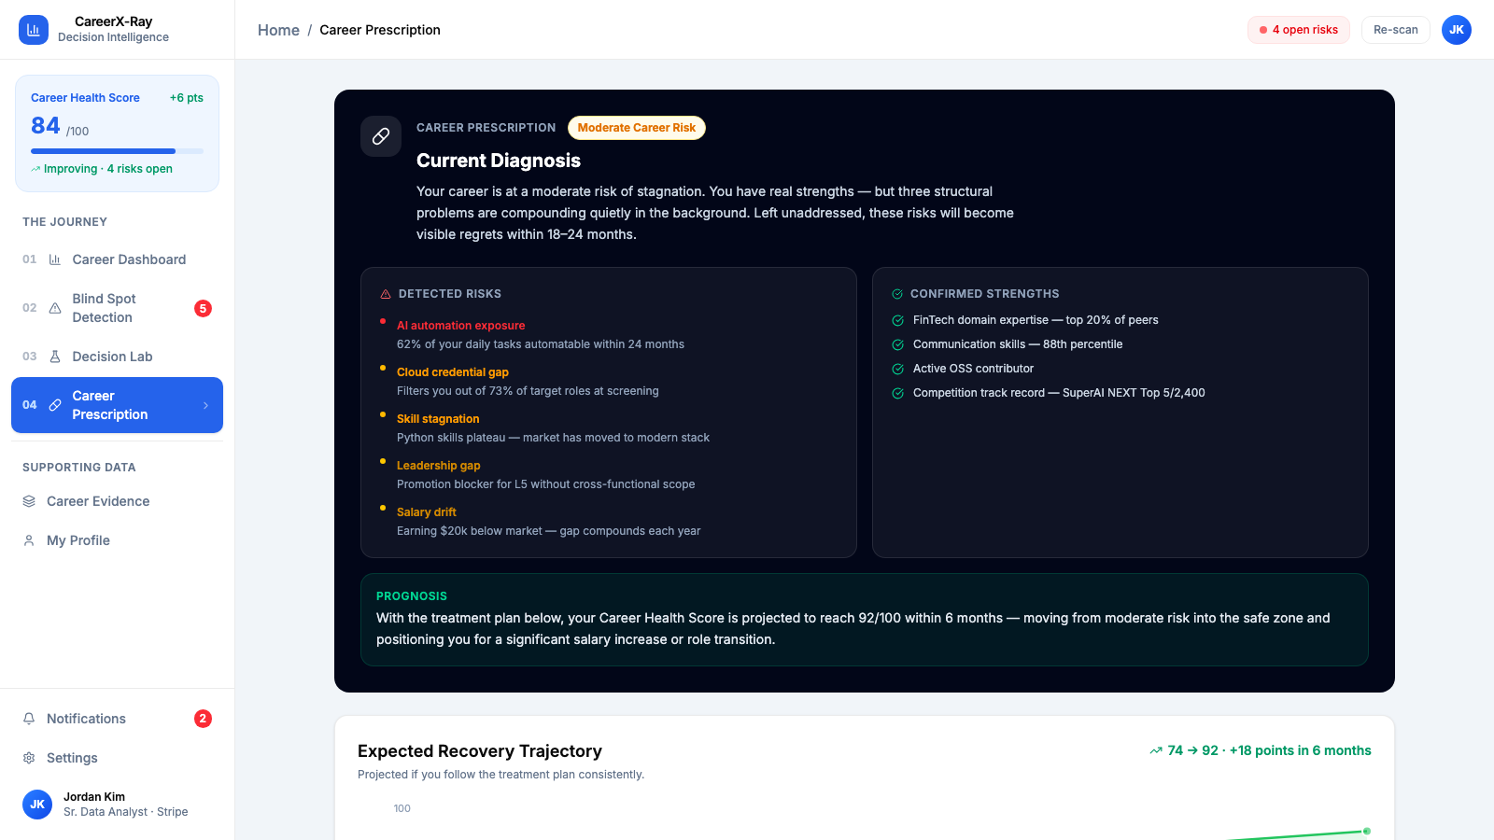
PRODUCT APPENDIX
Career Prescription
A prioritized roadmap from insight to measurable progress.
17

