Slide 1


SHRAMDAN
01
CORE DIRECTION 01
SHRAMDAN Is Becoming an Action Platform
समस्या देख्ने मात्र होइन, समाधानतर्फ लैजाने प्रणाली।
SHRAMDAN moves from public listings into a system for coordination, decisions, and real community action.
List → Discuss → Act
Major direction changes only

Slide 2

SHRAMDAN
02
CORE DIRECTION 02
Events + Issues Become the Core Discovery Layer
खोज, फिल्टर, स्थान, श्रेणी — सबै एउटै अनुभवमा।
Search, filters, category, location, and event/issue switching become the front door to civic work.
Discover what needs action
Major direction changes only

Slide 3
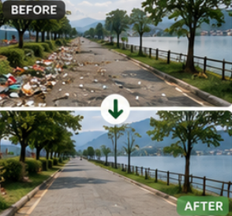
SHRAMDAN
03
CORE DIRECTION 03
Trust Through Transparent Funding
योगदान कहाँ जान्छ, सबै सदस्यले स्पष्ट देख्ने।
Monthly needs, operating costs, contributors, and usage become visible so SHRAMDAN can sustain itself with trust.
Transparent by default
Major direction changes only

Slide 4

SHRAMDAN
04
CORE DIRECTION 04
Shramesh: The 24x7 Digital Helper
सहयोग, सुझाव, बैठक, समन्वय — एउटै साथी।
Shramesh becomes SHRAMDAN's friendly digital staff: helping members coordinate, learn, organize, and eventually connect through LLM/RAG and WhatsApp.
Always-on coordination
Major direction changes only

Slide 5
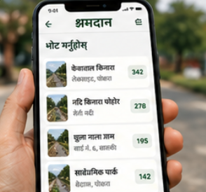
SHRAMDAN
05
CORE DIRECTION 05
App Development Becomes a Community Forum
एप पनि श्रमदानकै मुद्दा हो — छलफल, मतदान, अनुमोदन, कार्यान्वयन।
Building SHRAMDAN follows the same civic model: discuss current issues and upcoming features, vote on priorities, approve implementation, and track progress.
Discuss → Vote → Approve → Build
Major direction changes only

Slide 6
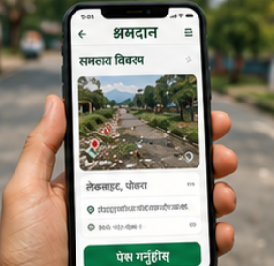
SHRAMDAN
06
CORE DIRECTION 06
Live Stats + System Pages Make SHRAMDAN Operable
मञ्च अब देखिने, मापन हुने, सुधारिने प्रणाली बन्छ।
Live stats, UI components, discussions, and operational pages turn SHRAMDAN into a measurable, improvable, publicly understandable system.
Visible. Measured. Improved.
Major direction changes only

