Slide 1
TASK-11
EMPATHY PROCESS FLOW CHAT
BELOW IS THE LUCID CHART

Slide 2
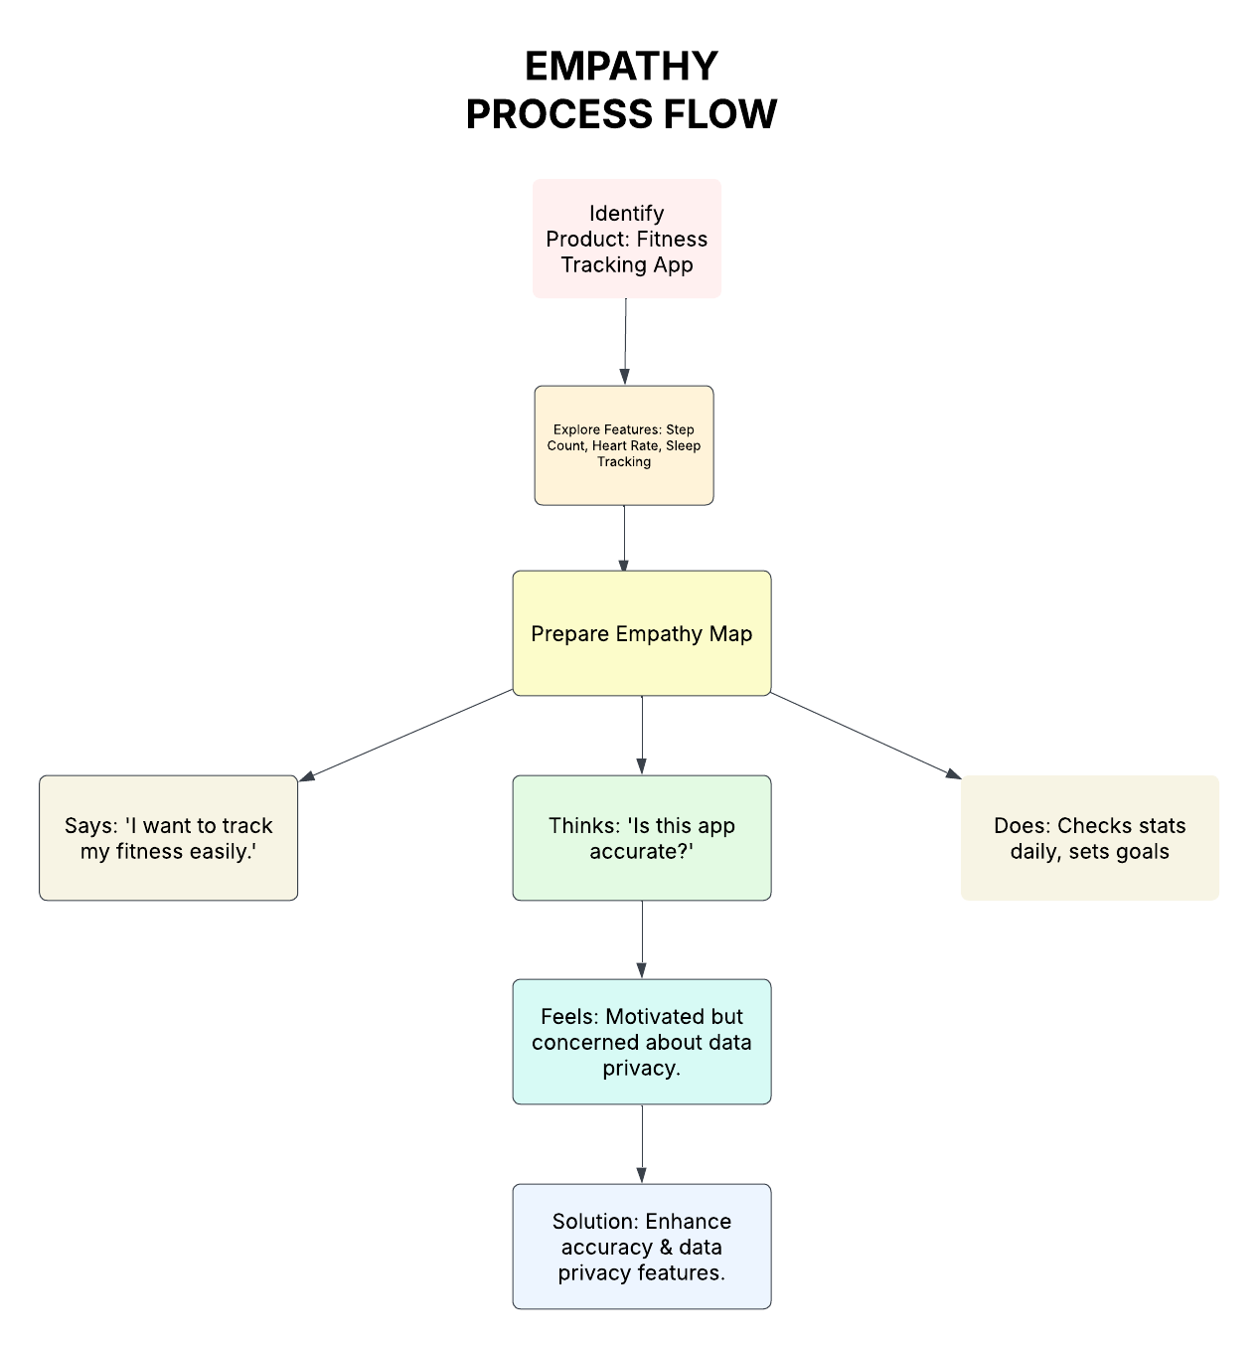

Slide 3
The below link to open lucid chart related to EMPATHY PROCESS FLOW CHART LUCID CHART OF EMPATHY PROCESS FLOW CHAT

