Slide 1
TASK-9
STAKEHOLDER MAPPING
BELOW IS THE LUCID CHART

Slide 2
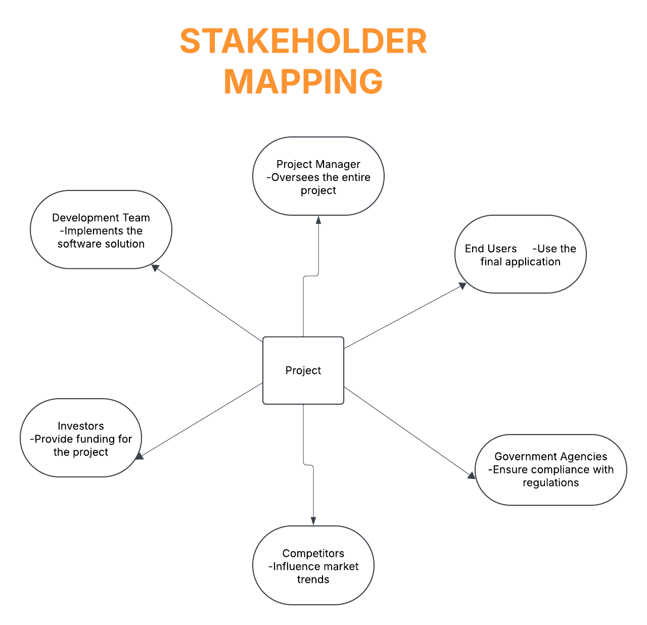

Slide 3
The below link to open lucid chart related to STACKHOLDER MAPPING STACKHOLDER MAPPING LUCID CHART :

