Slide 1
CXL-FUSEE A/B/C Protocol Comparison
Real Hardware Experimental Results
Intel Xeon 6787P + XConn XC50256 CXL switch + CXL Type 3 Memory
2026-04-19

Slide 2
Experimental Setup
Hardware
- 2 machines: g3, g4 (Intel Xeon 6787P, 800 GB DRAM) - CXL switch: XConn Technologies XC50256 - CXL memory: 512 GiB, target_node=1 - Devdax devices: /dev/dax0.0 (256 GB), /dev/dax0.1 (128 GB), /dev/dax0.2 (128 GB) - g3 dax0.0 and g4 dax0.0 map to the same physical address 0x4080000000 -> hardware supports cross-node shared memory via CXL switch
Software
- cxl_shm_profiling library (LFM mutex on non-coherent CXL) - Custom bench: ycsb_abc_bench.c (~700 lines, 3 protocols compile-time switched) - Single-host multi-process setup (4 processes simulate 4 nodes) - Cross-node ultimately blocked: g4 dax0.0 needed reboot to recover

Slide 3
Baseline: CXL vs DRAM Latency (g3)
Operation | DRAM (tmpfs) | CXL (/dev/dax0.0) | CXL / DRAM
plain store (cached) | 4.3 ns | 7.2 ns | 1.7x
plain load (cached) | 4.2 ns | 8.1 ns | 1.9x
CACHELINE_STORE +flush+sfence | 255.7 ns | 1558.7 ns | 6.1x
CACHELINE_LOAD +flush+mfence | 322.5 ns | 700.0 ns | 2.2x
Key observation
CXL flush to memory is 6x slower than flush to DRAM (which goes to pagecache). This makes every cross-node visibility primitive roughly 2-6x more expensive.

Slide 4
Main Results: YCSB A (50% write) & YCSB C (100% read)
Option | Workload | Throughput (ops/s) | Avg Latency
A | A (50% write) | 20,493 | w=774 us / r=0.4 us
A | C (100% read) | 77.1M | r=0.08 us
B | A (50% write) | 1.00M | w=14.2 us / r=1.2 us
B | C (100% read) | 13.77M | r=0.35 us
C | A (50% write) | 1.06M | w=10.3 us / r=4.2 us *
C | C (100% read) | 1.95M * | r=3.78 us *
* = Lazy RC strict-read overhead
Key ratios: - Write throughput C/A = 51.5x (C is 51x better than A on writes) - Write latency A/C = 75x (A is 75x slower than C on writes) - C's strict-read cost: ~3.7 us per read (flushes bucket+KV from CXL)

Slide 5
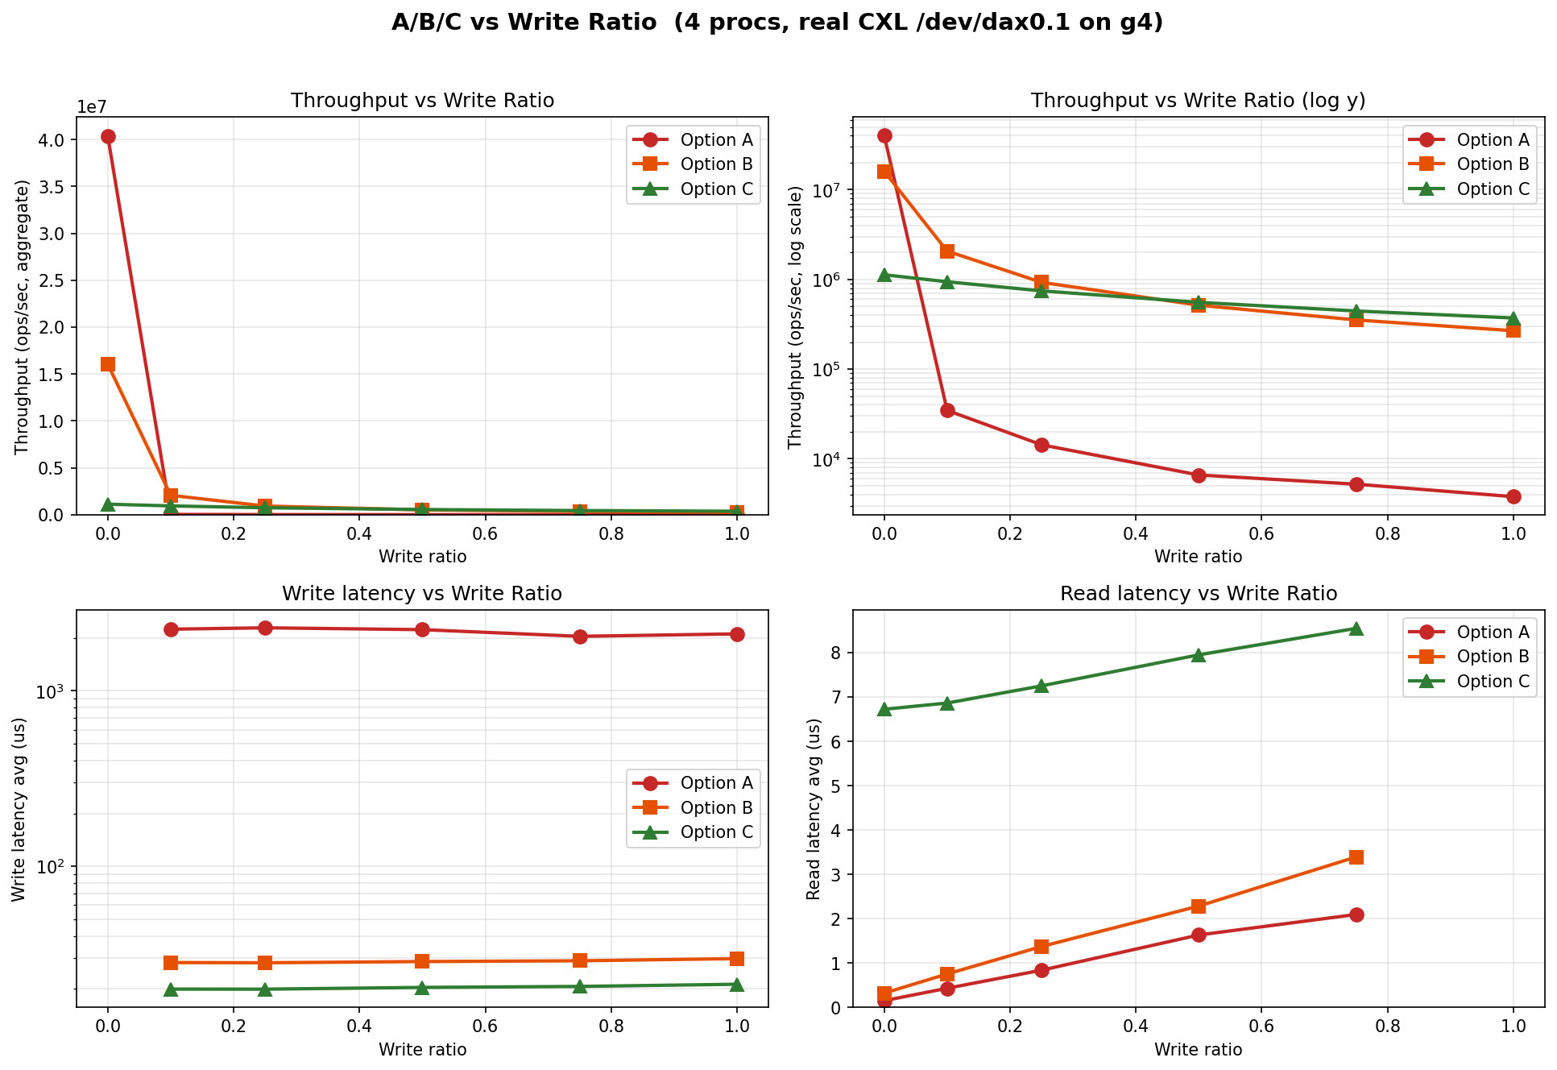
Write Ratio Sensitivity
Takeaways: 1. C is most stable across all write ratios 2. A is great at wr=0 (40M ops/s) but collapses at wr=0.1 3. B > C at wr <= 0.25 due to read cost 4. C > B at wr >= 0.5 (write-heavy)

Slide 6
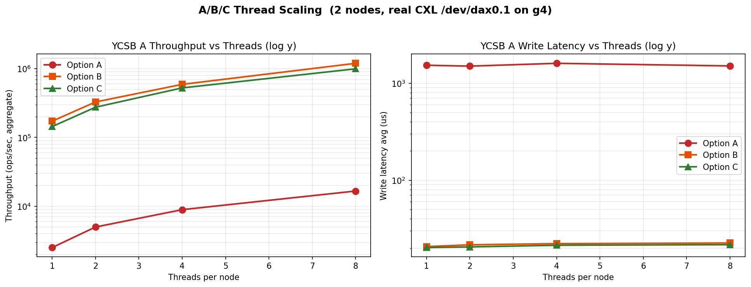
Thread Scaling
Setup: - 2 nodes (procs) - YCSB A (wr=0.5) - Threads per node: 1, 2, 4, 8
Findings
1. All three protocols scale near-linearly with thread count (7x from 1->8 threads) 2. Write latency essentially constant w.r.t. thread count (lock contention low per-bucket) 3. B maintains ~20% lead over C at high thread count, due to C's strict-read cost (YCSB A has 50% reads; C pays 2 us extra per read) 4. A's throughput stays 100-250x lower than B/C at every thread count

Slide 7
Decision Matrix: Which Option to Use?
Workload / Requirement | Recommended
Read-heavy, low latency reads matter | Option B
Write-heavy or balanced mixed | Option C (Lazy RC)
Eventual-consistency reads acceptable | Option C (fast path only)
Need CXL hardware fault tolerance | Option A (heavy cost)
Default / production | Option C (Lazy RC)
Overall recommendation
Option C (Lazy Release Consistency) is the default production recommendation. Provides the best write performance with clean RC semantics; read cost ~3.8 us is acceptable.

Slide 8
Open Items and Next Steps
Not Completed This Session
1. Cross-node test on real CXL: - g4's /dev/dax0.0 in broken state after mid-session reconfigure - Requires reboot + ~/cxl_net/g4-setup.sh to recover - g3 SSH blocked by pam_time during test window (will lift) - Hardware supports sharing (both map PA 0x4080000000); once g4 recovers, trivial to run 2. Full FUSEE source-tree integration (replace RDMA paths with CXL): - Estimated 2-3 weeks of engineering work - Detailed steps in cxl_implementation_guide.md
Immediate Next Steps
1. Reboot g4, run setup: ssh g4 reboot # after reboot: cd ~/cxl_net && ./g4-setup.sh 2. Cross-node test command pair: # g3: ./bench/ycsb_abc_bench --opt=C --workload=A --nodes=2 --node-id=0 --path=/dev/dax0.0 # g4: ./bench/ycsb_abc_bench --opt=C --workload=A --nodes=2 --node-id=1 --path=/dev/dax0.0 3. Start FUSEE integration Phase 1 (cxl_mm, cxl_bucket_lock)

