Slide 1
Tigon: A Distributed Database for a CXL Pod
Yibo Huang, Haowei Chen, Newton Ni, Yan Sun, Vijay Chidambaram, Dixin Tang, Emmett Witchel
OSDI 2025 | UT Austin & UIUC
Presented by: Yan Wang
Notes:
Welcome. I'll present Tigon, an OSDI 2025 paper out of UT Austin and
UIUC. The headline: it's the first distributed in-memory database that
synchronizes cross-host accesses through CXL memory instead of through
the network.
Plan: about 60 minutes. I'll motivate the problem, walk through why
existing solutions don't cut it, then dig into the design, and end with
evaluation and discussion. Please interrupt with questions at any time.

Slide 2
Outline
~60 minutes presentation
1. Background: CXL, CXL pods, and distributed transactional databases
2. Research problem: Cross-host synchronization is expensive
3. Existing solutions and why they fall short
4. Tigon's design
Data organization & software cache coherence
Concurrency control (2PL + next-key locking)
Logging & recovery without 2PC
5. Evaluation: TPC-C, YCSB, scalability, sensitivity studies
6. Discussion & takeaways
Notes:
Quick roadmap. I'll spend ~10 minutes on background because the
problem only makes sense if you understand CXL and CXL pods, which are
fairly new. Then ~5 minutes stating the research problem, ~8 minutes on
existing solutions and why each is insufficient, ~20 minutes on the
design (the meat of the paper), ~15 minutes on evaluation, and close
with discussion.
If you're familiar with CXL, feel free to nudge me to go faster through
the background.

Slide 3
1. Background
Distributed transactions, RDMA, and the arrival of CXL
Notes:
Let's start with background. Three things I need on the table:
what makes distributed transactional databases hard, why RDMA-based
approaches still leave performance on the table, and what CXL and a
CXL pod actually are.

Slide 4
Distributed Transactional Databases
Decades of research, still a bottleneck
In-memory OLTP databases scale horizontally by partitioning data
Transactions that touch a single partition are cheap and local
Multi-partition transactions require cross-host coordination:
Many message exchanges during execution
Two-phase commit (2PC) at the end for atomicity
Network latency dominates: one RTT ≈ microseconds
= hundreds of DRAM access times
Performance collapses as multi-partition ratio grows
Notes:
Distributed transactional databases. People have worked on these
since at least System R* in the 80s. The architecture almost everyone
uses is shared-nothing: partition the data, each host owns a shard,
route operations to the shard owner. Single-partition transactions
stay local and are fast.
The problem is multi-partition transactions. A multi-partition txn
needs data from two or more hosts. That means RPC round-trips during
execution, and then a two-phase commit at the end to guarantee
atomicity. A network RTT is in the microseconds; local DRAM access is
in the hundreds of nanoseconds — a factor of 100-1000.
The consequence: performance is fine until you have too many
multi-partition txns, and then it collapses. TPC-C by default has
10-15% multi-partition — real workloads have more.

Slide 5
Accelerating Distributed Transactions with RDMA
One-sided RDMA and disaggregated shared memory
RDMA bypasses the kernel: direct remote memory access
Two popular directions:
Optimize partition-based DBs with RDMA (FaRM, FaSST, DrTM, ...)
Shared disaggregated memory DBs (FORD, Motor, ...)
Still: RDMA latency is 1–2 orders of magnitude higher than local DRAM
Every synchronization is a network round-trip in microseconds
→ Even with RDMA, cross-host sync is the bottleneck
Notes:
RDMA was the natural next step. Bypass the kernel, bypass the
TCP stack, directly read remote memory. Two styles of systems:
One, keep partitioned shared-nothing, use RDMA to speed up the
messages and 2PC. FaRM, FaSST, DrTM are in this family.
Two, go all the way — disaggregate memory. The compute nodes have no
local data; everything is on the remote memory server accessed via
one-sided RDMA. FORD, Motor, XSTORE, Taurus. This avoids the
multi-partition problem by not partitioning.
Both still hit a ceiling. One-sided RDMA is fast by network standards
but one to two orders of magnitude slower than local DRAM. Every tuple
read could be a microsecond. Motor, the paper's baseline, tops out at
~100K TPC-C txn/s.

Slide 6
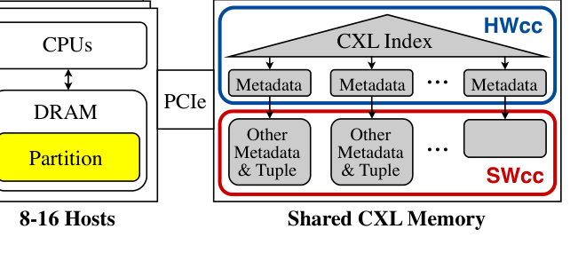
Compute Express Link (CXL)
A new, load/store-accessible memory fabric
Open-standard interconnect over PCIe 5.0 / 6.0
CXL.mem: CPUs access CXL memory via normal LD/ST
CXL 1.1: one host per device (memory expansion)
CXL 3.0 / 3.2: cacheline-granularity sharing across hosts with HW cache coherence
Hardware prototypes exist: SK Hynix Niagara 2.0 (8 hosts), Microsoft (2 hosts)
Notes:
Now CXL. Compute Express Link is an open standard on top of
PCIe 5/6. The key protocol for us is CXL.mem, which lets the CPU access
memory on a PCIe device using regular load/store instructions — no
RDMA verbs, no message passing API.
Three specification versions matter:
- CXL 1.1: one host per device. Just memory expansion.
- CXL 3.0: cacheline-granularity sharing across hosts, with optional
hardware cache coherence via back-invalidations.
- CXL 3.2: the current spec, refines 3.0.
Real hardware exists but is early. SK Hynix Niagara 2.0 supports up to
8 hosts but no HW cache coherence yet. Microsoft has a 2-host prototype.
The paper's design targets the 3.0 generation.
The figure on the right is Tigon's architecture — we'll unpack it
later; for now note the 'HWcc' box (the small hardware-coherent region)
and the 'SWcc' box (the larger region where Tigon provides coherence
in software).

Slide 7
CXL Pod
An intermediate between SMP and distributed systems
A small set of hosts (8–16) directly connected to a shared CXL memory
Via a multi-headed device (MHD) — no switch required → low latency
Each host has its own local DRAM (hardware cache coherent)
All hosts see a shared CXL memory region with limited HW cache coherence
Not quite SMP (inter-host coherence is expensive),
Not quite distributed (memory is load/store-addressable)
Tigon navigates this new tradeoff space
Notes:
A CXL pod is a specific topology: a small number of hosts — 8 to
16 — all directly connected to a single shared CXL memory device
through a multi-headed device, or MHD. An MHD is a CXL chip with
multiple host ports — no switch, which would add latency.
Why is this interesting? It's an intermediate architecture. It's not
a shared-memory multiprocessor because inter-host coherence is
expensive. It's not a fully distributed system because memory is
load/store addressable across hosts.
Architectural debates about the limits of SMP scalability — Kimberly
Keeton's 'The Machine', Keaton and Patterson's arguments — have been
around for years. CXL pods give us a new point. Tigon tries to
navigate the specific tradeoffs of that point.

Slide 8
CXL Performance: The Reality
Good — but not as good as local DRAM
Latency: 214–394 ns (CXL) vs. 111–117 ns (local DRAM)
Bandwidth: 18–52 GB/s (CXL) vs. 218–246 GB/s (local DRAM, read-only)
(Still 1–2 orders of magnitude better than RDMA for latency)
Takeaway #1: Cannot naively put all data on CXL memory
Takeaway #2: Must lean heavily on local DRAM for the hot path
Takeaway #3: Bandwidth is precious — minimize data movement
Notes:
But CXL is not local DRAM. Memory latency measurements from Sun
et al., the study the paper cites: CXL access is 214 to 394 nanoseconds,
depending on the device and pattern. Local DRAM is 111 to 117. So
1.5-3x latency penalty.
Bandwidth is the scarier number. Local DRAM on a modern server gives
you 200+ GB/s. CXL gives you 18-52 GB/s read-only, sometimes lower
depending on access pattern. That's roughly 10-20% of local DRAM
bandwidth.
Three design implications, which will recur throughout Tigon's design:
- You cannot put all your data on CXL; the hot path must hit local DRAM.
- You should copy data into CXL sparingly, not eagerly.
- You should minimize bandwidth-heavy operations like non-temporal
stores and uncached loads.

Slide 9
Why Hardware Cache Coherence is Limited
A practical, not theoretical, constraint
CXL 3.0+ supports inter-host HW cache coherence via back-invalidations
But: coherence requires a snoop filter that tracks every cacheable line
Snoop filter is expensive silicon — limited by area budget on the CXL controller
AMD report (ISCA'24): only tens to hundreds of MBs can be kept HW-coherent
Extreme example: Intel Granite Rapids 6980P would need 7.9 GB of tags for 16×504 MB
Practical devices: ≤ a few hundred MB of HWcc memory
→ Database synchronization structures must fit into a small HWcc budget
Notes:
There's an extra limitation specific to cross-host sharing:
hardware cache coherence. CXL 3.0 says the device can provide
coherence via back-invalidations, like a processor snoop filter.
The problem is silicon area. A snoop filter that covers every
cacheable line on every host costs huge area. AMD did the math: to
hardware-cover 16 hosts × 504 MB of cacheable data on an Intel
Granite Rapids you'd need 7.9 GB of tag storage. Not happening.
So vendors will ship devices that keep a limited region hardware-
coherent — tens to hundreds of megabytes. Everything else is still
CXL memory, still addressable, still shareable — but software has to
handle coherence.
This is the single most important constraint Tigon designs around.

Slide 10
2. Research Problem
Build an efficient distributed transactional DB on a CXL pod
Notes:
OK, enough background. Let's pin down the research problem.

Slide 11
The Core Question
Synchronize through memory, not through the network
Existing distributed DBs: synchronize concurrent cross-host accesses via messages
Proposal: synchronize directly through shared memory using atomic ops on CXL
Why now? CXL 3.x makes load/store-addressable, cache-coherent shared memory real
Why not trivial? CXL has three hardware limitations we must confront:
Higher latency than local DRAM
Lower bandwidth than local DRAM
Very limited HW-cache-coherent region
Can we convert message exchanges into data-structure operations?
Notes:
Everything I showed you up to now is about sending messages
across hosts — RPC, RDMA verbs, whatever. CXL lets us do something
fundamentally different: let hosts synchronize by running atomic
operations on shared memory, the way threads in a single process
synchronize on locks.
That's Tigon's core proposal. Synchronize through memory, not through
the network.
Why isn't this trivial? Three CXL limitations that bite:
- Latency higher than local DRAM, so we can't indiscriminately access
CXL.
- Bandwidth lower than local DRAM, so we can't move data freely.
- Hardware cache coherence is limited to a small region, so we can't
assume everything in CXL memory is seen the same way by every host.
The research question is: can we convert cross-host message exchanges
into data-structure operations on shared memory — efficiently — under
these constraints?

Slide 12
Design Goals
What a good CXL-pod database must achieve
G1. Match or beat single-partition performance of shared-nothing DBs when no sharing
G2. Scale gracefully as the fraction of multi-partition transactions grows
G3. Obey HWcc memory budget (tens–hundreds of MB) without killing performance
G4. Use CXL bandwidth sparingly (bandwidth is the real bottleneck)
G5. Preserve standard transaction semantics (serializability, durability, recovery)
G6. Avoid 2PC and its hidden latency tax
Notes:
Six design goals for a good CXL-pod database. G1-G2 are about
end-to-end performance — single-partition should not regress compared
to shared-nothing, and multi-partition should degrade gracefully. G3
is the HWcc budget constraint — the design has to work in a few
hundred MB. G4 is bandwidth — CXL bandwidth is precious. G5 is
standard database correctness: serializability, durability, recovery.
G6 is the 2PC tax — if we truly synchronize via memory, we should be
able to commit without 2PC.
Any database design for CXL pods should check these boxes.

Slide 13
3. Existing Solutions — and Why They Fall Short
Three strawmen we must do better than
Notes:
Before presenting Tigon's design, let me sharpen the picture by
walking through four natural approaches and explaining why each one
falls short. This is the motivation for Tigon's specific design
choices.

Slide 14
Approach 1: Shared-Nothing + 2PC
Sundial, DS2PL, H-Store, Spanner, …
Partition data across hosts. Each host handles its partition.
Multi-partition transactions: coordinator gathers remote ops, runs 2PC
Why it falls short:
Heavy messaging: read/write RPCs + prepare + commit (2 extra RTTs)
Paper measures 3.3 – 4.1 messages/transaction for TPC-C 60/90
Throughput drops sharply as multi-partition % grows
Even with RDMA or CXL used only as a transport, performance remains limited
Notes:
Approach 1: the classic. Shared-nothing partitioning with 2PC
at the end. Sundial, DS2PL, H-Store, Spanner all fit here.
Why it doesn't cut it for us: every multi-partition transaction
involves many messages. Read/write RPCs during execution, then a
prepare round, then a commit round. The paper measures 3.3 messages
per transaction for Sundial on TPC-C 60/90, 4.1 for DS2PL.
You'll see in the evaluation that even with the best 2PL or OCC
protocol, performance drops sharply as multi-partition ratio grows,
and 2PC is the inescapable tax.

Slide 15
Approach 2: RDMA-based Shared Disaggregated Memory
FORD, Motor, XSTORE, …
Compute and memory are separated; compute nodes read/write remote tuples via RDMA
Avoids partitioning → no multi-partition problem, no 2PC
Why it falls short:
One-sided RDMA latency is in the microseconds — 10–100× local DRAM
Every tuple access can be a network round-trip
Motor’s published peak: ~100K TPC-C txn/s; our testbed: ~30K/s (bandwidth-bound)
CXL memory is load/store-addressable and much faster — RDMA leaves perf on the table
Notes:
Approach 2: disaggregated memory with RDMA. Motor is the most
recent published example. No partitioning — tuples live on memory
servers, compute nodes read them over RDMA.
No multi-partition problem, no 2PC. But every tuple read is a network
RTT. The paper's evaluation shows Motor is bandwidth-limited at ~30K
txn/s on their 25 Gbps NICs — but even in Motor's own paper, with
100 Gbps, it tops out around 100K/s.
CXL memory is load/store-addressable and much faster. RDMA leaves a
lot of performance on the table.

Slide 16
Approach 3: CXL as a Faster Network
HydraRPC-style: reuse CXL only for message passing
Keep shared-nothing architecture, just replace the network with CXL queues
Paper’s improved baselines Sundial-CXL / DS2PL-CXL do exactly this
Result: 2× improvement for TPC-C 60/90 (message RTT shrinks)
Why it still falls short:
You still exchange messages — just faster ones
You still run 2PC
You ignore the unique capability of CXL: shared memory with atomic ops
Tigon asks: what if we eliminate messages on the critical path instead?
Notes:
Approach 3: keep shared-nothing, but swap the network for CXL
message queues. HydraRPC-style. The paper actually implements this as
a baseline — Sundial-CXL and DS2PL-CXL. Shows a clean 2x improvement
at 60/90 multi-partition.
But: you still exchange messages. You still run 2PC. You're using CXL
as a better pipe. You're not exploiting its unique capability, which
is load-store-accessible shared memory with atomic operations.
Tigon asks: what if we get rid of messaging on the critical path
altogether?

Slide 17
Approach 4: Put Everything on CXL Memory
The obvious strawman
Every tuple lives in shared CXL memory; every host reads/writes directly
Why it falls short:
CXL is 1.6–3× slower than local DRAM (latency) → hot path suffers
CXL bandwidth is ~13% of local DRAM → cores starve
HW cache coherence only covers ~hundreds of MB → won’t fit the database
→ Data placement must be careful: hot data local, shared data on CXL
Notes:
Approach 4: put every tuple in CXL memory. Now every host
directly accesses every tuple — no partitioning needed.
Three problems:
- CXL latency is 1.6-3x local DRAM, so your hot path is 1.6-3x slower.
- CXL bandwidth is 13% of local DRAM, so you'll saturate it.
- HW cache coherence only covers ~200 MB; a real database doesn't fit.
So there's no free lunch. You can't just move everything to CXL.
Data placement matters — hot data local, shared data on CXL.

Slide 18
Summary of Prior Art
Tigon occupies a new point in the design space
Partition + 2PC: messaging bound, 2PC overhead
RDMA disaggregated: μs-scale per-access latency
CXL as fast network: still messaging, still 2PC
Naive all-on-CXL: violates HWcc budget, bandwidth starvation
Insight behind Tigon:
Only a tiny set of tuples is concurrently shared at any instant (the CAT)
Keep the CAT in CXL memory; everything else local
Convert cross-host messages into local atomic ops on shared structures
Notes:
So where are we? Four natural approaches, each with a fatal
flaw. Tigon's insight connects them: at any point in time, only a
small set of tuples is concurrently shared across hosts — the
Cross-host Active Tuple set, or CAT. This set is small — megabytes.
That's exactly the size where HWcc memory is feasible.
Tigon: keep the CAT in CXL memory. Everything else in local DRAM.
Use atomic operations on CXL-resident metadata for synchronization
instead of messages. Co-design concurrency control and logging so
that 2PC is unnecessary.
Let's dig in.

Slide 19
4. Tigon Design
The first distributed DB designed for a CXL pod
Notes:
Section 4: Tigon's design. I'll cover the key insight, the
architecture, how data is organized, the software cache coherence
protocol, concurrency control, and logging. This is the largest
section — about 20 minutes.

Slide 20
Key Insight: the Cross-host Active Tuple (CAT)
Working set of shared data is tiny
Databases can be huge, but at any instant only a few tuples are actively shared
Why? In-memory OLTP has ~#cores concurrent transactions, each touching a few tuples
Back-of-envelope for TPC-C: 1000 cores × 39 tuples × ~190 B = ~7 MB
This is exactly the size regime where HWcc memory can help
Tigon’s north star: keep the CAT in CXL memory, use atomic ops on it for sync
Notes:
The foundational insight. Databases can be huge — gigabytes,
terabytes. But the set of tuples actually being touched concurrently
by running transactions is tiny.
Why? Simple arithmetic. In-memory OLTP has roughly one transaction
per CPU core at a time. Each transaction touches maybe 10-40 tuples.
Say 1000 cores, 40 tuples each, ~200 bytes per tuple: 7 MB. That's
it. That's the working set of shared data at any instant.
This is the CAT — Cross-host Active Tuples. The paper's north star:
keep the CAT in CXL memory, use atomic operations on it for
synchronization. Nothing else needs to live in CXL memory all the
time.

Slide 21
Tigon Architecture at a Glance
Partitioned local DRAM + shared CXL memory
Notes:
Here's the high-level architecture. Each host owns a data
partition, which lives in its local DRAM. Normal DRAM, hardware
cache-coherent within the host, fast.
Shared CXL memory is split into two regions. A small HWcc region at
top — this is where latches, the CXL index, and the HWcc record for
each CAT tuple live. A larger SWcc region at bottom — this holds
tuple bodies and larger metadata that we manage coherence for in
software.
When a host needs a tuple it doesn't own, Tigon moves that tuple
into CXL memory — from then on it's part of the CAT, accessible by
all hosts. If the HWcc budget gets tight, tuples get evicted back
to their owner's local DRAM.

Slide 22
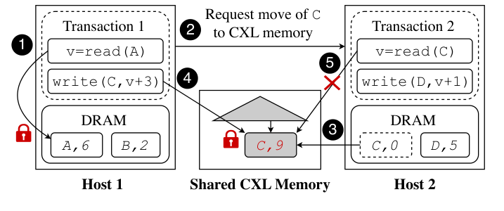
Example Transaction Workflow
From the paper's Figure 2
Notes:
An end-to-end example — Figure 2. Two hosts, transaction 1 on
Host 1 wants to read A (local) and write C (owned by Host 2).
Step 1: T1 reads A locally, takes read lock.
Step 2: T1 needs C. It sends a message to Host 2 asking it to move C
into CXL memory.
Step 3: Host 2 copies C into the SWcc region and creates an HWcc
record for it.
Step 4: T1 grabs the write lock on C's HWcc record via an atomic CAS,
updates C to C=9.
Step 5: Meanwhile, T2 on Host 2 also wants C. It looks up C via the
CXL index, sees the lock held, aborts under NO_WAIT.
At the end, T1 commits locally — no 2PC. It wrote all tuple changes
to its local log. The CAT here is literally one tuple, C.
This is the key trick: all coordination on C happens through the
HWcc latch, not through messages.

Slide 23
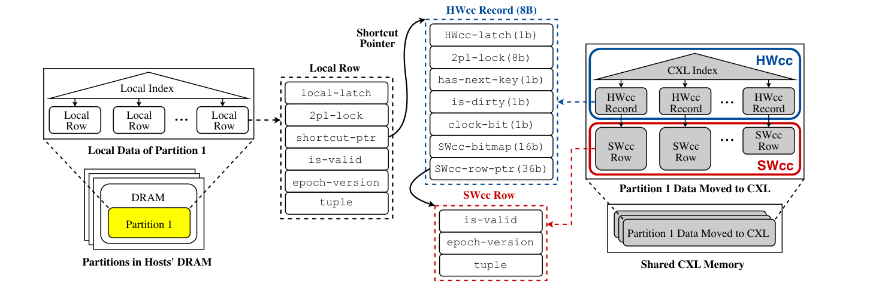
Data Organization in Tigon
HWcc record vs. SWcc row
Notes:
The data organization. This is Figure 3 — the densest figure
in the paper.
Three things to look at. Left: each host has a local index in its
DRAM, mapping keys to 'local rows'. A local row holds a local latch,
a 2PL lock, a shortcut-ptr, an is-valid flag, an epoch-version for
logging, and the tuple itself.
Middle: when a tuple is moved into CXL memory, the row is split. An
8-byte HWcc record goes to the HWcc region; an SWcc row goes to the
non-HWcc region. The local row's shortcut-ptr now points to the HWcc
record.
Right: the CXL index — a B+-tree per table-partition — lives in HWcc
memory and indexes all CAT tuples from that partition. All hosts can
look up tuples through it.

Slide 24
The 8-Byte HWcc Record
Minimize HWcc footprint — everything frequently synced fits here
1 bit HWcc-latch (mutual exclusion for the record)
8 bit 2pl-lock (read count + write bit)
1 bit has-next-key (needed for correct next-key locking across hosts)
1 bit is-dirty (tuple modified since moved to CXL)
1 bit clock-bit (for CLOCK eviction)
16 bit SWcc-bitmap (per-host cacheability for SWcc row)
36 bit SWcc-row-ptr (offset pointer to the SWcc row)
Design point: only latch + lock + tiny metadata need HW coherence
Notes:
Let's zero in on the 8-byte HWcc record. Every bit matters
because HWcc memory is scarce.
1 bit for a cross-host latch (HWcc-latch). 8 bits for the 2PL lock
(counts readers, holds a writer bit). 1 bit has-next-key, needed for
correct next-key locking — I'll come back to this. 1 bit is-dirty —
says whether the tuple was modified since moving to CXL. 1 bit
clock-bit for the eviction policy. 16 bits SWcc-bitmap — one bit per
host, used by the software cache coherence protocol. 36 bits
SWcc-row-ptr — a compact offset pointer to the full SWcc row.
Total: 8 bytes. Tiny. That's what lets Tigon pack thousands of CAT
tuples into the HWcc budget.
Note everything here is HW-coherent: the latch, the lock, the tiny
flags. The SW-coherent stuff, the actual tuple body, lives elsewhere.

Slide 25
Indexes and the Shortcut Pointer
Fast path for owners, general path for non-owners
Each host has a local index in DRAM over its own partition
An additional CXL index lives in HWcc memory for tuples in CXL memory
For an owned tuple that has been moved to CXL, the local row caches a shortcut-ptr
Owner hosts skip the CXL index using the shortcut pointer — saves CXL lookup
Non-owners look up in the CXL index (synchronized via HWcc latches)
Key challenge: shortcut-ptr correctness under concurrent data movement
Solution: local-latch on the local row serializes owner-side operations
Non-owners can only drive moves via request messages, never directly
Notes:
Indexes. Each host has a local B+-tree in DRAM, indexing its
own partition. Standard.
Plus a CXL index in HWcc memory, indexing the CAT. All hosts can
read/write the CXL index via HWcc atomics.
An optimization: when the owner of a tuple sees that its tuple has
been moved to CXL, it caches a shortcut pointer on the local row
pointing directly to the HWcc record. This saves the owner a CXL
index lookup — important because the owner accesses its own tuples
most often.
The non-trivial part is keeping shortcut pointers correct under
concurrent data movement. The rule is: only the owner host can
initiate data movement for its own tuples. Non-owners must send a
move request. Owner-side operations are serialized by the local-latch
on the local row. So the shortcut pointer is always either null or
pointing at a valid HWcc record. Non-owners, who race with movement,
are protected by the HWcc-latch and the is-valid flag — if a tuple
gets moved back to local DRAM, is-valid becomes false and stale
pointers fail safely.

Slide 26
Software Cache Coherence (SWcc)
Make the large non-HWcc region usable for tuple data
Problem: most of CXL memory is NOT hardware cache coherent
If hosts cache SWcc rows, stale data is possible
Insight: the database already has latches (HWcc-latch) gating every access
Co-design the SW coherence protocol with the latch:
Attach a 16-bit SWcc-bitmap to each HWcc record: one bit per host
Reader: if my bit is set → cacheable load; else flush+reload, set my bit
Writer: invalidate (unset) all other hosts' bits on write
Coherence granularity = tuple (larger than a cacheline) → metadata cheap
Result: database can use lots of SWcc memory with cacheable reads
Notes:
Now the software cache coherence protocol — one of the key
novelties.
Most of CXL memory is NOT hardware cache coherent. If hosts cache
SWcc rows, you get stale data. Classic solution: bypass the cache
with non-temporal loads, or pin reads to a single host. Both are slow.
Tigon's insight: the database already has latches. Every access to a
tuple goes through a latch. So piggy-back a coherence protocol on the
latch.
The 16-bit SWcc-bitmap has one bit per host. When a host reads a
tuple, it checks its bit. If set, its cached copy is valid — use a
normal cached load. If not set, flush the cacheline, read from CXL,
set the bit. When a host writes, it unsets the bits for all other
hosts.
Result: coherence granularity is a tuple (coarser than a cacheline,
so cheaper), metadata is one word per tuple, and normal cached loads
work for readers once they've populated the cache. Much better than
non-temporal loads for workloads that reuse tuples.
The catch: this requires database-side changes. It's not a
transparent protocol; it's co-designed with the latching.

Slide 27
Data Movement Policy: CLOCK
Cheap eviction that respects the HWcc budget
Non-owner access → request owner to move tuple to CXL memory
HWcc memory fills up → evict least-likely-reused tuples back to local DRAM
LRU is ideal but needs a linked list + metadata updates on every access
Tigon uses CLOCK: a single reference bit per tuple
Circular cursor scans tuples; bit set → clear and skip; bit clear → evict
Evaluation: CLOCK uses ~25% less HWcc than LRU; 2.4× faster under budget pressure
Notes:
Tuples move into CXL memory when non-owners ask for them.
They have to move back out when HWcc memory fills up.
Perfect policy would be LRU on cross-host access — evict whichever
tuple is least likely to be remotely reused. But LRU needs a linked
list threaded through all CAT tuples, and every access updates it.
That's expensive: HWcc memory for the list, contention on list
pointers.
Tigon uses CLOCK. One bit per tuple: set on any non-owner access. A
circular cursor scans CAT tuples. Bit set → clear it and move on. Bit
clear → evict.
Ablation in the eval: under tight HWcc budget, CLOCK is 2.4x faster
than LRU. Under unlimited HWcc, CLOCK is still 17% faster (less lock
contention). CLOCK wins on metadata efficiency.

Slide 28
Concurrency Control: 2PL with NO_WAIT
Single-host CC extended to shared CXL data
Tigon uses strong strict 2PL (SS2PL) — acquire during exec, release on commit
Read/write locks live in the 2pl-lock byte inside the HWcc record
Acquired via atomic ops on HWcc memory — no messages needed
NO_WAIT deadlock prevention: abort on lock conflict (prior work shows it scales best)
Standard OCC/MVCC left as future work (they add complexity under CXL pod model)
Notes:
Concurrency control. Tigon uses strong strict 2PL — acquire
locks during execution, release at commit. This is classical and easy
to reason about.
Locks live in the 2pl-lock byte of the HWcc record. Acquired via an
atomic compare-and-swap on HWcc memory. From the perspective of any
host, taking a lock on a CAT tuple is just a local atomic op — no
messages.
Deadlock handling: NO_WAIT. If you can't get the lock, abort and
retry. Prior work (Yu et al.) shows NO_WAIT scales best for in-memory
DBs. The paper goes with that.
OCC and MVCC would be interesting but are explicitly future work.
Adapting them to CXL pods is non-trivial and the authors wanted to
focus on the more widely deployed 2PL first.

Slide 29
Avoiding Phantoms: Enhanced Next-Key Locking
Serializable ranges across hosts, with a partial CXL index
Classic next-key lock: lock the next key in the ordered index on insert/delete/scan
Challenge: CXL index is a subset of the host's local index
The 'next key' in CXL index may not be the true next key!
Solution: add has-next-key bit per CXL-index entry
Set if next-in-CXL-index == next-in-local-index
Maintained on insert/delete/move events
If the bit isn’t set, ask the remote host to move the real next key to CXL
Paper: phantom-avoidance costs 10–12% throughput (reasonable)
Notes:
The phantom problem. Classical example: a range scan sees keys
10, 20, 30. Meanwhile another transaction inserts 15. If we just
locked the individual keys we saw, 15 can be inserted — violating
serializability.
Standard fix: next-key locking. On insert/delete/scan, lock not just
the key but the 'next key' in the ordered index.
In Tigon, this is harder because the CXL index only contains the
subset of keys that are in the CAT. The 'next key' in the CXL index
might not be the true next key in the local index.
Fix: add a has-next-key bit to each CXL-index entry. Bit is set if
the CXL-index next key is the same as the local-index next key.
Maintained by the owner as inserts, deletes, and moves happen. If the
bit isn't set, the transaction must ask the owner to move the real
next key into CXL before locking.
Cost: 10-12% throughput hit for correctness. Reasonable — and a
variant that ignores phantoms actually outperforms Sundial+ even on
TPC-C default.

Slide 30
Logging & Recovery Without 2PC
Adapt SiloR’s epoch-group-commit to 2PL + CAT
Observation 1: by keeping the CAT in CXL memory, a single host can complete and log all tuple modifications of its transaction
Observation 2: indexes can be reconstructed from tuples → no need to log index changes
→ One host logs all effects → no 2PC!
Borrowed from SiloR [Zheng'14]:
Epoch-based group commit (transactions batch into 10 ms epochs)
Parallel value logging: each worker writes its own log buffer to local SSD
Each tuple carries (epoch, version); tuple with highest (epoch, version) wins on recovery
A global epoch counter lives in HWcc memory — synchronization is ~negligible
Notes:
Logging and recovery — and, crucially, how Tigon avoids 2PC.
Two observations.
One: because the CAT lives in CXL memory, the transaction worker on
one host can complete all tuple modifications of its transaction —
it takes locks, it writes tuples, all through atomic operations on
CXL. No cooperation from other hosts is needed to mutate state.
Two: indexes can be reconstructed from tuples during recovery. So we
don't need to log index changes; we only need to log tuple changes.
Combine these: one host has all the state changes for its transaction
in its own log. It can commit locally, durably. No 2PC.
Mechanics, borrowed from SiloR: epoch-based group commit, 10 ms
epochs; parallel value logging — each worker thread writes its own
buffer to SSD; each tuple carries (epoch, version) so recovery can
pick the latest write. The global epoch counter is in HWcc memory;
advancing it is a cheap atomic op.
This is the logging/CC co-design that makes 2PC unnecessary.

Slide 31
Implementation
Open source: github.com/ut-datasys/tigon
C++ on top of Lotus (≈18K LoC); ≈5K new LoC for Tigon
API: read, write, insert, delete, range query + parameterized transactions
B+-tree with optimistic crabbing (extended with next-key locking)
Offset pointers → CXL-resident structures are position-independent
CXL memory exposed as a CPU-less NUMA node; modified mimalloc allocator
CXL transport: lock-free MPSC ring buffers (metadata in HWcc, payload in non-HWcc)
Epoch-based reclamation (EBR) via per-worker epoch counters in HWcc
Notes:
Implementation notes.
Built on Lotus — about 18K lines of existing C++, plus 5K new lines.
Standard DB API: read, write, insert, delete, range query,
parameterized transactions.
B+-tree with optimistic crabbing, extended for next-key locking.
Offset pointers make CXL-resident structures position-independent —
the base address can differ across hosts. CXL memory appears as a
CPU-less NUMA node in Linux; they modified mimalloc to allocate from
it.
Message transport, used only for non-critical-path things like move
requests: lock-free MPSC ring buffers, metadata (head/tail) in HWcc,
payload in non-HWcc. Fast.
Epoch-based reclamation (Fraser's EBR) for memory safety — per-worker
local epoch counters in HWcc.
All open source at github.com/ut-datasys/tigon.

Slide 32
5. Evaluation
TPC-C, YCSB, scalability, sensitivity, ablations
Notes:
Evaluation. Five questions the paper asks. End-to-end
performance vs state-of-the-art. How HWcc budget affects performance.
How much software cache coherence helps. Logging impact on latency.
Ablations of the various optimizations. I'll cover all five.

Slide 33
Experimental Setup
Emulated CXL pod on a single Intel server
Hardware: Intel Xeon Platinum 8568Y+, 512 GB DRAM, 128 GB CXL 1.1 (PCIe 5.0 x8)
Measured: CXL latency 259 ns vs DRAM 159 ns; CXL BW 31.8 GB/s vs DRAM 238 GB/s
Emulation: 8 VMs share the CXL device; inter-VM coherence ≈ inter-host coherence
HWcc budget: capped to 200 MB (varied in sensitivity study)
Baselines:
Sundial+, DS2PL+: optimized shared-nothing DBs with CXL transport
Motor: RDMA-based shared disaggregated memory DB
Workloads: full TPC-C (24 warehouses); YCSB-like (2.4M keys, Zipf 0.7/0.99)
Notes:
Setup. Emulated CXL pod — because real HW with inter-host cache
coherence doesn't exist yet.
One physical machine: Intel Xeon Platinum 8568Y+, 512 GB DRAM, 128 GB
CXL 1.1 device on PCIe 5.0 x8. Measured latency/bandwidth: CXL 259 ns
vs DRAM 159 ns, CXL 31.8 GB/s vs DRAM 238 GB/s.
8 VMs on that machine, each with 5 vCPUs and 10 GB DRAM. They share
the CXL device to emulate an 8-host CXL pod. Inter-VM cache coherence
(provided by the physical CPU) stands in for inter-host HW coherence.
This is optimistic; the paper analyzes a more pessimistic case later.
HWcc budget: 200 MB by default. Paper varies this down to 10 MB in a
sensitivity study.
Baselines: Sundial+ (OCC reads + 2PL writes), DS2PL+ (2PL), Motor
(RDMA-disaggregated). All optimized.
Workloads: full TPC-C at 24 warehouses (2.2 GB), and a YCSB variant
(2.4M keys × 1 KB values, Zipf 0.7 and 0.99).

Slide 34
Why 'Improved' Baselines?
Make the comparison genuinely fair
Baselines originally use TCP/RDMA as transport — unfair vs CXL-native Tigon
Enhancements applied to Sundial and DS2PL:
Replace network transport with CXL message queues (Sundial-CXL, DS2PL-CXL) — +2× at 60/90
Convert the freed I/O thread into an extra worker thread (Sundial+, DS2PL+)
Added logging, phantom avoidance, and full TPC-C coverage (5 txns)
Total: baselines are up to 4.2× faster than their original forms
All comparisons below are Tigon vs. these improved baselines
Notes:
A detour on the baselines. Sundial and DS2PL were originally
TCP-based. An unoptimized comparison vs Tigon would be unfair.
So the paper improves them:
- Replace network transport with a CXL message queue (same queue
Tigon uses). That alone gives them 2x at 60/90.
- Convert the now-unneeded I/O thread into a worker thread. Another
factor.
- Add durable logging (same SiloR-style protocol Tigon uses).
- Add next-key locking for phantom avoidance.
- Fill in missing TPC-C stored procedures (insert, delete, scan) so
they actually run all 5 TPC-C transactions.
Net: the improved baselines are up to 4.2x faster than their
originals. This is a much stronger fence Tigon has to clear. All
comparisons in the rest of the talk are vs these improved baselines.

Slide 35
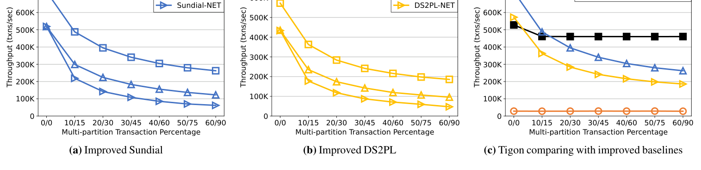
End-to-End: TPC-C Throughput
Varying % multi-partition transactions
Notes:
The headline result. TPC-C throughput. X-axis: percent of
multi-partition transactions, from 0/0 to 60/90. 0/0 means standard
TPC-C with 0% remote NewOrder and Payment; 60/90 is the most
cross-host-heavy configuration.
At 0/0: Sundial+ beats Tigon by 37%. This is because Sundial uses OCC
for reads (faster for read-heavy) and doesn't do phantom avoidance.
Expected, fair loss for Tigon.
At 60/90: Tigon is 75% faster than Sundial+ and 2.5x faster than
DS2PL+. Sundial+ and DS2PL+ throughput drops sharply as
multi-partition ratio grows — the message and 2PC tax.
Motor: 15.9 to 18.5x slower than Tigon across the board, because
one-sided RDMA latency is the bottleneck on the testbed.

Slide 36
TPC-C: Where Tigon Wins
No messages on the critical path
At 60/90 multi-partition ratio:
Sundial+ / DS2PL+ send 3.3 and 4.1 messages per txn
Tigon sends 0 on the critical path — sync via atomic ops on HWcc
CUSTOMER and STOCK tables get hot → Tigon moves 720K+2.4M tuples into CXL during warmup
176 MB HWcc + 1.6 GB CXL total
No data moves back during the run → CLOCK policy never triggers
Vs. Motor: bandwidth of 25 Gbps NIC is the bottleneck; peak ≈ 30 K/s
Even with a better NIC, Motor paper reports ≤100 K/s
Notes:
Where does Tigon's win come from on TPC-C?
At 60/90, Sundial+ sends 3.3 messages per transaction, DS2PL+ sends
4.1. Tigon sends zero on the critical path. When T1 wants a remote
tuple, the tuple is already in CXL memory — it just does a CAS on the
HWcc lock.
How? Tigon moves the hot tables (CUSTOMER and STOCK) into CXL during
warmup. 720K + 2.4M tuples, 176 MB HWcc, 1.6 GB total CXL. It fits in
the HWcc budget, and once moved, it stays — CLOCK eviction never
triggers because the HWcc budget isn't exceeded.
Motor's performance is bandwidth-limited. Their testbed NICs are 25
Gbps; Motor's own OSDI'24 paper reports ~100K txn/s peak at 100 Gbps.
Tigon is ~500K txn/s on the same workload.

Slide 37
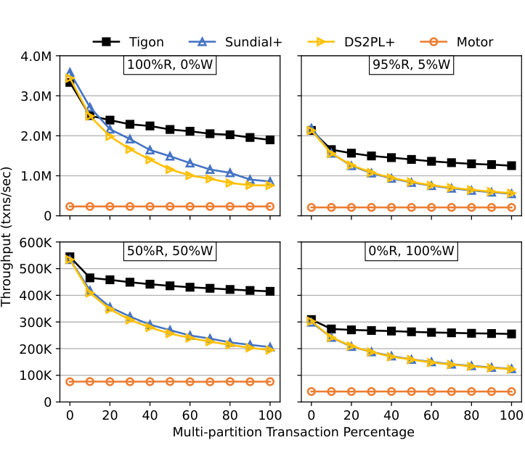
End-to-End: YCSB Throughput
4 read/write mixes × varying multi-partition %
Notes:
YCSB. Four read/write mixes × varying multi-partition percent.
At 0% multi-partition, all systems within 3.3% — nobody pays cross-
host cost.
Where Tigon wins is when multi-partition goes up. I'll explain on the
next slide; let the audience eyeball the curves first. The pattern:
Tigon holds roughly flat, baselines drop.

Slide 38
YCSB: Findings
Larger wins on higher contention
At 0% multi-partition: all systems within 3.3% (no cross-host sync)
At 100% multi-partition:
Read-only: Tigon 2.0×–2.3× over Sundial+
50R/50W: Tigon 2.7× over Sundial+, 3.5× over DS2PL+ (Zipf 0.99)
Motor: 5.4×–14.3× slower than Tigon
Tigon moves all 2.4M tuples to CXL (112 MB HWcc + 2.6 GB CXL) — fits in budget
Large win on writes: atomic-op writes beat message-based sync
Notes:
YCSB findings in detail.
Read-only at 100% multi-partition: Tigon is 2.0-2.3x over Sundial+.
At 50/50 reads/writes, 100% multi-partition, Zipf 0.99: Tigon is 2.7x
over Sundial+ and 3.5x over DS2PL+. Even bigger wins on writes — each
write is an atomic op rather than a message chain.
Motor: 5.4 to 14.3x slower.
Memory footprint: Tigon moves all 2.4M tuples to CXL. 112 MB HWcc,
2.6 GB total — fits comfortably in the 200 MB HWcc budget. No
evictions. Software cache coherence is doing the heavy lifting here
because everyone's reading the same big table.

Slide 39
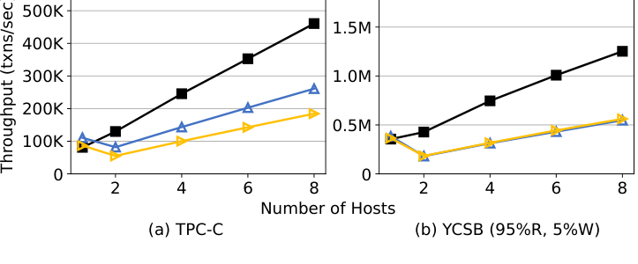
Scalability: 1 → 8 Hosts
TPC-C 60/90 and YCSB 95R/5W, 100% multi-partition
Notes:
Scalability. 1, 2, 4, 6, 8 hosts. Workload: TPC-C 60/90 and
YCSB 95R/5W with 100% multi-partition.
Tigon: 5.7x on TPC-C, 3.5x on YCSB going from 1 to 8 hosts. Sundial+
and DS2PL+: 2.4x and 2.1x on TPC-C. The slopes: Tigon 55K txn/s per
host, Sundial+ 30K, DS2PL+ 22K.
Limits: the paper can't tell you the scalability ceiling — they're
emulating on one machine. Plausible bottlenecks: atomic-op
scalability over CXL, HW coherence bandwidth, fixed HWcc region size.
Open research question.

Slide 40
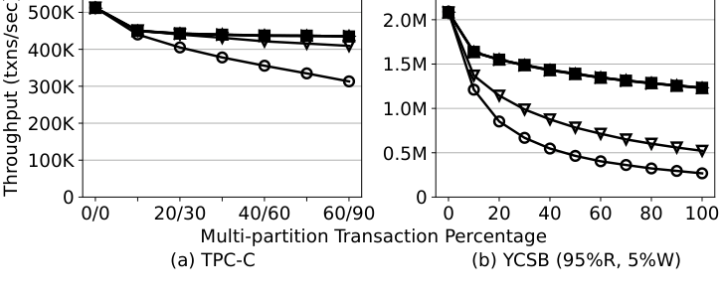
Sensitivity: HWcc Memory Budget
Even 50 MB works for TPC-C
Notes:
Sensitivity to HWcc memory budget. Vary from 200 MB down to
10 MB.
Key result: even 50 MB of HWcc memory is essentially enough for TPC-C
— only 5.8% slower than the default 200 MB. That's a very frugal
design.
At 10 MB, you see real thrashing — Tigon moves 16K TPC-C tuples or
110K YCSB tuples per second between local DRAM and CXL. But that only
consumes 1.1% / 9.1% of CXL bandwidth — the cost is latency, not
bandwidth. This is why minimizing HWcc footprint mattered in the
design — so we can survive in tiny HWcc regions.
The implication: even quite small real CXL HWcc regions should be
workable.

Slide 41
Under Realistic Inter-Host Coherence Cost
Conservative estimate of back-invalidation penalty
Testbed uses intra-socket coherence — optimistic vs real CXL back-invalidations
Paper can only count software invalidations (no HW counter): 12 M / 82 M = 14.5% of accesses
Assume back-invalidations are 4× slower than our intra-socket measurements
Net effect: Tigon throughput –41.4%
Even then: Tigon still beats Sundial+ (+2.8%), DS2PL+ (+45%), Motor (9.6×)
Tigon’s design principle (small HWcc region) protects it from HW coherence costs
Notes:
An important 'what if' experiment. Their emulation uses
intra-socket cache coherence, which is faster than what real inter-
host CXL back-invalidations will be. They can't directly measure
back-invalidations (no HW counter) but they can count software
invalidations: 14.5% of accesses need them.
Conservative assumption: real back-invalidations are 4x slower than
intra-socket. That would cost Tigon 41.4% of throughput.
Even with that pessimistic discount: Tigon is still 2.8% faster than
Sundial+, 45% faster than DS2PL+, 9.6x faster than Motor. Tigon's
'minimize HWcc usage' design principle directly pays off here — the
less traffic on HW-coherent lines, the less it hurts when back-
invalidations are expensive.

Slide 42
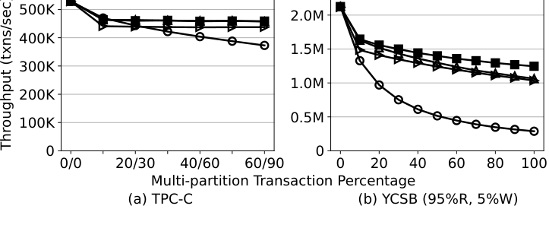
Does Software Cache Coherence Matter?
Four configurations compared
Notes:
Software cache coherence ablation. Four configurations:
NoSWcc (HWcc-only — everything must fit in HWcc), NonTemporal (no
caching; every SWcc read is non-temporal), NoSharedReader (only one
host at a time can read-cache any given SWcc row), and full Tigon.
TPC-C: NoSWcc is 19% slower at 60/90 (thrashing due to small HWcc
region). NonTemporal is only 4.5-5.1% slower — because tuples get
cached in local DRAM already, so the cacheable-read win on CXL is
small.
YCSB has more cross-host sharing, so the gaps widen. NoSWcc is 4.3x
slower at 100% multi-partition. NonTemporal is 11-20% slower.
NoSharedReader is 15% slower — it forces SWcc-bitmap flips and
cacheline flushes that Tigon avoids.
Takeaway: SWcc is essential for read-heavy workloads with cross-host
sharing. Just using HWcc memory is not enough once the CAT is large.

Slide 43
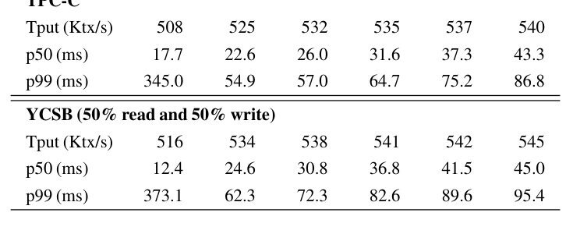
Logging Epoch vs. Throughput/Latency
Group commit is the right tradeoff
Notes:
Logging latency tradeoff. Epoch duration vs throughput and
tail latency.
Tiny epoch (1 ms): throughput drops ~5%, but p99 explodes — 345 ms —
because you're doing many small writes and SSD queue grows under
contention.
10 ms epoch: 2.8% slower than 50 ms but 48% lower p50 latency (17.7
ms). Good tradeoff. That's what Tigon uses by default.
Without logging, Tigon is only ~6% faster than with 10 ms logging —
so logging is cheap.
Motor uses 3-way in-memory replication for durability, no group
commit. Their p50 is in hundreds of microseconds, but throughput is
10x lower. Tigon trades a few ms of tail latency for throughput.

Slide 44
Optimization Ablations
Each piece pulls its weight
CLOCK vs. LRU:
LRU needs 33% more HWcc; 2.4× slower under HWcc pressure
Under unlimited HWcc, LRU still 17% slower (lock contention on LRU list)
Shortcut pointer (owner-side fast path):
+16% on TPC-C, +8–24% on YCSB 95R/5W
is-dirty (read clean tuples from local DRAM):
+60% YCSB read-only at 10% multi-partition; +27% at 100%
Together these are what make Tigon frugal with CXL bandwidth
Notes:
Three optimization ablations.
CLOCK vs LRU: LRU needs a linked list in HWcc, which bloats HWcc
memory by 33% and adds lock contention. Under tight HWcc budget, LRU
is 2.4x slower. Under unlimited HWcc, still 17% slower. CLOCK wins
clearly.
Shortcut pointer: lets the owner skip the CXL index. +16% TPC-C,
+8-24% YCSB 95R/5W. Substantial.
is-dirty tracking: lets the owner read clean tuples from local DRAM
rather than CXL. +60% on YCSB read-only at 10% multi-partition, +27%
at 100%. Huge for read-heavy.
Together these are what make Tigon frugal with CXL bandwidth.

Slide 45
6. Discussion & Takeaways
What did we learn? What's next?
Notes:
Let me wrap up with discussion and takeaways.

Slide 46
Discussion Points
Questions worth debating
Is the CAT assumption robust to analytical / long-running transactions?
What happens at 32+ hosts? SWcc-bitmap is 16-bit; HWcc size is fixed by silicon
Co-design or decouple: SW coherence requires DB-side changes — reusable by other apps?
Real CXL 3.x hardware doesn’t exist yet with HW coherence — evaluation extrapolates
2PL + NO_WAIT — abort rates under very high contention?
Failure model: single-machine correlated failure undermines the pod (shared memory device)
Compare against OCC/MVCC-based CXL designs as they emerge
Notes:
Questions worth debating in Q&A.
Is the CAT assumption robust outside OLTP — e.g., for long-running
analytical queries that touch huge scans? Probably not; the design
is specifically for OLTP.
What happens at 32 or 64 hosts? The SWcc-bitmap is 16 bits today.
HWcc region is finite. Scaling out the CXL pod is an open question.
SWcc requires database-side code changes. Is it reusable by other
applications? Probably not directly — you'd redo the co-design per
system.
No real HW today — the eval is on emulated CXL. Numbers are indicative
but not final.
2PL + NO_WAIT: abort rate under very high contention could be an
issue.
Failure model: a CXL pod shares a memory device. That device's
failure takes down the pod. Is that acceptable? Pasha (the architecture
paper) and CXL-SHM study partial-failure models — worth reading
alongside.
OCC/MVCC on CXL pods: left as future work.

Slide 47
Takeaways
Why this paper matters
CXL pods are a new architectural point — not SMP, not fully distributed
The right abstraction for databases is NOT 'CXL as a faster network'
Turn messages into atomic ops on shared structures — eliminate 2PC
Be stingy with HWcc memory: co-design a software coherence protocol for the bulk
Result: up to 2.5× over optimized shared-nothing baselines, 18.5× over RDMA DBs
Opens a research agenda: OCC/MVCC on CXL pods, larger pods, real HW experiments
Notes:
Takeaways.
One: CXL pods are a genuinely new architectural point. Treating them
like a faster network misses the opportunity.
Two: the right abstraction for distributed OLTP on a CXL pod is
shared memory with atomic ops, not message passing.
Three: convert messages into atomic ops. That's what kills 2PC.
Four: be stingy with hardware cache coherence — it's fundamentally
limited by silicon area. Co-design a software coherence protocol for
the bulk of your data.
Five: the results — 2.5x over the best optimized shared-nothing
baseline, 18.5x over RDMA — suggest the approach is worth chasing
further.
This opens a research agenda: OCC and MVCC variants, handling larger
pods, real hardware experiments once CXL 3.x with inter-host coherence
ships, and better failure models.

Slide 48
Questions?
Thank you!
Paper: https://www.usenix.org/conference/osdi25/presentation/huang-yibo
Code: https://github.com/ut-datasys/tigon
Related papers worth reading:
Pasha (CIDR'25) — CXL-pod DB architecture (same authors)
SiloR (SOSP'13) — the logging protocol Tigon adapts
Octopus (2025) — CXL memory pooling, relevant failure models
Motor (OSDI'24) — the RDMA-disaggregated baseline
Notes:
Thank you. Happy to take questions.
The paper is up at the OSDI 25 proceedings page, code is open source
on GitHub. Related reading I found useful: Pasha at CIDR'25 (the
architecture precursor from the same group), SiloR at SOSP'13 (the
logging protocol Tigon adapts), Octopus (2025) on CXL memory pooling
at scale, and Motor at OSDI'24 (the RDMA baseline).

