Slide 1
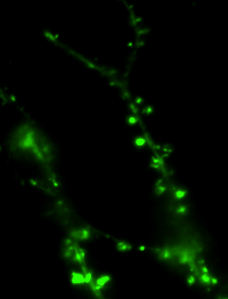
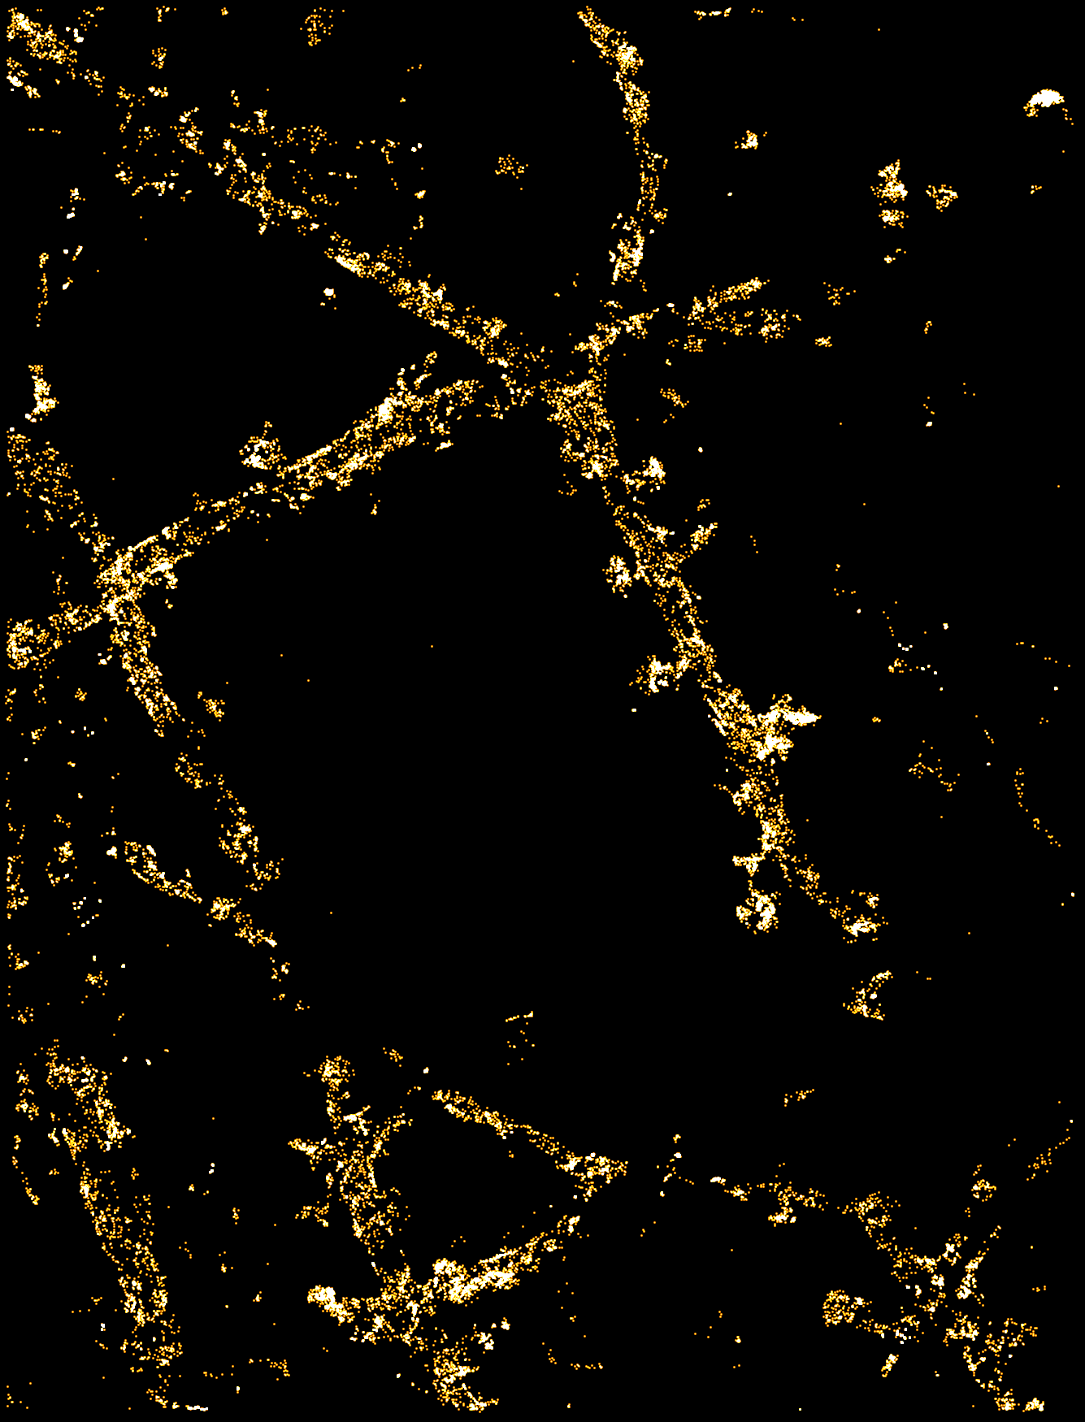
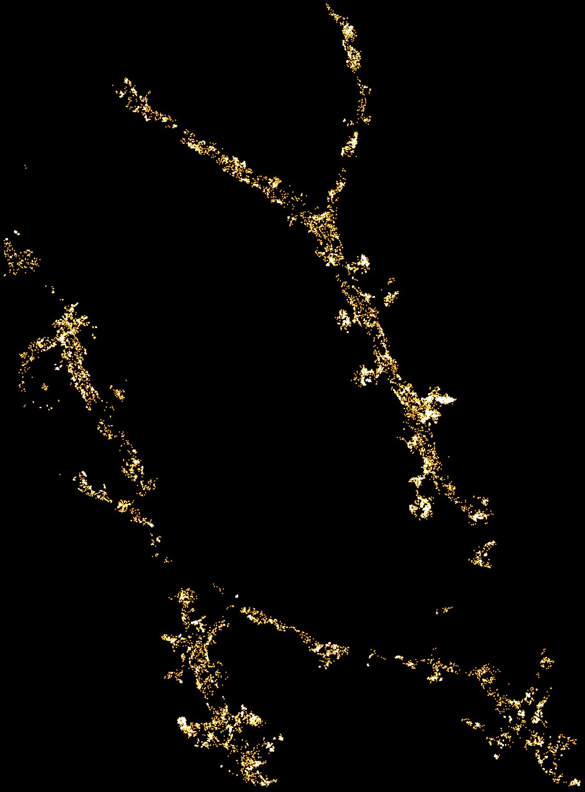
When you use antibody or scFv (or whatever probe that labels endogenous) and want to filter out the binding on non-transfected targets-> use Filter_ThunderSTORM_by_contour.m by YY

