Slide 1
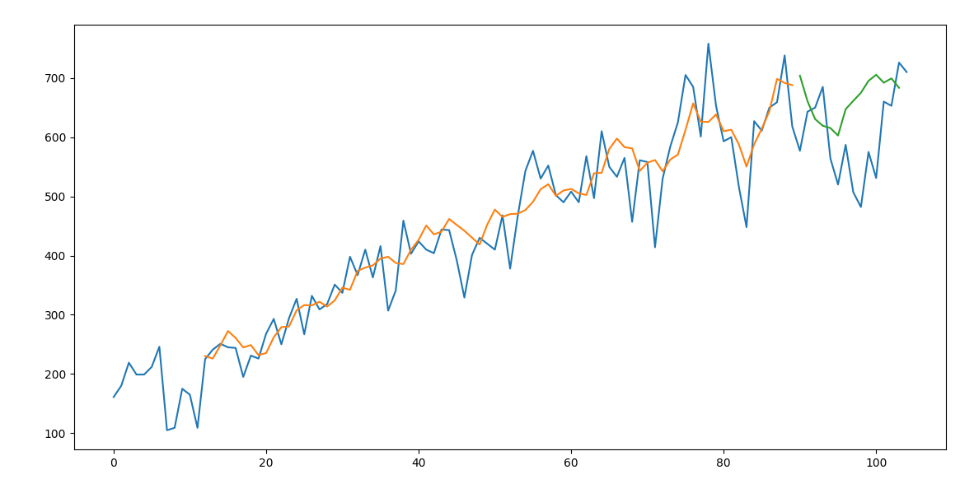
ORD_COUNT
Lookback = 12
epochs = 30
split data = 0.867

Slide 2
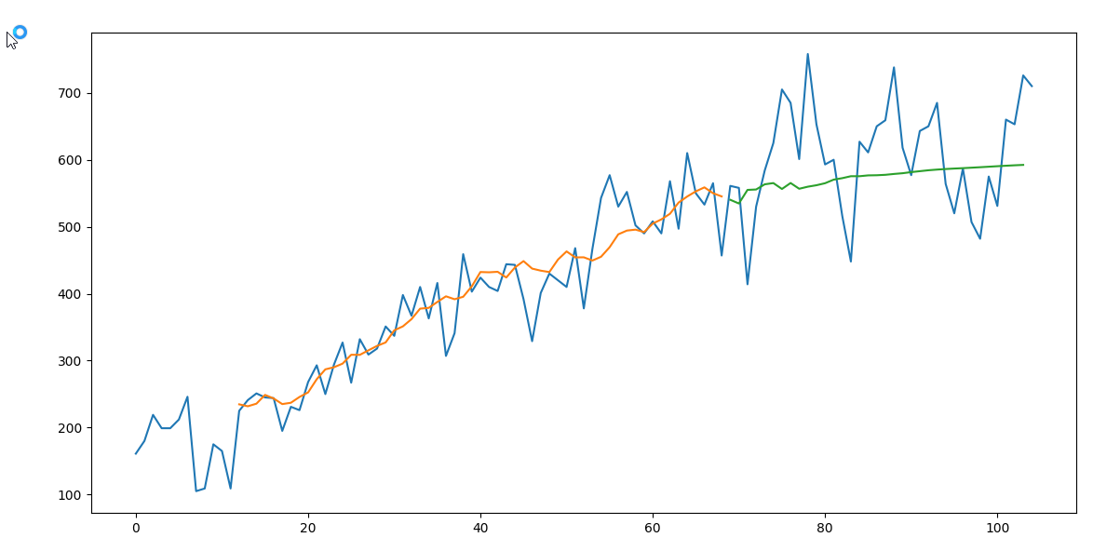
ORD_COUNT
Lookback = 12
epochs = 30
split data = 0.67

Slide 3
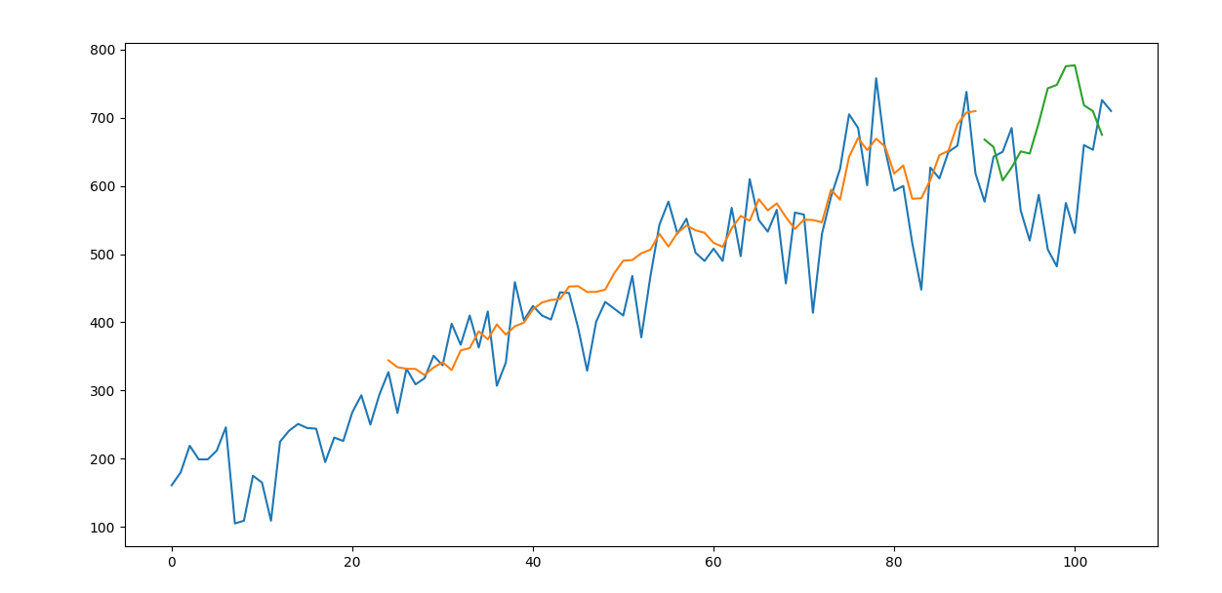
ORD_COUNT
Lookback = 24
epochs = 30
split data = 0.867

Slide 4
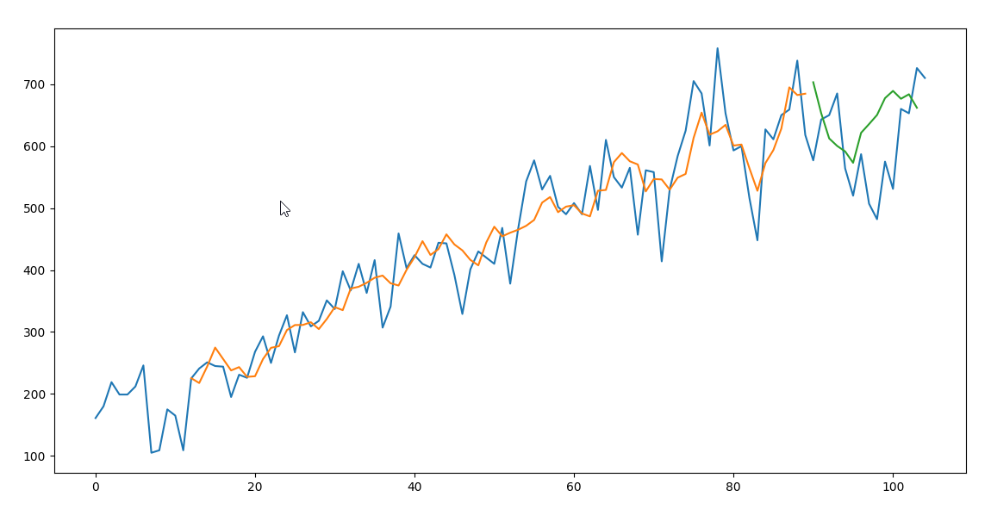
ORD_COUNT
Lookback = 12
epochs = 50
split data = 0.867

Slide 5
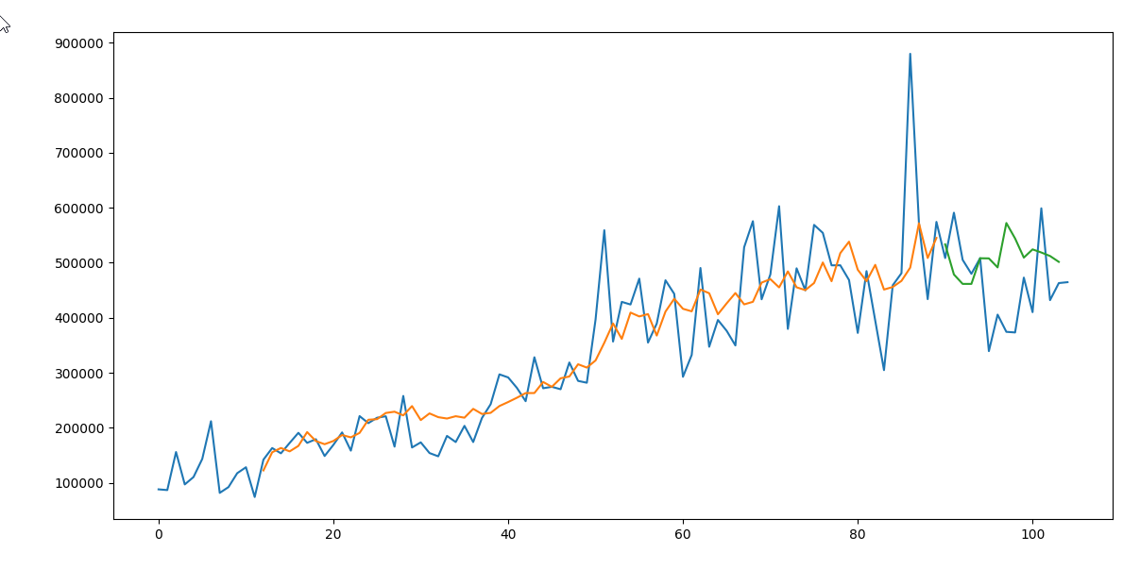
ORD_SUM
ORD_SUM
Lookback = 12
Lookback = 12
epochs = 30
epochs = 30
split data = 0.867
split data = 0.867

Slide 6
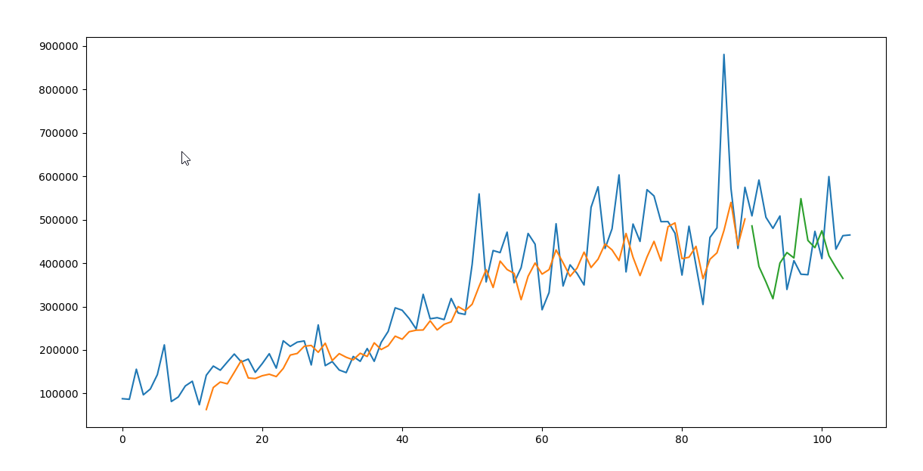
ORD_SUM
ORD_SUM
Lookback = 12
Lookback = 12
epochs = 30
epochs = 130
split data = 0.867
split data = 0.867

Slide 7
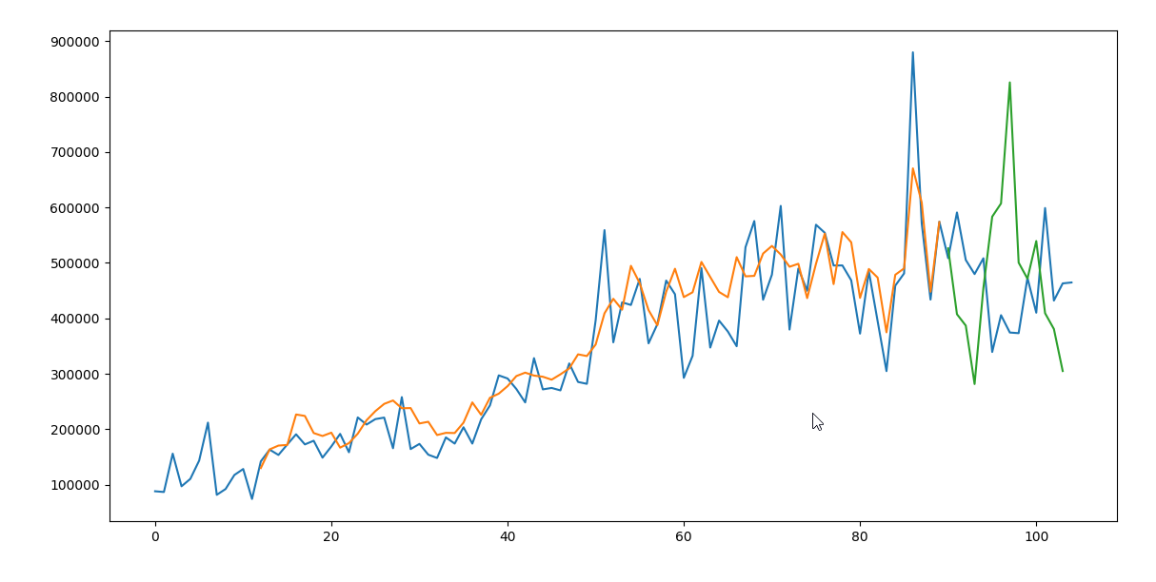
ORD_SUM
ORD_SUM
Lookback = 12
Lookback = 12
epochs = 30
epochs = 300
split data = 0.867
split data = 0.867

