Slide 1
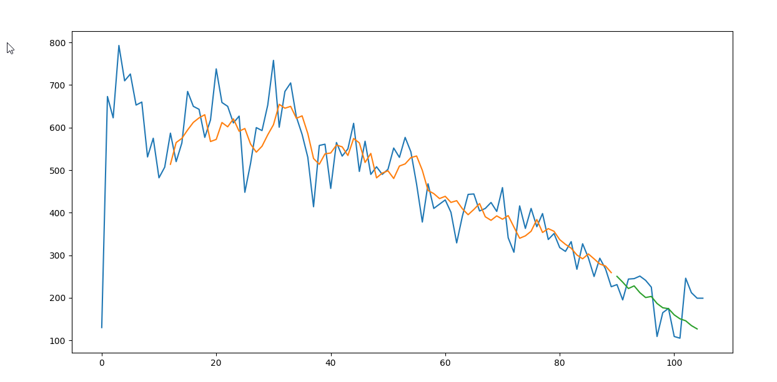
ds_PACASABAT_110m-01

Slide 2
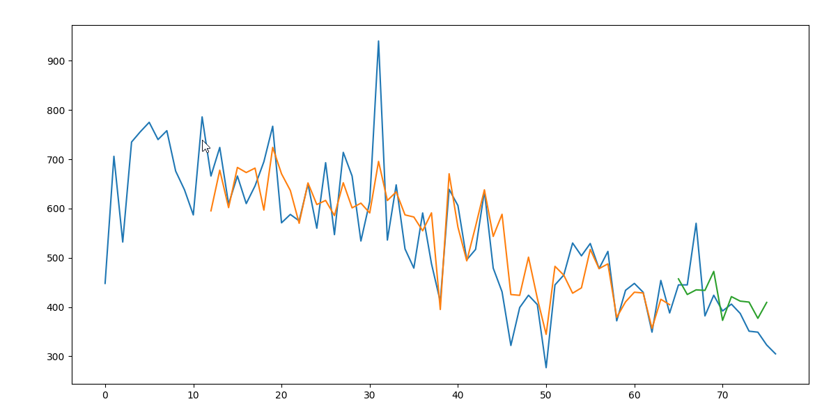
ds_U94911_83m-01

Slide 3
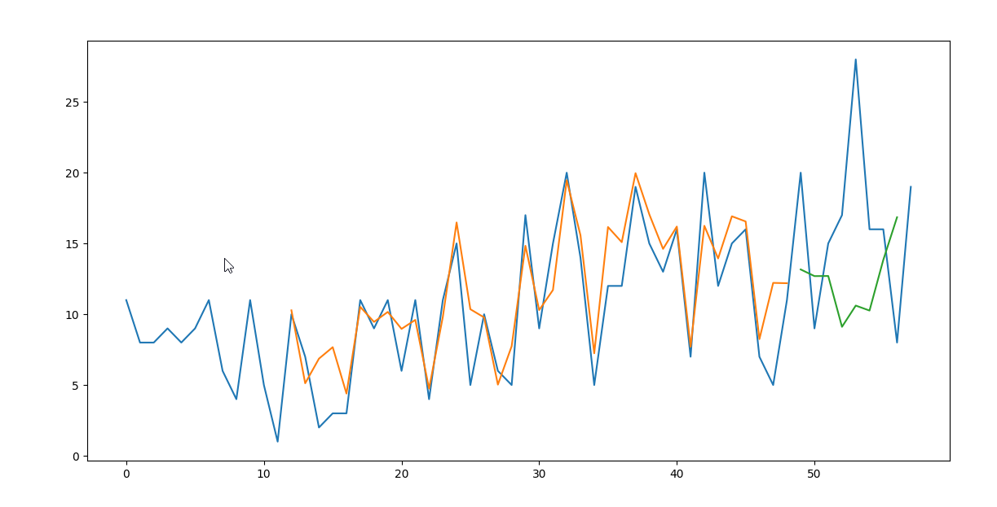
ds_94925_61m-01

Slide 4
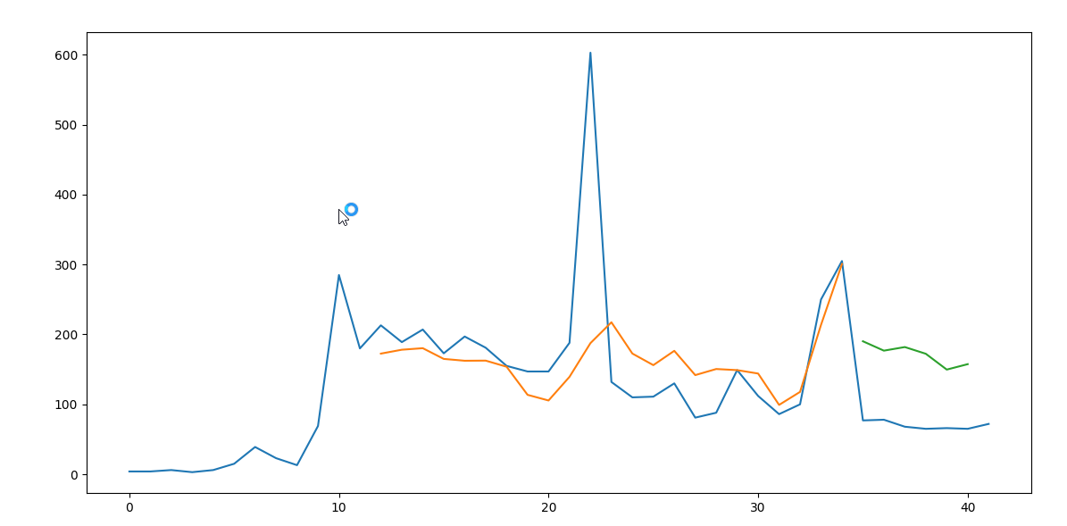
ds_HUGEDB_45m-01

Slide 5
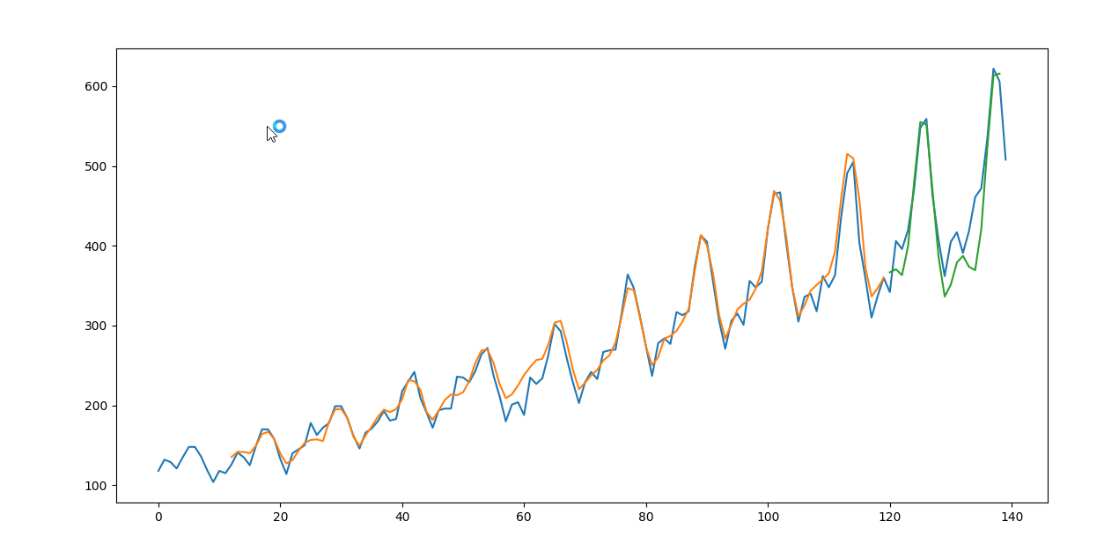
AirPassengers

Slide 6
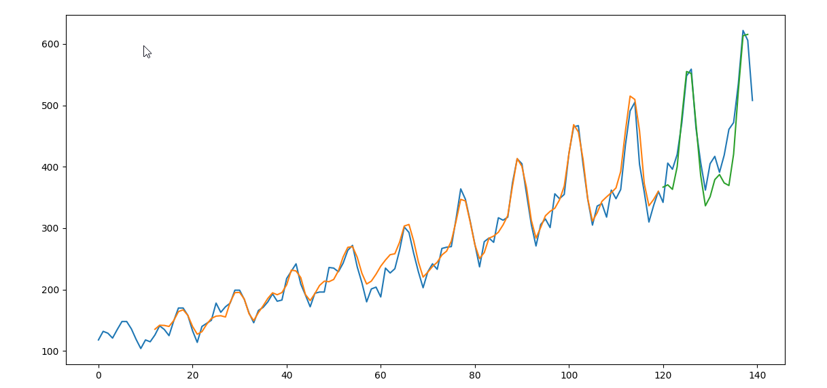
AirPassengers3

